Slide 1



DEPARTMENT OF COMPUTER SYSTEMS ENGINEERING UET
Multi-Path Fading Channel
Department of Computer System Engineering University Of Engineering and Technology Peshawar Pakistan.
Mobile Station
Multi-Path Fading
Channel

Slide 2
Mobile Channel Parameters
Time delay spread |
Coherence Bandwidth | -> ISI
Doppler Spread |
Coherence Time
Flat fading
•
•
•
| -> Unstable channel
Frequency selective fading
Fast fading
Slow fading
Multi-Path Fading
Channel

Slide 3



Multi-path Propagation
Multi-path smears or spreads out the signal
– delay spread
Causes inter-symbol interference
– limits the maximum symbol rate
Base Statio n
Mobile Statio n
Transmitted Symbol
Received Symbol
t
Multi-Path Fading
Channel

Slide 4





Delay Spread
Base Station
Space
Mobile Station
Transmitted Symbol
Received
Symbol
t
Time
Multi-Path Fading
Channel

Slide 5
Intersymbol Interference
Received
Transmitted Symbol of Interest
Symbol of Interest
t
Transmitted Symbols
Received Symbols
t
Multi-Path Fading
Channel

Slide 6
Average Delay Spread
Average delay spread τ
∑ ªk
2
τ_{k} ∑ P(τ_{k} )τ_{k}
_{τ =} k ₌ k
∑ ªk
k
2
∑ P(τ_{k} )
k
P(τ_{k} )
Multi-path Profile (Discrete)
P(τ₁ )
P(τ₀ )
P(τ₂ )
P(τ_{k} )
t
τ₀ = 0
τ₁
τ₂
τ_{k}
Multi-Path Fading
Channel

Slide 7
RMS Delay Spread
(Discrete)
RMS delay spread στ
2 2
σ_{τ} = τ − τ
∑ ªk k ∑
2
2
τ
P(τ )τ
2
_{τ}2
k k
₌ k ₌ k
∑ ªk
k
∑ P(τ_{k} )
k
2
Multi-Path Fading
Channel

Slide 8
Coherence Bandwidth
Coherence bandwidth B_{c} is a range of frequencies
over which the channel can be considered flat
– passes all spectral components with approximately equal gain and liner phase
Bandwidth where the correlation function R_{T}(ω) for signal envelopes is high
Therefore two sinusoidal signals with frequencies that are farther apart than the coherence bandwidth will fade independently.
Multi-Path Fading
Channel

Slide 9
Coherence Bandwidth
• If R_{T}(ω) > 0.9
1
B =
C
50σ_{τ}
• If R_{T}(ω) > 0.5
1
B =
C
5σ_{τ}
An exact relationship between coherence
bandwidth & delay spread does not exist
Multi-Path Fading
Channel

Slide 10
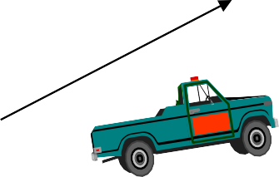


Doppler Shift
f_{c} broadening from f_{c} to (f_{c} + f_{m} )
_{v} v
f = f ⋅
m
c
c
v
BS1
Multi-Path Fading
Channel

Slide 11
Relativistic Doppler Frequency
The observed frequency is
1+ ^{v}
c
v
f = f ⋅
c
f_{d} = f − f_{c} ≈ f_{c} ⋅
c
1− ^{v}
c
where the relative velocity v is positive if the source is approaching and negative if receding.
f_{c}- carrier freq., c-speed of light, f_{d}-Doppler shift
Multi-Path Fading
Channel

Slide 12
Doppler Spread & Coherence
Time
Describes the time varying nature of the channel
in a local area
Doppler Spread B_{D}, is a measure of the spectral broadening caused by the time rate of change
f_{c} broadening from (f_{c} - f_{m}) to (f_{c} + f_{m} )
If the base-band signal bandwidth is much greater than B_{D}, the effects of Doppler spread are negligible at the receiver
Multi-Path Fading
Channel

Slide 13
Coherence Time
Coherence Time is the time domain dual of
Doppler spread
Doppler spread and coherence time are
inversely proportional
T_{C} = 1/f_{m}
Statistical measure of the time duration over which the channel impulse response is invariant
Multi-Path Fading
Channel

Slide 14
Coherence Time
If the coherence time is defined as the time over
which the correlation function is above 0.5, then
9
T_{C} ≈
16π f
m
Rule of thumb for modern digital communication defines TC as the geometric mean of the above two expressions for TC
9
T_{C} =
16π f ²
m
Multi-Path Fading
Channel

Slide 15
Inter-symbol Interference
For no Inter-symbol Interference the transmission rate R for a digital transmission is limited by delay spread and is represented by: R < 1/2σ_{τ} ;
If R >1/2σ_{τ} Inter-symbol Interference (ISI) occurs
Need for ISI removal measures (Equalizers)
Multi-Path Fading
Channel

Slide 16
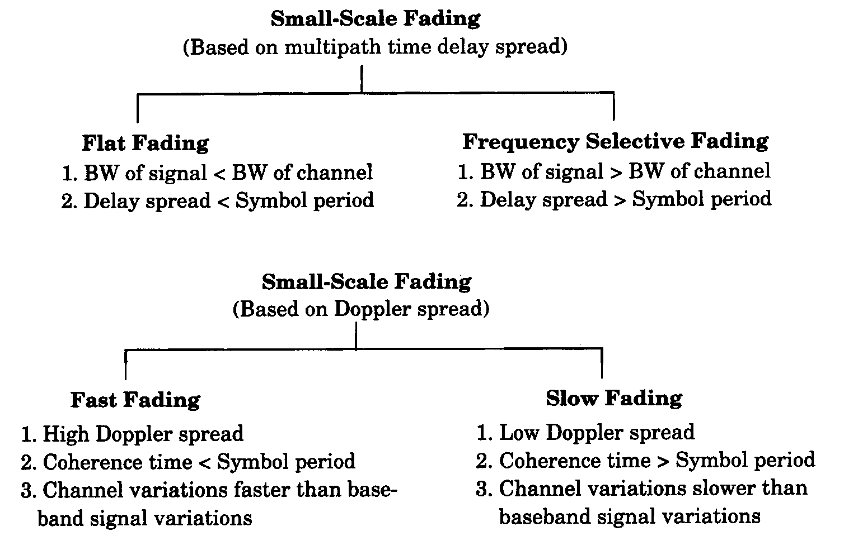
Types of Small-Scale Fading
Multi-Path Fading
Channel

Slide 17
Small-Scale Fading
Delay Spread
Small-Scale Fading
(Based on time delay spread)
Flat Fading
1. BW of signal < Coherence BW of channel
Frequency Selective Fading
1. BW of signal > Coherence BW of channel
2. Delay Spread < Symbol period
2. Delay Spread > Symbol period
Multi-Path Fading
Channel

Slide 18
Small-Scale Fading
Time Variations
Small-Scale Fading
(Based on Doppler spread)
Fast Fading
High Doppler spread
Coherence time < Symbol period
Channel variations faster then
Slow Fading
Low Doppler spread
Coherence time > Symbol period
Channel variations slower then
base-band signal variations
base-band signal variations
Multi-Path Fading
Channel

Slide 19
Flat Fading 1
If the mobile radio channel has a constant gain and linear phase over a bandwidth greater than the bandwidth of the transmitted signal - the received signal will undergo flat fading
Please, observe that the fading is flat (or frequency selective) depending on the signal bandwidth relative to the channel coherence bandwidth.
Multi-Path Fading
Channel

Slide 20
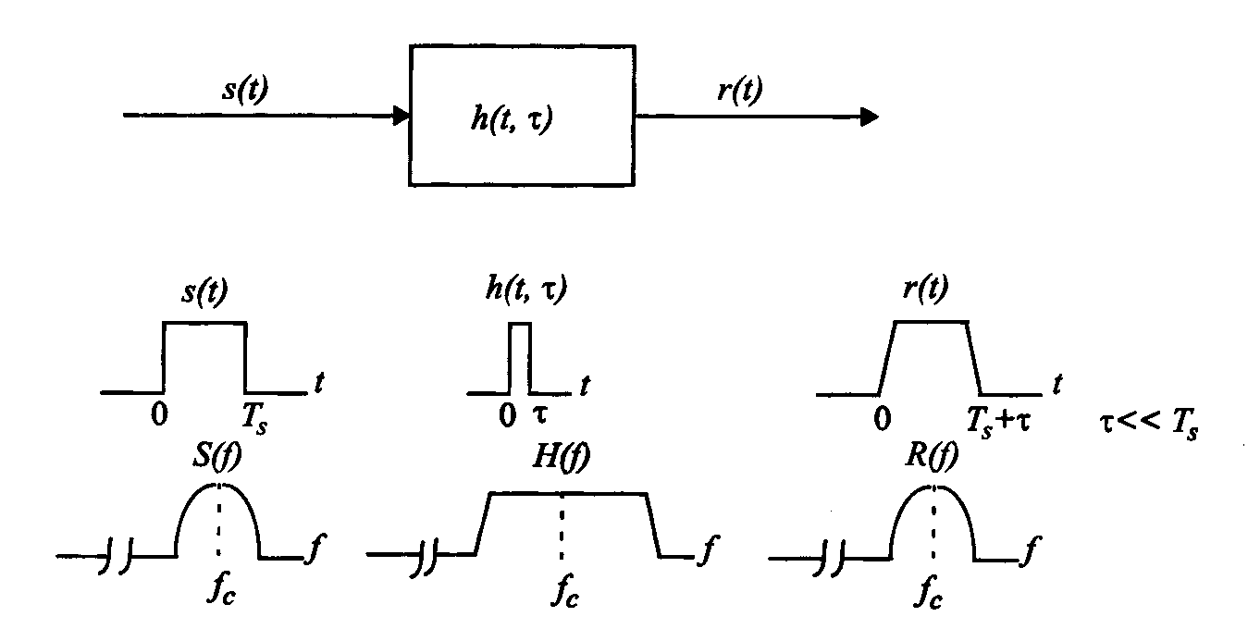
Flat Fading 2
• BS << B_{C} & T_{S} >> σ_{τ}
Multi-Path Fading
Channel

Slide 21
Frequency Selective Fading 1
If the mobile radio channel as a constant gain and linear phase over a coherence bandwidth, smaller than the bandwidth of the transmitted signal - the received signal will undergo frequency selective fading
Again, the signal bandwidth is wider then the channel coherence bandwidth, causing one or more areas of attenuation of the signal within the signal bandwidth
Multi-Path Fading
Channel

Slide 22
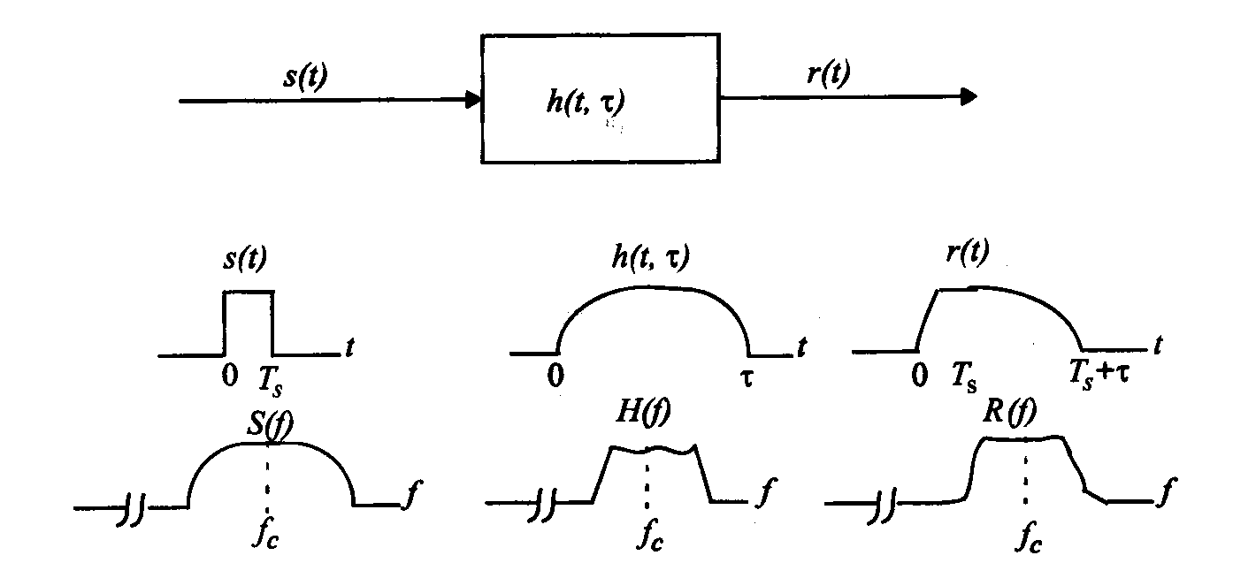
Frequency Selective Fading 2
BS > B_{C} & T_{S} < σ_{τ}
Multi-Path Fading
Channel

Slide 23
Fast Fading
The channel impulse response changes rapidly within the symbol duration - coherence time < symbol period
T_{S} > T_{c} and B_{S} < B_{D}
Channel specifies as a fast or slow fading channel does not specify whether the channel is flat fading or frequency selective fading
Multi-Path Fading
Channel

Slide 24
Slow Fading
The channel impulse response changes at a rate much slower than the transmitted base-band signal.
Doppler spread is much less than the bandwidth of
the base-band signal
T_{S} << T_{c} and B_{S} >> B_{D}
Velocity of the MS and the base-band signaling determines whether a signal undergoes fast or slow fading
Multi-Path Fading
Channel

Slide 25
Summary
Fast and slow fading deal with the relationship between the time rate of change in the channel and the transmitted signal, NOT with propagation path loss models
Multi-Path Fading
Channel

Slide 26



Typical Cellular Mobile Environment
Remote Dominant Reflectors/Scatterers (Influential)
Medium-Distance Dominant Reflectors/Scatterers (Influential)
Elevated BS Antenna
MS
Scatterers local to BS (Non-influential)
Scatterers local to MS (Influential)
Multi-Path Fading
Channel

Slide 27

Fading
Fading: The interference between two or more versions of the transmitted signal which arrive at the receiver at slightly different times
Multipaths: Above mentioned versions of the transmitted signal
Multi-Path Fading
Channel

Slide 28


Fading (Continued)
Delay Spread ←→ Coherence Bandwidth
Frequency separation at which two frequency components of Tx signal undergo independent attenuations
Doppler Spread ←→Coherence Time
Time separation at which two time components of Tx signal undergo independent attenuations
Multi-Path Fading
Channel

Slide 29




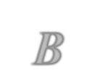





Fading (Continued)
Bandwidth
Flat in Time and Selective in Frequency
Selective in both Time and Frequency
B_{c}
Flat in Time and
Frequency
Flat in Frequency and
Selective in Time
Time
T_{c}
Multi-Path Fading
Channel

Slide 30




Fading (Continued)
Fast and Slow Fading
If the channel response changes within a symbol interval, then the channel is regarded FAST FADING
Otherwise
the channel is regarded as SLOW FADING
Multi-Path Fading
Channel

Slide 31


Fast Fading
When?
The channel impulse response changes rapidly within the symbol period of the transmitted signal.
What?
The Doppler Spread causes frequency dispersion which leads to signal distortion.
Multi-Path Fading
Channel

Slide 32






Doppler Spread
The Doppler effect (in addition to the fading effect) renders the received pulse to be time-varying
The State Transitions are determined from the dynamics of the fading channel (Fading Correlation Function or The Doppler Spectrum)
Multi-Path Fading
Channel

Slide 33
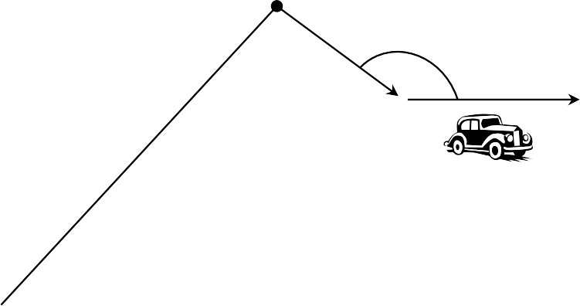
Doppler Spread (Continued)
f: carrier frequency
c: speed of light
v: mobile speed
θ: Angle of motion with incoming multipath
y
Scattering Point
θ
Incoming multipath
MS
v
Line of Sight
x
BS
Multi-Path Fading
Channel

Slide 34
Doppler Spread (Continued)
f: carrier frequency
c: speed of light
v: mobile speed
θ: Angle of motion with incoming multipath
₌ f v cosθ
f
d
c
Multi-Path Fading
Channel

Slide 35
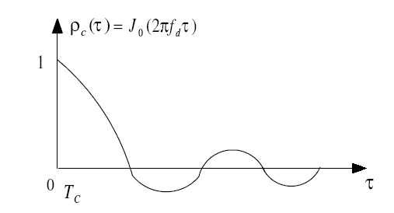
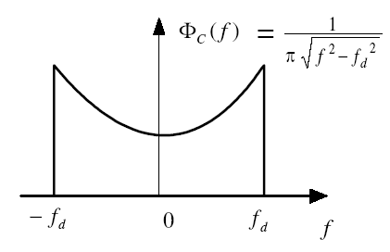
Doppler Spread (Continued)
For the land mobile fading spectrum,
The Auto-Correlation Function
Doppler Fading Spectrum
Multi-Path Fading
Channel

Slide 36

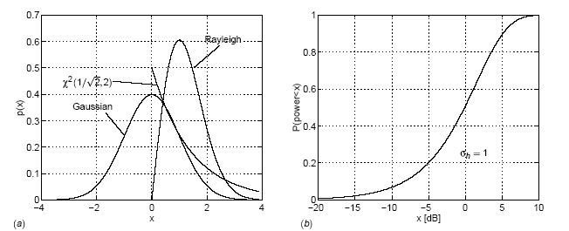
Doppler Spread (Continued)
➢h is the channel impulse response
➢h has a complex normal distribution with zero mean
➢|h| is Raleigh distributed
➢Phase φ is uniformly distributed between 0 and 2π
is Chi-square distributed
Multi-Path Fading
Channel

Slide 37











Fading in Brief
Large Doppler Spread
Time-Selective Fading
Large Delay Spread Frequency-Selective Fading
Large Angle Spread
Space-Selective Fading
Multi-Path Fading
Channel

Slide 38
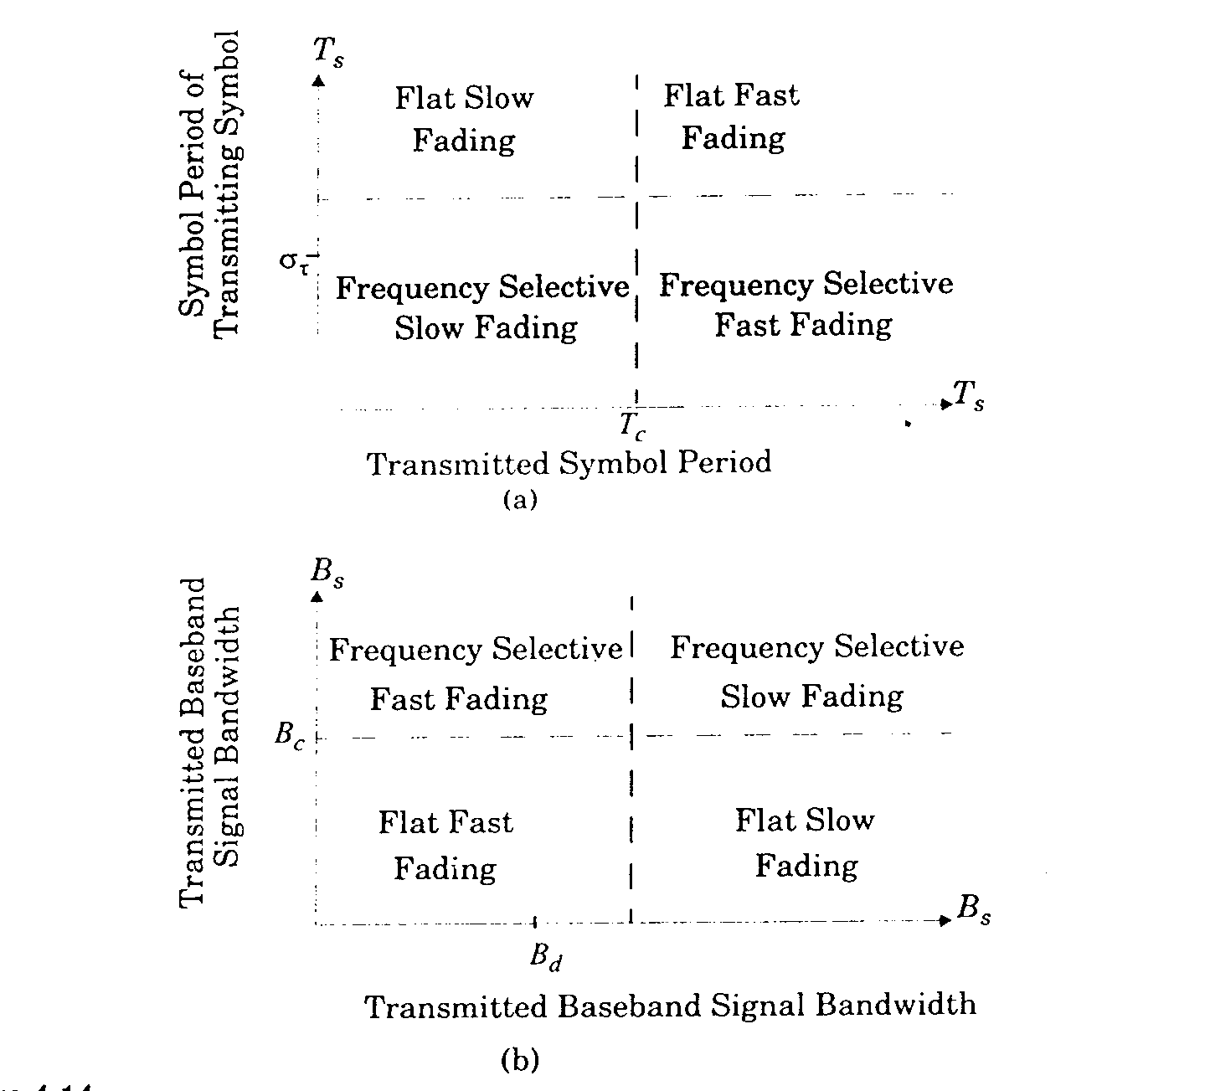
Multi-Path Fading
Channel

Slide 39
Rayleigh Fading 1
The received envelope (amplitude) of a flat fading signal is described as a Rayleigh distribution
– Square root sum r, of two quadrature Gaussian noise signals x_{I} and y_{Q} has a Rayleigh distribution (Papoulis65)
⎧ r
⎛
_{r} 2
⎞
p(r) =
⎜
⎟
2 2
exp −
; (0 ≤ r ≤ ∞)
r = x + y
⎨
⎩
⎜
⎟
I
Q
σ
2
⎝
2σ
2
⎠
Multi-Path Fading
Channel

Slide 40
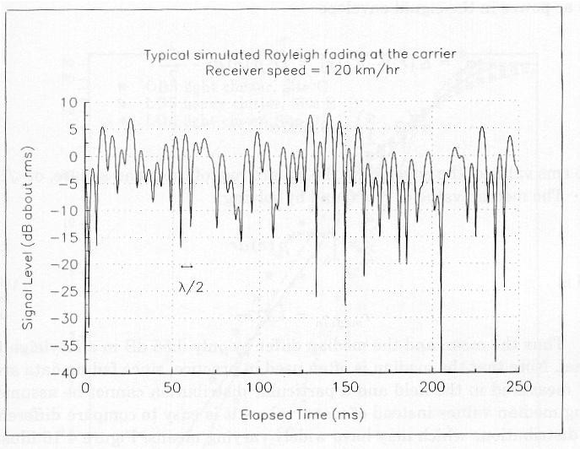
Rayleigh Fading 2
Multi-Path Fading
Channel

Slide 41
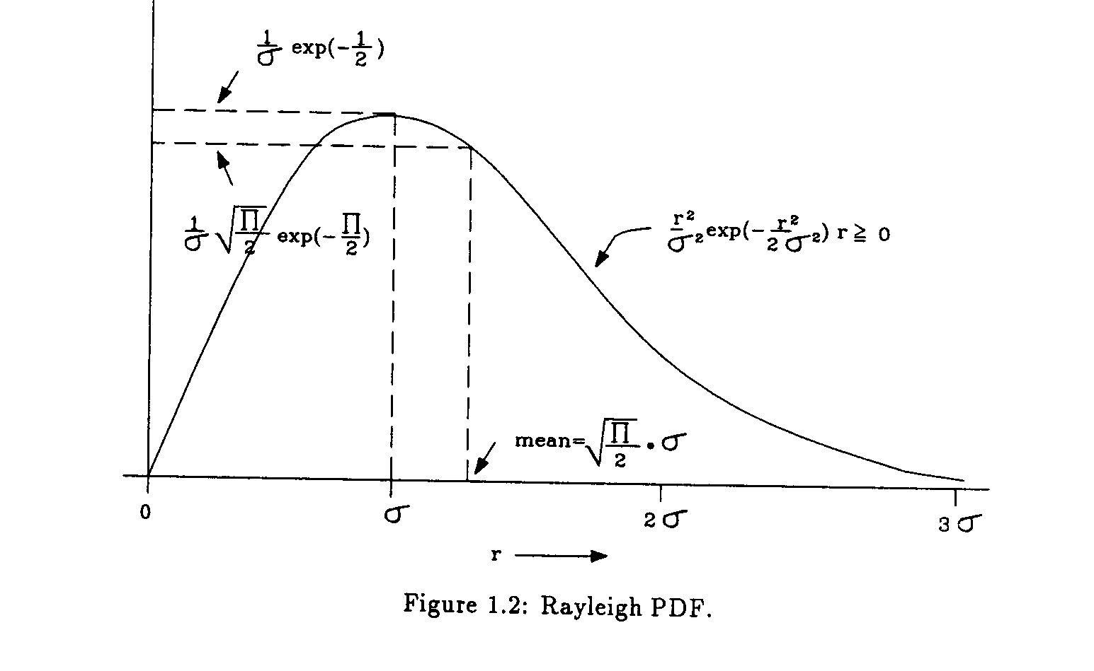
Rayleigh Fading PDF
Multi-Path Fading
Channel

Slide 42
Rayleigh Fading 3
⎧ r
⎛
_{r}2
⎞
p(r) =
⎨
⎩
exp ⎜−
⎟
(0 ≤ r ≤ ∞)
σ
2
⎜
2σ
2
⎟
⎝ ⎠
σ - rms value of the received voltage signal before envelope detection
σ² - time average power before envelope detection
The probability that the received signal envelope does not exceed R is given by:
R
⎛
_{R}2
⎞
P(R) = Pr(r ≤ R) = ∫ p(r)dr = 1 − exp ⎜⎜ −
_{2 ⎟}⎟
⎝
2σ
⎠
0
Multi-Path Fading
Channel

Slide 43
Rayleigh Fading 4
The median value of r is found by solving
1 ₌
^{r}med ia n
∫ p(r)dr
2
0
r_{median} = 1.77σ
Mean and median differ by only 0.55dB
Multi-Path Fading
Channel

Slide 44
Ricean Fading 1
When there is a dominant stationary signal
component
At the output of an envelope detector - adding a DC component ot the random multi-path
r
−
(r ² + A² )
⎛ Ar ⎞
p(r) = e
2σ
2
I ⎜
⎟;
for ( A ≥ 0, r ≥ 0)
_{ο} e
0
⎝ σ ² ⎠
Multi-Path Fading
Channel

Slide 45
Ricean Fading 2
A - peak amplitude of the dominant signal
I₀ () - modified Bessel function of the first kind and zero order
Described in terms of a Ricean factor, K
A
2
K (dB) = 10log
(dB)
2σ ²
Multi-Path Fading
Channel

Slide 46
Ricean PDF
K = −∞ dB
p(r)
K = −6 dB
Received signal envelope voltage r (V)
Multi-Path Fading
Channel

Slide 47
Clarks Model for Flat Fading 1
Statistical Characteristics of the EM fields of the received signal at the MS are obtained from scattering
Assumes
Fixed transmitter & vertically polarized antenna
Fields incident on the mobile antenna comprises of N waves in azimuth plane with arbitrary carrier phases and azimuth angels of arrival
equal average signal amplitude
Multi-Path Fading
Channel

Slide 48
Clarks Model for Flat Fading 2
The model shows that the random received signal envelope r has a Rayleigh distribution and is given by:
_{r} 2
r
⎛
⎞
p(r) =
⎜
⎟
exp −
;
0 < r ≤ ∞
σ
⎜
2σ
⎟
2
⎝
2
⎠
Multi-Path Fading
Channel

Slide 49
Effect of Doppler Spread
It can be shown that if the angle of the received signals, α_{i} is uniformly distributed that the Doppler frequency has a random cosine distribution.
Then the Doppler power spectral density S(f) can be computed by equating the incident received power in an angle dα with Doppler power S(f)df
– df is found by differentiating the Doppler term f_{m}cosα
wrt α.
Multi-Path Fading
Channel

Slide 50
Function of One Random
Variable
x - random
variable
b
∫ f_{X} (x) dx = 1
a
y
y = g(x)
g(b)
g(x)
g(a)
y =g(x);
function of x
f_{Y} ( y)
f (x)
X
x
a
x
b
y - random variable
g (b)
∫ f_{Y} ( y) dy = 1
g (a)
g (b)
∫ f_{Y} ( y) dy = 1
g (a)
f_{Y} ( y) dy = f_{X} (x) dx
Multi-Path Fading Channel

Slide 51


Function of One Random
Variable
b
x - random variable
y =g(x); function of x
y - random variable
∫ f_{X} (x) dx = 1
a
y
y = g(x)
g(b)
g(x)
g(a)
f_{Y} ( y)
f_{X} (x)
x
x
a
b
f_{Y} ( y) dy = f_{X} (x) dx
Multi-Path Fading Channel

Slide 52
Function of One Random
Variable
g (b)
∫ f_{Y} ( y) dy = 1
g (a)
y - random
y
g (b)
g ( a )
variable
y =g(x);
function of x
substitution
g (b)
∫ f_{Y} ( y) dy = 1
y =g(x); in
g (a)
dy = g'(x) dx;
b
g (b)
b
f_{Y} ( y) =
f_{Y} (g(x));
b
y
g ( a )
⇒ x
a
∫ f_{Y} (g(x))g'(x) dx
=∫ f_{X} (x)dx = 1
a
g ( x)
a
x
∫ f_{Y} (g(x))g'(x) dx =∫ f_{X} (x)dx
a a
Multi-Path Fading
Channel

Slide 53
Function of One Random
Variable
g ( x)
∫ f_{Y} (g(x))g'(x) dx
x
=∫ f_{X} (x)dx
a a
f_{Y} (g(x))g'(x) = f_{X} (x)
f_{Y} ( y)g'(x) = f_{X} (x)
f_{X} (x) g'(x)
f ( y) =
Y
Multi-Path Fading
Channel

Slide 54

Doppler Shift
f_{c} broadening from f_{c} to (f_{c} + f_{m} )
⋅ v c
f = f
m
c
f_{D} = f_{m} cosα
α
v
Multi-Path Fading
Channel

Slide 55
Effect of Doppler Spread
f = f_{m}cosα
α - uniformly distributed (0,2π)
S_{α} (α )
S ( f ) =
f
( f cosα )'
1
sin α = 1− cos² α
m
f
S ( f ) =
cosα =
f
2πf_{m} sinα
1
f_{m}
S ( f ) =
f
f
2
2πf_{m} 1−
f
2
m
Multi-Path Fading
Channel

Slide 56
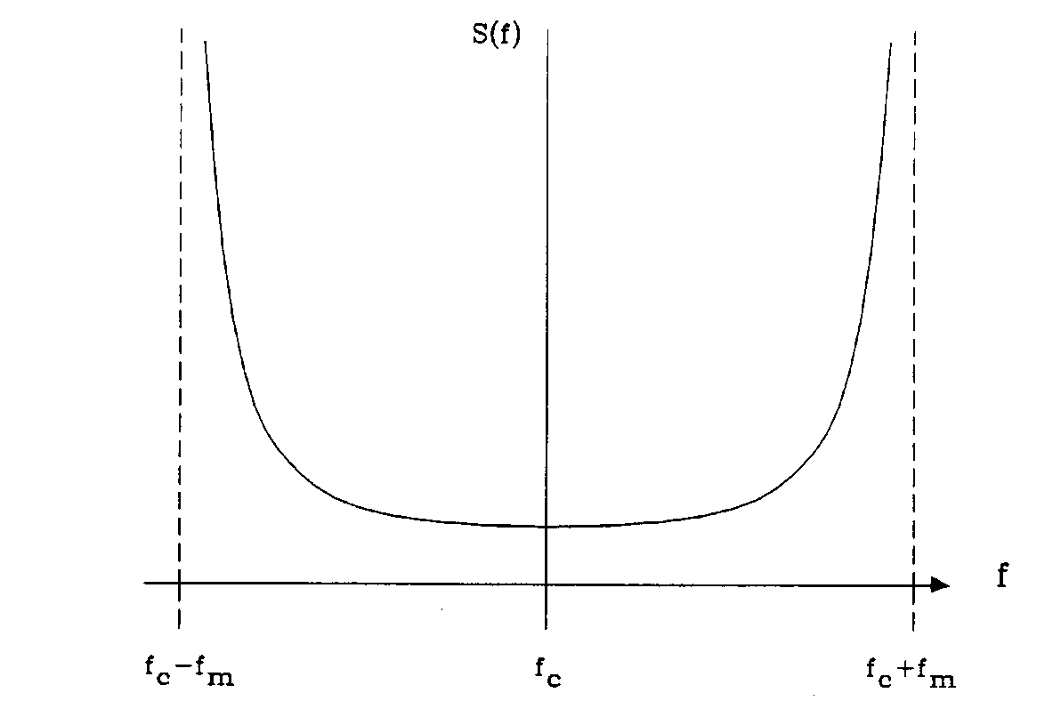
Doppler Spectrum
the incident received power at the MS depends on the
power gain of the antenna and the polarization used
2
A
S( f ) =
1 − ( f / f_{m} )
Multi-Path Fading
Channel

Slide 57
Two-ray Rayleigh Fading
Model
Clarke’s model for flat fading
It is necessary to model multi-path delay spread as well
Commonly used model is the two-ray
model
Multi-Path Fading
Channel

Slide 58
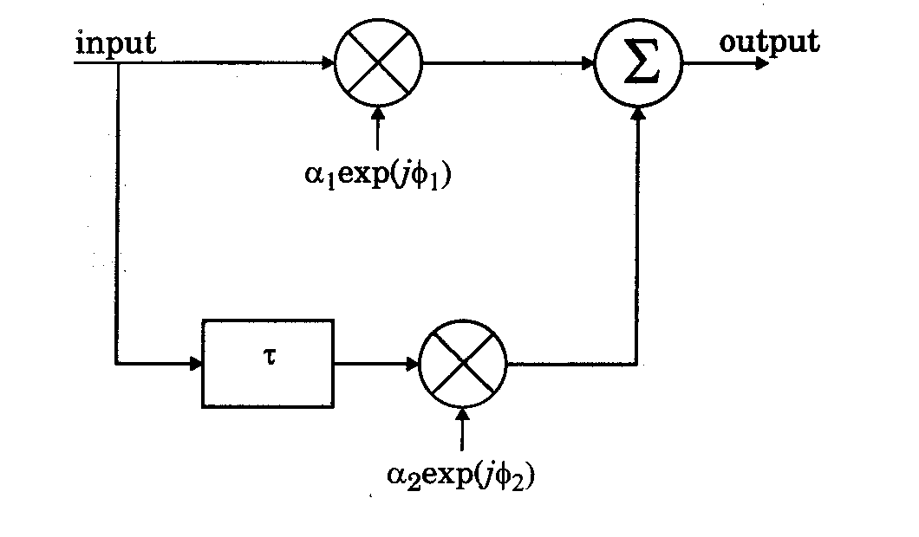
Two-ray Rayleigh Fading
Model
Multi-Path Fading
Channel

Slide 59
Two-ray Rayleigh Fading
Model
The impulse response of the model
h_{b} = α₁ exp( jφ₁)δ (t) + α₁ exp( jφ₂ )δ (t −τ )
α.₁ and α.₂ are independent and Rayleigh distributed
φ₁ and φ₁ are independent and uniformly distributed over [0,2π]
τ - time delay between the two rays
By varying τ it is possible to create a wide range of
frequency selective fading effects
Multi-Path Fading
Channel

Slide 60
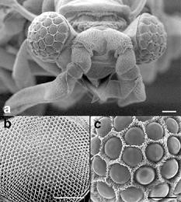
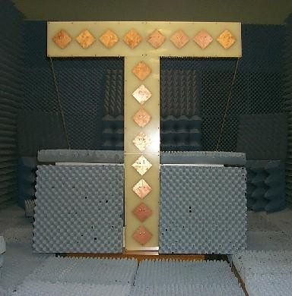
Beyond Current Engineering
Practice
Multi-Path Fading
Channel

Slide 61
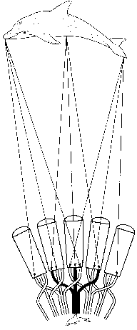
Antenna Arrays are
Electromagnetic Eyes
Multi-Path Fading
Channel

Slide 62
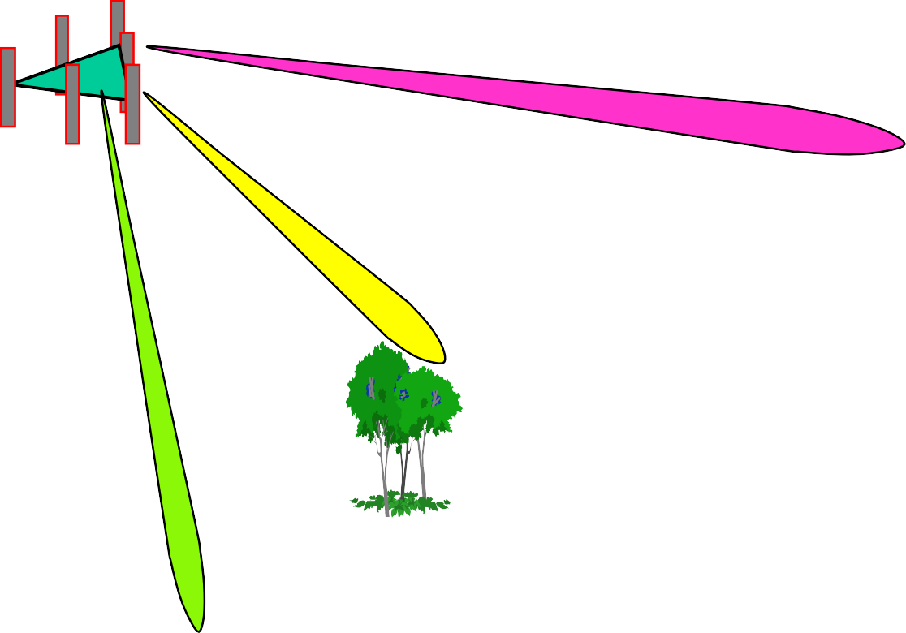







Smart Antenna System with
Multi-path
BS
y = Sx+ n
Multi-Path Fading
Channel

Slide 63
Multi-user System Model
E{nn^{H}} = σ²I
y = Sx+ n
•y - received signal (N X 1) dimensional vector
•S - signature matrix (N X K) dimensional matrix
•x - transmitted symbols (K X 1) dimensional vector
•n - Gaussian noise (N X 1) dimensional vector
•N - Number of antenna elements
•K - Number of Users
Multi-Path Fading
Channel

Slide 64
Multi-user System Information
Capacity
SV S^{H}
y = Sx+ n
_{I +} x
C = log
_{σ}2
2
n
V = E{xx^{H} }= PI − Signal symbolpower
x
σ ² − Noise n (variance) power
n
⎛ P ⎞
C = log 1+
_{2 ⎜}⎜ ⎟⎟
_{σ}2
⎝
n ⎠
Multi-Path Fading
Channel

Slide 65
Multiuser Spatial Filter
y = Sx + n
Moore-Penrose Pseudo Inverse
Optimum Spatial Filter
β = (S^{H} S)⁻¹S^{H}
xˆ = (S^{H} S)⁻¹S^{H} ⋅ y
= (S^{H} S)⁻¹ S^{H} ⋅ Sx+
= x + 0_{MAI} + n~
(S^{H} S)⁻¹S^{H}
n
Multi-Path Fading
Channel

Slide 66
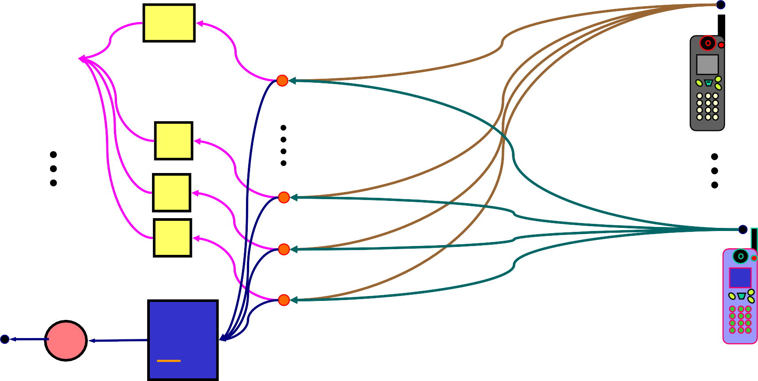
Array of N Elements
z array axis
P₁
P₁
^{β} N-1
+
N-1
β₂
β₁
β₀
2
P_{k}
1
0
P_{k}
_{β}k
+
β₁ = | β₁ | e ^{j α}1
Multi-Path Fading
Channel

Slide 67
Capacity of 2G/3G vs
Achievable Capacity
⎛ ⎞
C= 0.1 log ⎜1+ ¹ ⎟ = 0.3bits / Hz / s
2G/3G
2
⎝
0.1⎠
⎛
1
⎞
C= 30 log ⎜1+
⎟ = 300bits / Hz / s
3G+
2
⎝
0.001⎠
300 / 0.3 = 1000
Capacity improvement factor
Multi-Path Fading
Channel

