Slide 1
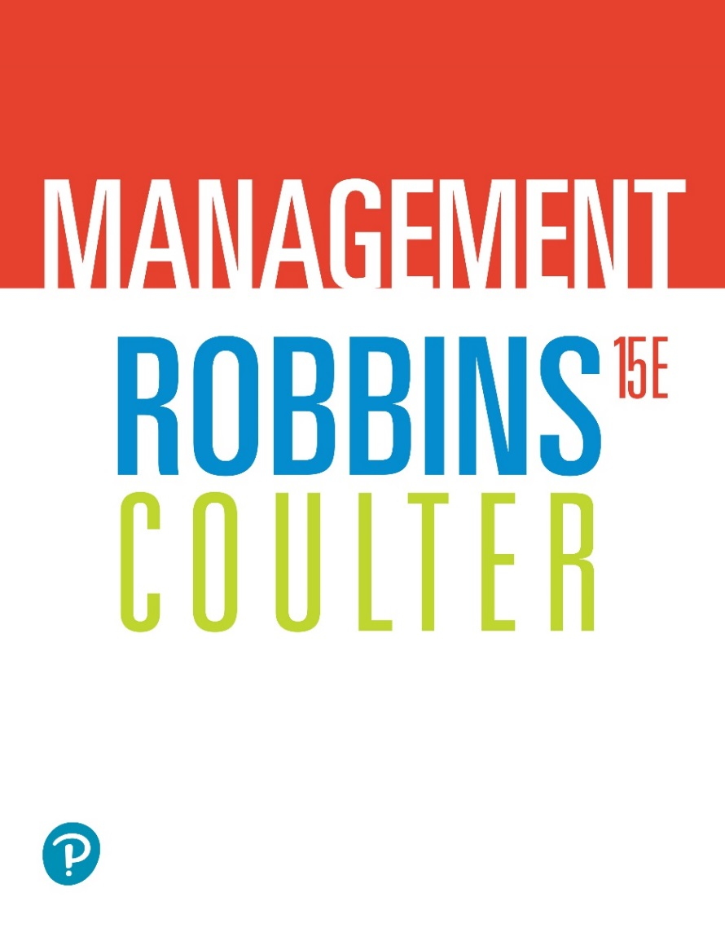
Management
Fifteenth Edition
Chapter 6
Managing Social Responsibility and Ethics
Copyright © 2021, 2018, 2016 Pearson Education, Inc. All Rights Reserved
Notes:
If this PowerPoint presentation contains mathematical equations, you may need to check that your computer has the following installed:
1) MathType Plugin
2) Math Player (free versions available)
3) NVDA Reader (free versions available)

Slide 2
Learning Objectives
6.1 Discuss what it means to be socially responsible and what factors influence that decision.
6.2 Explain green management and how organizations can go green.
6.3 Discuss the factors that lead to ethical and unethical behavior.
6.4 Describe management’s role in encouraging ethical behavior.
6.5 Discuss current social responsibility and ethics issues.

Slide 3
From Obligations to Responsiveness to Responsibility
Social obligation: when a firm engages in social actions because of its obligation to meet certain economic and legal responsibilities
Classical view: the view that management’s only social responsibility is to maximize profits
Notes:
The concept of social responsibility has been described in different ways. For instance, it’s been called “profit making only,” “going beyond profit making,” “any discretionary corporate activity intended to further social welfare,” and “improving social or environmental conditions.” We can understand it better if we first compare it to two similar concepts: social obligation and social responsiveness. Social obligation is when a firm engages in social actions because of its obligation to meet certain economic and legal responsibilities. The organization does what it’s obligated to do and nothing more. This idea reflects the classical view of social responsibility, which says that management’s only social responsibility is to maximize profits. The most outspoken advocate of this approach is economist and Nobel laureate Milton Friedman. He argued that managers’ primary responsibility is to operate the business in the best interests of the stockholders, whose primary concerns are financial.

Slide 4
The Socioeconomic View
Socioeconomic view: the view that managers’ social responsibilities go beyond making profits to include protecting and improving society’s welfare
Social responsiveness: when a company engages in social actions in response to some popular social need
Social responsibility: A business’s intention, beyond its legal and economic obligations, to do the right things and act in ways that are good for society
Notes:
The other two concepts—social responsiveness and social responsibility—reflect the socioeconomic view, which says that managers’ social responsibilities go beyond making profits to include protecting and improving society’s welfare. This view is based on the belief that corporations are not independent entities responsible only to stockholders, but have an obligation to the larger society. Organizations around the world have embraced this view as shown by a survey of global executives in which 84 percent said that companies must balance obligations to shareholders with obligations to the public good.
Social responsiveness is when a company engages in social actions in response to some popular social need. Managers are guided by social norms and values and make practical, market-oriented decisions about their actions. For instance, Ford Motor Company became the first automaker to endorse a federal ban on sending text messages while driving.
A socially responsible organization goes beyond what it’s obligated to do or chooses to do because of some popular social need and does what it can to help improve society because it’s the right thing to do. We define social responsibility as a business’s intention, beyond its legal and economic obligations, to do the right things and act in ways that are good for society. A socially responsible organization does what is right because it feels it has an ethical responsibility to do so.

Slide 5
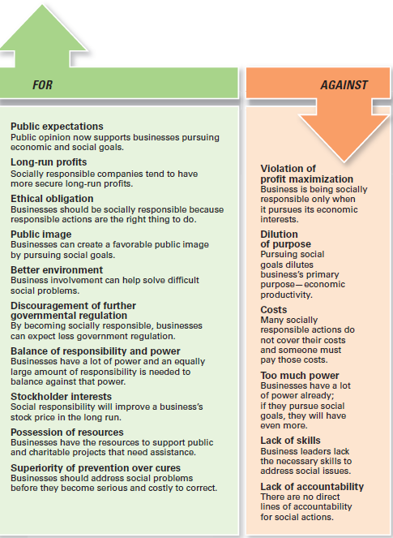
Exhibit 6.1 Arguments For and Against Social Responsibility
Exhibit 6.1 outlines arguments for and against social involvement.
Notes:
Other than meeting their social obligations (which they must do), should organizations be socially involved? One way to look at this question is by examining arguments for and against social involvement. Several points are outlined in Exhibit 6-1.
Long Description:
The arguments for social responsibility are as follows:
Public expectations: Public opinion now supports businesses pursuing economic and social goals.
Long-run profits: Socially responsible companies tend to have more secure long-run profits.
Ethical obligation: Businesses should be socially responsible because responsible actions are the right thing to do.
Public image: Businesses can create a favorable public image by pursuing social goals.
Better environment: Business involvement can help solve difficult social problems.
Discouragement of further governmental regulation: By becoming socially responsible, businesses can expect less government regulation.
Balance of responsibility and power: Businesses have a lot of power and an equally large amount of responsibility is needed to balance against that power.
Stockholder interests: Social responsibility will improve a business’s stock price in the long run.
Possession of resources: Businesses have the resources to support public and charitable projects that need assistance.
Superiority of prevention over cures: Businesses should address social problems before they become serious and costly to correct.
The arguments against social responsibility are as follows:
Violation of profit maximization: Business is being socially responsible only when it pursues its economic interests.
Dilution of purpose: Pursuing social goals dilutes business’s primary purpose—economic productivity.
Costs: Many socially responsible actions do not cover their costs and someone must pay those costs.
Too much power: Businesses have a lot of power already; if they pursue social goals, they will have even more.
Lack of skills: Business leaders lack the necessary skills to address social issues.
Lack of accountability: There are no direct lines of accountability for social actions.

Slide 6
Social Responsibility Versus Social Responsiveness
Exhibit 6.2 Social Responsibility Versus Social Responsiveness
Blank | Social Responsibility | Social Responsiveness
Major consideration Focus Emphasis Decision framework | Ethical Ends Obligation Long-term | Pragmatic Means Responses Medium- and short-term
Source: Adapted from Steven L. Wartick and Philip L. Cochran, “The Evolution of the Corporate Social Performance Model,” Academy of Management Review (October 1985): p. 766.
Notes:
Exhibit 6.2 shows the difference between social responsibility and social responsiveness using four different dimensions.

Slide 7
Green Management and Sustainability
Green management: managers consider the impact of their organization on the natural environment
Notes:
Until the late 1960s, few people (and organizations) paid attention to the environmental consequences of their decisions and actions. However, a number of environmental disasters brought a new spirit of environmentalism to individuals, groups, and organizations. Increasingly, managers have begun to consider the impact of their organization on the natural environment, which we call green management.

Slide 8
How Organizations Go Green
Legal (light green) approach
Market approach
Stakeholder approach
Activist approach
Notes:
Managers and organizations can do many things to protect and preserve the natural environment. Some do no more than what is required by law; that is, they fulfill their social obligation. The first approach, the legal (or light green) approach, is simply doing what is required legally. In this approach, which illustrates social obligation, organizations exhibit little environmental sensitivity. They obey laws, rules, and regulations without legal challenge and that’s the extent of their being green.
As an organization becomes more sensitive to environmental issues, it may adopt the market approach and respond to environmental preferences of customers. Whatever customers demand in terms of environmentally friendly products will be what the organization provides.
In the stakeholder approach, an organization works to meet the environmental demands of multiple stakeholders such as employees, suppliers, or community.
Finally, if an organization pursues an activist (or dark green) approach, it looks for ways to protect the earth’s natural resources. The activist approach reflects the highest degree of environmental sensitivity and illustrates social responsibility.

Slide 9
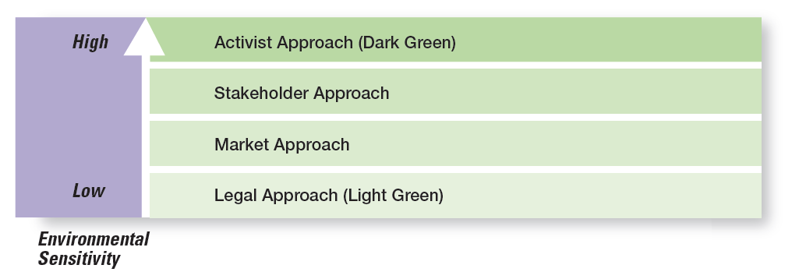
Exhibit 6.3 Green Approaches
Exhibit 6.3 uses the terms shades of green to describe the different environmental approaches that organizations may take.
Notes:
Source: Based on R. E. Freeman, J. Pierce, and R. Dodd, Shades of Green: Business Ethics and the Environment (New York: Oxford University Press, 1995).
Long Description:
A scale of “Environmental Sensitivity” begins with a light shade of green at “Low;” as “Environmental Sensitivity” increases, the green shade become darker, and is darkest at “High.” The positions of the approaches on the scale from “Low” to “High” are as follows:
Legal Approach (Light green)
Market Approach
Stakeholder Approach
Activist Approach (Dark Green)

Slide 10
Evaluating Green Management Actions
Company-issued reports on environmental performance
ISO 9000 (quality management) and ISO 14000 (environmental management) standards
Global 100 list of the most sustainable corporations in the world
Notes:
More than 7,500 companies around the globe now voluntarily report their efforts in promoting environmental sustainability using the guidelines developed by the Global Reporting Initiative (GRI). These reports, which can be found on the GRI website (www.globalreporting.org), describe the numerous green actions of these organizations.
Another way organizations show their commitment to being green is through pursuing standards developed by the nongovernmental International Organization for Standardization (ISO). Organizations that want to become ISO 14000 compliant must develop a total management system for meeting environmental challenges.
One final way to evaluate a company’s green actions is to use the Global 100 list of the most sustainable corporations in the world (www.corporateknights.com). To be named to this list a company has displayed a superior ability to effectively manage environmental and social factors.

Slide 11
Managers and Ethical Behavior
Ethics: principles, values, and beliefs that define right and wrong behavior
In the next slide of Exhibit 6-4 you will find several tests a manager can use when faced with an ethical dilemma
Posing one of the questions listed in Exhibit 6-4 can help you make an ethical choice
Notes:
What do we mean by ethics? We’re defining it as the principles, values, and beliefs that define right and wrong decisions and behavior. Many decisions managers make require them to consider both the process and who’s affected by the result. To better understand the ethical issues involved in such decisions, let’s look at the factors that determine whether a person acts ethically or unethically.

Slide 12
Exhibit 6.4 Helping You Make Ethical Decisions
When faced with an ethical dilemma, consider using one or more of these tests:
The Golden Rule Test: Would I want people to do this to me?
The What-If-Everybody-Did-This Test: Would I want everyone to do this? Would I want to live in that kind of world?
The Family Test: How would my parents/spouse/significant other/children feel if they found out I did this?
The Conscience Test: Does this action go against my conscience? Will I feel guilty afterwards?
The Front Page/Social Media Test: How would I feel if this action was reported on the front page of my hometown newspaper or splashed across social media outlets for all to see?
Source: Based on T. Lickona, Character Matters: How to Help Our Children Develop Good Judgment Integrity, and Other Essential Virtues (New York: Touchstone Publishing, 2004); A. Goodman, “The Dilemma: Addicted and Conflicted About Laughing at the Afflicted,” Institute for Global Ethics, June 3, 2013, globalethics.org; and G. Enck, “Six-Step Framework for Ethical Decision Making,” Journal of Health Services Research and Policy (January 2014): pp. 62–64.
Notes:
When you are faced with an ethical decision, ask yourself one or more of these questions. It will help you determine what to do.

Slide 13
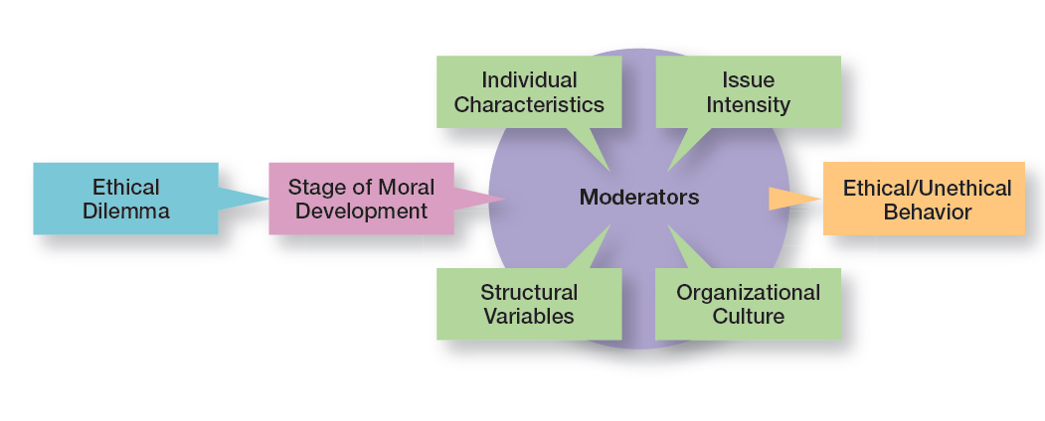
Exhibit 6.5 Factors that Determine Ethical and Unethical Behavior
Exhibit 6.5 shows factors that determine ethical and unethical behavior.
Notes:
Whether someone behaves ethically or unethically when faced with an ethical dilemma is influenced by several things: his or her stage of moral development and other moderating variables, including individual characteristics and the organization’s structural design, which we will discuss in a later section of the chapter, and the intensity of the ethical issue.
Long Description:
In the diagram, “Ethical dilemma” leads to “Stage of moral development;” A complex interaction between stage of moral development and the 4 “Moderators” of ‘Individual characteristics”, the organization’s “Structural variables”, the “Organizational culture, and the “Issue Intensity” results in “Ethical or Unethical behavior.”

Slide 14
Stage of Moral Development
Preconventional level
Conventional level
Principled level
Notes:
Research divides moral development into three levels, each having two stages. At each successive stage, an individual’s moral judgment becomes less dependent on outside influences and more internalized.
At the first level, the preconventional level, a person’s choice between right or wrong is based on personal consequences from outside sources, such as physical punishment, reward, or exchange of favors.
At the second level, the conventional level, ethical decisions rely on maintaining expected standards and living up to the expectations of others.
At the principled level, individuals define moral values apart from the authority of the groups to which they belong or society in general.

Slide 15
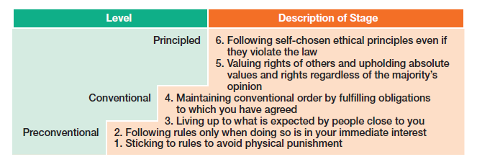
Exhibit 6.6 Stages of Moral Development
Exhibit 6.6 shows the three levels and six stages of moral development.
Notes:
Source: L. Kohlberg, “Moral Stages and Moralization: The Cognitive-Development Approach,” in Moral Development and Behavior: Theory, Research, and Social Issues, ed. T. Lickona (New York: Holt, Rinehart & Winston, 1976), pp. 34–35.
Long Description:
The six stages grouped into three levels and their descriptions are as follows:
Preconventional
Stage 1: Sticking to rules to avoid physical punishment.
Stage 2: Following rules only when doing so is in your immediate interest.
Conventional
Stage 3: Living up to what is expected by people close to you.
Stage 4: Maintaining conventional order by fulfilling obligations to which you have agreed.
Principled
Stage 5: Valuing rights of others.
Stage 6: Following self-chosen ethical principles even if they violate the law.

Slide 16
Individual Characteristics
Values
Ego strength
Locus of control
Notes:
Two individual characteristics—values and personality—play a role in determining whether a person behaves ethically. Each person comes to an organization with a relatively entrenched set of personal values, which represent basic convictions about what is right and wrong. Our values develop from a young age based on what we see and hear from parents, teachers, friends, and others.
Two personality variables have been found to influence an individual’s actions according to his or her beliefs about what is right or wrong: ego strength and locus of control. Ego strength measures the strength of a person’s convictions. People with high ego strength are likely to resist impulses to act unethically and instead follow their convictions. Locus of control is the degree to which people believe they control their own fate. People with an internal locus of control believe they control their own destinies. They’re more likely to take responsibility for consequences and rely on their own internal standards of right and wrong to guide their behavior.

Slide 17
Structural Variables
Ethical behavior can be influenced by:
An organization’s structural design
Goals
Performance appraisal system
Reward allocation
Notes:
Those structures that minimize ambiguity and uncertainty with formal rules and regulations and those that continuously remind employees of what is ethical are more likely to encourage ethical behavior.
Although many organizations use goals to guide and motivate employees, those goals can create some unexpected problems. One study found that people who don’t reach set goals are more likely to engage in unethical behavior, even if they do or don’t have economic incentives to do so.
An organization’s performance appraisal system can also influence ethical behavior. Some systems focus exclusively on outcomes, while others evaluate means as well as ends. When employees are evaluated only on outcomes, they may be pressured to do whatever is necessary to look good on the outcomes and not be concerned with how they got those results.
The more that rewards or punishment depend on specific goal outcomes, the more employees are pressured to do whatever they must to reach those goals—perhaps to the point of compromising their ethical standards.

Slide 18
Exhibit 6.7 Issue Intensity
As Exhibit 6.7 shows, six characteristics determine issue intensity or how important an ethical issue is to an individual: greatness of harm, consensus of wrong, probability of harm, immediacy of consequences, proximity to victim(s), and concentration of effect.
Notes:
As Exhibit 6.7 shows, six characteristics determine issue intensity or how important an ethical issue is to an individual: greatness of harm, consensus of wrong, probability of harm, immediacy of consequences, proximity to victim(s), and concentration of effect.
Long Description:
The diagram shows “Issue Intensity” at the center. The six characteristics are shown around it. The characteristics and the question that determines the intensity of each characteristic are summarized below:
Greatness of Harm: How many people will be harmed?
Consensus of Wrong: How much agreement is there that this action is wrong?
Probability of Harm: How likely is it that this action will cause harm?
Immediacy of Consequences: Will harm be felt immediately?
Proximity to Victim or Victims: How close are the potential victims?
Concentration of Effect: How concentrated is the effect of the action on the victim or victims?

Slide 19
Issue Intensity
The six factors suggest that:
the larger the number of people harmed
the more agreement that the action is wrong
the greater the likelihood that the action will cause harm
the more immediately the consequences of the action will be felt
the closer the person feels to the victim
The more concentrated the effect of the action on the victim(s)…
The greater the issue intensity or importance
Notes:
A student who would never consider breaking into an instructor’s office to steal an accounting exam doesn’t think twice about asking a friend who took the same course from the same instructor last semester what questions were on an exam. Similarly, a manager might think nothing about taking home a few office supplies, yet be highly concerned about the possible embezzlement of company funds. These examples illustrate the final factor that influences ethical behavior: the intensity of the ethical issue itself.

Slide 20
Ethics in an International Context
Ethical standards are not universal
Foreign Corrupt Practices Act
United Nations Global Contract
Notes:
Are ethical standards universal? Although some common moral beliefs exist, social and cultural differences between countries are important factors that determine ethical and unethical behavior.
In the case of payments to influence foreign officials or politicians, U.S. managers are guided by the Foreign Corrupt Practices Act (FCPA), which makes it illegal to knowingly corrupt a foreign official. However, even this law doesn’t always reduce ethical dilemmas to black and white. In some countries, government bureaucrat salaries are low because custom dictates that they receive small payments from those they serve. Payoffs to these bureaucrats “grease the machinery” and ensure that things get done.
Another guide to being ethical in international business is the United Nations Global Compact, shown in Exhibit 6-8.

Slide 21
Exhibit 6.8 The Ten Principles of the UN Global Compact (1 of 2)
Principle Number | Principle Text
Human Rights | blank
Principle 1 | Business should support and respect the protection of internationally proclaimed human rights within their sphere of influence; and
Principle 2 | Make sure they are not complicit in human rights abuses.
Labor Standards | blank
Principle 3 | Business should uphold the freedom of association and the effective recognition of the right to collective bargaining;
Principle 4 | The elimination of all forms of forced and compulsory labor;
Principle 5 | The effective abolition of child labor; and
Principle 6 | The elimination of discrimination in respect to employment and occupation.
Exhibit 6.8 shows the UN Global Compact, which asks companies to embrace, support, and enact, within their sphere of infuence, a set of core values in the areas of human rights, labor standards, the environment, and anti-corruption.
Notes:
Source: Copyright © 2012 by United Nations Global Compact (www.unglobalcompact.org). Reprinted with permission.

Slide 22
Exhibit 6.8 The Ten Principles of the U N Global Compact (2 of 2)
Principle Number | Principle Text
Environment | Blank
Principle 7 | Business should support a precautionary approach to environmental challenges;
Principle 8 | Undertake initiatives to promote greater environmental responsibility; and
Principle 9 | Encourage the development and diffusion of environmentally friendly technologies.
Anti-Corruption | blank
Principle 10 | Business should work against corruption in all its forms, including extortion and bribery.
Exhibit 6.8 shows the UN Global Compact, which asks companies to embrace, support, and enact, within their sphere of infuence, a set of core values in the areas of human rights, labor standards, the environment, and anti-corruption.
Notes:
Source: Copyright © 2012 by United Nations Global Compact (www.unglobalcompact.org). Reprinted with permission.

Slide 23
Employee Selection
Some firms do pre-employment integrity testing to weed out applicants that are likely to be dishonest or engage in other undesirable workplace behaviors
Firms need to state that background checks will be conducted and references contacted
Use the interview to pose ethical questions to determine the applicant’s integrity
Notes:
The selection process (interviews, tests, background checks, and so forth) should be viewed as an opportunity to learn about an individual’s level of moral development, personal values, ego strength, and locus of control.
A strong culture exerts more influence on employees than does a weak one. If a culture is strong and supports high ethical standards, it has a powerful and positive influence on the decision to act ethically or unethically.

Slide 24
Codes of Ethics and Decision Rules
Code of ethics: a formal statement of an organization’s primary values and the ethical rules it expects its employees to follow
The effectiveness of a code of ethics depends heavily on whether management supports them and how employees that violate the codes are treated
Notes:
Uncertainty about what is and is not ethical can be a problem for employees. A code of ethics, a formal statement of an organization’s values and the ethical rules it expects employees to follow, is a popular choice for reducing that ambiguity. Research shows that 97 percent of organizations with more than 10,000 employees have a written code of ethics.

Slide 25
Developing Codes of Ethics
Organizational leaders should model appropriate behavior and reward those who act ethically.
Managers should reaffirm the importance of the ethics code and discipline those who break it
Stakeholders should be considered as an ethics code is developed or improved
Managers should communicate and reinforce the ethics code regularly
Managers should use the five-step process to guide employees when faced with ethical dilemmas
Notes:
Unfortunately, codes of ethics may not work as well as we think they should. A survey of employees in U.S. businesses found that 41 percent of those surveyed had observed ethical or legal violations in the previous 12 months, including such things as conflicts of interest, abusive or intimidating behavior, and lying to employees. And 37 percent of those employees didn’t report observed misconduct. Does this mean that codes of ethics shouldn’t be developed? No. However, in doing so, managers should use these suggestions.

Slide 26
Leadership at the Top
Doing business ethically requires a commitment from managers at all levels, but especially the top level because:
they uphold the shared values and set the cultural tone
they’re role models in both words and actions
Notes:
Doing business ethically requires a commitment from managers at all levels, but especially the top level. Why? Because they’re the ones who uphold the shared values and set the cultural tone. They’re role models in terms of both words and actions, though what they do is far more important than what they say. If top managers, for example, take company resources for their personal use, inflate their expense accounts, or give favored treatment to friends, they imply that such behavior is acceptable for all employees.

Slide 27
Job Goals and Performance Appraisal
Under the stress of unrealistic goals, otherwise ethical employees may feel they have no choice but to do whatever is necessary to meet those goals.
Notes:
Under the stress of unrealistic goals, otherwise ethical employees may feel they have no choice but to do whatever is necessary to meet those goals. Also, goal achievement is usually a key issue in performance appraisal. If performance appraisals focus only on economic goals, ends will begin to justify means. To encourage ethical behavior, both ends and means should be evaluated. For example, a manager’s annual review of employees might include a point-by-point evaluation of how their decisions measured up against the company’s code of ethics as well as how well goals were met.

Slide 28
Ethics Training
More organizations are setting up seminars, workshops, and similar ethics training programs to encourage ethical behavior.
Notes:
Such training programs aren’t without controversy, as the primary concern is whether ethics can be taught. Critics stress that the effort is pointless because people establish their individual value systems when they’re young. Proponents note, however, that several studies have shown that values can be learned after early childhood. In addition, they cite evidence that shows that teaching ethical problem solving can make an actual difference in ethical behaviors; that training has increased individuals’ level of moral development; and that, if nothing else, ethics training increases awareness of ethical issues in business.

Slide 29
Independent Social Audits
Independent social audits: evaluate decisions and management practices in terms of the organization’s code of ethics
Notes:
The fear of being caught can be an important deterrent to unethical behavior. Independent social audits, which evaluate decisions and management practices in terms of the organization’s code of ethics, increase that likelihood. Such audits can be regular evaluations or they can occur randomly with no prior announcement. An effective ethics program probably needs both. To maintain integrity, auditors should be responsible to the company’s board of directors and present their findings directly to the board.

Slide 30
Protection of Employees Who Raise Ethical Issues
Whistle-blower: individual who raises ethical concerns or issues to others
Currently 22 federal statutes protecting whistle-blowers
Managers retaliating against whistle-blowers could face a ten-year prison sentence
OSHA has proposed that anti-retaliation programs have the 5 key elements discussed next
Notes:
It’s important for managers to assure employees who raise ethical concerns or issues that they will face no personal or career risks. These individuals, often called whistle-blowers, can be a key part of any company’s ethics program.
How can employees be protected so they’re willing to step up if they see unethical or illegal things occurring? One way is to set up toll-free ethics hotlines. Another way is to have in place a “procedurally just process,” which means making sure the decision-making process is fair and that employees are treated respectfully about their concerns. Backlash against whistle-blowers can be costly.
Finally, federal legislation offers some legal protection. According to the Sarbanes-Oxley Act, any manager who retaliates against an employee for reporting violations faces a stiff penalty: a 10-year jail sentence. Antiretaliation protections against whistle-blowers have been strengthened by the more recent Dodd-Frank Wall Street Reform Act. Unfortunately, despite this protection, fewer than two of every three employees felt they would be protected from retaliation, and about the same proportion fear losing their jobs if they do not meet performance targets.

Slide 31
O S H A Anti-Retaliation Program Elements
Management Commitment: Management needs to demonstrate it is committed to addressing concerns
Compliance Concern Response System: Need to have established procedures for confidential reporting
Anti-Retaliation Response System: Need clearly designated channels that bypass managers accused of retaliation
Anti-Retaliation Training: All employees need to be trained about the law
Program Oversight: The program needs rigorous oversight in the form of monitoring processes
Notes:
These five elements are critical for an effective anti-retaliation program that satisfies OSHA’s recommendations and shows the firm is committed to protecting whistle-blowers.

Slide 32
Social Entrepreneurship
Social entrepreneur: an individual or organization that seeks out opportunities to improve society by using practical, innovative, and sustainable approaches
Notes:
Social entrepreneurs want to make the world a better place and have a driving passion to make that happen. For example, Microsoft Corporation announced that it would donate $1 billion in cloud services to nonprofits and university researchers. Microsoft’s goal is to provide the same computing tools that have allowed business firms to become more agile and tackle substantial technical challenges. Also, social entrepreneurs use creativity and ingenuity to solve problems. For instance, Seattle-based PATH (Program for Appropriate Technology in Health) is an international nonprofit organization that uses low-cost technology to provide needed healthcare solutions for poor, developing countries. TOMS Shoes is another good example of a firm that demonstrates social entrepreneurship. The students can probably list other current examples.

Slide 33
Social Media and Social Responsibility
Social media has a growing impact on everyone
It has been recognized as a tool managers can use to communicate and promote socially responsible actions
Some research shows it can enhance a company’s reputation
Currently one of the best ways for an organization to promote transparency
Provides a means to shape an organization’s image or reputation
Notes:
Someone is always filming you and posting it online. The same goes for information about an organization. If you don’t want it to appear on social media, don’t do it or say it. It can make or break a person’s reputation, or a company’s reputation, almost overnight. Mistakes can be very difficult to overcome.

Slide 34
Corporate Philanthropy
Corporate philanthropy: can be an effective way for companies to address societal problems
Walmart, Google, and ExxonMobil are in the top 10 most charitable companies
Philanthropy is good for employee morale and increases the firm’s ability to attract top talent
55% of online consumers indicated they would pay more for a product to support philanthropy
Notes:
Corporate philanthropy can be an effective way for companies to address societal problems. For instance, the breast cancer “pink” campaign and the global AIDS Red campaign (started by Bono) are ways that companies support social causes.
Employee volunteering is another popular way for businesses to be involved in promoting social change. For instance, Dow Corning sent a small team of employees to rural India to help women “examine stitchery and figure out prices for garments to be sold in local markets.” Molson-Coors’ 11-member executive team spent a full day at their annual team-building retreat building a house in Las Vegas with Habitat for Humanity. PricewaterhouseCoopers employees renovated an abandoned school in Newark, New Jersey. Every Wachovia employee is given six paid days off from work each year to volunteer in his or her community.
Google gives over $100 million a year in grants that support good causes ranging from helping the poor to developing a navigation app for the blind.

Slide 35
Review Learning Objective 6.1
Discuss what it means to be socially responsible and what factors influence that decision.
Social obligation: a firm engages in social actions because of its obligation to meet certain economic and legal responsibilities
Social responsiveness—when a firm engages in social actions in response to some popular social need
Notes:
Social obligation, which reflects the classical view of social responsibility, is when a firm engages in social actions because of its obligation to meet certain economic and legal responsibilities.
Social responsiveness is when a firm engages in social actions in response to some popular social need. Social responsibility is a business’s intention, beyond its economic and legal obligations, to pursue long-term goals that are good for society. Both these reflect the socioeconomic view of social responsibility. Determining whether organizations should be socially involved can be done by looking at arguments for and against it. Other ways are to assess the impact of social involvement on a company’s economic performance and evaluate the performance of SRI funds versus non-SRI funds. We can conclude that a company’s social responsibility doesn’t appear to hurt its economic performance.

Slide 36
Review Learning Objective 6.2
Explain green management and how organizations can go green.
Different approaches
Legal or light green approach
Market approach
Stakeholder approach
Activist or dark green approach
Notes:
Green management is when managers consider the impact of their organization on the natural environment. Organizations can “go green” in different ways.
The light green approach is doing what is required legally, which is social obligation. Using the market approach, organizations respond to the environmental preferences of their customers.
Using the stakeholder approach, organizations respond to the environmental demands of multiple stakeholders. Both the market and stakeholder approaches can be viewed as social responsiveness.
With an activist or dark green approach, an organization looks for ways to respect and preserve the earth and its natural resources, which can be viewed as social responsibility.
Green actions can be evaluated by examining reports that companies compile about their environmental performance, by looking for compliance with global standards for environmental management (ISO 14000), and by using the Global 100 list of the most sustainable corporations in the world.

Slide 37
Review Learning Objective 6.3
Discuss the factors that lead to ethical and unethical behavior.
Factors that affect ethical and unethical behavior include:
An individual’s level of moral development
Individual characteristics
Structural variables
Organizational culture
Issue intensity
Notes:
Ethics refers to the principles, values, and beliefs that define right and wrong decisions and behavior. The factors that affect ethical and unethical behavior include an individual’s level of moral development (preconventional, conventional, or principled), individual characteristics (values and personality variables—ego strength and locus of control), structural variables (structural design, use of goals, performance appraisal systems, and reward allocation procedures), organizational culture (shared values and cultural strength), and issue intensity (greatness of harm, consensus of wrong, probability of harm, immediacy of consequences, proximity to victims, and concentration of effect). Since ethical standards aren’t universal, managers should know what they can and cannot do legally as defined by the Foreign Corrupt Practices Act. It’s also important to recognize any cultural differences and to clarify ethical guidelines for employees working in different global locations. Finally, managers should know about the principles of the Global Compact and the Anti-Bribery Convention.

Slide 38
Review Learning Objective 6.4
Describe management’s role in encouraging ethical behavior.
The behavior of managers is the single most important influence on an individual’s decision to act ethically or unethically.
Nonprogrammed decisions are unique decisions that require a custom-made solution and are used when the problems are new or unusual (unstructured) and for which information is ambiguous or incomplete.
Notes:
The behavior of managers is the single most important influence on an individual’s decision to act ethically or unethically. Some specific ways managers can encourage ethical behavior include paying attention to employee selection, having and using a code of ethics, recognizing the important ethical leadership role they play and how what they do is far more important than what they say, making sure that the performance appraisal process doesn’t reward goal achievement without taking into account how those goals were achieved, using ethics training and independent social audits, and establishing protective mechanisms.

Slide 39
Review Learning Objective 6.5
Discuss current social responsibility and ethics issues.
Firms should adopt policies to protect whistle-blowers.
Social entrepreneurship has the potential to solve numerous global problems.
Social media is a good way to communicate socially responsible actions.
Corporate philanthropy has benefits to society and the firm.
Notes:
Managers can manage ethical lapses and social irresponsibility by being strong ethical leaders and by protecting employees who raise ethical issues. The example set by managers has a strong influence on whether employees behave ethically. Ethical leaders also are honest, share their values, stress important shared values, and use the reward system appropriately. Managers can protect whistle-blowers (employees who raise ethical issues or concerns) by encouraging them to come forward, by setting up toll-free ethics hotlines, and by establishing a culture in which employees can complain and be heard without fear of reprisal. Social entrepreneurs play an important role in solving social problems by seeking out opportunities to improve society by using practical, innovative, and sustainable approaches. Social entrepreneurs want to make the world a better place and have a driving passion to make that happen. Businesses can promote positive social change through corporate philanthropy and employee volunteering efforts. Discuss some of the ways that social media can help or harm the organization and list a few current examples of corporate philanthropy.

Slide 40

Copyright
This work is protected by United States copyright laws and is provided solely for the use of instructors in teaching their courses and assessing student learning. Dissemination or sale of any part of this work (including on the World Wide Web) will destroy the integrity of the work and is not permitted. The work and materials from it should never be made available to students except by instructors using the accompanying text in their classes. All recipients of this work are expected to abide by these restrictions and to honor the intended pedagogical purposes and the needs of other instructors who rely on these materials.

