Slide 1
Network Intrusion Detection

Slide 2
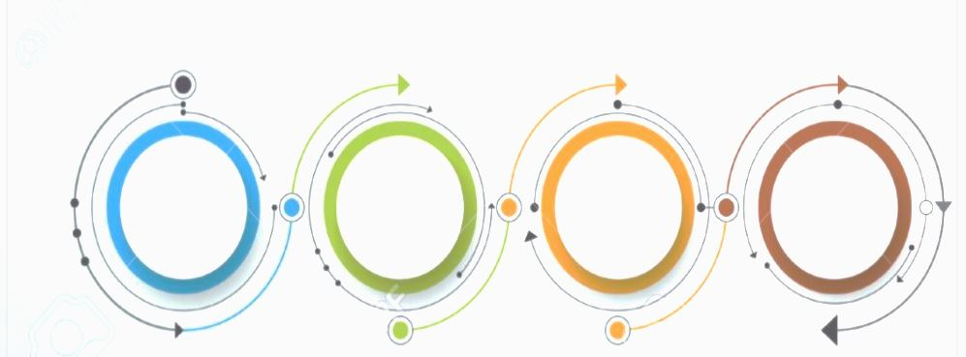
CONTENTS :
Introduction
Dataset
Algorithm
Tools

Slide 3
Introduction :
In the last three years, the networking revolution has finally come of age.
More than ever before, we see that the Internet is changing computing as we know it. The possibilities and opportunities are limitless; unfortunately, so too are the risks and chances of malicious intrusions.

Slide 4
Dataset :
SECURITY
Needed
Source
https://www.kaggle.com/sampadab17/network-intrusion-detection?select=Train_data.csv
The dataset to be audited was provided which consists of a wide variety of intrusions simulated in a military network environment. It created an environment to acquire raw TCP/IP dump data for a network by simulating a typical US Air Force LAN. The LAN was focused like a real environment and blasted with multiple attacks. A connection is a sequence of TCP packets starting and ending at some time duration between which data flows to and from a source IP address to a target IP address under some well-defined protocol.
The class variable has two categories:
• Normal
• Anomalous

Slide 5
Algorithm :
01
04
Logistic regression
Viterbi
02
05
Knn
Sort
03
06
genetic
classification

Slide 6

Tools :
?????
computer
Numpy
IPython
pandas
Powerpoint

Slide 7
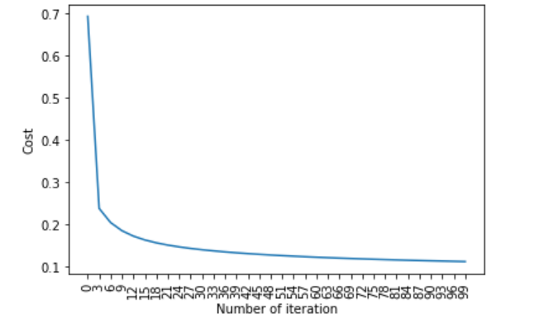
This is the carve for Cost and Number of iteration

Slide 8
Conclusion
We can use this Project for all the following :
Government Servers
Computer Company
Server Company
Antivirus company

Slide 9
THANKS!
Do you have any questions?

