Slide 1
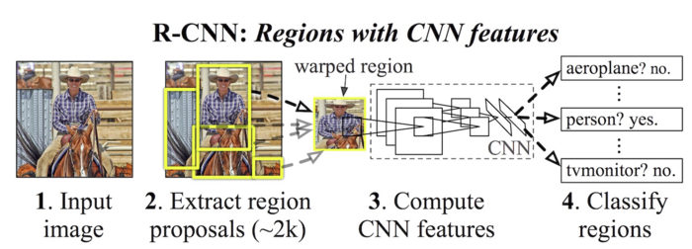
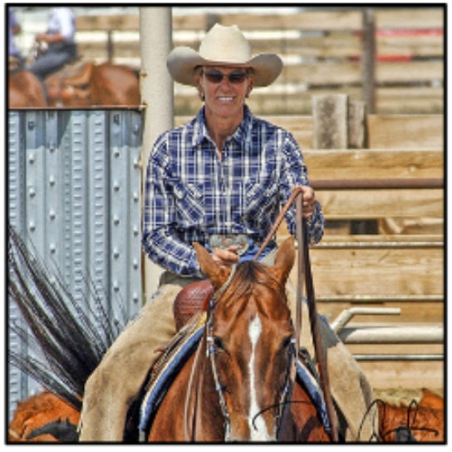
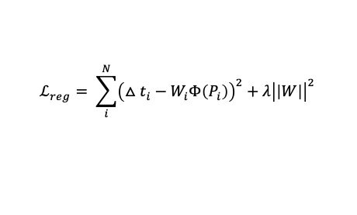
Warped image
$$ℒ_{reg}= \sum_{i}^{N}{{\left(△t_{i}−W_{i}Φ\left(P_{i}\right)\right)}^{2}+λ{\left|\left|W\right|\right|}^{2} }$$
2. One Region Proposal
3. Compute
CNN features
5. Bounding-box
Regression

