Slide 1
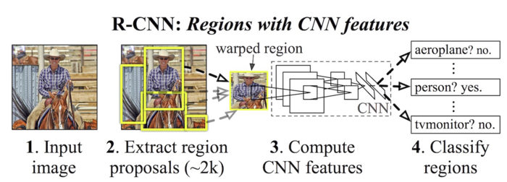
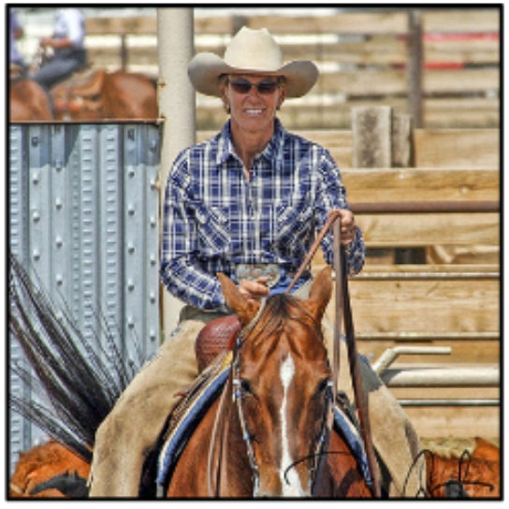
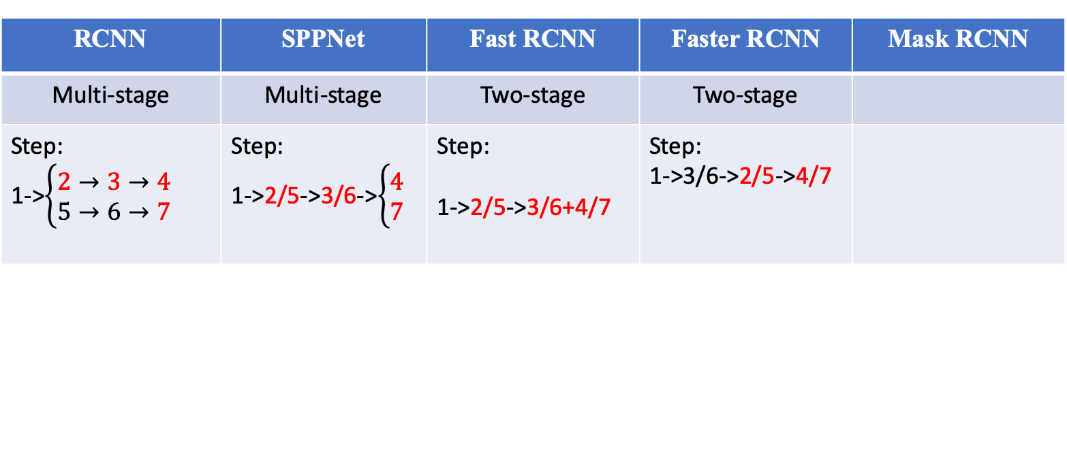
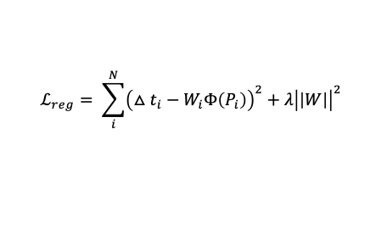
RCNN | SPPNet | Fast RCNN | Faster RCNN | Mask RCNN
Multi-stage | Multi-stage | Two-stage | Two-stage
Step: 1->$\left\{\begin{aligned}2→3→4 \\ 5→6→7\end{aligned}\right.$ | Step: 1->2/5->3/6->$\left\{\begin{aligned}4 \\ 7\end{aligned}\right.$ | Step: 1->2/5->3/6+4/7 | Step: 1->3/6->2/5->4/7
Multi-stage:
Region Proposal Selection (Selective Search)
CNN features extraction
Classification
Bounding-box Regression
Warped image
$$ℒ_{reg}= \sum_{i}^{N}{{\left(△t_{i}−W_{i}Φ\left(P_{i}\right)\right)}^{2}+λ{\left|\left|W\right|\right|}^{2} }$$
Two-stage:
Region Proposal Selection (Selective Search for Fast RCNN, RPN for Faster RCNN)
CNN features extraction for both Classification and Bounding-box Regression
5. One Region Proposal
6. Compute
CNN features
7. Bounding-box
Regression

Slide 2
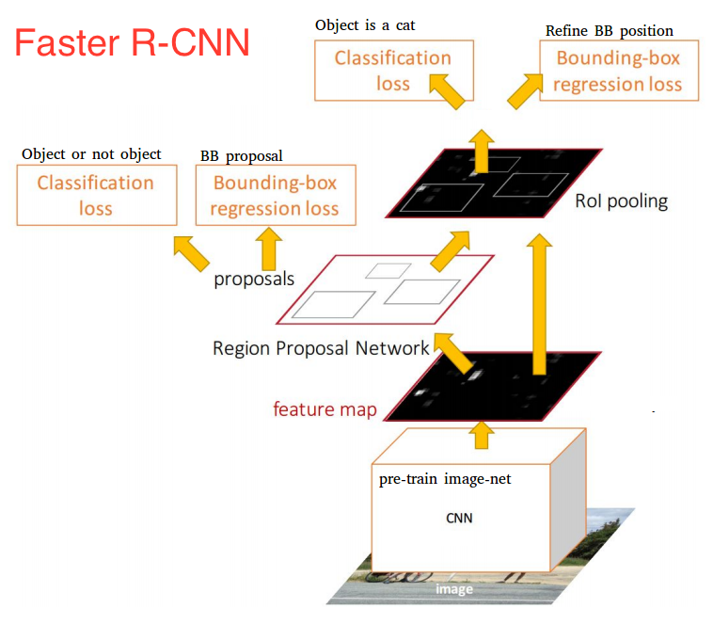

Slide 3
