Slide 1
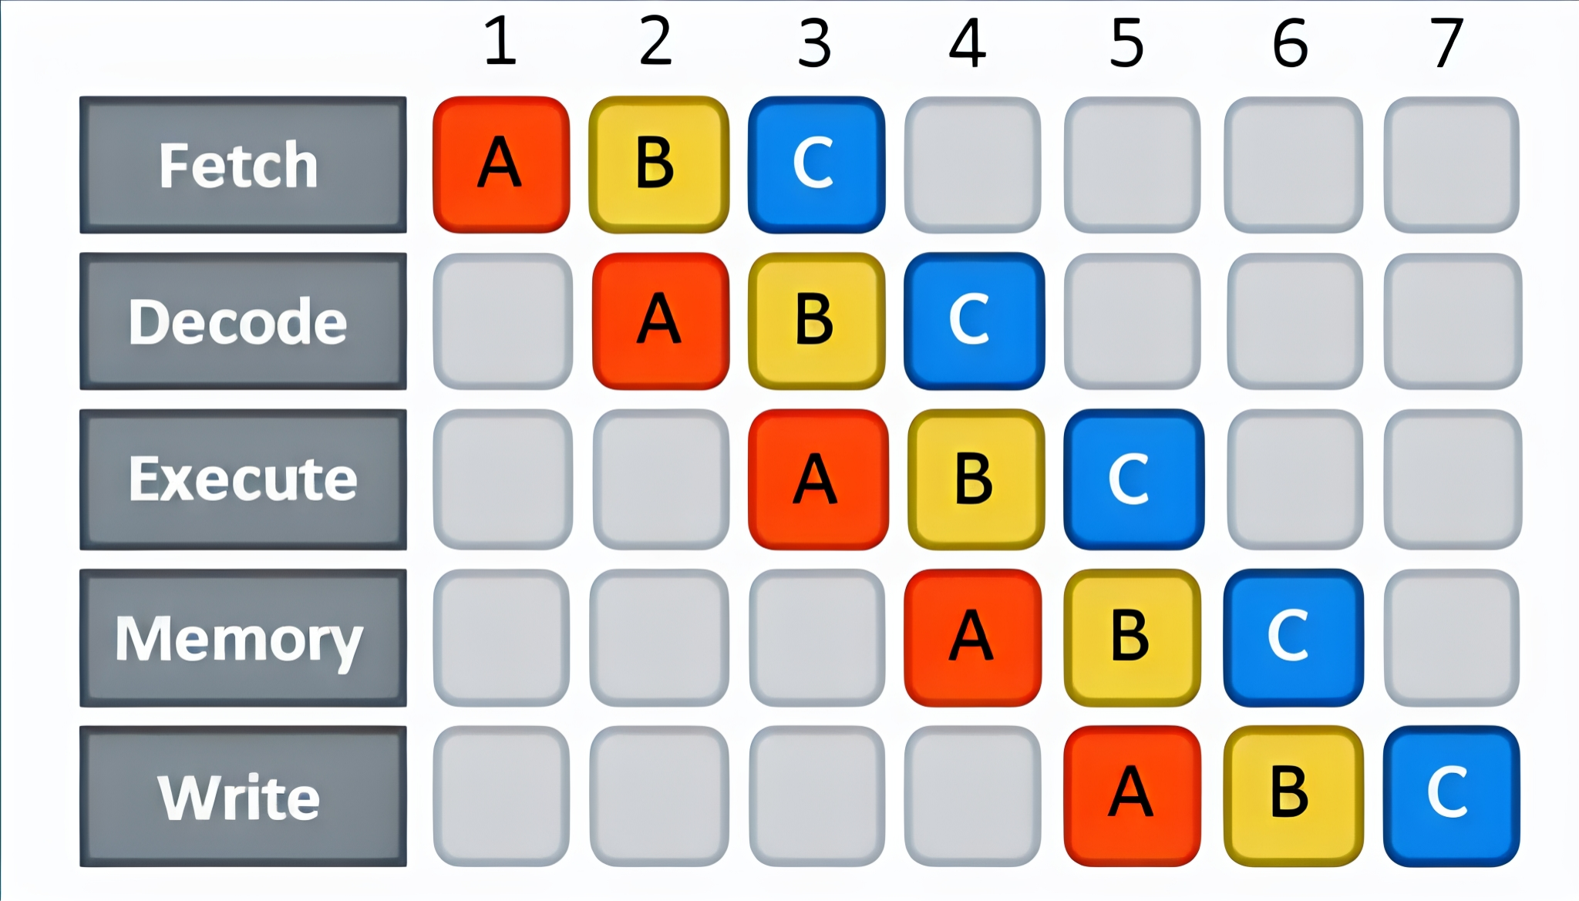
Pipeline
By:
Ali Haider Dhahir
Ahmad Abdullah Ghadeer
Zaynab Asaad Sattar
Ali Sattar Jbari
Ali Basil Abbas

Slide 2
Contents
Abstract
introduction
Single-Cycle & piprline
Pipelining Strategy
Pipelining difficulties
Pipelining Hazards
conclusion

Slide 3
Abstract
We will explain the idea of instruction pipelining and why it makes processors much faster.
Instead of running one instruction from start to finish in a single long cycle, pipelining breaks the instruction into smaller stages like fetch, decode, execute, and write-back. These stages run in parallel, so while one instruction is being decoded, another one is already being fetched.
This overlap increases performance and makes better use of hardware, a simple comparison between single-cycle, multi-cycle, and pipelined processors is included to show how pipelining reduces cycle time and improves overall efficiency
1

Slide 4
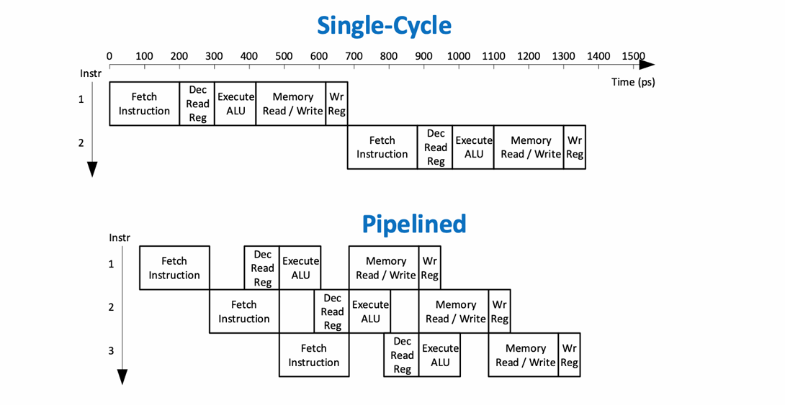
The idea of pipelining is to divide the single-cycle instruction cycles into 5 separate stages, Then add a register between each stage so that different stages can happen in parallel, Each instruction is in different stage of completion.
introduction
2

Slide 5
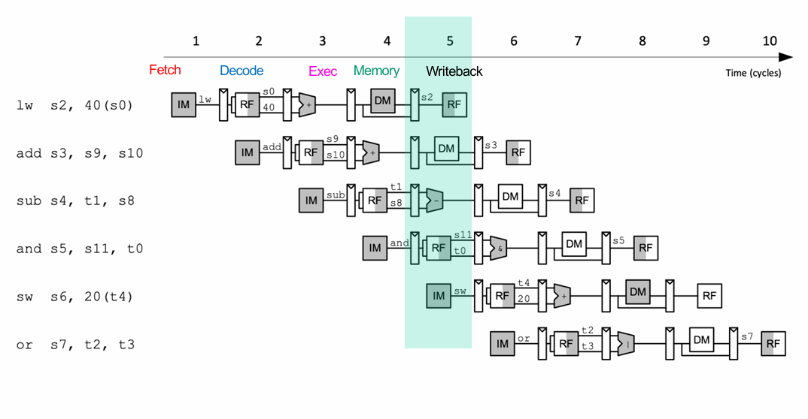
introduction
Instruction pipelining is like the use of an assembly line in a manufacturing plant. An assembly line takes advantage of the fact that a product goes through various stages of production.
3

Slide 6
Single-Cycle & piprline
Single-Cycle Processor:
Each instruction completes all stages in one long cycle, no overlap between instructions-each waits for the previous, this makes execution simple but very slow.
Pipelined Processor:
Each instruction is divided into stages that run in parallel, while one executes, the next one starts immediately, this overlap makes execution much faster.
4

Slide 7
1. Fetch Instruction (FI) Read the next instruction from memory. 2. Decode Instruction (DI) Identify the instruction type (opcode) . 3. Calculate Operands (CO) Compute the memory address of each operand. 4. Fetch Operands (FO) Retrieve the required operands from memory. 5. Execute Instruction (EI) Carry the operation and write the result to location. 6. Write operand (WO) Store the result in memory.
Pipelining Strategy
5

Slide 8
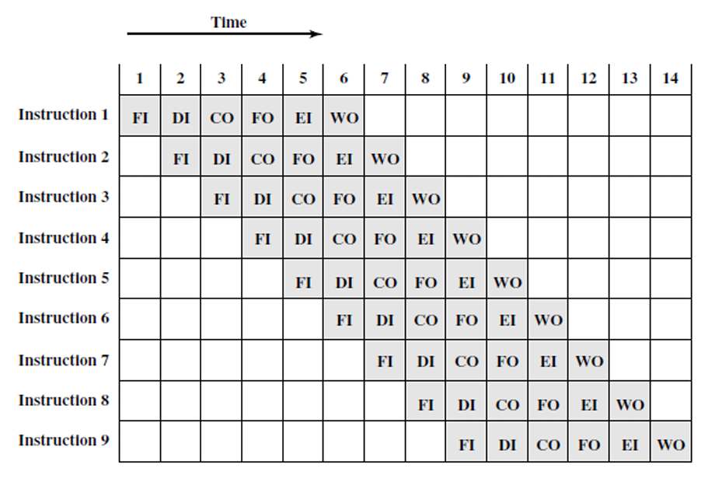
Timing Diagram for Instruction Pipeline Operation.
6

Slide 9
Pipeline difficulties
Pipelining doesn’t always achieve ideal speed because some stages may take longer than others, causing delays.
The biggest slowdown comes from conditional branches and interrupts, which make the next instruction unpredictable.
If a branch is taken, the CPU discovers this too late, so the incorrect instructions already loaded in the pipeline must be cleared.this results in several wasted cycles.
Modern CPUs reduce this penalty using dedicated logic to handle branches and interrupts more efficiently (like figure B).
7

Slide 10
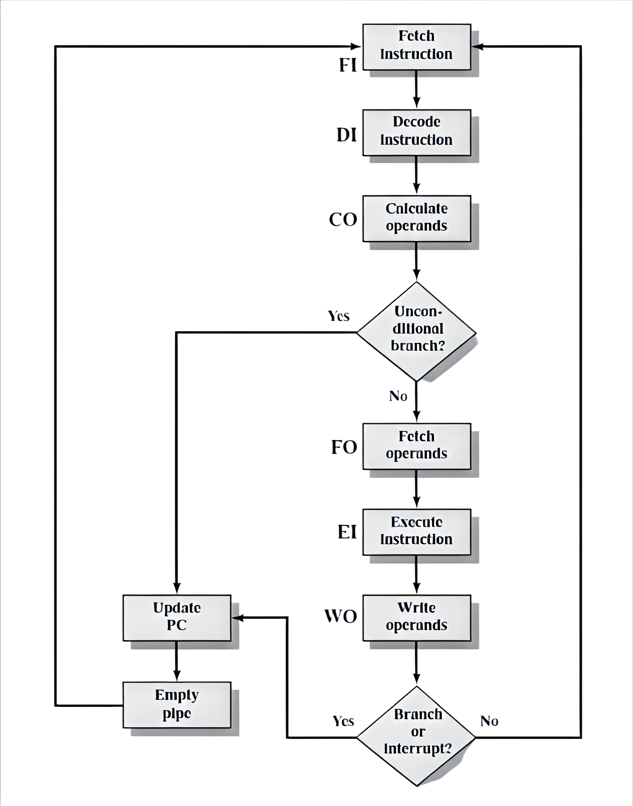
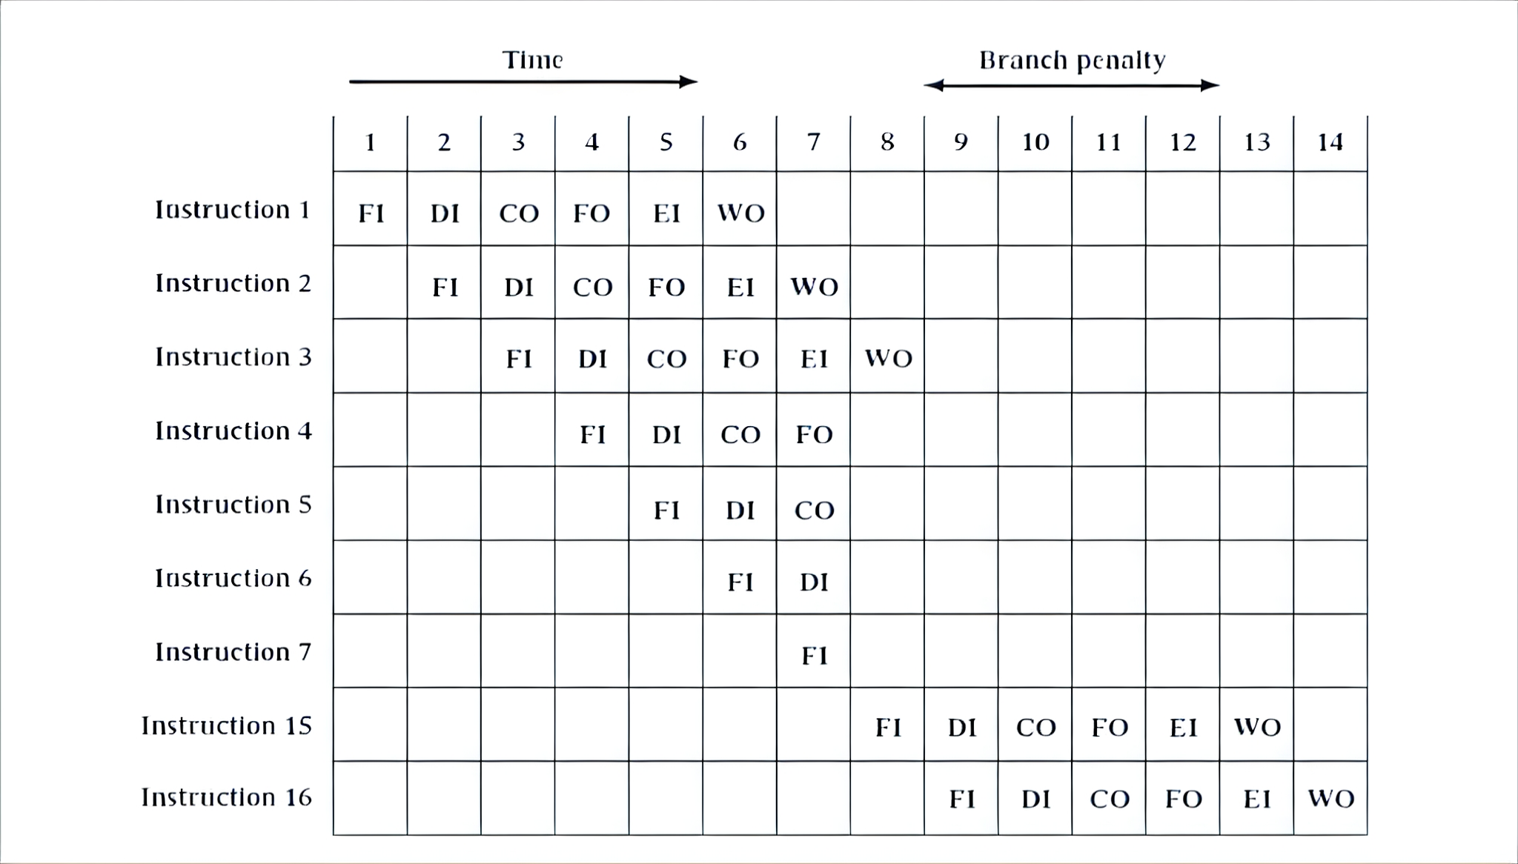
(A)
(B)
8

Slide 11
Why Pipeline?
If we execute 100 instructions
Single Cycle Machine:
• 45 ns/cycle x 1 CPI x 100 inst = 4500 ns
Ideal pipelined machine:
• 10 ns/cycle x (1 CPI x 100 inst + 4 cycle drain) = 1040 ns
9

Slide 12
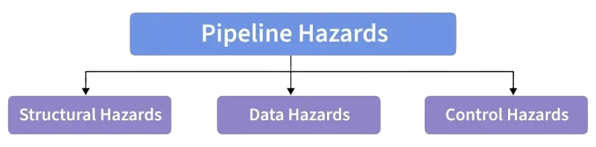
Pipeline Hazards
When do pipeline hazards occur?!
when the pipeline, or some portion of the pipeline, must stall because conditions do not permit continued execution. Such a pipeline stall is also referred to as a pipeline bubble. There are three types of hazards:
Resource Hazards
Data Hazards
Control Hazards
10

Slide 13
Pipeline Hazards
Resource Hazards:
Happen when multiple instructions need the same hardware, causing delays.
Data Hazards:
Occur when an instruction depends on data that hasn’t been updated yet, requiring stalls (bubble) or forwarding to avoid errors.
Control Hazards:
Caused by branches when the CPU fetches the wrong instructions, which must then be discarded.
11

Slide 14
Pipeline stall (bubble)
A forced pause inside the pipeline.
It happens when the CPU cannot safely move an instruction to the next stage, so it inserts an empty cycle to prevent errors.
An instruction waits in the CPU, until whatever is blocking it is resolved.
The main causes of stalls are:
Data hazards → an instruction needs a value that isn’t produced yet.
Control hazards → branch decisions are uncertain or mispredicted.
Resource hazards → two instructions need the same hardware at the same time.
12

Slide 15
Pipeline stall (bubble)
A stall creates a “bubble” in the pipeline, meaning one stage does no useful work during that cycle.
Modern CPUs use techniques like data forwarding, branch prediction, and extra hardware units to reduce the number of stalls, but they cannot eliminate them completely.
Stalls reduce pipeline efficiency, increasing CPI (cycles per instruction) and lowering throughput.
13

Slide 16
Hazard Resolution Techniques
Hazard resolution techniques are methods used by the CPU to reduce or eliminate pipeline stalls caused by data, control, or resource hazards. The main techniques include:
Forwarding (Bypassing):
Sends results directly from one pipeline stage to another without waiting for the write-back stage, reducing data hazards.
Stalling:
Temporarily pauses the pipeline to wait for needed data or resources when no faster solution is possible.
14

Slide 17
Branch Prediction:
Predicts the outcome of branch instructions to avoid control hazards and minimize pipeline flushing.
Speculative Execution:
Executes instructions ahead of time based on predictions to hide delays.
Out-of-Order Execution:
Allows instructions that aren’t affected by hazards to execute early, improving overall performance.
Multiple Hardware Units:
Adds extra resources (e.g., separate memory paths or extra ALUs) to reduce structural hazards.
15

Slide 18
conclusion
In summary, pipelining offers a powerful way to improve CPU performance by allowing multiple instructions to overlap in execution.
However, its efficiency is naturally limited by several challenges, including resource conflicts, data dependencies, and the uncertainty caused by branches and interrupts. Understanding these hazards and how they affect instruction flow is essential to appreciating both the strengths and limitations of the pipeline model.
Despite these issues, pipelining remains a fundamental technique in modern processor design, enabling higher throughput and more effective use of hardware resources.
16

