Slide 1
Virtual Filesystem
Alibek Sayak

Slide 2
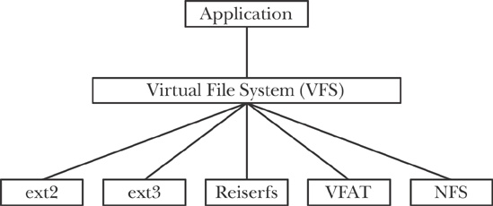
What is VFS?

Slide 3

Which problems are solved by VFS?

Slide 4
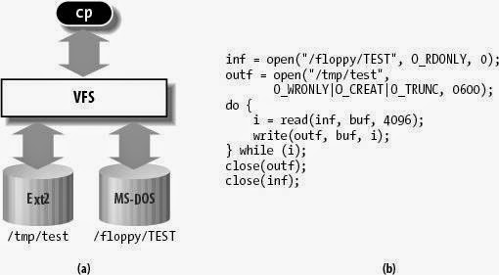
Which problems are solved by VFS?

Slide 5
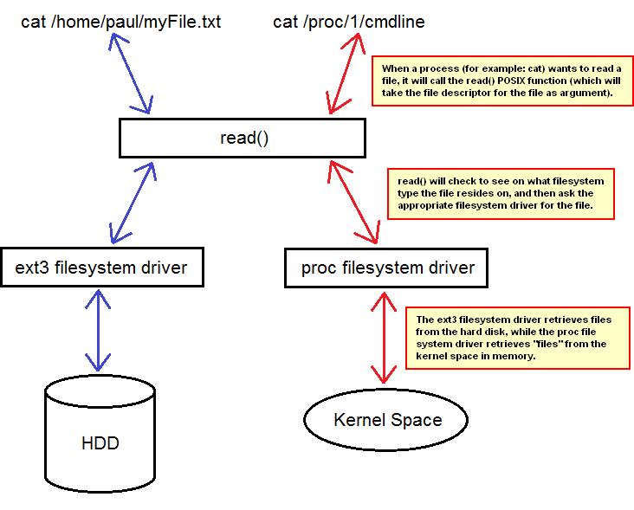
Which problems are solved by VFS?

Slide 6
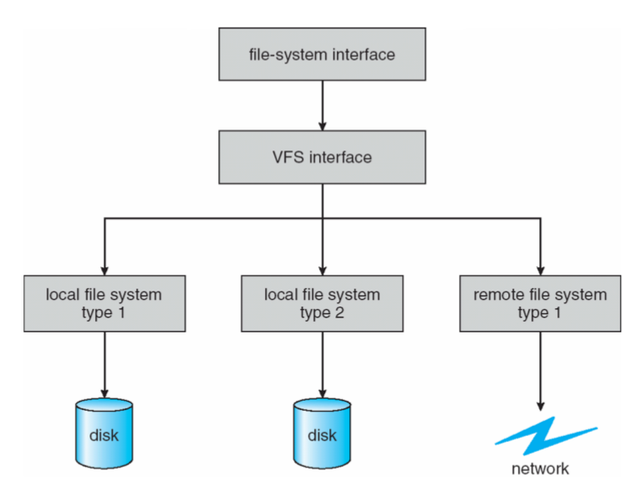
Which problems are solved by VFS?

Slide 7
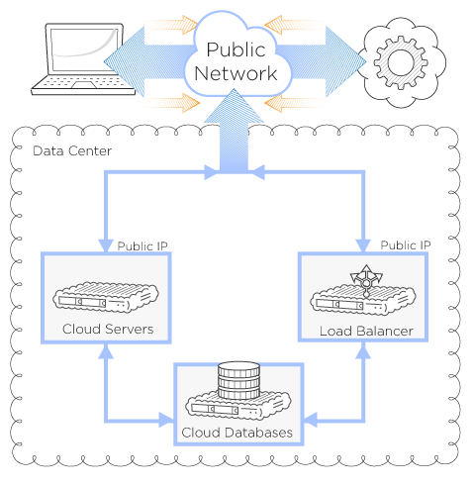
Which problems are solved by VFS?

Slide 8


