Slide 1

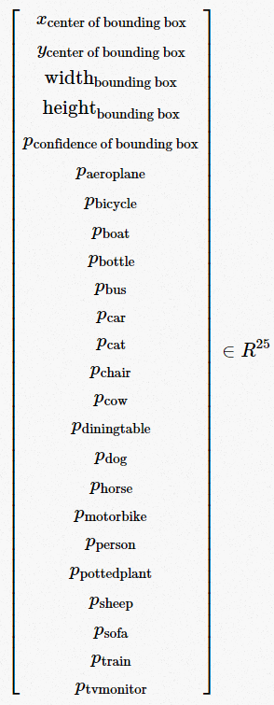
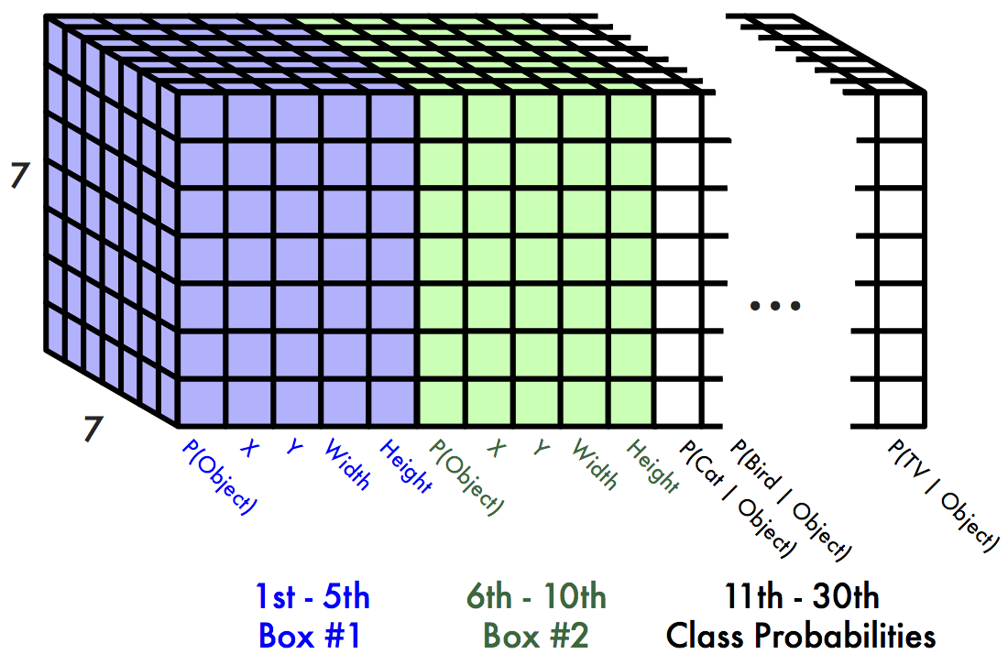
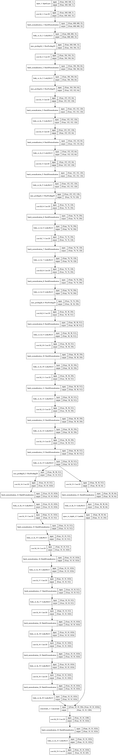
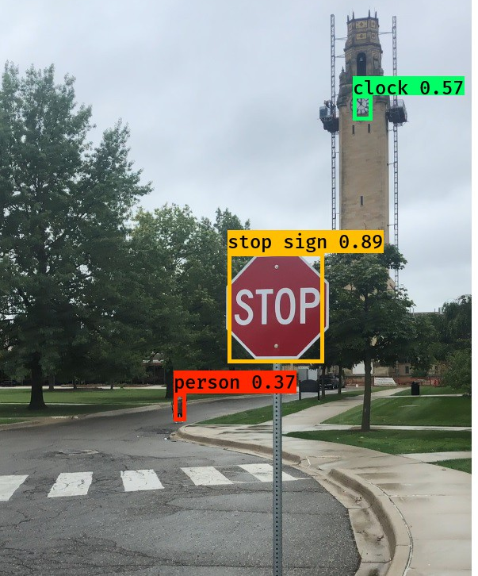
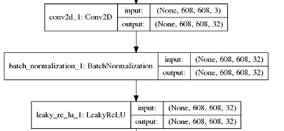
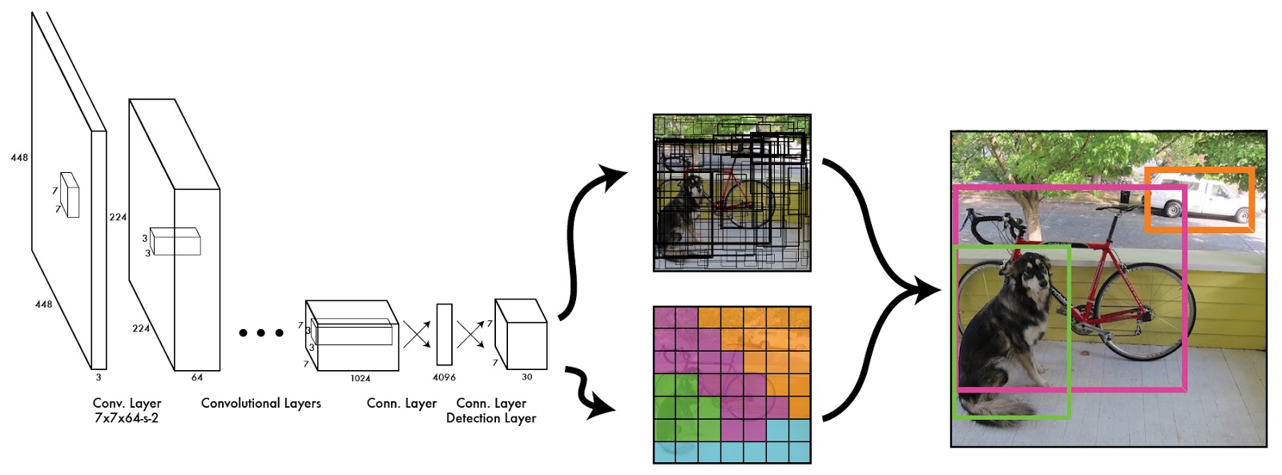
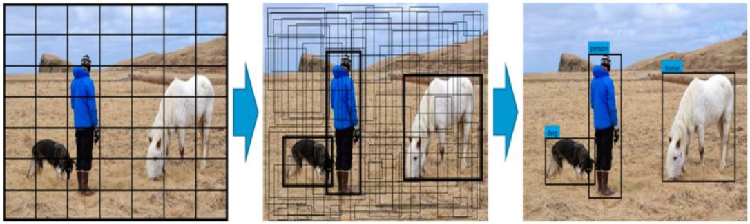
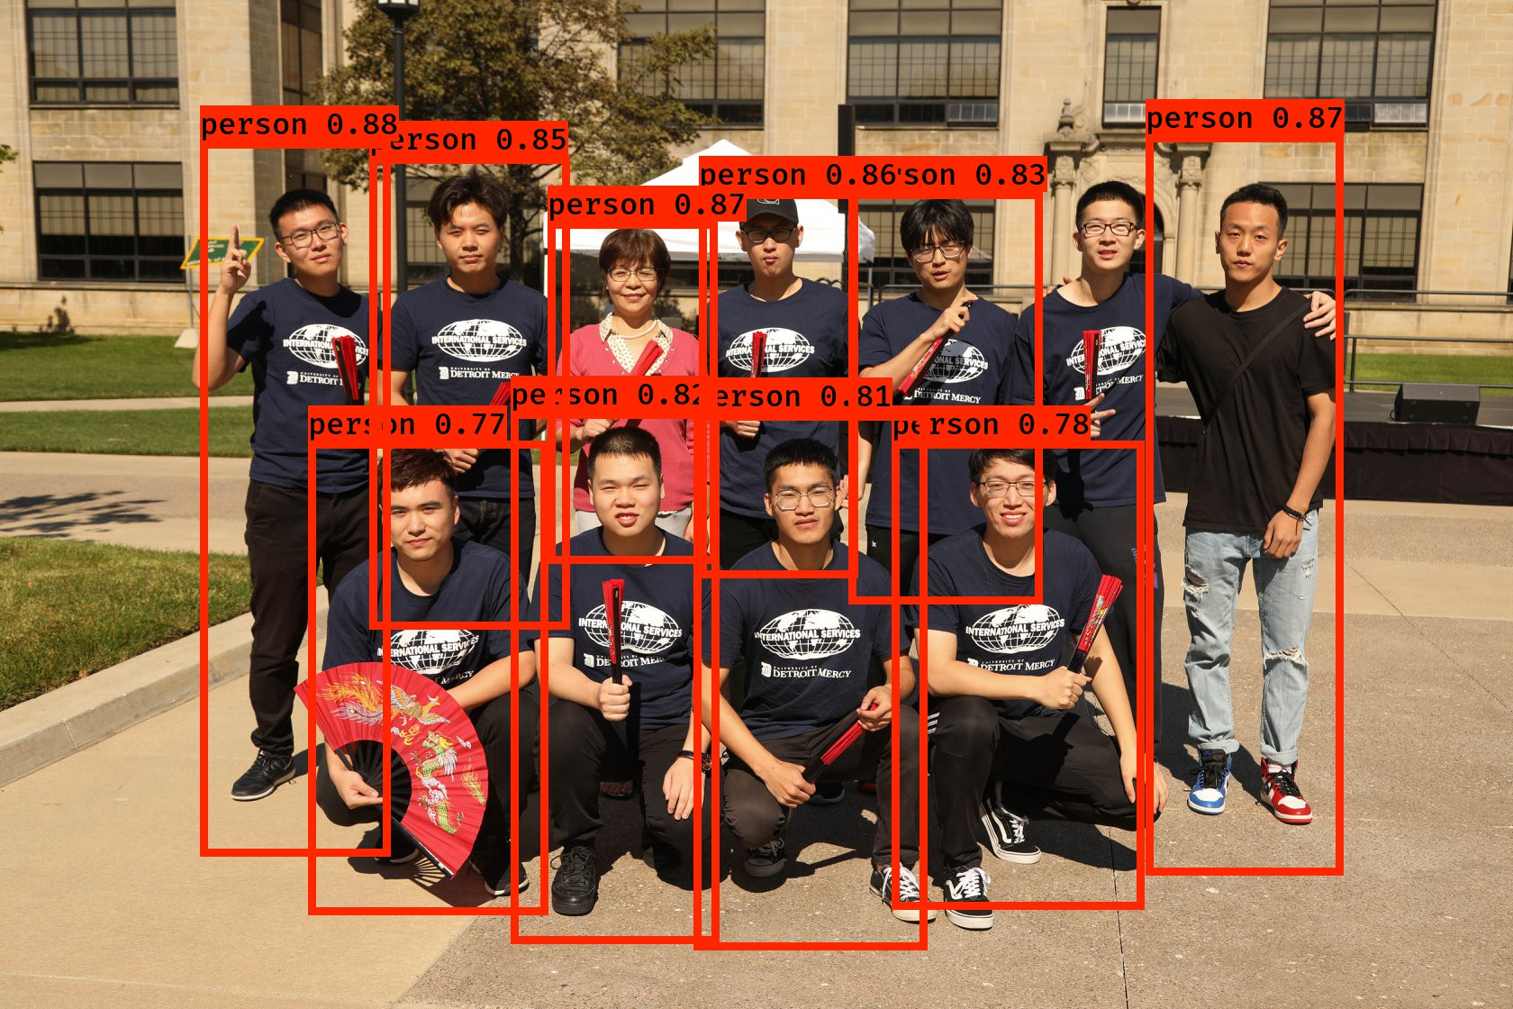
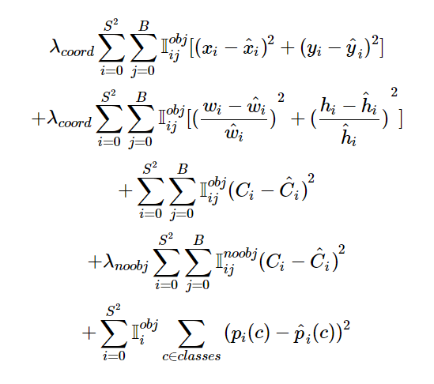
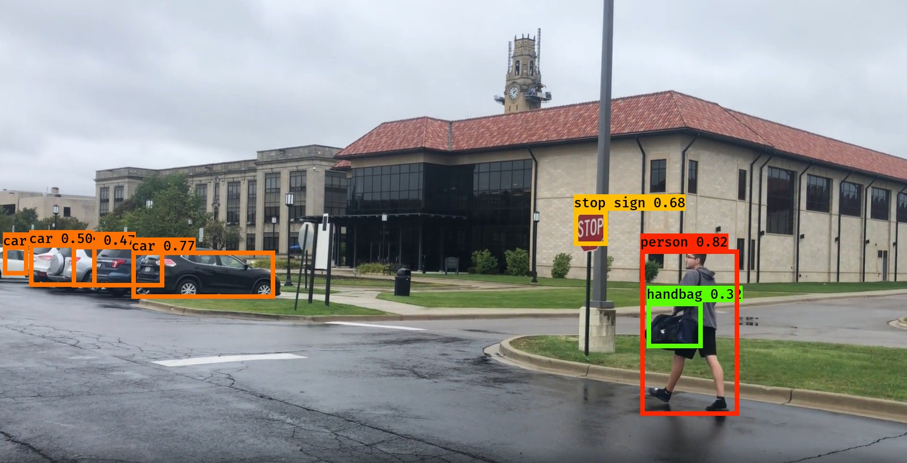
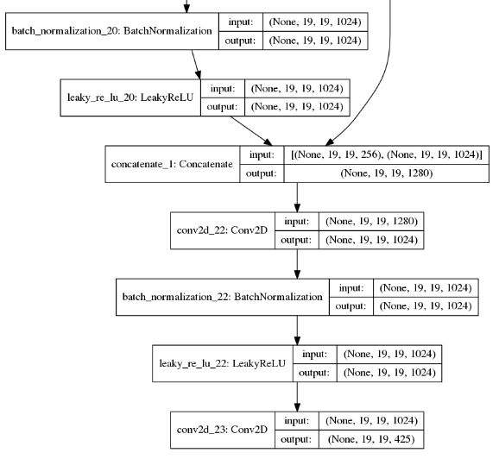

Fast Pedestrian Detection Using YOLO, A Deep Convolutional Neural Network Ali Babolhavaeji Under the guidance of Dr. Mohammad Fanaei Electrical and Computer Engineering Department, University of Detroit Mercy
￼
ABSTRACT
YOLO V2 ARCHITECTURE
CONCLUSION & DISCUSSION
In self-driving vehicles, a real-time system is needed to reliably detect pedestrians, vehicles, traffic signs, and lane lines. The goal of this research is to design, implement, and test a real-time pedestrian detection system to be used in self-driving vehicles, where the prior knowledge obtained through the analysis of many images with labeled pedestrians (i.e., training set) will be used to recognize a pedestrian in a given unseen image. It is a non-trivial problem because of the wide range of human poses and the variety of complex backgrounds in the images of interest as well as the processing speed that this application demands. A typical object detector can locate an object in any location and scale in an image. The object detector must classify each object inside the image and determine its location. Generally, an object detector has two parts, namely feature extraction and classification. There are many techniques to extract complex features from an image such as handcraft feature descriptors (e.g., SIFT, HOG, and LBP) or using sliding window over the image and convolutional neural networks (CNN). The CNN-based feature extraction models have proven in recent research studies to be more promising than other competitors. In this research the YOLO V2 object detection model is implemented. We have used a Microsoft kinetic camera get image and feed it to the network for the real time pedestrian detection task.
Figure2. The output tensor by considering 7 by 7 grid cell and 2 bounding boxes and 20 classes of objects [2]. (this is just an example for output tensor we have used 13 by 13 grid cells with 5 bounding boxes in this project.)
Figure1. Each grid cell estimate these number for a detector with 20 classes of PASCAL VOC dataset [1]
Figure3. The final output picture after passing through the network. It is for YOLO V1 (It is used just for displaying the entire model.) [2].
Figure5. The result of implemented model on the Microsoft Kinect at the University of Detroit Mercy.
INTRODUCTION
You Look Only Once (YOLO) is proposed by Redmon et al [3]. that is the end-to-end object detection method in 2016. YOLO is extremally fast algorithm which it use a very deep convolutional neural network architecture. YOLO uses the global features from the entire image. It splits image to S ×S grids which each grid has B bounding boxes (X ,Y ,W and H and confidence of each object) with different dimensions for each grid. The values of w and h represent the width and height of the box relative to the whole image. The values of (x, y) represent the center coordinates of the box relative to the bounds of the grid cell. The object confidence represents the reliability of existing object in the box, which is defined as follow: (In the Figure.4 this formula is used)
The number of classes changes the size of output tensor. For example for PASCAL VOC data set there are 20 classes so each grid in output tensor estimate 25 numbers for each bunding boxes (Figure.1). The out put image after passing through the network can be seen at Figure.2 .At the right-side of the next section the total architecture of YOLO V2 is shown. It has 23 layers convolutional neural network which is included convolutional layers, Max-polling layers and ReLU activation function
Figure4. Calculate the confidence score and thresholding the objects [2].
While training YOLOv2, different object sizes had different effects on the whole model, which resulted in larger errors for larger-sized objects than for smaller-sized objects. In order to reduce this influence, the loss calculation for the width and height of the bounding boxes was improved using normalization. The loss function is shown in following Equation [4]:
Figure6. Human detection in a picture form Chinese students at University of Detroit Mercy.
Figure7. The result of implemented model on the Microsoft Kinect at the University of Detroit Mercy
[1]https://fairyonice.github.io/Step_by_Step_Data_Science_Night_Complete.html
[2]https://docs.google.com/presentation/d/1kAa7NOamBt4calBU9iHgT8a86RRHz9Yz2oh4-GTdX6M/edit#slide=id.g151008b386_0_57
[3] Redmon J., Divvala S., Girshick R., Farhadi A. You only look once: Unified, real-time object detection; Proceedings of the IEEE Conference on Computer Vision and Pattern Recognition (CVPR)
[4] https://www.ncbi.nlm.nih.gov/pmc/articles/PMC6308705/

