Slide 1

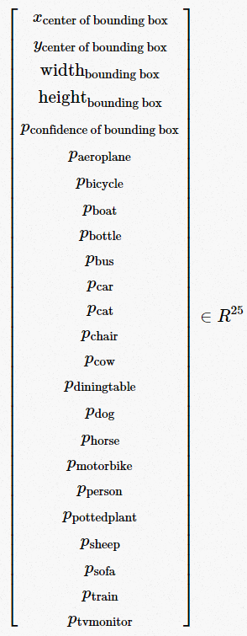
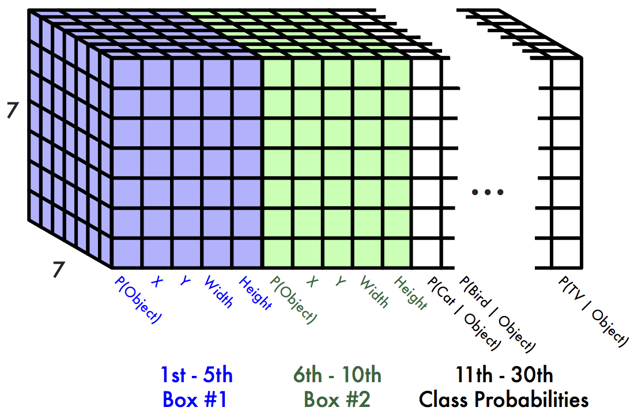
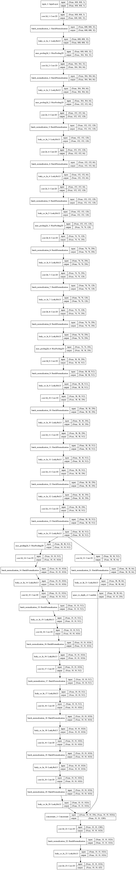
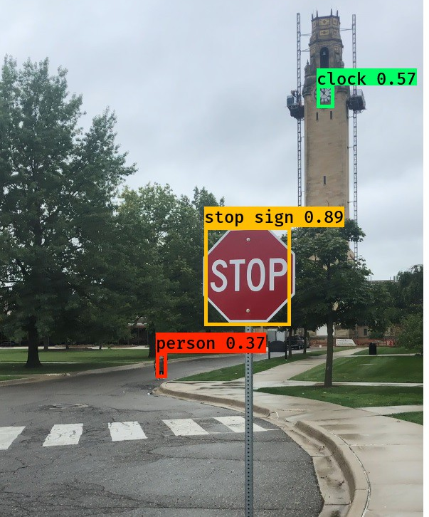
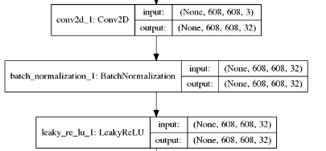
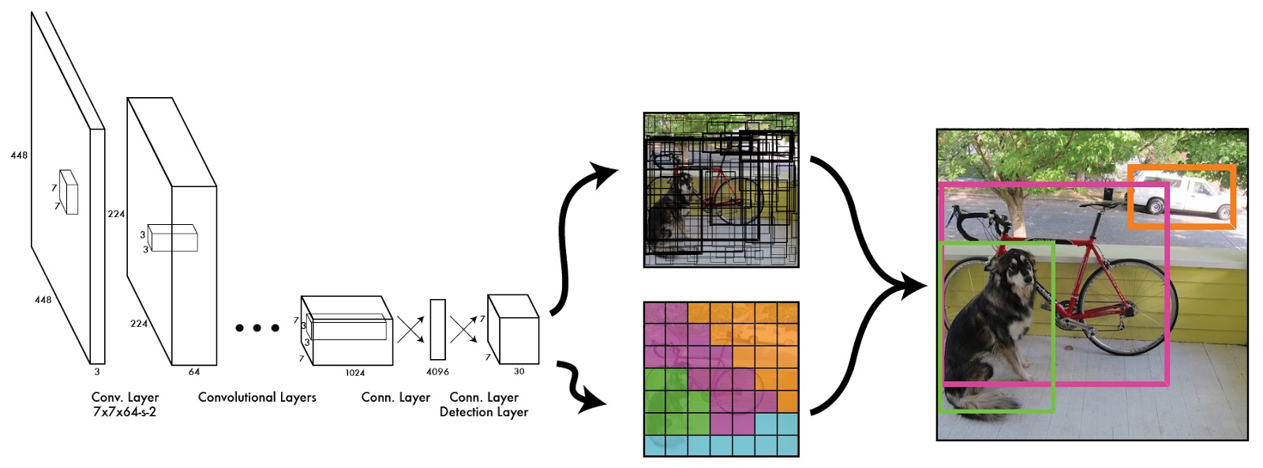
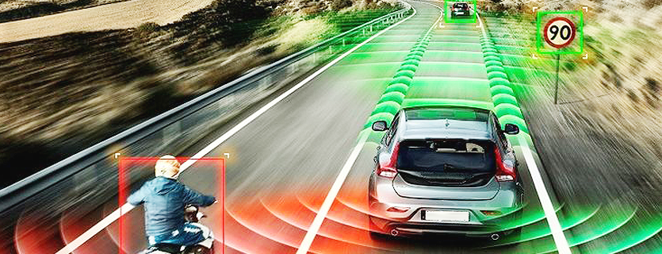
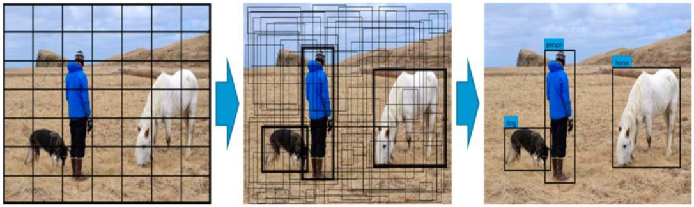
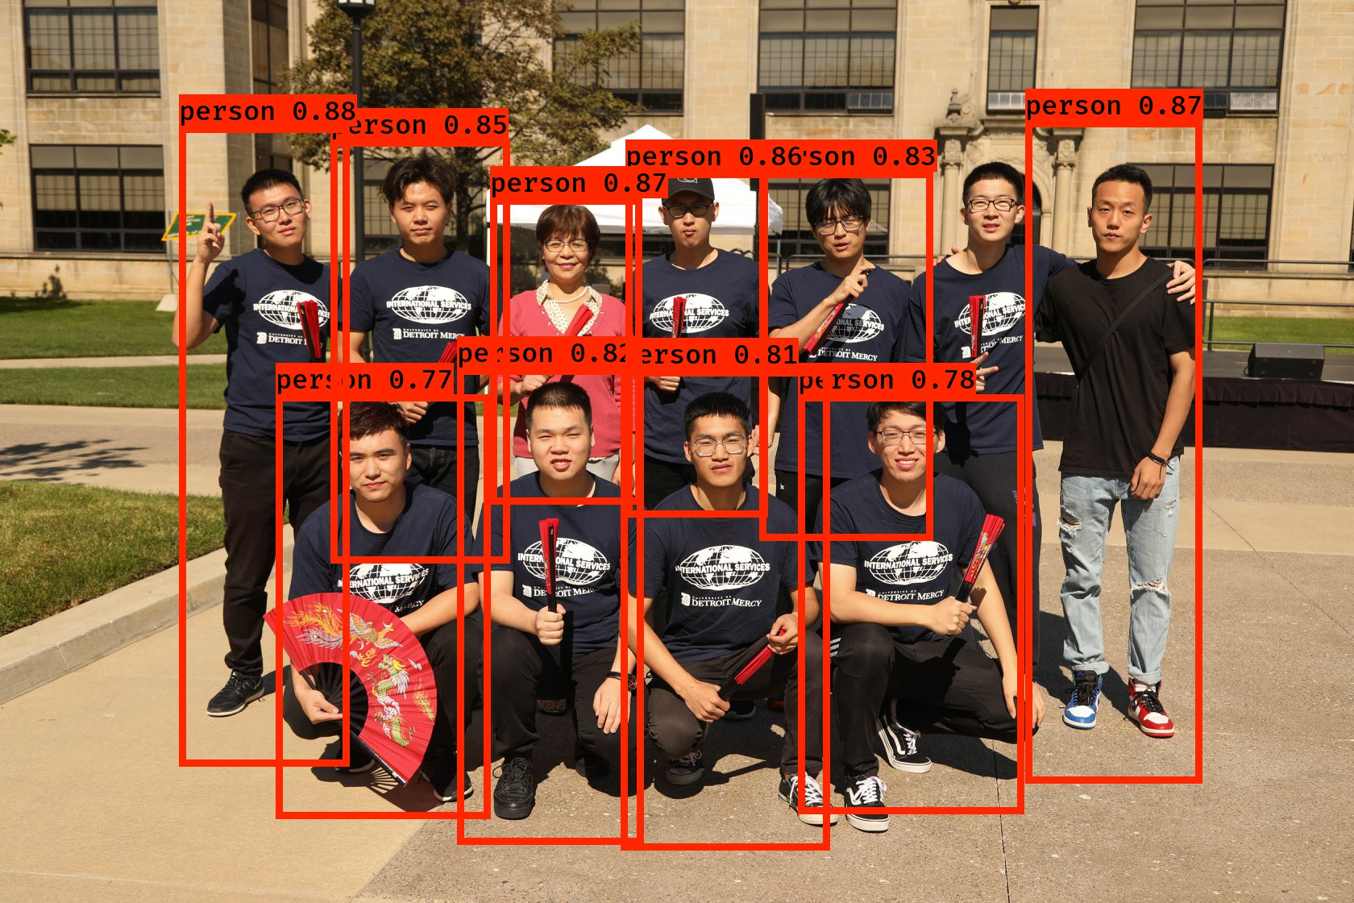
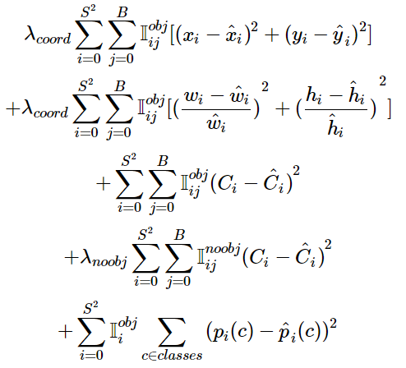
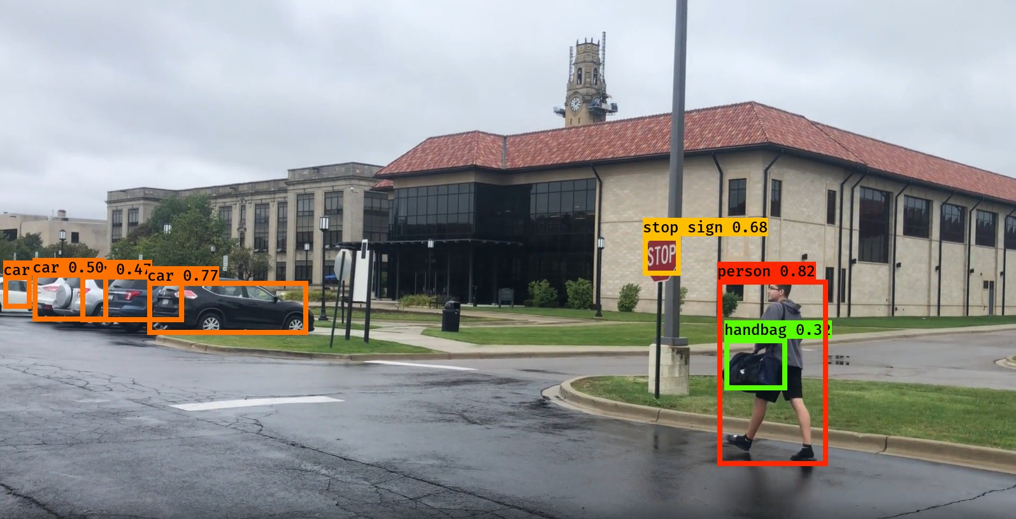
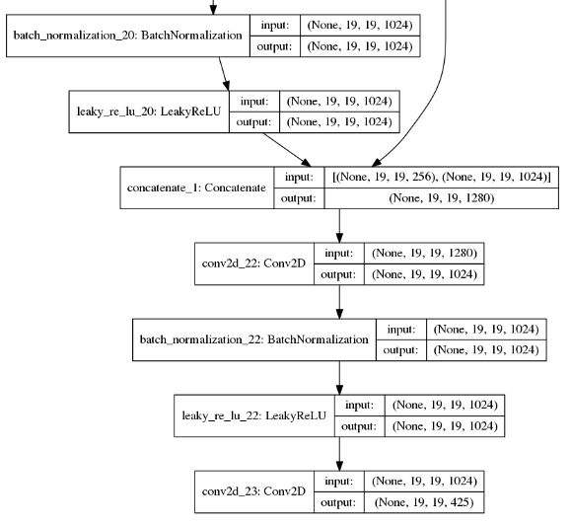

Fast Pedestrian Detection Using Deep Convolutional Neural Networks Ali Babolhavaeji, Dr. Mohammad Fanaei {babolhal, fanaeimo}@udmercy.edu Department of Electrical and Computer Engineering and Computer Science University of Detroit Mercy
￼
MOTIVATION
YOLO V2 ARCHITECTURE
RESULTS & DEMONSTRATION
In self-driving vehicles, a real-time system is needed to reliably detect pedestrians, vehicles, traffic signs, and lane lines.
The goal of this research is to design, implement, and test a real-time pedestrian detection system to be used in self-driving vehicles.
It is a non-trivial problem because of the wide range of human poses and the variety of complex backgrounds in the images of interest as well as the processing speed that this application demands.
A typical object detector can locate an object in any location and scale in an image. The object detector must classify each object inside the image and determine its location.
The feature extraction models based on convolutional neural networks (CNN) have proven to be more promising than other competitors. In this research, the YOLO V2 object detection model is implemented.
Figure 2. Example output tensor by considering a 7x7 grid cell and 2 bounding boxes and 20 classes of objects [2]. This is just an example output tensor. We have used 13x13 grid cells with 5 bounding boxes in this project.
Figure 1. Each grid cell estimates these numbers for a detector with 20 classes of PASCAL VOC dataset [1].
Figure 3. Final output picture after passing through the network. It is produced by YOLO V1, used just to display the entire model [2].
Figure 5. The result of implemented model on the Microsoft Kinect at the University of Detroit Mercy.
KEY IDEAS
You Only Look Once (YOLO) is an end-to-end object detection method proposed by Redmon et al. [3] in 2016.
YOLO uses the global features from the entire image.
It splits image to an S×S grid, where each grid has B bounding boxes (X, Y, W and H and confidence of each object) with different dimensions for each grid.
The values of W and H represent the width and height of the box relative to the whole image.
The values of (X, Y) represent the center coordinates of the box relative to the bounds of the grid cell.
The object’s confidence represents the reliability of existing object in the box, defined as follows: (In Figure 4, this formula is used)
The number of classes changes the size of the output tensor.
Example: For PASCAL VOC data set, there are 20 classes so each grid in the output tensor estimates 25 numbers for each bunding boxes (Figure 1).
The output image after passing through the network can be seen in Figure 2.
Figure 4. Calculate the confidence score and thresholding the objects [2].
While training YOLOv2, different object sizes had different effects on the whole model, which resulted in larger errors for larger-sized objects. In order to reduce this influence, the loss calculation for the width and height of the bounding boxes was improved using normalization. The loss function is shown in the following Equation [4]:
Figure 6. Human detection in a picture form our students at the University of Detroit Mercy.
Figure 7. The result of implemented model on the Microsoft Kinect at the University of Detroit Mercy.
https://fairyonice.github.io/Step_by_Step_Data_Science_Night_Complete.html
https://docs.google.com/presentation/d/1kAa7NOamBt4calBU9iHgT8a86RRHz9Yz2oh4-GTdX6M/edit#slide=id.g151008b386_0_57
Redmon J., Divvala S., Girshick R., Farhadi A. You only look once: Unified, real-time object detection; Proceedings of the IEEE Conference on Computer Vision and Pattern Recognition (CVPR)
https://www.ncbi.nlm.nih.gov/pmc/articles/PMC6308705/
Engineering and Science Undergraduate and Graduate Research Symposium, University of Detroit Mercy October 18, 2019

