Slide 1
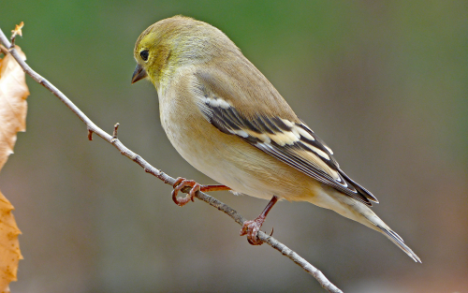
BIRD SONG CLASSIFICATION
Performing feature extraction with Librosa

Slide 2
WHY BIRD SONG?
Provide insights into bird behavior and evolution
A playground for analyzing complex audio signals
Fun Application of Machine Learning

Slide 3

ROBUST DATA
4000+ Audio mp3 files from Cornell Lab(2021)

Slide 4
MY INTENTIONS
Get experience with audio analysis
1
Make a Bird Song Classifier
2
Not Fail STAT 400
3

Slide 5

DATA PREPROCESSING
Converted .mp3 to .wav
Imported to Jupyter Notebook
Extracted Species names from the file paths and sorted the files in order of frequency of each species
Work on files with most samples per species

Slide 6
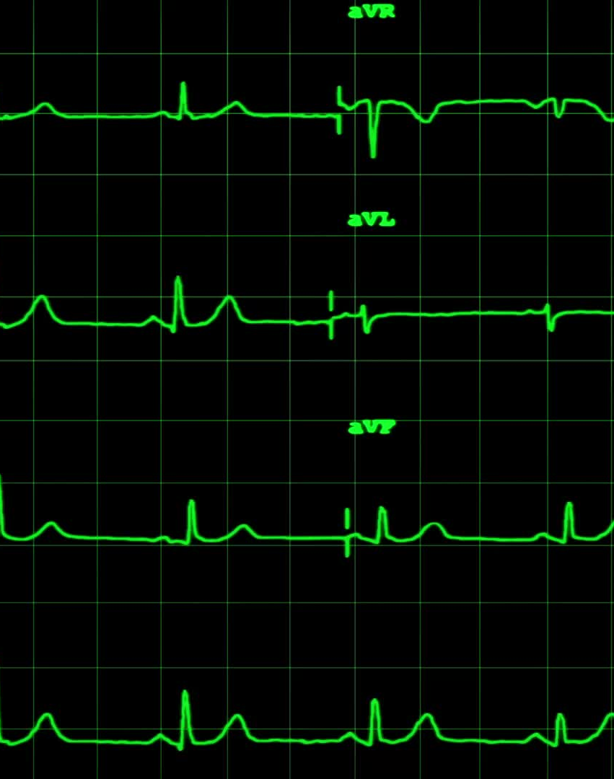
FEATURE EXTRACTION
Get to build your own dataset
Package Librosa.py
Audio signal processing techniques - Mel-frequency cepstral coefficients (MFCCs), Chroma Short-Time Fourier Transform (Chroma STFT),wavelet analysis etc.

Slide 7
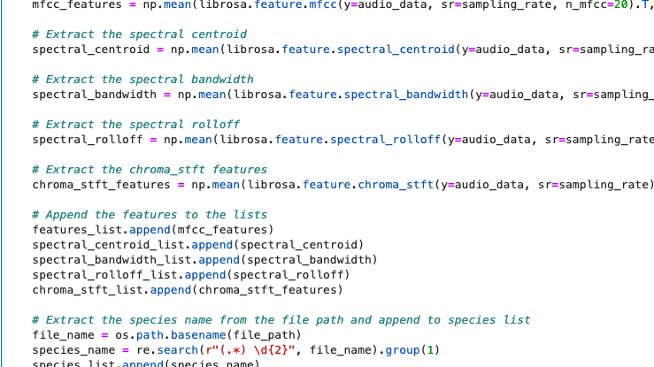

Slide 8
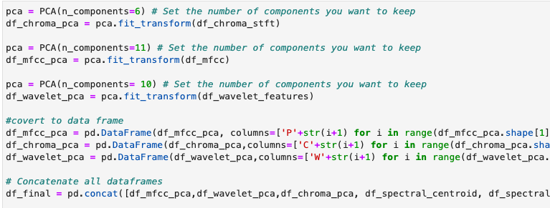
DIMENSIONALITY REDUCTION

Slide 9
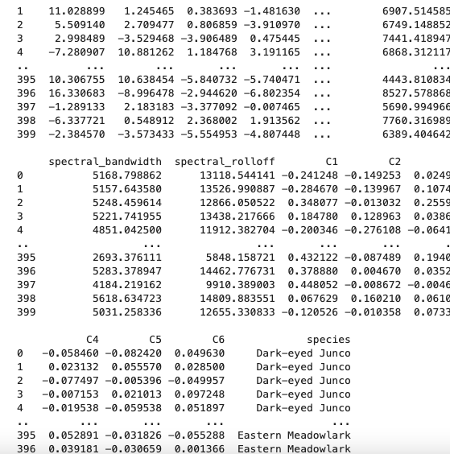
Voila!
Hard part’s over :’)

Slide 10
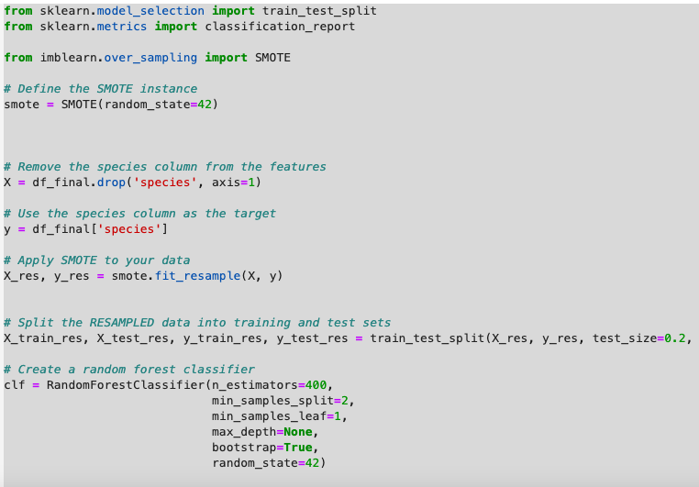
RANDOM FOREST Classifier

Slide 11

Performance?

Slide 12
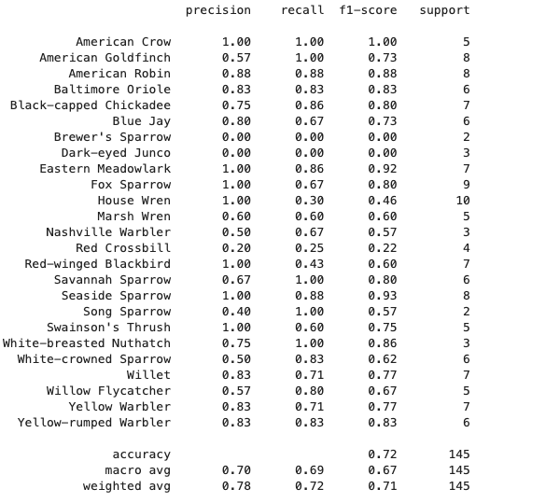
Current best - 72% accuracy
Really good at classifying House Wren
Terrible with Dark Eyed Junco
25 Species Total

Slide 13
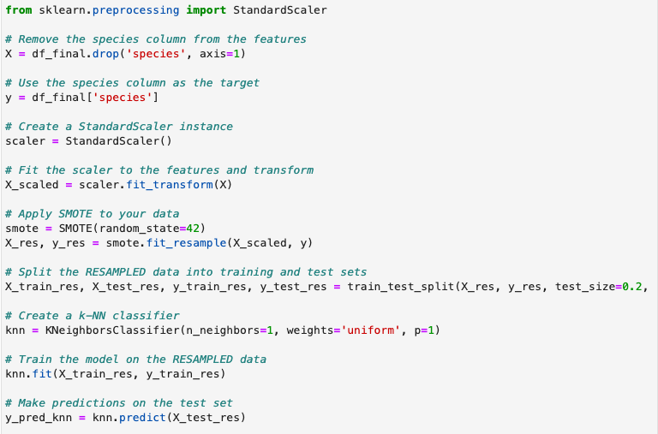
K-NN classifier

Slide 14
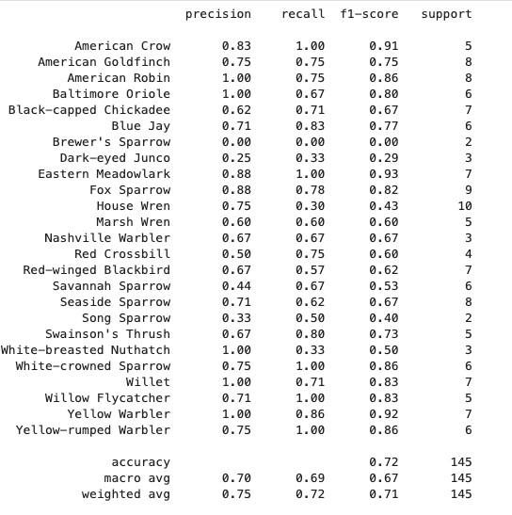
Current best also 72% accuracy
Subtle Differences – Better Precision for American Gold Finch(0.57 vs 0.75)
Neither model can correctly identify Brewer’s Sparrow. The precision, recall, and F1-score are all 0.00 for both models.

Slide 15
LIMITATIONS
Small Models
72% accuracy isn’t great
Some birds were never identified
Trained only on 25 species

Slide 16

LOTS OF DIRECTIONS TO GO
Built these models with short extraction times in mind
Increase the size
More Processing Power
More Samples
Other feature extraction techniques and models

