Slide 1

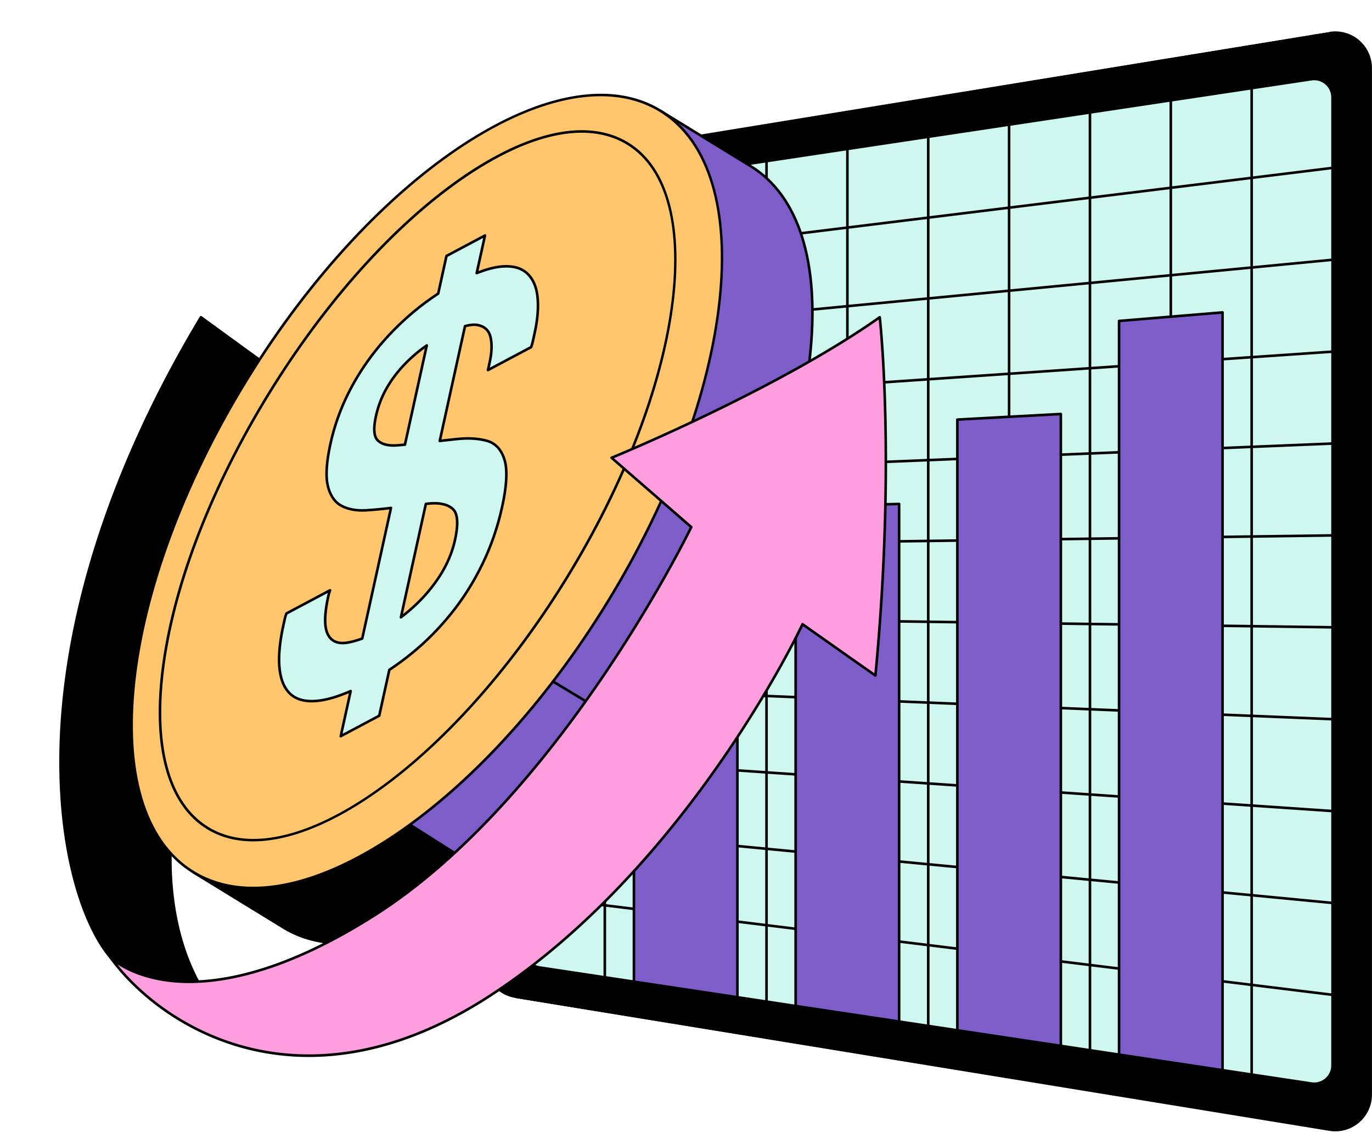
HOME
ABOUT
CONTENT
OTHERS
Economic Predictions
By Layoffs
Shuhan Jhang

Slide 2

Problem
Global layoffs surged during and after COVID-19, impacting economic stability.
Companies, investors, and policymakers need early signals of market downturn or recovery.
Problem:
  Can layoff data predict movements in major U.S. financial indices such as VIX, S&P 500, and Dow Jones?

Slide 3
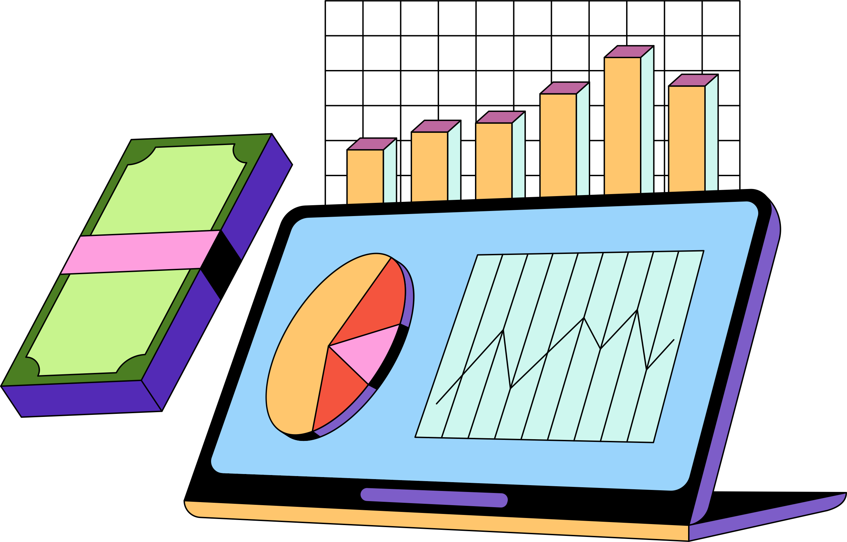

Solution: Decision Tree Model

Slide 4
Dataset & Feature
Datasets Used
World Layoff Dataset (2020–2023)
  Percentage laid off
  Company, industry, country
  Layoff Index
Financial Datasets
  VIX Index (fear index)
  S&P 500 values
  Dow Jones values
Feature Engineering
Extracted year, month, day
One-hot encoding for categorical features
Source from : Kaggle / Layoffs.fyi/Yahoo Finance

Slide 5
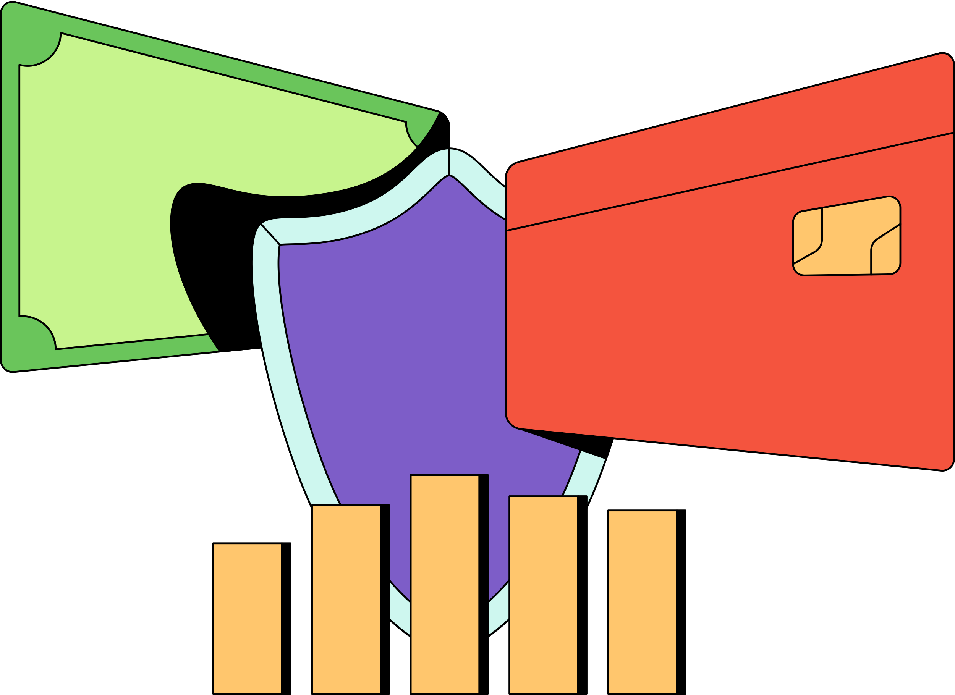
Data Cleaning & Alignment
  Selected Only Relevant Columns
  Converted All Date Columns to a Standard Datetime Format
  Filtered All Datasets into the Same Time Range
  Sorted All Datasets by Date
  Standardized Column Names for Merging
  Performed Left Joins to Merge All Datasets Together
  Removed Rows With Missing Key Values
  Created Features From Raw Data(ex:Layoff Index)

Slide 6

MODEL TRAINING & Evaluation
Defines a binary target :
Column | Meaning
SP5_Up = 1 | S&P 500 moved UP from previous day
SP5_Up = 0 | S&P 500 moved DOWN
DJ_Up = 1 | Dow Jones moved UP
VIX_Up = 1 | VIX Fear Index increased (higher fear)

Slide 7
Train a Decision Tree Model
Decision Tree Classifier:
A decision tree is chosen because it naturally handles mixed feature types (numeric fields, and categorical fields)
Split train and test sets: 80% training 20% testing
Using Layoff_Index to predict Economic Index (daily)

Slide 8
Result

Slide 9
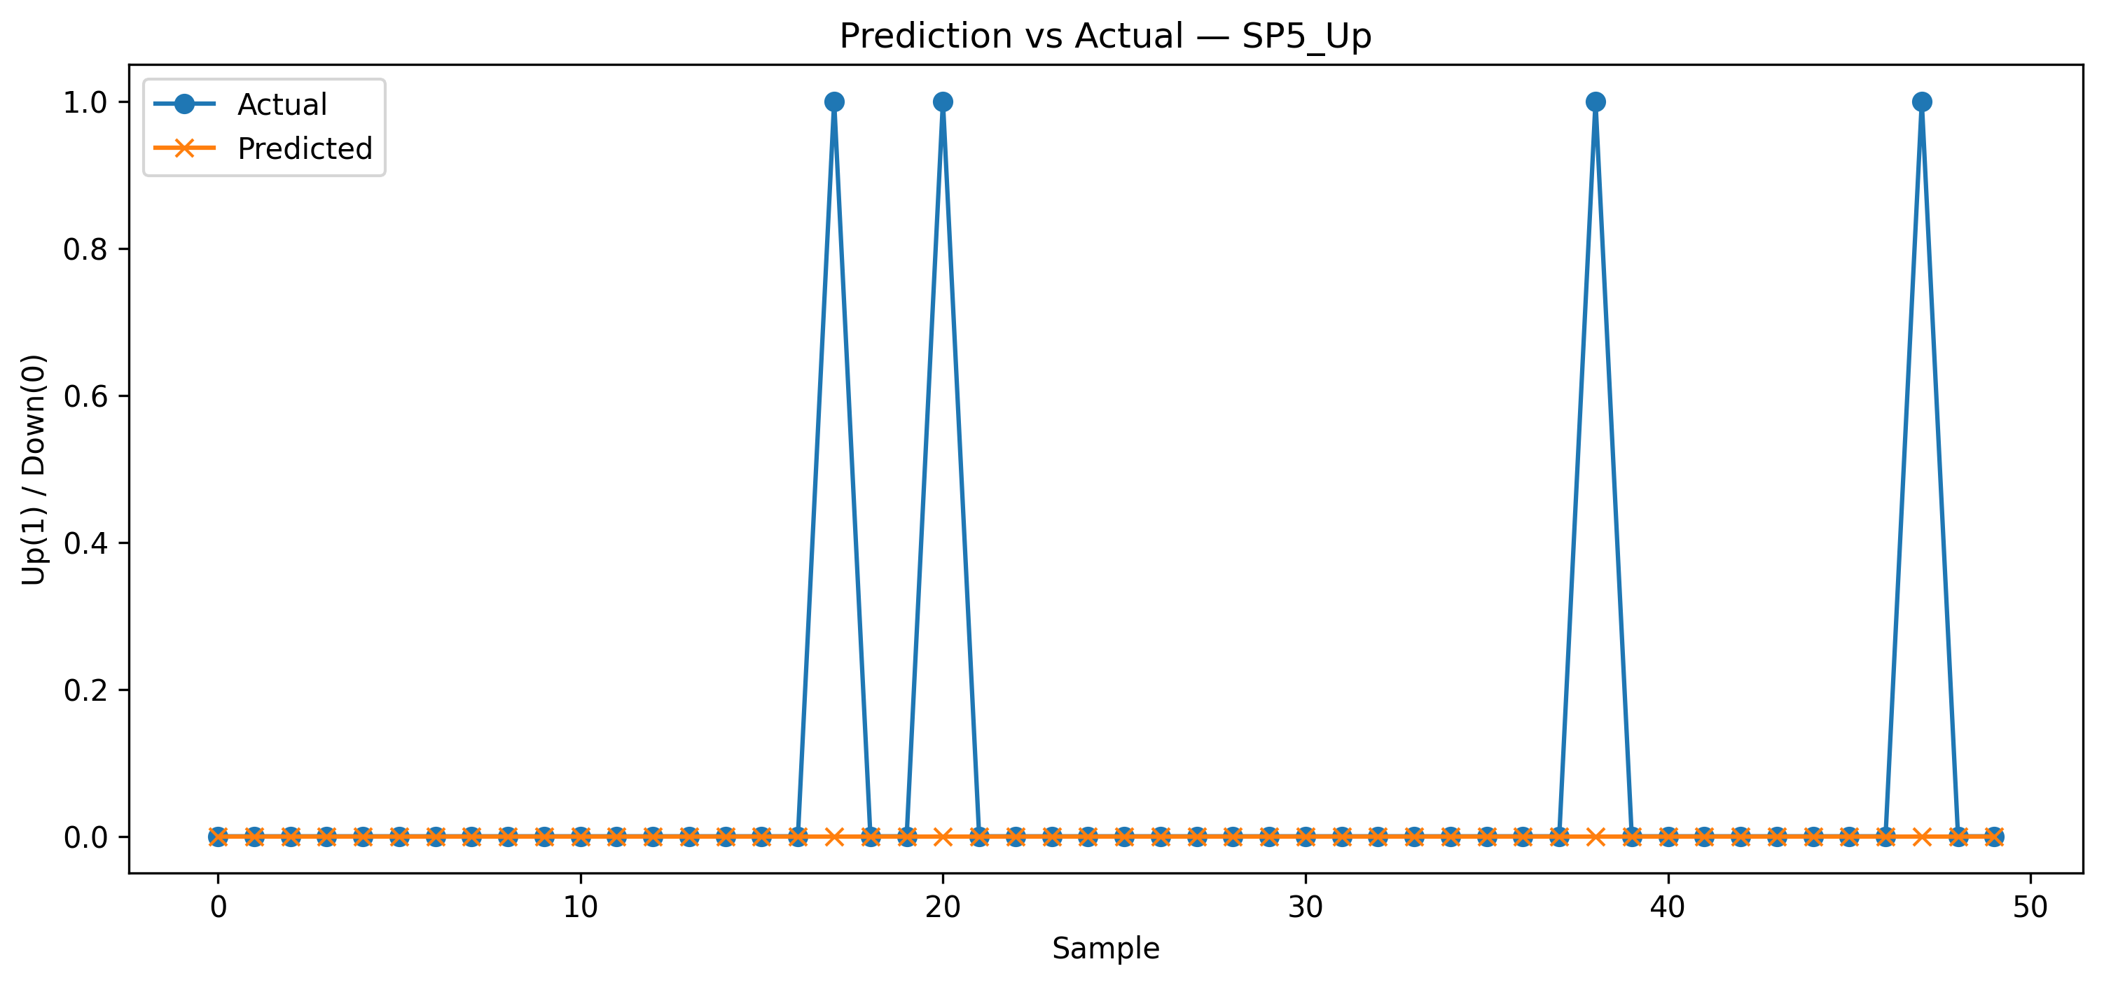
Accuracy: S&P 500 index increased
The S&P 500 index increased compared to the previous day.)
Using Layoff_Index to predict S&P 500 index increased
Accuracy for SP5_Up: 0.8762, 87.6% accuracy
False Positives (FP) = predicted Up, actual Down

Slide 10
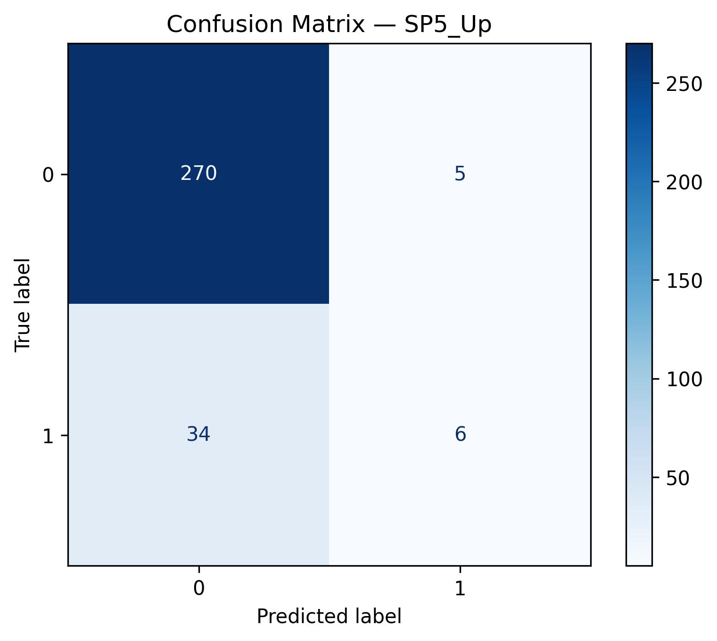
Confusion Matrix: S&P 500 index increased
MODEL of for SP5_Up (The S&P 500 index increased compared to the previous day.)
  True Positives (TP) = model predicted Up, actual Up
  True Negatives (TN) = model predicted Down, actual Down
  False Positives (FP) = predicted Up, actual Down
  False Negatives (FN) = predicted Down, actual Up
False Positives (FP)
True Negatives (TN)
True Positives (TP)
False Negatives (FN)

Slide 11
Model error(39): S&P 500 index increased
MODEL of for SP5_Up (The S&P 500 index increased compared to the previous day.)
False Positives (FP) = predicted Up, actual Down
Possible reasons:
  Sudden negative economic news not captured in layoff data
  The model overweighted a specific industry/location
  Market volatility spikes (unexpected events)
False Positives (FP)
True Negatives (TN)
False Negatives (FN)
Model predicted Down when the market went Up.
Possible reasons:
Market recovered due to positive news unrelated to layoffs
Limited representation of rare market behavior
Decision Tree oversimplifying complex market patterns
True Positives (TP)
False Negatives (FN)
87.6% accuracy

Slide 12
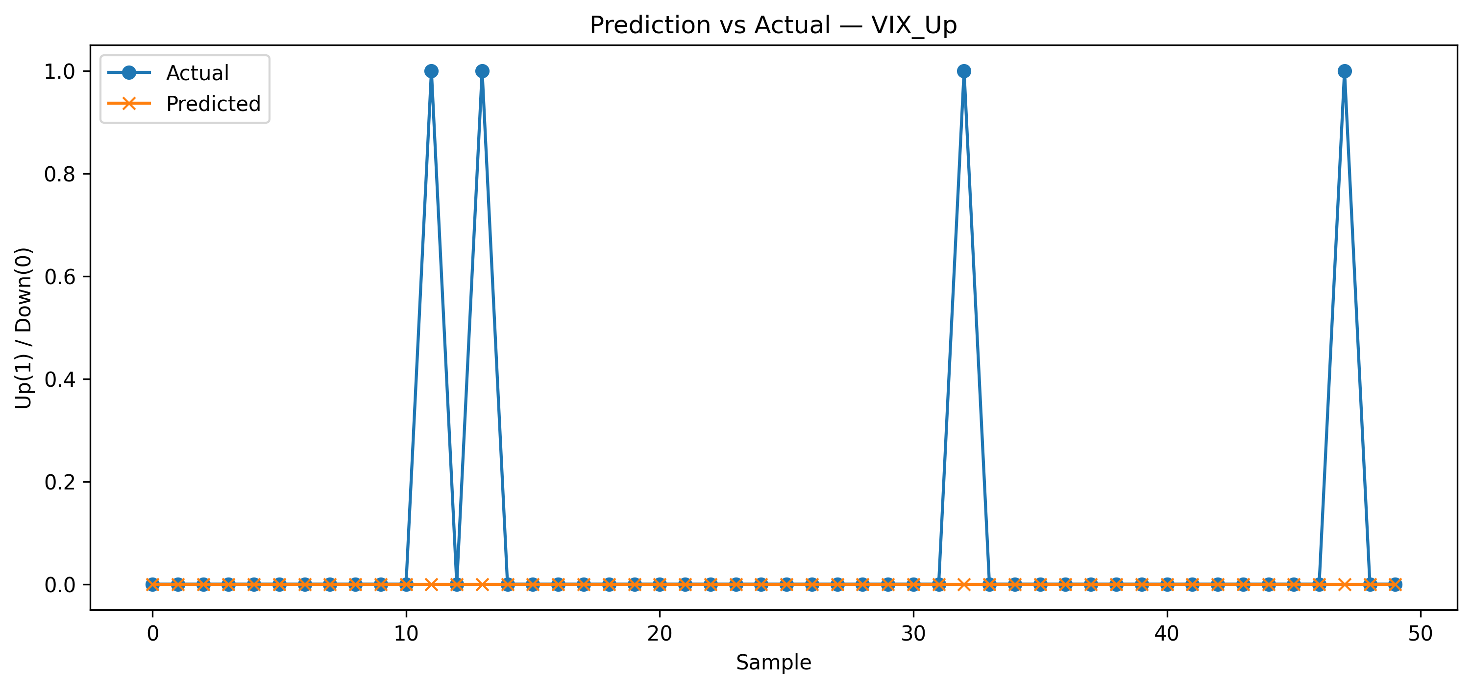

Accuracy: VIX index increased
The VIX index = “fear index”, measuring market volatility
Using Layoff_Index to predict VIX index increased
Accuracy for VIX_Up (VIX index increased ): 0.8889, 88.89% accuracy

Slide 13

Confusion Matrix & Model error (35) :
VIX index increased
False Positives (FP)
  True Positives (TP) = model predicted Up, actual Up
  True Negatives (TN) = model predicted Down, actual Down
  False Positives (FP) = predicted Up, actual Down
  False Negatives (FN) = predicted Down, actual Up
Model error
True Negatives (TN)
Model error
True Positives (TP)
False Negatives (FN)
88.89% accuracy

Slide 14
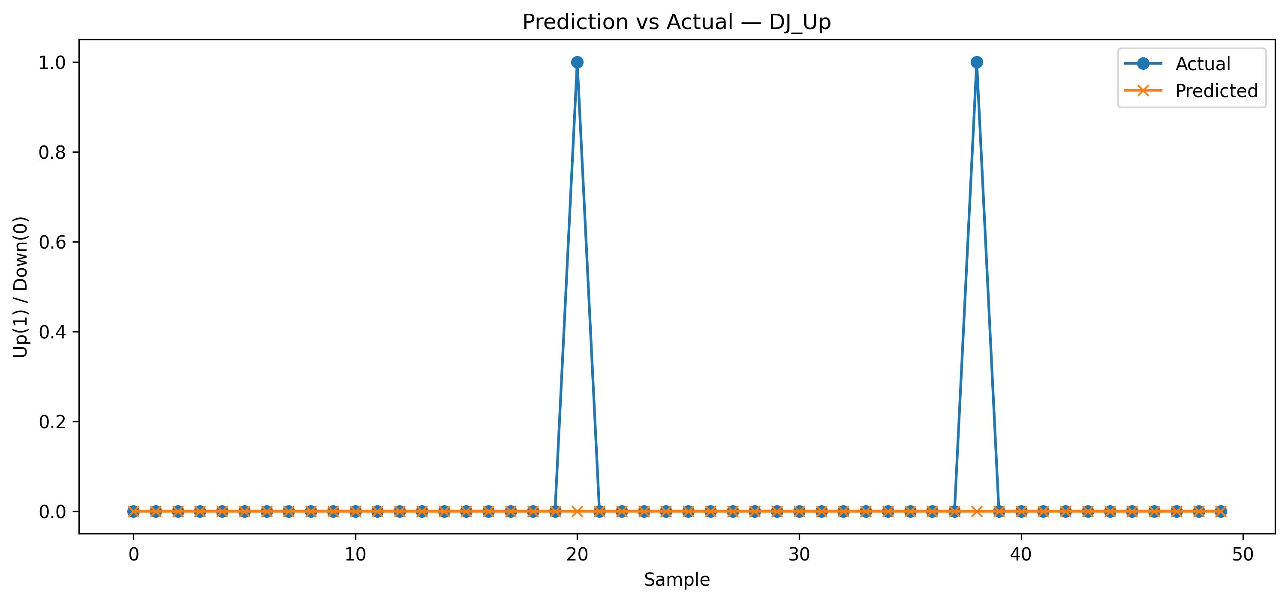
Accuracy:
Dow Jones Industrial Average increased
Using Layoff_Index to predict Dow Jones Industrial Average increased (DJ_Up )
Accuracy for DJ_Up (VIX index increased ): 0.8698, 86.98% accuracy

Slide 15

Confusion Matrix & Model error (41):
Dow Jones Industrial Average increased
False Positives (FP)
True Negatives (TN)
Model error
Model error
True Positives (TP)
False Negatives (FN)
86.98% accuracy

Slide 16
Users / Usefulness
This system can be useful for:
1. Financial Analysts & Traders
Identifying market sentiment signals driven by workforce reductions.
Adding alternative datasets (layoff data) to trading models.
2. Economists & Policy Researchers
Understanding how labor market stress correlates with market volatility.
Monitoring systemic risk indicators during recession periods.
3. Business Strategy Teams
Evaluating whether layoff trends within industries impact investor reactions

Slide 17
Future Work
1. Add Macro-Economic Features
Interest rates
Inflation (CPI)
Unemployment rates
GDP changes
This would reduce false negatives and improve robustness.
2. Handle Class Imbalance
Use SMOTE
Apply class-weighted training
Balance Up vs Down days more effectively
3. Convert to a Time-Series Forecasting Model
Instead of treating each day independently, incorporate:
lag values
moving averages
volatility windows

