Slide 1

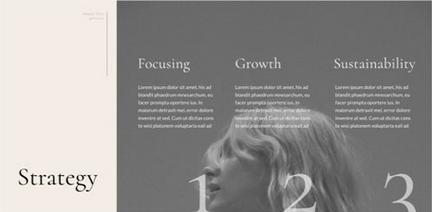

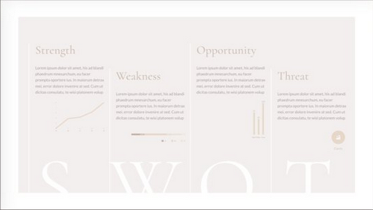
Header nav
writing
Carousel portfolio
circular progress bar

Slide 2

A little intro about me:
I am a front-end web developer who loves to connect with others through
This journey of mine began in summer 2018, when I was reflecting on my life in general. At that time, I realized that as much as I enjoyed and felt contributory as an early childhood educator, I have set aside many interests of mine. One of them being a curiosity for technology. Determined to bring about changes, I soon started my very first web development course at HackerYou. That was when I became certain that I wanted to explore further into the field.
I value working collaboratively with other, making balanced use of logical thinking and creative expressions, on innovation, and the advocate toward inclusiveness and accessibility. The career path seems to offer a promising growth opportunity for me individually and as a long term career option. Currently, I am looking forward to becoming involved in the field and working together with many different people to further my knowledge in various programming languages.

Slide 3

RESUME 2019
CONTACT
ABOUT
416-358-1168
A front-end developer who has set out on a life-long learning journey.
Coming from a background of education and psychology, I am especially curious about how ideas and information are being expressed and perceived. I thrive to create inclusive and pleasant web experiences for the users by writing clean and semantic codes. To continuously improve the quality of my products, I am excited to expand my knowledge in divergent areas, from UI/UX, learning about Node.js, and Redux, to searching for novel ways of using CSS properties.
alice.p.k.lau@gmail.com
/alice-lau-992330186
alice-lau.com
EDUCATION
SKILLS
2016 – 2018
Seneca College
Child Development Practitioner
2009 - 2013
University of Toronto
Psychology Specialist
HTML5, CSS3, Scss
JavaScript, jQuery, React
Working with APIs, Firebase
Modern text editor, snippets, & Emmet
Responsive design
Website accessibility
GitHub version control & Collaboration
Paired programming & team-based development
Project scope management
Modern web development best practices
FEATURED PROJECTS
WORK
EXPERIENCE
Hello Cactus
http://alice-lau.com/helloCactus/
HTML / SCSS / JavaScript / jQuery / SVG
A mini game where user interacts and takes care of a little cactus.
Build Your Bento
https://alicelauprojectfive.firebaseapp.com
JSX / CSS / JavaScript / React / Firebase / SVG
Put together your ideal Japanese lunch box and showcase it to others.
What’s for Dinner?
http://alice-lau.com/whatsForDinner/
HTML / SCSS / JavaScript / jQuery / API
A search engine that helps you find your ideal restaurant for dinner in your city.
2018 – 2019
Kids Come First Child Care Services
Registered Early Childhood Educator
2013 – 2018
Kids Come First Child Care Services
Early Childhood Educational Assistant
2012 - 2015
Unison Academy of Music
Piano Instructor
Music Theory Instructor
Music History Instructor
VOLUNTEER
HackerYou
Web Dev 101
Mentoring web-making with HTML & CSS

