Slide 1
Ionomics Data preliminary analysis

Slide 2
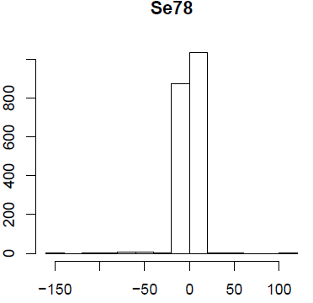
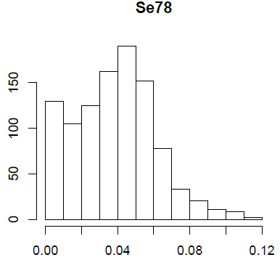
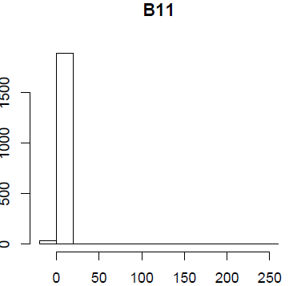
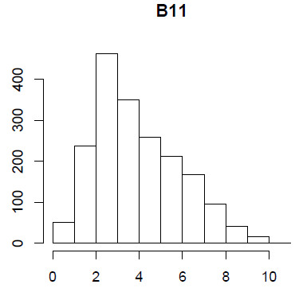
Negative values in the datasets:
A large number of negative values: Se78.
1060 out of 2286 are negative.
how to deal with this? This trait did not
work in Genstat.
2. A small number of negative values: B11.
Should they be changed to 0 or NA?
currently, I am treating as NA, it worked in Genstat
Outlier removal:
any strategies?
currently, I am using
boxplot.stats(x, coef = 2) in R
Before outlier removal
After outlier removal
Coef: this determines how far the plot ‘whiskers’ extend out from the box. If coef is positive, the whiskers extend to the most extreme data point which is no more than coef times the length of the box away from the box. A value of zero causes the whiskers to extend to the data extremes (and no outliers be returned).

Slide 3
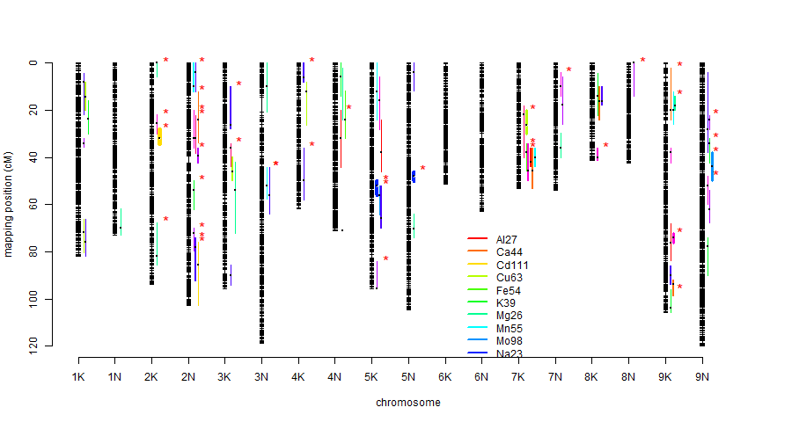
QTL summary (14 out of 18 traits)
Se78 did not work in Genstat at all.
As75, B11, and Co59 do not have QTLs found.

