Slide 1

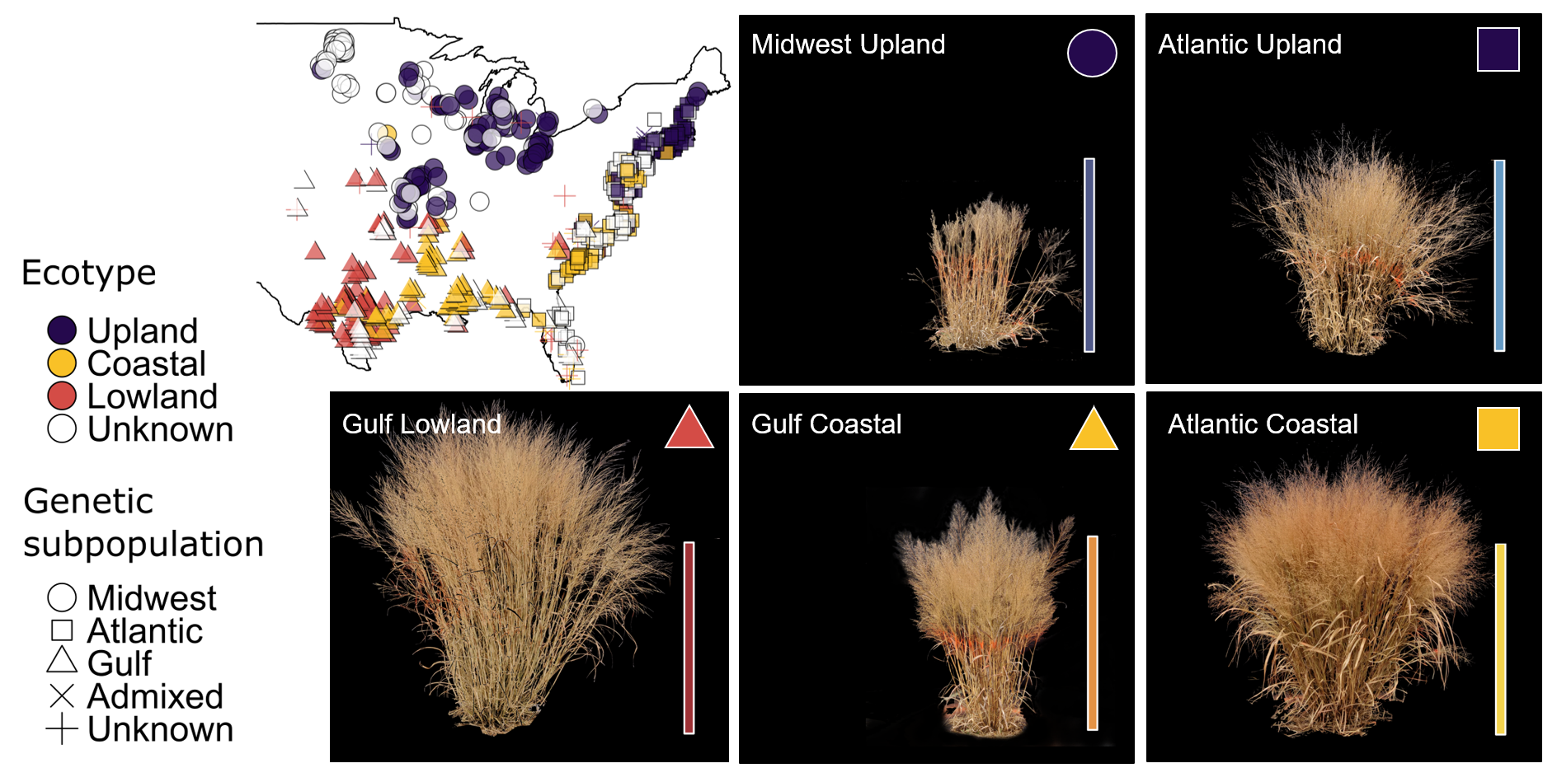

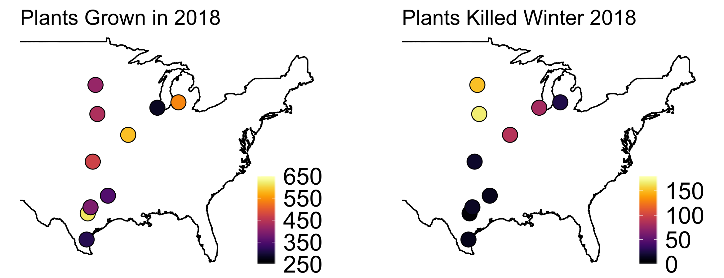
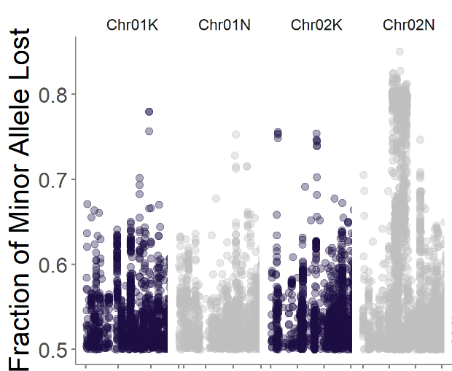
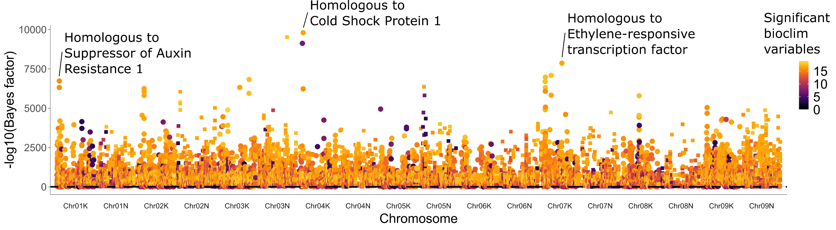
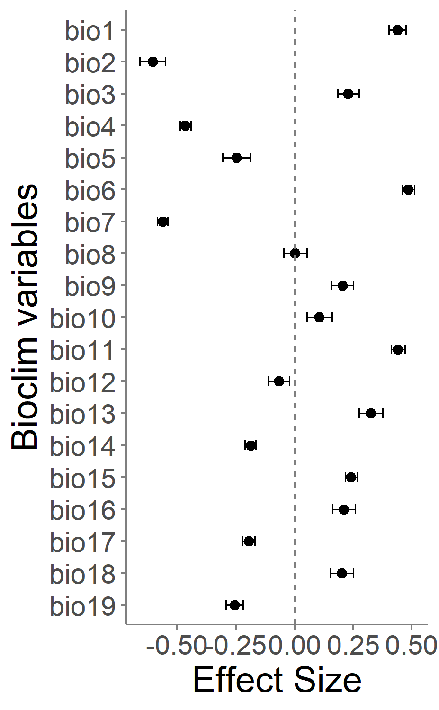
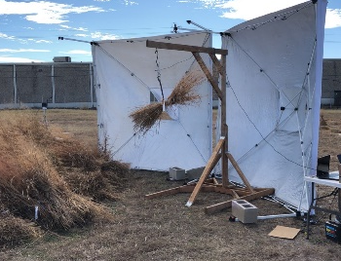
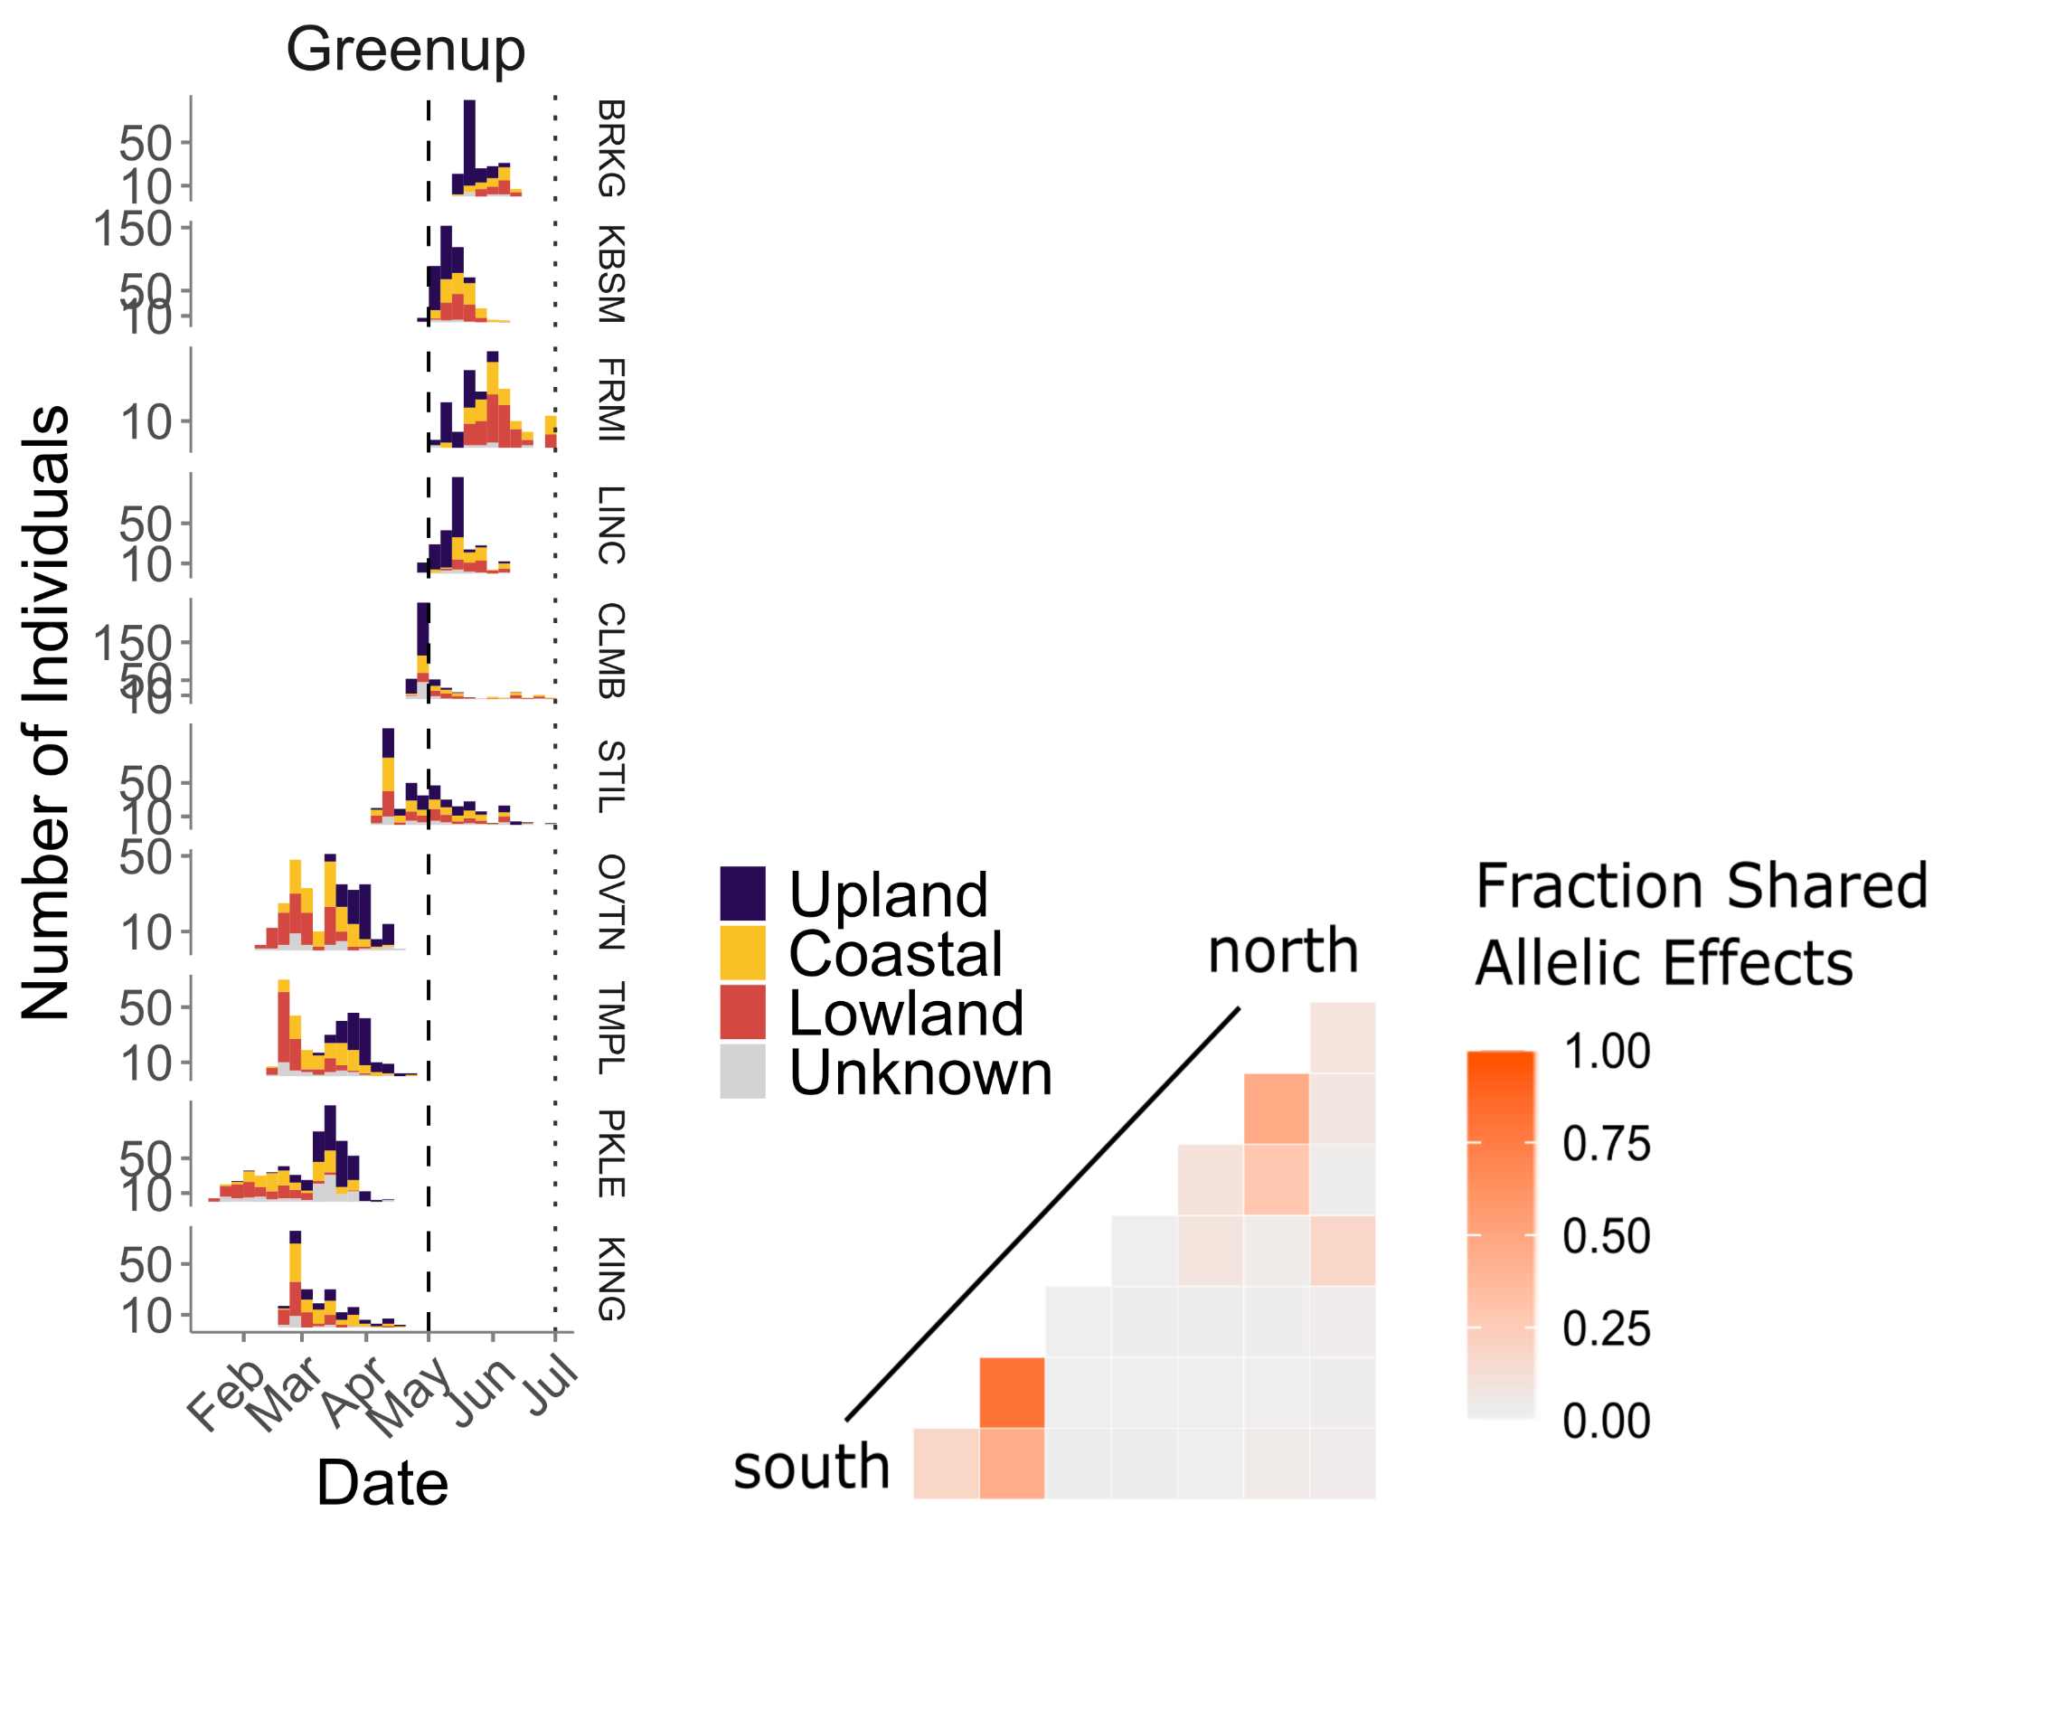
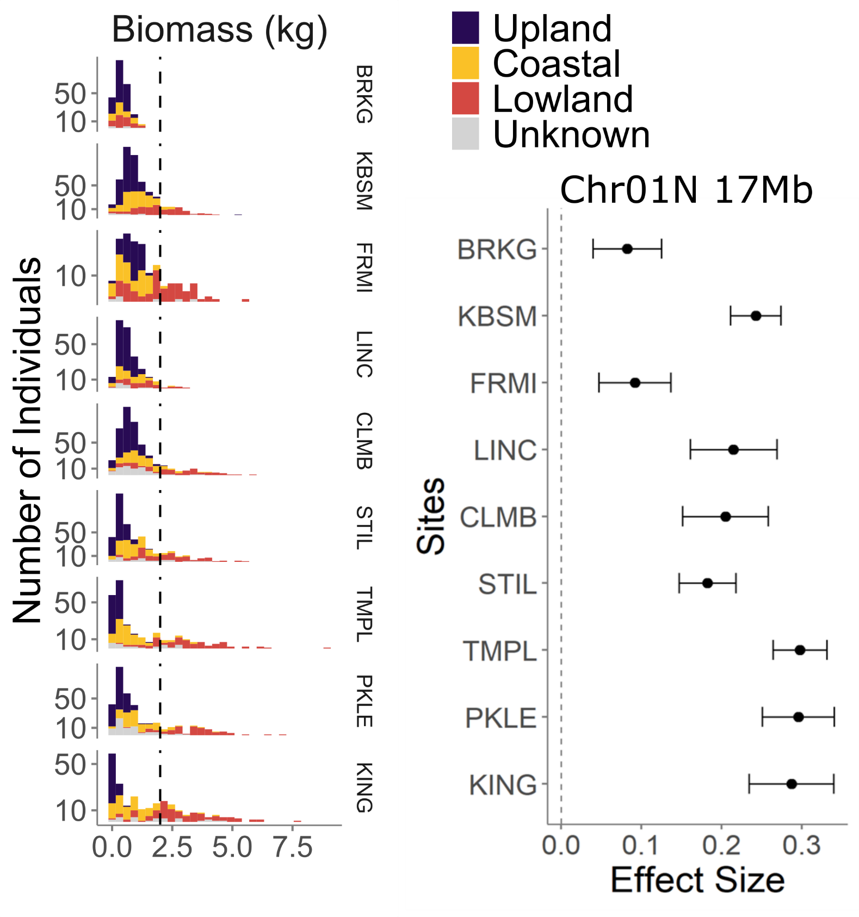
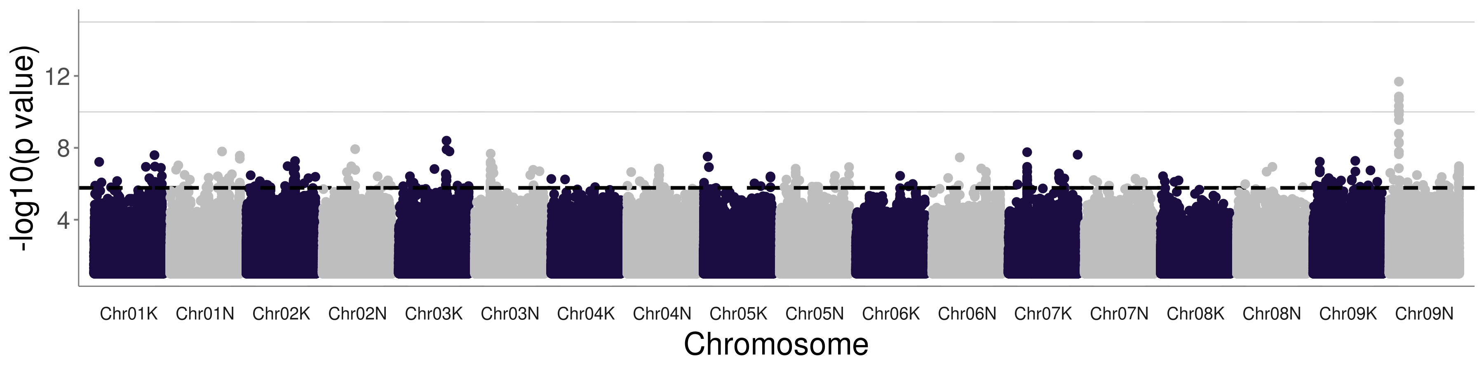
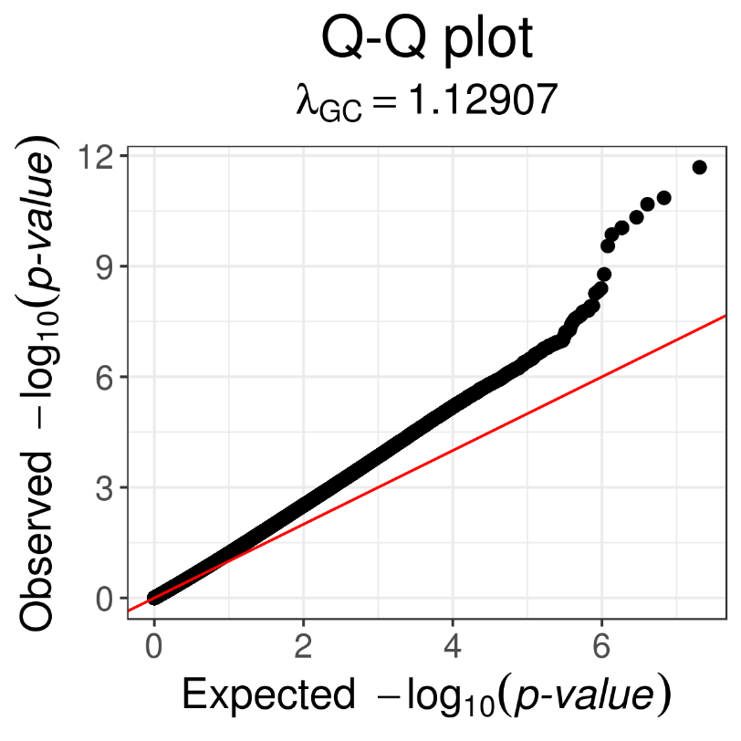
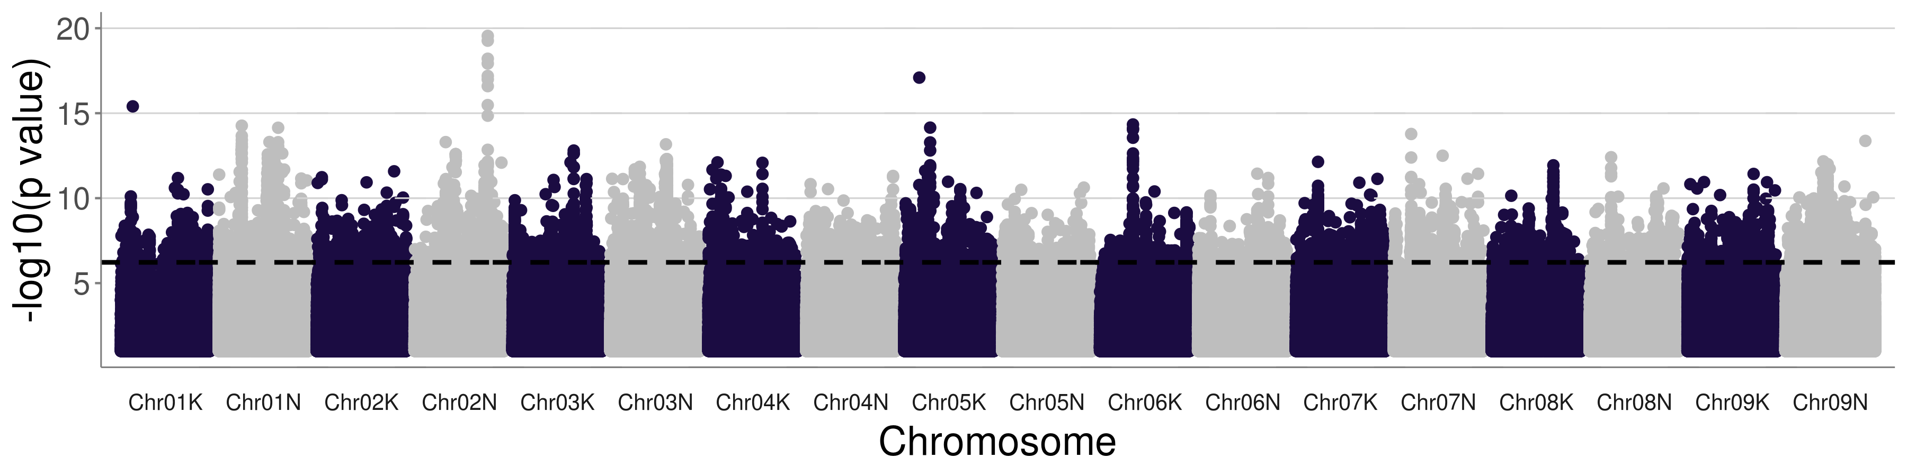

DOE BER DESC0014156
‘Climate adaptation and sustainability in switchgrass: exploring plant-microbe-soil interactions
across continental scale environmental gradients’
Genetics of Climate Adaptation Using Genome-Wide Association in Switchgrass
Tom Juenger¹, Alice MacQueen¹*, The Switchgrass Genomics Team**, Jason Bonette¹, John Lovell², Sujan Mamidi², and Jeremy Schmutz²
Why Switchgrass?
Diversity
Panel
1: University of Texas at Austin
2: HudsonAlpha Institute of Biotechnology
and Joint Genome Institute
BIOFUELS: Switchgrass (Panicum virgatum) is the model herbaceous
bioenergy crop; it has high biomass yields and is productive on marginal
lands; its ethanol yield can exceed that of maize on a per acre basis.
CLIMATE ADAPTATION: Natural switchgrass populations are found across
North America east of the Rocky Mountains, and span eight USDA cold
hardiness zones. Natural selection to climate has shaped the genetics of
these populations and shaped phenotypic groupings into upland (mostly
northern), lowland (mostly southern), and coastal ecotypes. These
ecotypes likely have different adaptations to climate.
Major phenotypic and genetic groups in the tetraploid switchgrass diversity panel. Plant specimens for the five major types are shown.
*Presenting Author
**Switchgrass genomics team members:
Jerry Jenkins, Chris Plott, Shengqiang Shu,
Avinash Sreedasyam, Adam Healey, Li Zhang,
Taslima Haque, Joe Napier, Adam Session,
Michael Udvardi, Malay Saha, Yuhong Tang,
Laura Bartley, Katrien Devos, Michael Casler,
Jiming Jiang, David Lowry, Guohong Wu,
David Kudma, Kerrie Barry, Jane Grimwood,
Dan Rohksar
Continent-Scale Adaptation Using Common Gardens
Genome-Wide Association Studies of Environments at Plant Locations of Origin
A
B
C
A
B
FGF
A The diversity panel was planted at ten common garden locations in 2018.
B Four northern common garden locations had significant overwinter plant death in winter 2018-2019.
C Specific gulf alleles were lost at high frequency in the north in the winter of 2018/2019. The fraction of alleles lost varied across the genome (first four chromosomes are shown).
SNPs with significant associations with one or more bioclim variable. A Significant SNPs were typically associated with 14-18 bioclim variables when analyzed with mash (Urbut et al., 2019 Nat. Gen.) Three nearby genes are noted.
B The starred allele in A has alternate alleles found in plants from consistent temperature, warmer climates.
A
Genome-Wide Association Studies for Common Garden Traits Show Climate Adaptation
E
B
C
E Biomass shows environment and ecotype by environment effects. Sites are arranged in latitudinal order and bars are colored by plant ecotype.
F Manhattan plot for the starred distribution in E, biomass in Temple, Texas. Dotted line indicates the 5% false discovery rate threshold.
G The effect sizes for the starred allele in F, analyzed using mash (Urbut et al., 2019 Nat. Gen). This SNP has an alternate allele that increases biomass at all ten sites with a latitudinal gradient in effect magnitude.
G
D
A Greenup shows environment and ecotype by environment effects. Sites are arranged in latitudinal order and bars are colored by plant ecotype.
B Manhattan plot for the starred distribution in A.
C Q-Q plot for Manhattan in B. D Southern and northern sites have similar allelic effects on greenup. Mash analysis of alleles with pairwise similar effects.
F
Take-home message
switchgrassGWAS R Package
Contact
Winter survival in the northern U.S. is a major selective agent in switchgrass.
Environmental GWAS show allelic effects that partition plants into “winter kill” and “non-winter kill” locations; e.g., warmer climates with more consistent temperatures (and more variable precipitation) versus cooler climates with more variable temperatures and more consistent precipitation.
Common garden phenotypes show genotype by environment interactions and strong signals of genetic association that vary by location.
https://github.com/Alice-MacQueen/switchgrassGWAS
Alice MacQueen: alice.macqueen@utexas.edu
Tom Juenger: tjuenger@utexas.edu
Run Genome-Wide Association with `pvdiv_gwas`
Find annotations with `pvdiv_table_topsnps`
Analyze data at multiple sites using mash, with:
`pvdiv_bigsnp2mashr`
`mash_standard_run`
`mash_plot_manhattan_by_condition`
`mash_plot_effects`
Notes:
The alternate allele for this SNP near Cold Shock Protein 1 is associated with consistently warmer climates with higher rainfall that is more variable across the season. Its strongest effects are on mean diurnal temperature range, followed by temperature annual range and temperature seasonality.

