Slide 1



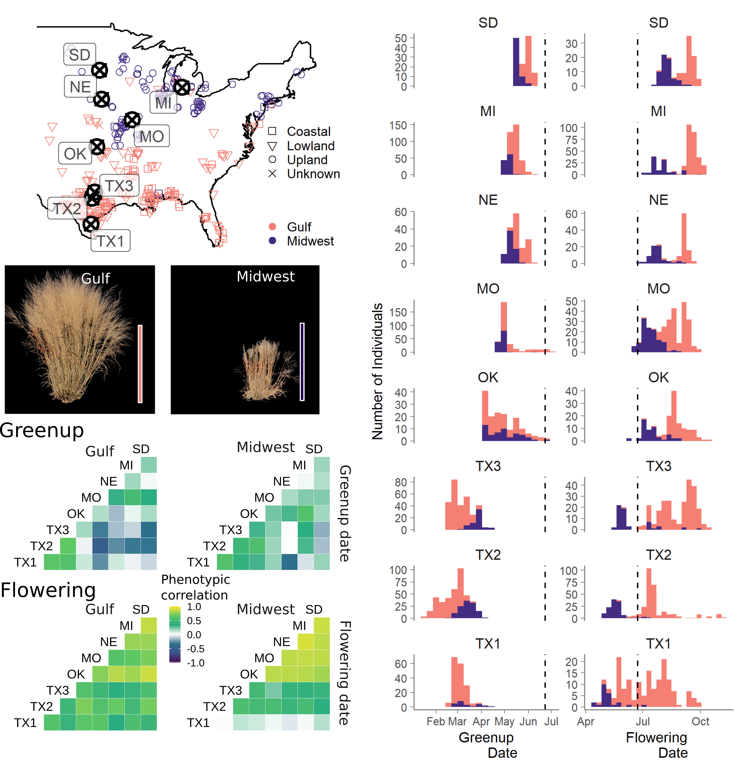
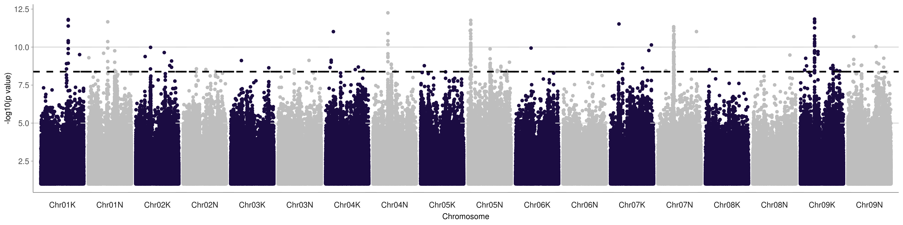
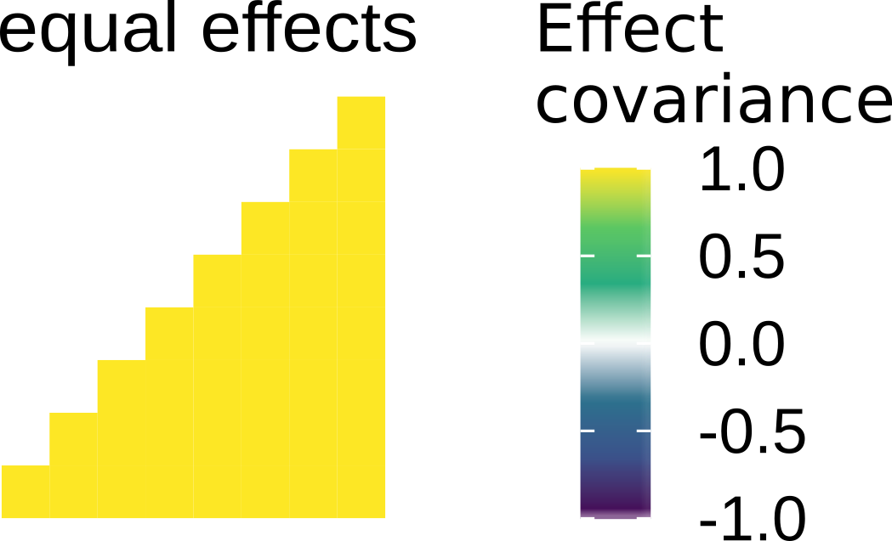
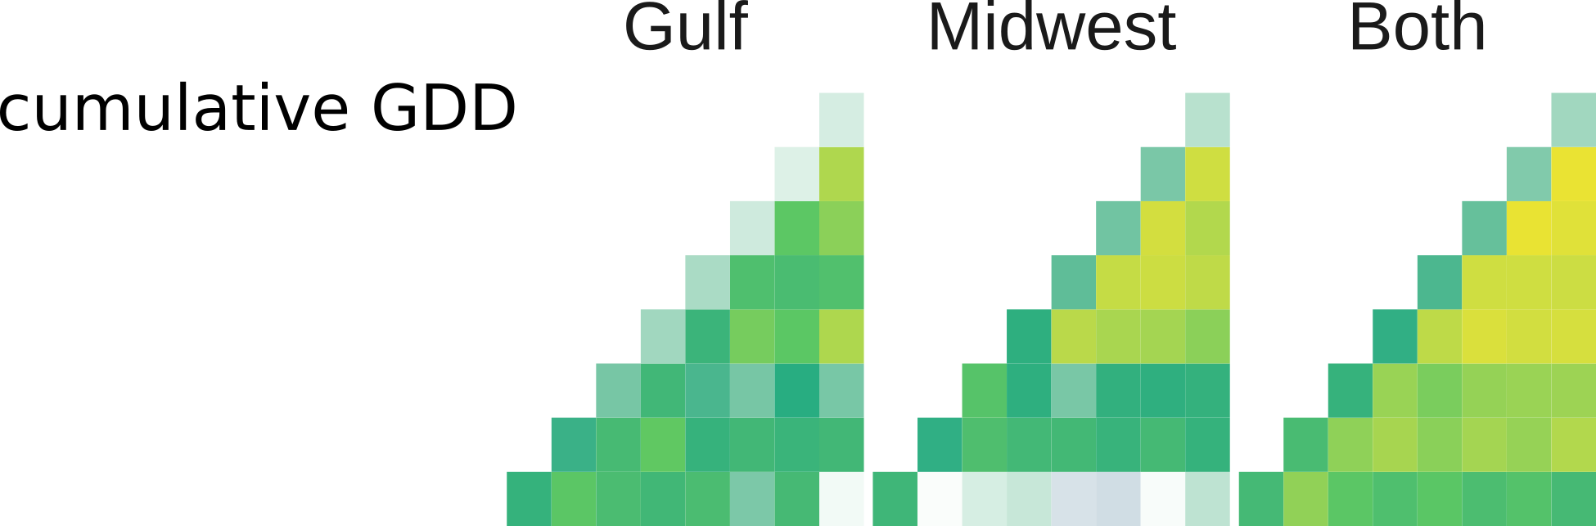
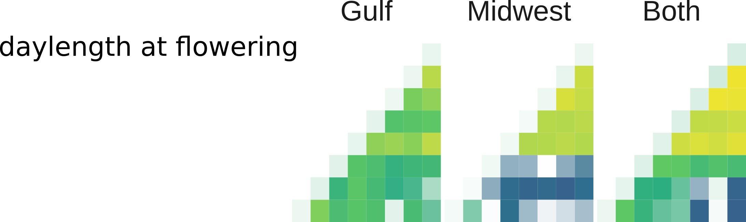
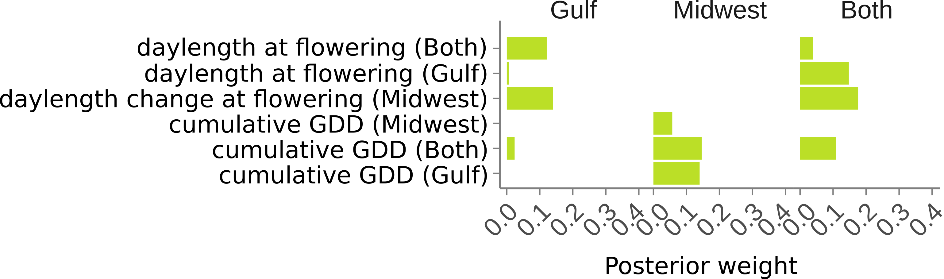
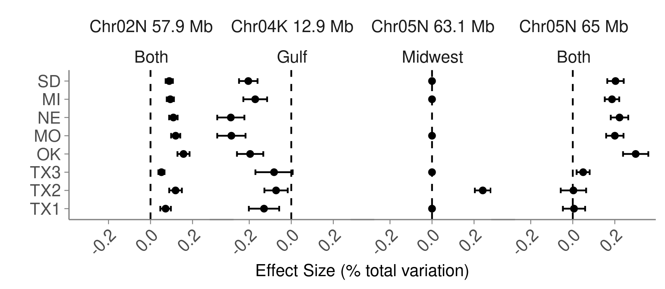
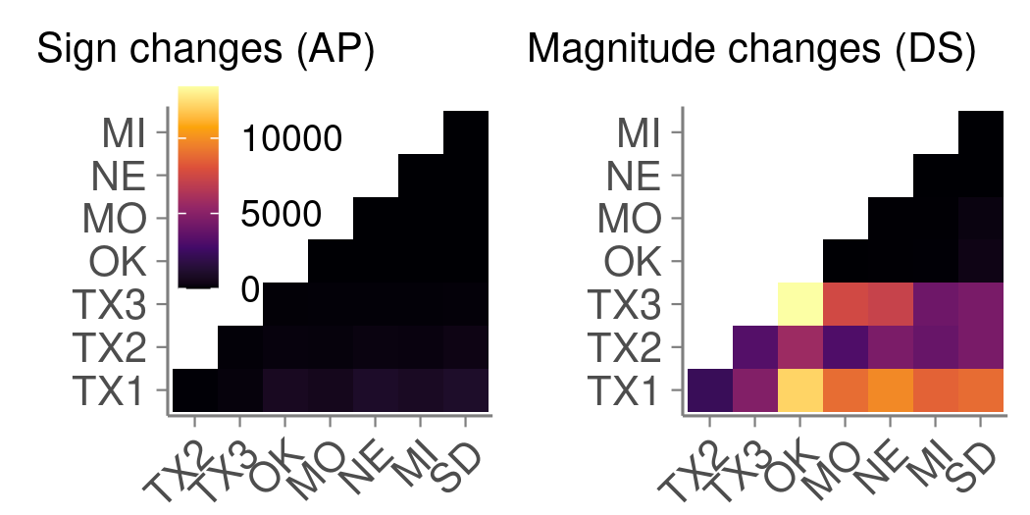

DOE BER DE-SC0021126
‘Testing predictions of plant-microbe-environment interactions to
optimize climate adaptation and improve sustainability in switchgrass feedstocks gradients’
Community Resources to Study Switchgrass Adaptation Using Genome-Wide Association
Tom Juenger¹, Alice MacQueen¹*, Li Zhang¹, The Switchgrass Genomics Team**, and Jeremy Schmutz²
Why Switchgrass?
2. switchgrassGWAS R Package
1: University of Texas at Austin
2: HudsonAlpha Institute of Biotechnology
and Joint Genome Institute
BIOFUELS: Switchgrass (Panicum virgatum) is the model herbaceous
bioenergy crop; it has high biomass yields and is productive on marginal
lands; its ethanol yield can exceed that of maize on a per acre basis.
GENETIC DIVERSITY: Natural switchgrass populations are found across
North America east of the Rocky Mountains. These populations are
morphologically and genetically divergent and have distinct environmental
adaptations. Genetic differences in flowering date and photoperiod
response will be an early point of exploitation in biomass crop breeding.
https://alice-macqueen.github.io/switchgrassGWAS/
1. Run Genome-Wide Association with `pvdiv_standard_gwas’
2. Conduct multivariate analysis using mash with `pvdiv_bigsnp2mashr`,
`mash_standard_run`, `mash_plot_effects`.
*Presenting Author
**Switchgrass genomics team members:
John Lovell, Sujan Mamidi, Jason Bonnette,
Jerry Jenkins, Joseph Napier,
Avinash Sreedasyam, Adam Healey,
Adam Session, Shengqiang Shu,
Kerrie Barry, Stacy Bonos, LoriBeth Boston,
Christopher Daum, Shweta Deshpande,
Aren Ewing, Paul Grabowski, Taslima Haque,
Melanie Harrison, Jiming Jiang, Dave Kudrna,
Anna Lipzen, Thomas Pendergast, Chris Plott,
Peng Qi, Christopher Saski, Eugene Shakirov,
David Sims, Manoj Sharma, Rita Sharma,
Ada Stewart, Vasanth Singan, Yuhong Tang,
Sandra Thibivillier, Jenell Webber, Xiaoyu Weng,
Melissa Williams, Guohong Albert Wu,
Yuko Yoshinaga, Matthew Zane, Jiyi Zhang,
Kathrine Behrman, Arvid Boe, Philip Fay,
Felix Fritschi, Julie Jastrow, John Lloyd-Reilley,
Juan Manual Martnez-Reyna, Roser Matamala,
Robert Mitchell, Francis Rouquette Jr,
Pamela Ronald, Malay Saha, Christian Tobias,
Michael Udvardi, Rod Wing, Yanqi Wu,
Laura Bartley, Michael Casler, Katrien M Devos,
David Lowry, Daniel Rokhsar, Jane Grimwood.
Associated with the article published in the
18-February 2021 issue of Nature:
DOI: 10.1038/s41586-020-03127-1
Article
News & Views
1. Continent-Scale Adaptation Using Common Gardens
3. Genome-Wide Association Studies
Phenotypic distributions for spring plant green-up and flowering date.
Locations of origin for genotypes from two genetic subpopulations. White circles: eight experimental gardens.
Photos of representative individuals from each genetic subpopulation, scaled
identically.
Manhattan plot showing genome-wide association results for flowering date in MI for both the Gulf and Midwest genetic subpopulations. Effect size estimates for the most significant SNPs are used for multivariate analysis with mash (Urbut et al 2019 Nat. Gen.)
4. Multivariate analysis assigns environmental drivers to SNP effect patterns
1. Make covariance matrices using environmental cues
(shown here are matrices for flowering date).
Phenotypic correlations for spring plant green-up and flowering date.
2. Assign SNPs posterior weights on each covariance matrix
using maximum likelihood.
Gulf genotype effects have high posterior weights on flowering daylength covariance matrices; Midwest genotype effects have high posterior weights on cumulative GDD covariance matrices.
Covariance matrices created by correlating environmental variables at each genotype’s flowering date.
3. Find significant SNP effects that covary with
particular environmental drivers using
multivariate adaptive shrinkage (mash).
Patterns of highly significant SNP effects across eight common gardens. These SNPs were also in significant quantitative trait loci for flowering date in an independent pseudo-F2 cross grown at the same eight common gardens.
Take-home message
4. Explore overall patterns of SNP effects, including those not affected by any hypothesized environmental driver.
The switchgrassGWAS R package allows genetic mapping of genetic and genotype-by-environment effects in the switchgrass diversity panel.
The Midwest and Gulf genetic subpopulations flower in response to distinct environmental cues: only Gulf genotypes are photoperiod responsive.
Number of SNPs with sign changes (antagonistic pleiotropy) and magnitude changes (differential sensitivity) for flowering date between pairs of common gardens.
Notes:
The alternate allele for this SNP near Cold Shock Protein 1 is associated with consistently warmer climates with higher rainfall that is more variable across the season. Its strongest effects are on mean diurnal temperature range, followed by temperature annual range and temperature seasonality.

