Slide 2
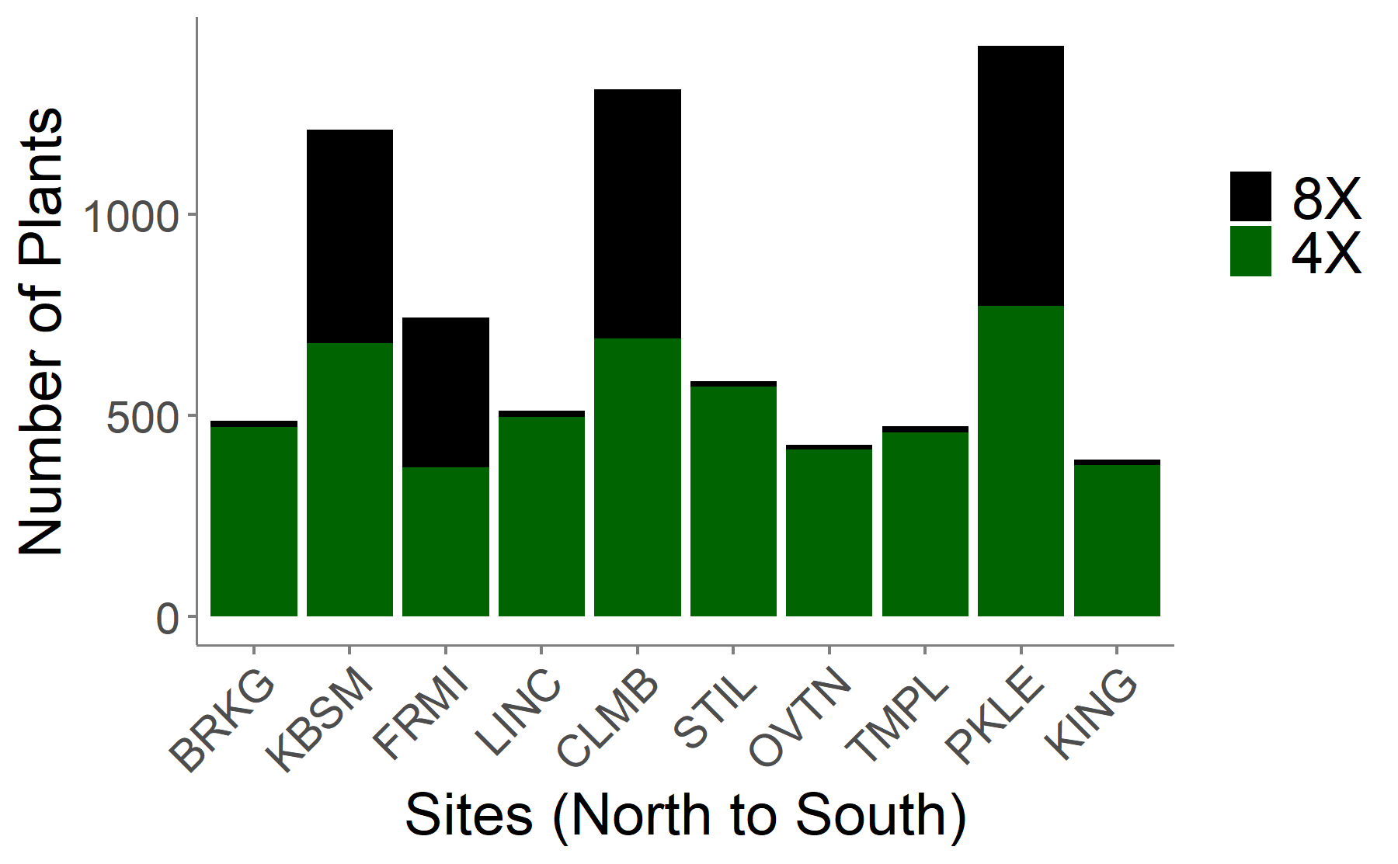
Ploidy of plants at common garden sites
Jason wanted me to make this for you

Slide 3
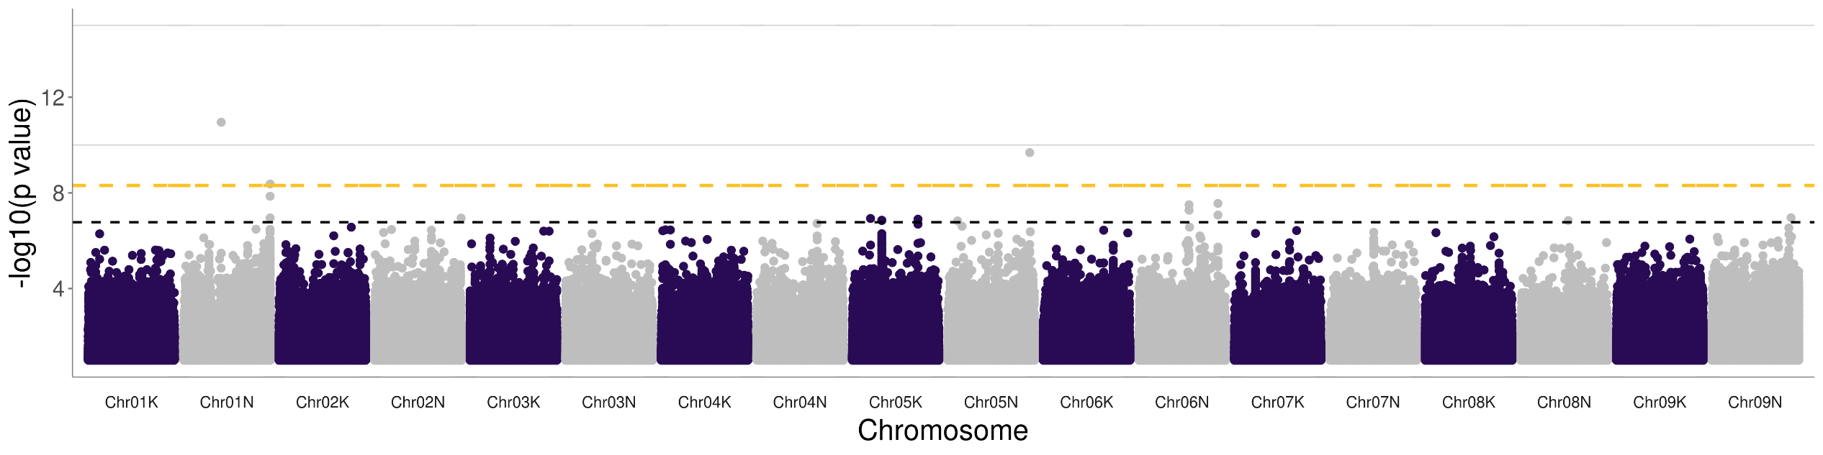
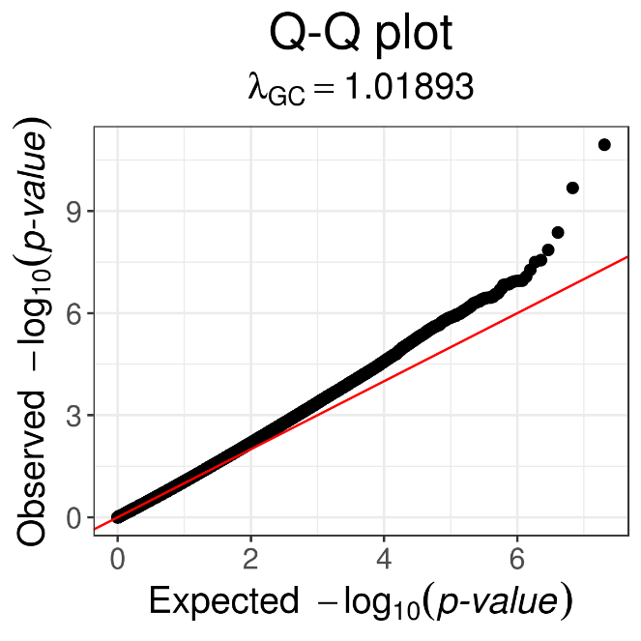
Fraction dead at five northern sites with Bonferroni (orange, ~8.3) and 10% FDR (black)

Slide 4
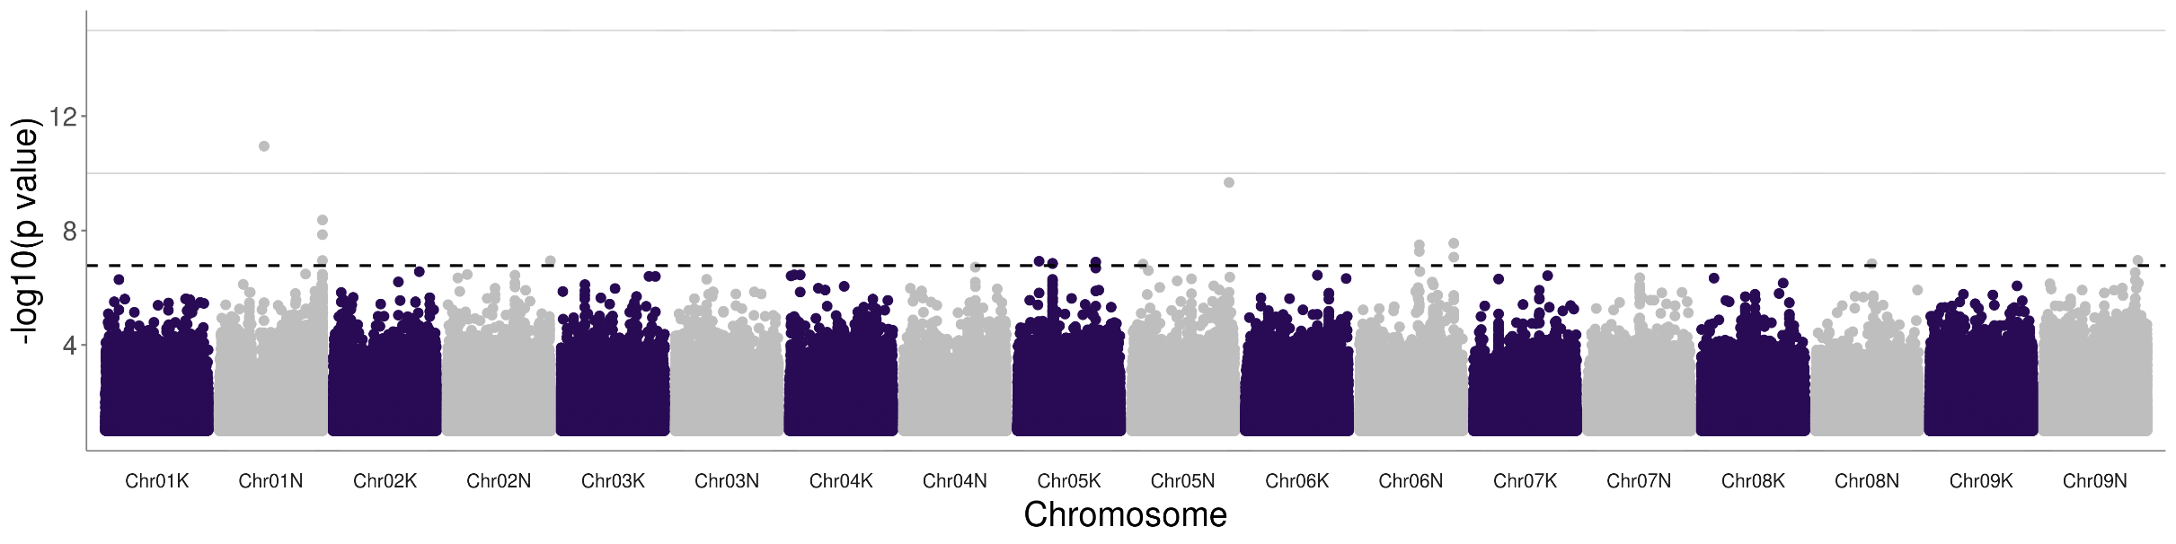

Fraction dead at five northern sites with Bonferroni (orange) or 10% FDR (black)

Slide 5
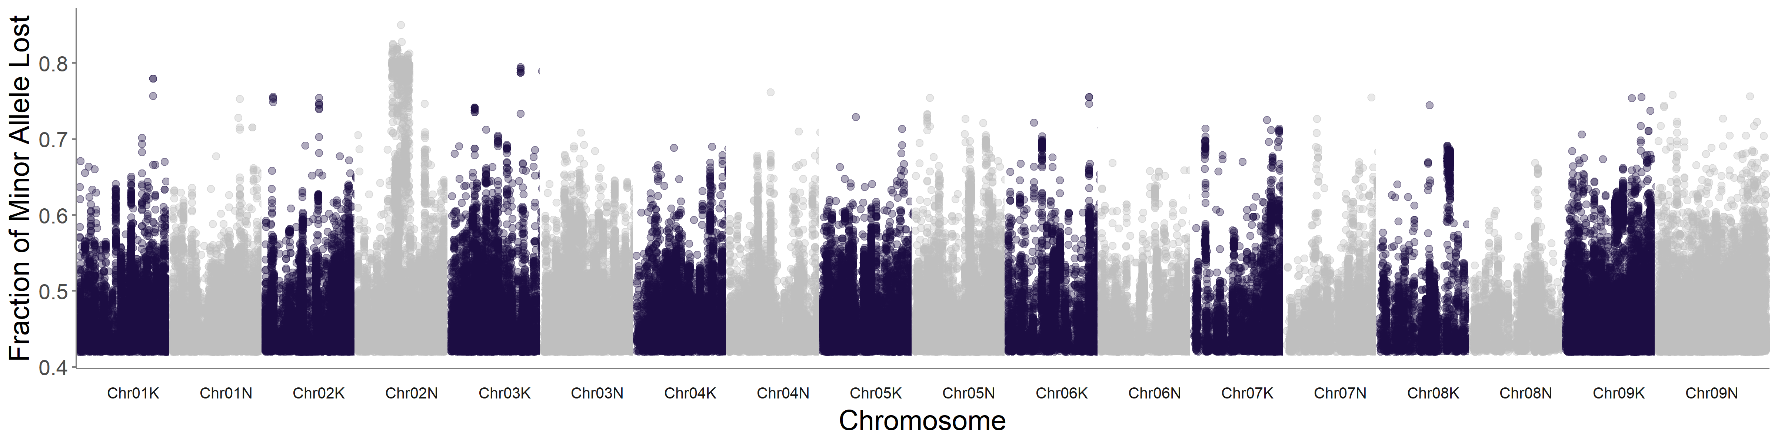
Fraction of alleles lost at four freezing sites

Slide 6
Top associations for Fraction dead at five northern sites with Bonferroni (orange) or 10% FDR (black) GWAS
Chrom. | Position | Genes | Gene ID | Homologous gene annotation
Chr01N | 29 Mb | 7 genes within 100kb | Pavir.1NG163100 (40kb) | Apoptosis inhibitory protein 5 (API5)
Chr05N | 68.2 Mb | 11 genes within 100kb | Pavir.5NG012646(1kb) | glycine-rich RNA-binding protein 2
Chr01N | 66.8 Mb | 6 genes within 100kb | Pavir.1NG542200 (8kb) | ferredoxin-related

Slide 7
Biomass

Slide 8
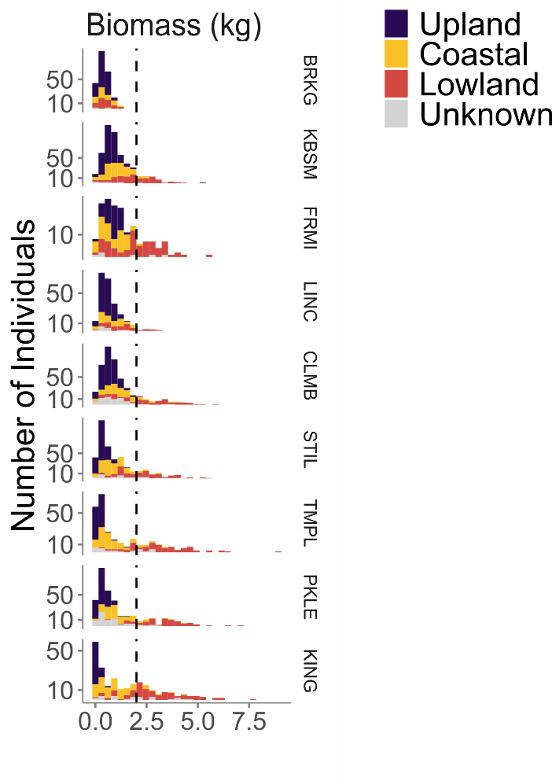
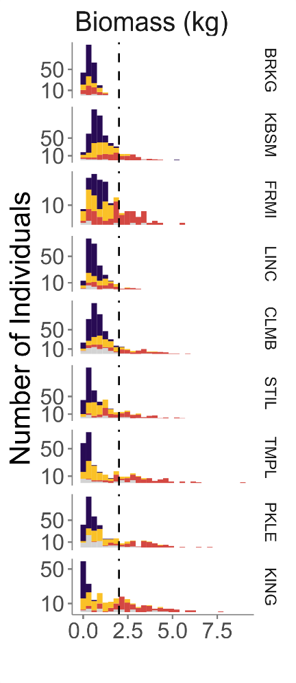
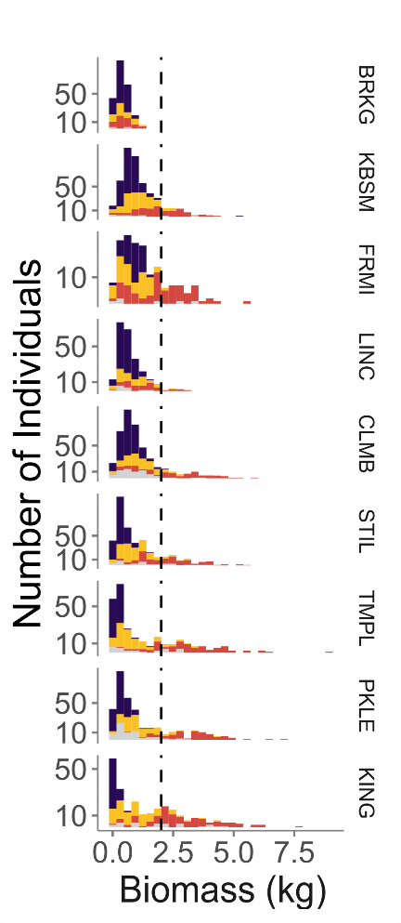

Biomass distribution plot options – 4 objects here

Slide 9
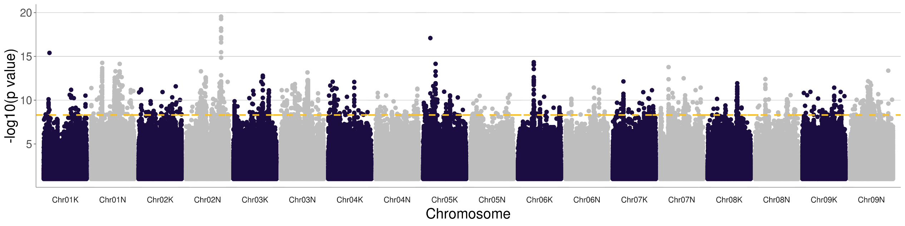
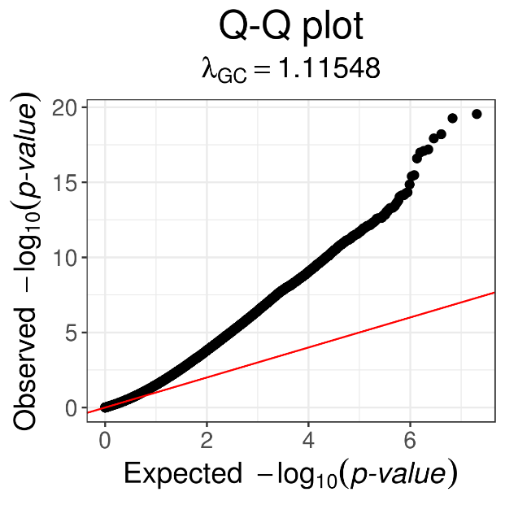
Biomass at Temple, Texas (Bonferroni – orange)

Slide 10
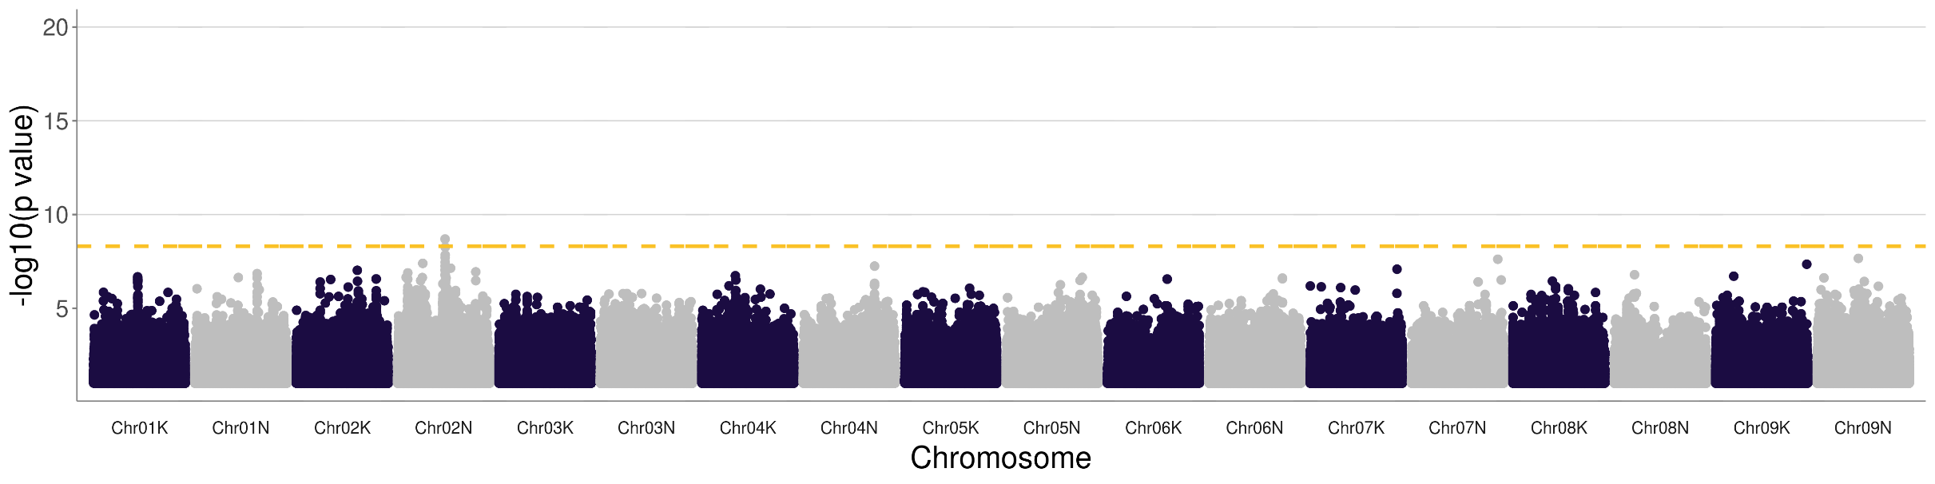
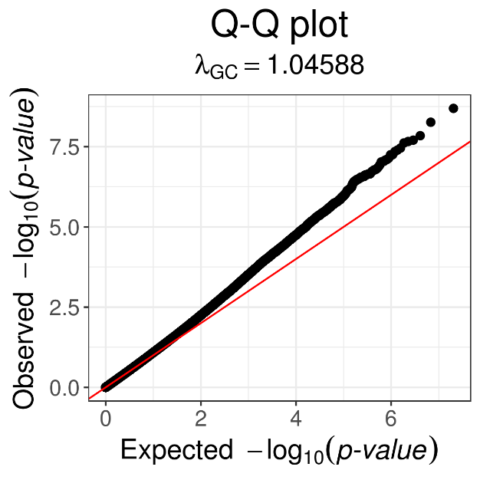
Biomass at Brookings, South Dakota

Slide 11
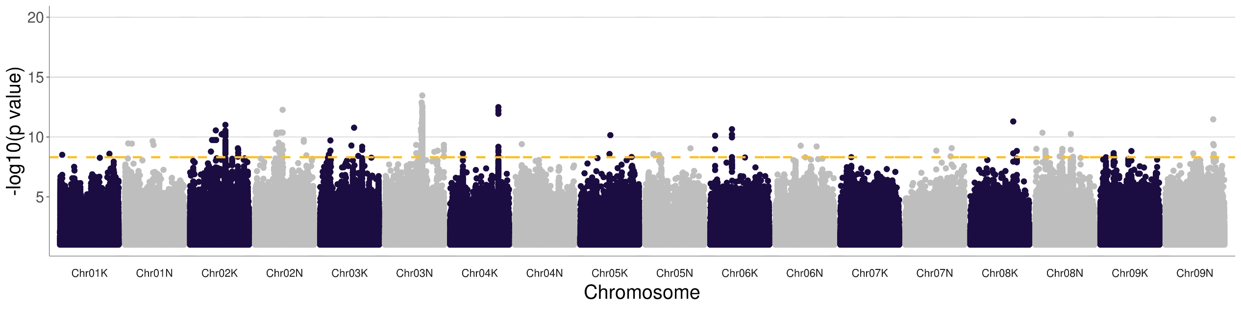
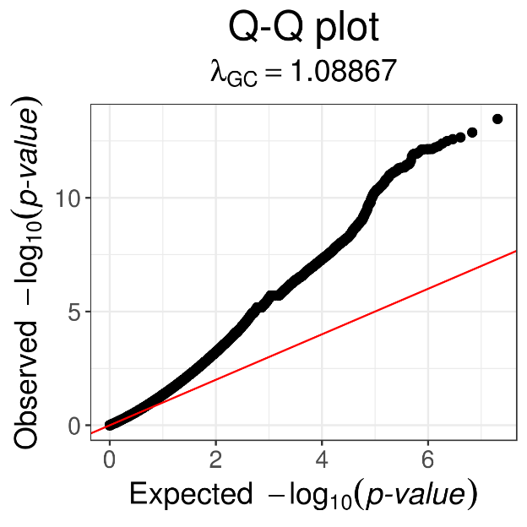
Biomass at Kingsville, Texas

