Slide 1

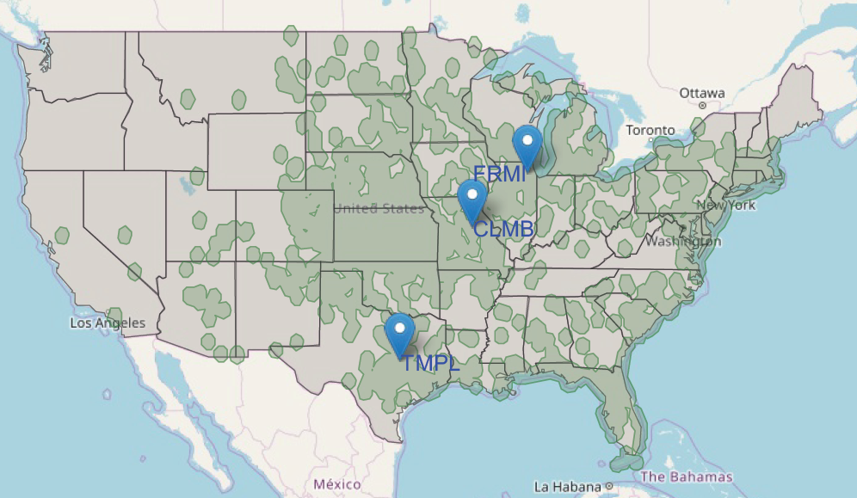



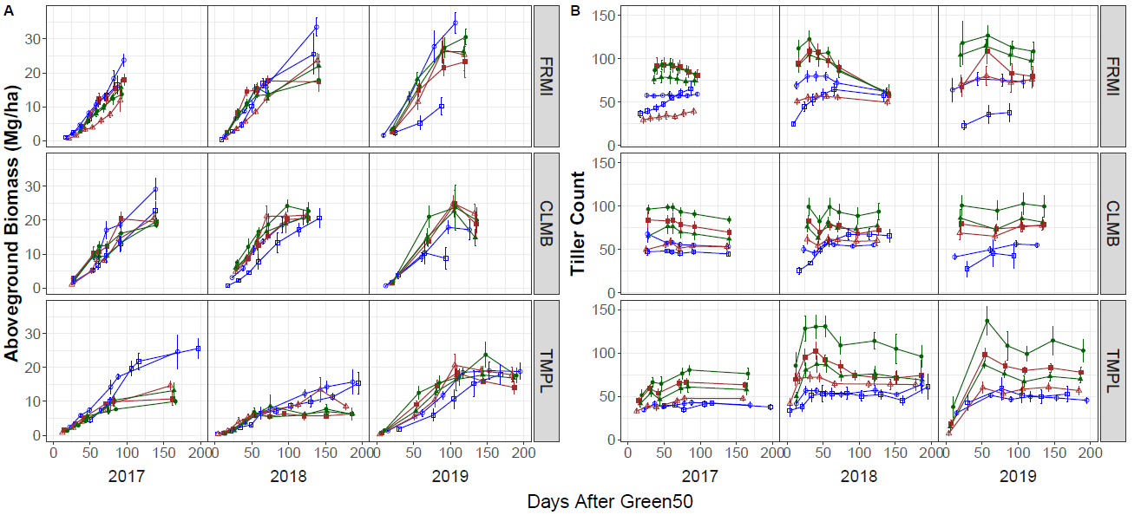
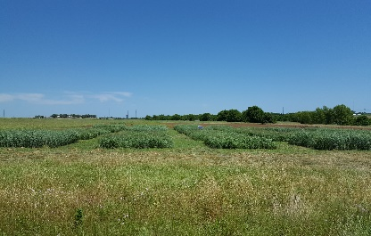
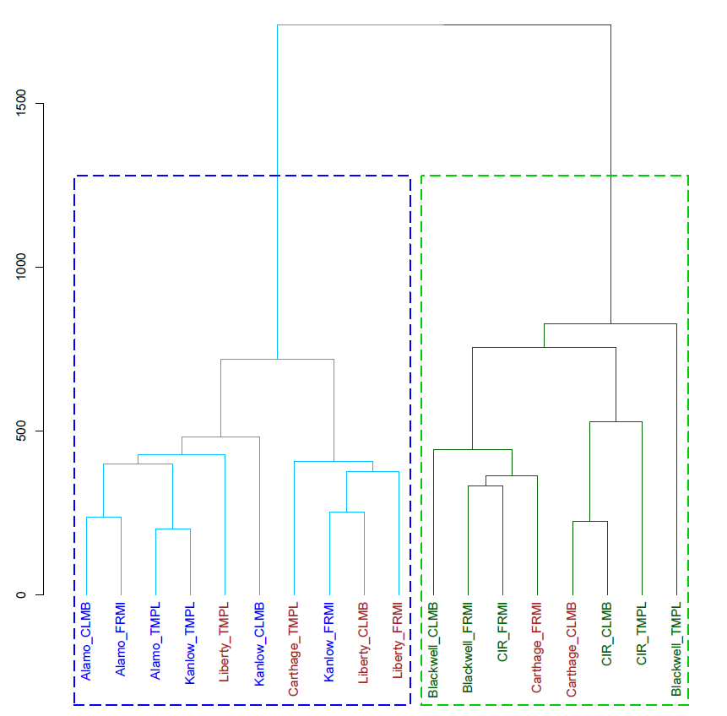
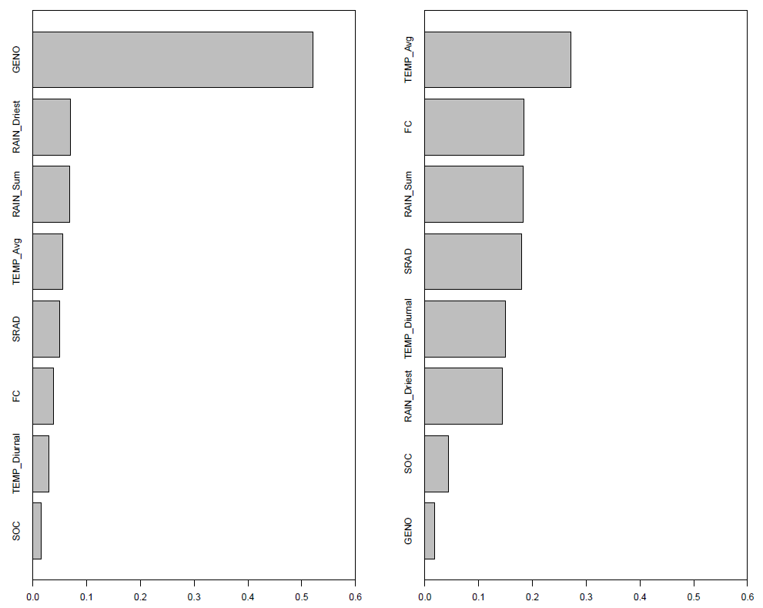
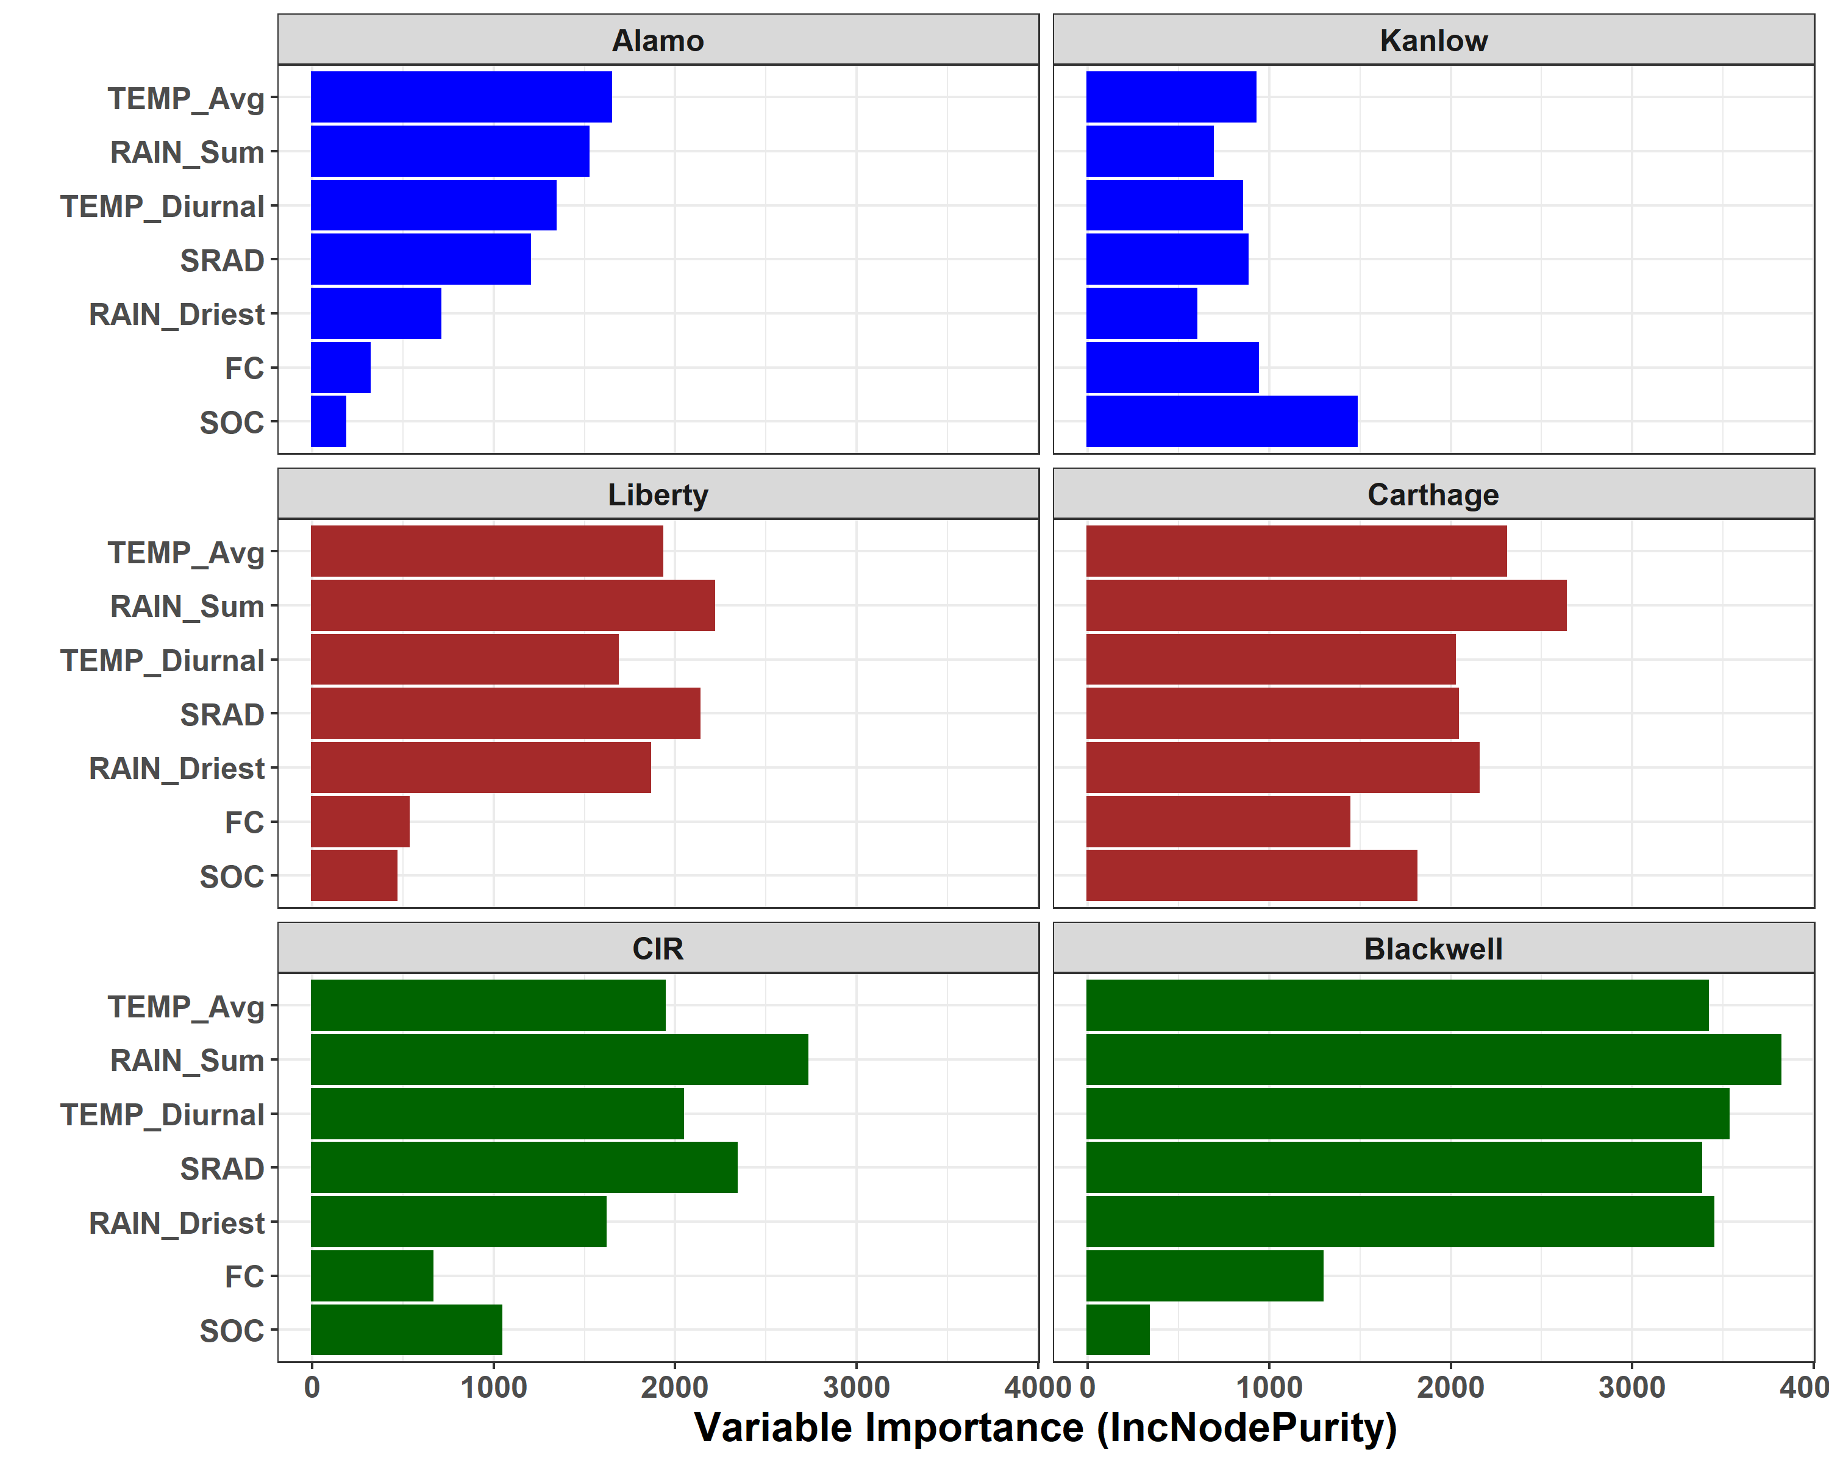
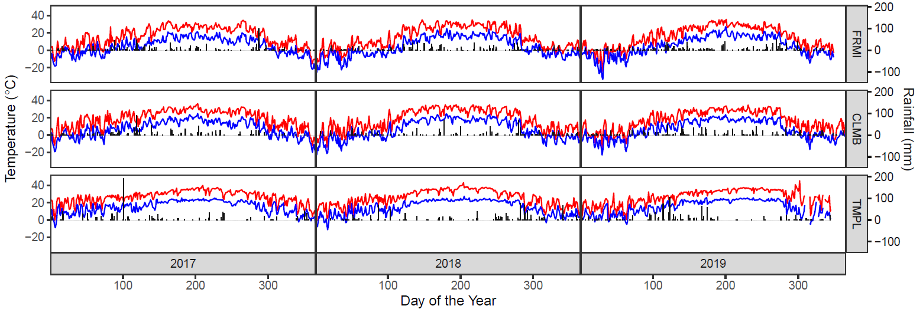
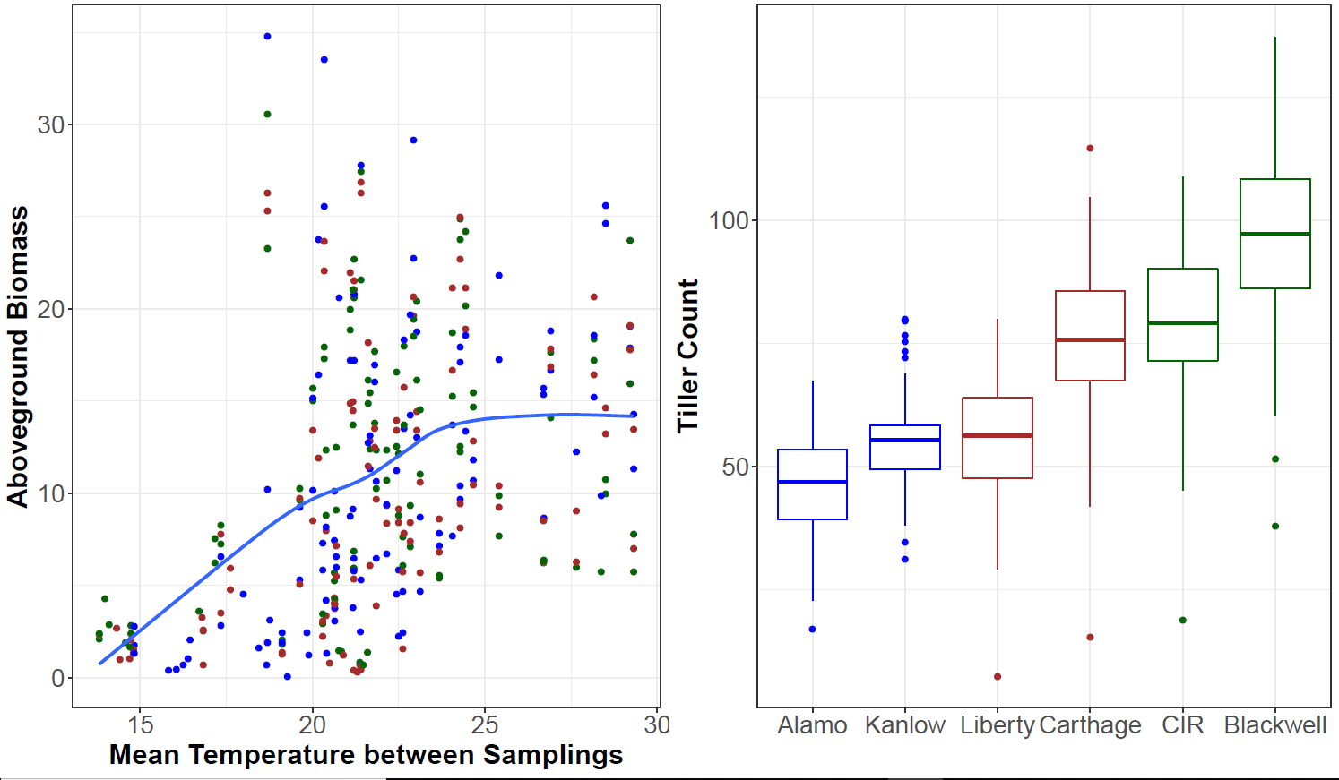

DOE BER DESC0014156 ‘Climate adaptation and sustainability in switchgrass: exploring plant-microbe-soil interactions across continental scale environmental gradients’
Using Machine Learning to Identify Cultivar x Site Interaction and Environmental Variable Affecting Aboveground Biomass
Thomas Juenger¹, Li Zhang¹*, Jason Bonnette¹, Kathrine Behrman¹
Background: Switchgrass, a perennial grass native to North American, is a promising second generation biofuel crop.
Switchgrass yields are sensitive to climatic variability and exhibit cultivar x environment interactions associated with temperature and precipitation in space and time.
Objectives: 1) Determine how cultivar specific seasonal growth patterns for aboveground biomass and tiller counts are related. 2) Identify environmental variable(s) affecting the seasonal phenotypes.
Field Experiments:
Fermin Lab, IL (FRMI)
Columbia, MO (CLMB)
Temple, TX (TMPL)
Results:
Common Garden
Multivariate Time Series Clustering
Multivariate Random Forest
Variable Importance for Tiller Count
Tiller Count Aboveground Biomass
GENO
TEMP_Avg
RAIN_Driest
FC
RAIN_Sum
RAIN_Sum
TEMP_Avg
SRAD
Lowland: Alamo, Kanlow
Upland: CIR, Blackwell
Hybrid: Liberty, Carthage
SRAD
TEMP_Diurnal
Lowland
Upland
FC
RAIN_Driest
TEMP_Diurnal
SOC
SOC
GENO
Standardized Variable Importance
TEMP_Avg: Mean Temperature between samplings
RAIN_Sum: Total Precipitation between samplings
TEMP_Diural: Mean Diurnal Range of Temperature between samplings
RAIN_Driest: Precipitation of the Driest Month
SRAD: Solar Radiation between samplings
FC: Field Capacity, SOC: Soil Organic Carbon, GENO: Cultivar
Conclusions:
The two upland cultivars (Alamo and Kanlow) and the two lowland cultivars (Blackwell and CIR) form two distinct clusters regardless of site.
The hybrid Liberty always clutters with the lowland cultivars, indicating that it is phenotypically lowland. The other hybrid, Carthage, phenotypically resembles an upland in the northern sites (CLMB and FRMI) and a lowland in the southern site (TMPL), thus indicating this cultivar is displaying strong cultivar x environment interactions.
Average temperature (TEMP_Avg) between each sampling interval was identified as the major factor influencing aboveground biomass. There is a positive linear relationship between temperature and biomass when average temperature is between 15 to 25°C. At average temperature values between 25 to 30°C, biomass is constant.
Tiller counts differ by cultivar and the dominant environmental variable affecting tiller count for each cultivar is different. However, average temperature (TEMP_Avg) or total precipitation (RAIN_Sum) between sampling intervals are the most common environmental variable impacting tiller count for all cultivars except Kanlow.
Contacts:
lz5943@utexas.edu
tjuenger@austin.utexas.edu
kate.behrman@gmail.com

