Slide 1


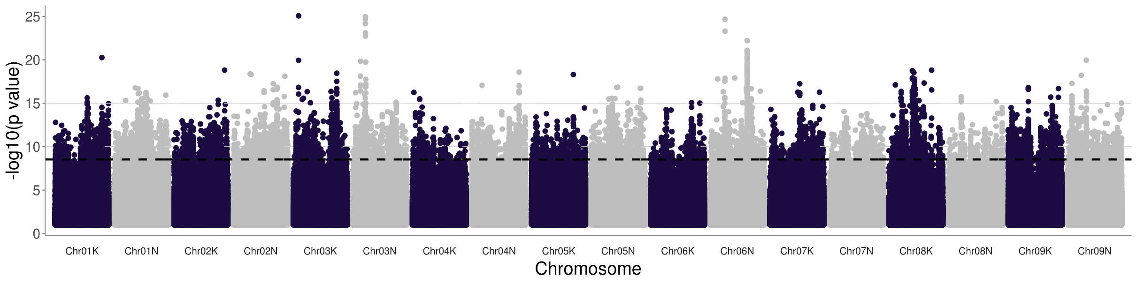
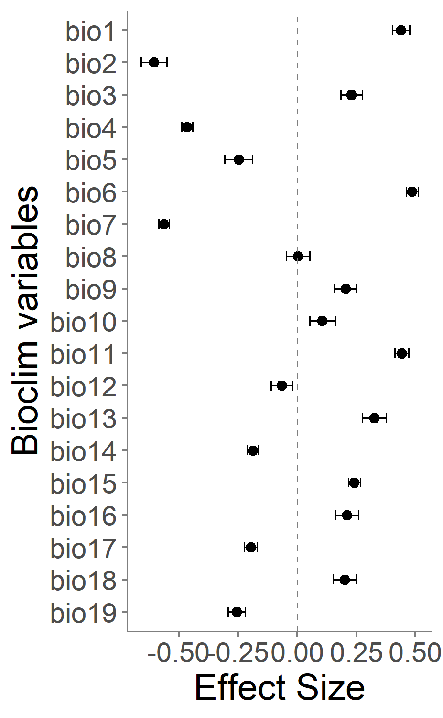
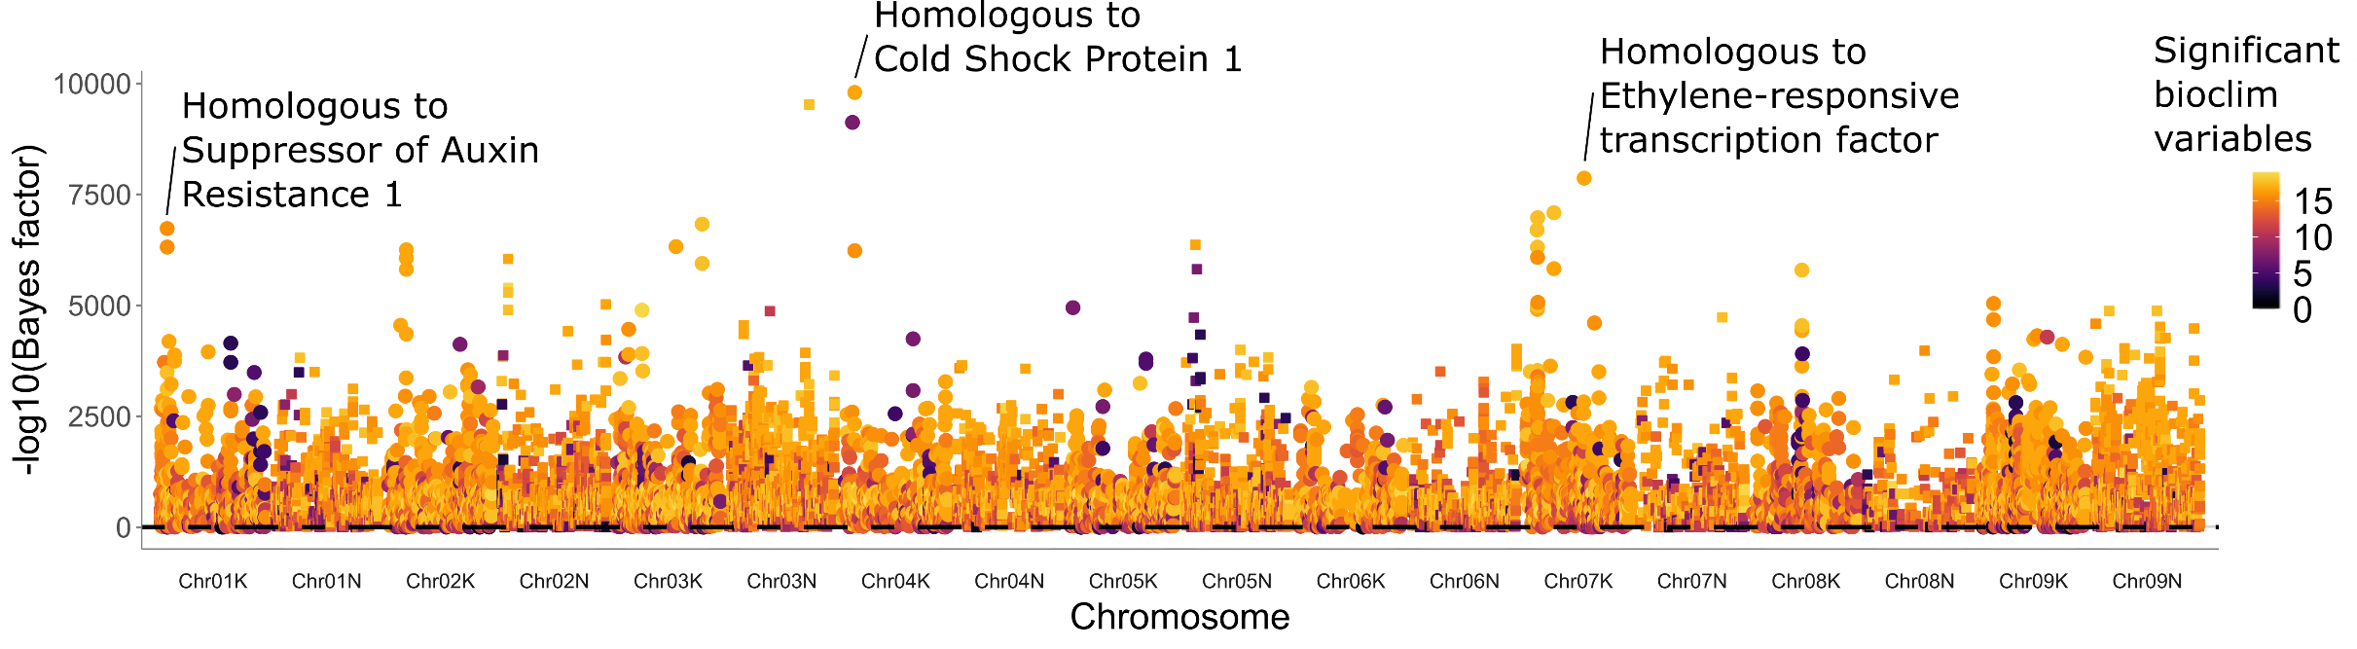
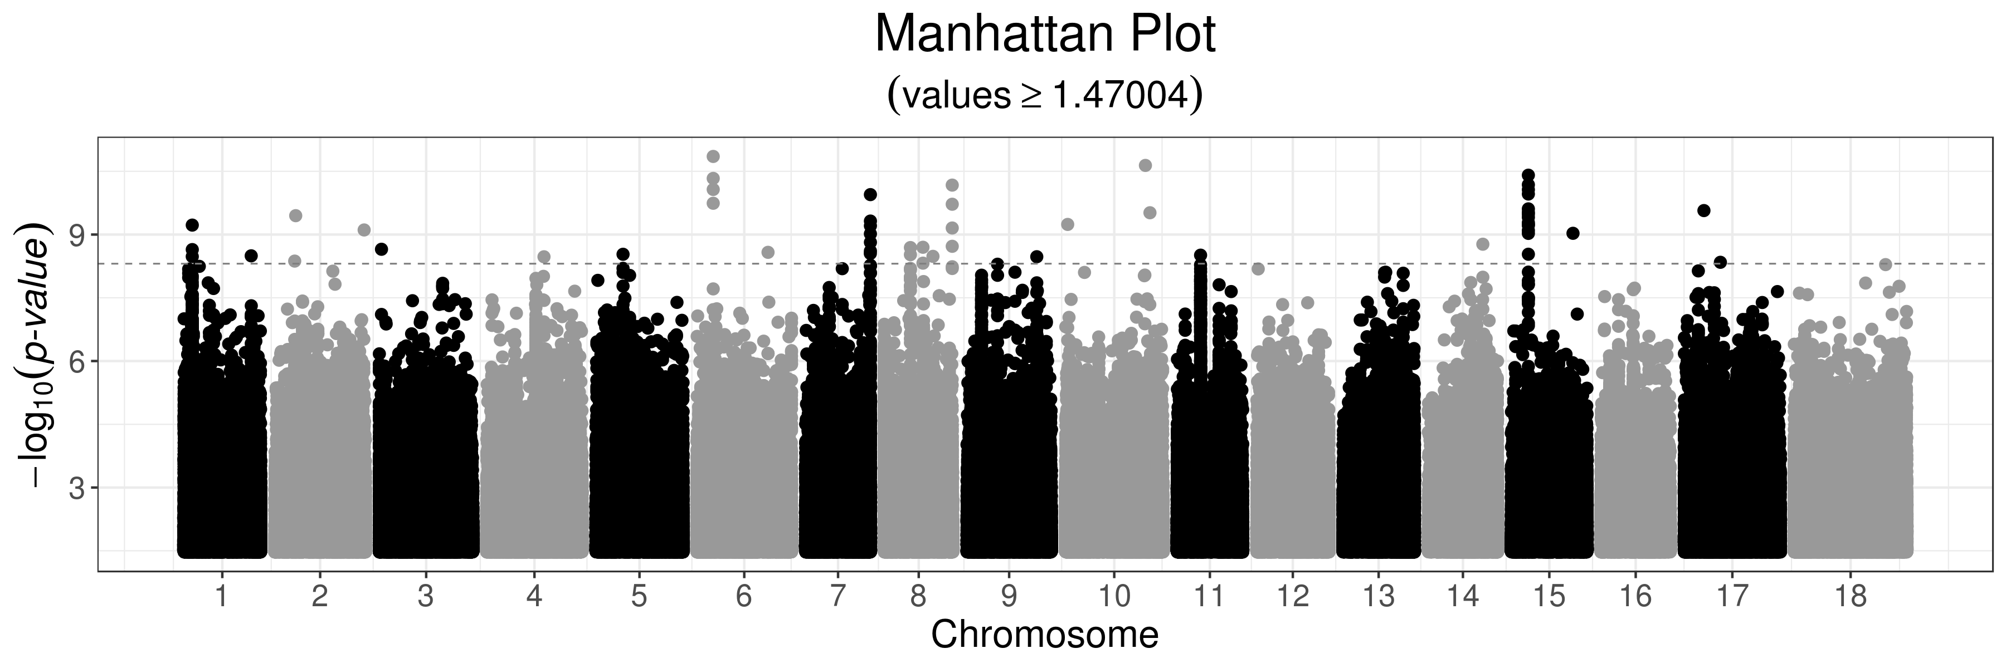
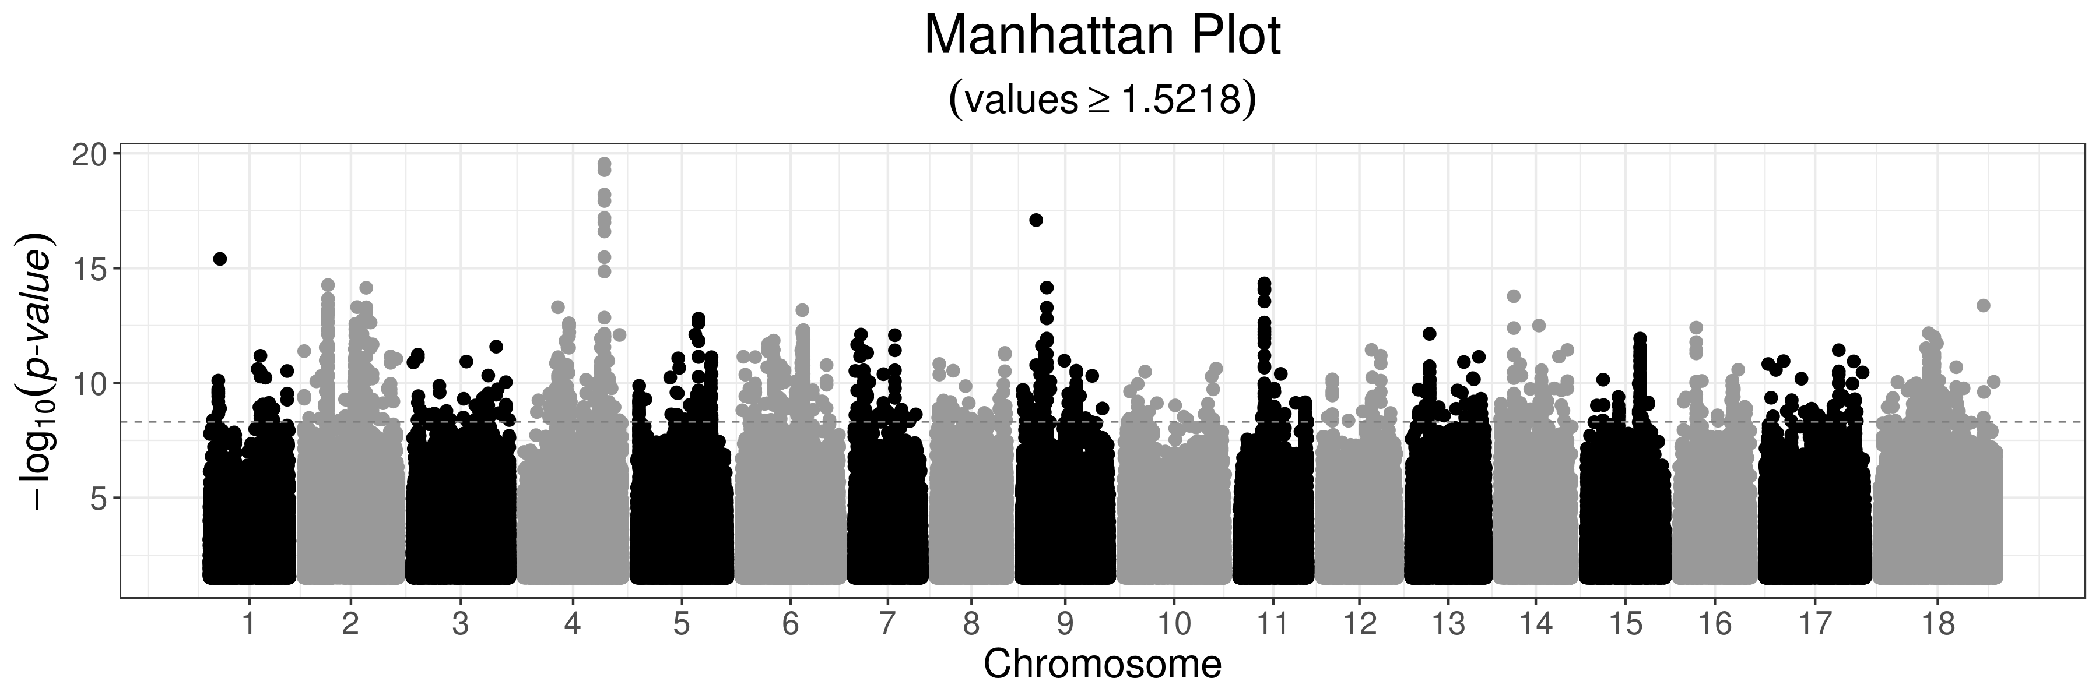
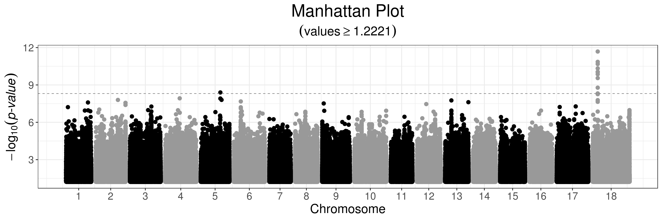

DOE BER DESC0014156
‘Climate adaptation and sustainability in switchgrass: exploring plant-microbe-soil interactions
across continental scale environmental gradients’
Genetics of Climate Adaptation Using Genome-Wide Association in Switchgrass
Tom Juenger¹, Alice MacQueen¹*, The Switchgrass Genomics Team**, Jason Bonette¹, John Lovell², Sujan Mamidi², and Jeremy Schmutz²
Why Switchgrass?
Diversity Panel
1: University of Texas at Austin
2: HudsonAlpha Institute of Biotechnology
and Joint Genome Institute
BIOFUELS: Switchgrass (Panicum virgatum) biomass can be effectively
converted into ethanol and other bioproducts; ethanol yield can exceed
that of maize on a per acre basis.
CLIMATE ADAPTATION: Natural switchgrass populations span >3,000 km
of latitude. Natural selection to climate has shaped the genetics of these
populations and shaped phenotypic groupings into upland (mostly
northern) and lowland (mostly southern) ecotypes.
*Presenting Author
**Switchgrass genomics team members:
Jerry Jenkins, Chris Plott, Shengqiang Shu,
Avinash Sreedasyam, Adam Healey, Li Zhang,
Taslima Haque, Joe Napier, Adam Session,
Michael Udvardi, Malay Saha, Yuhong Tang,
Laura Bartley, Katrien Devos, Michael Casler,
Jiming Jiang, David Lowry, Guohong Wu,
David Kudma, Kerrie Barry, Jane Grimwood,
Dan Rohksar
Continent-Scale Adaptation Using Common Gardens
Genome-Wide Association Studies for Environments at Plant Locations of Origin
A Example of figure
text/annotation size.
A Associations for BIO5, Max Temperature of Warmest Month
Genome-Wide Association Studies for Traits Involved in Climate Adaptation
A Associations for the time between greenup and flowering in Temple, Texas
A Associations for biomass in Temple, Texas
A Associations for 50% Greenup in Michigan
Take-home message
switchgrassGWAS R Package
Contact
Environmental GWAS and population structure are inextricably linked in this species.
Strong signals for associations
https://github.com/Alice-MacQueen/switchgrassGWAS
Alice MacQueen: alice.macqueen@utexas.edu
Tom Juenger: tjuenger@utexas.edu
Run Genome-Wide Association with `pvdiv_gwas`
Find annotations with `pvdiv_table_topsnps`
Analyze data at multiple sites using mash, with:
`pvdiv_bigsnp2mashr`
`mash_standard_run`
`mash_plot_manhattan_by_condition`
`mash_plot_effects`
Notes:
The alternate allele for this SNP near Cold Shock Protein 1 is associated with consistently warmer climates with higher rainfall that is more variable across the season. Its strongest effects are on mean diurnal temperature range, followed by temperature annual range and temperature seasonality.

