Slide 2
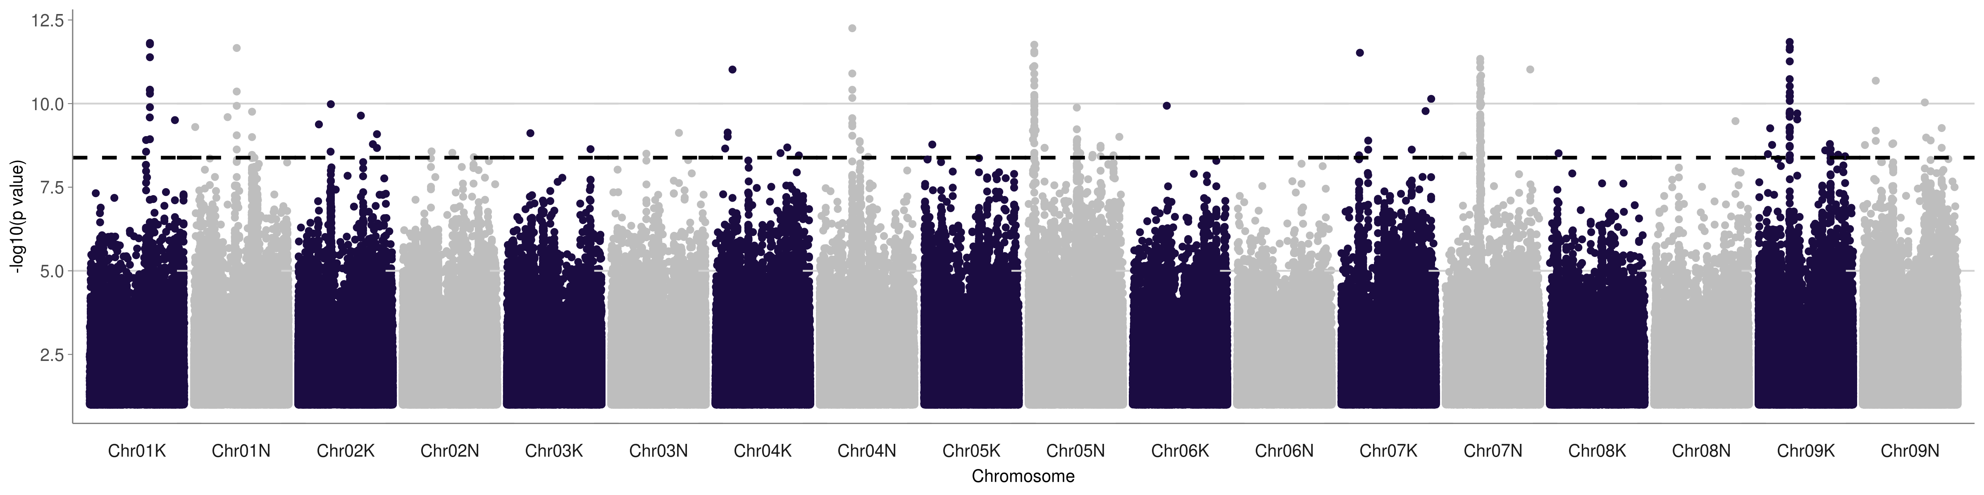
Gulf & Midwest FL50 MI 2019

Slide 3
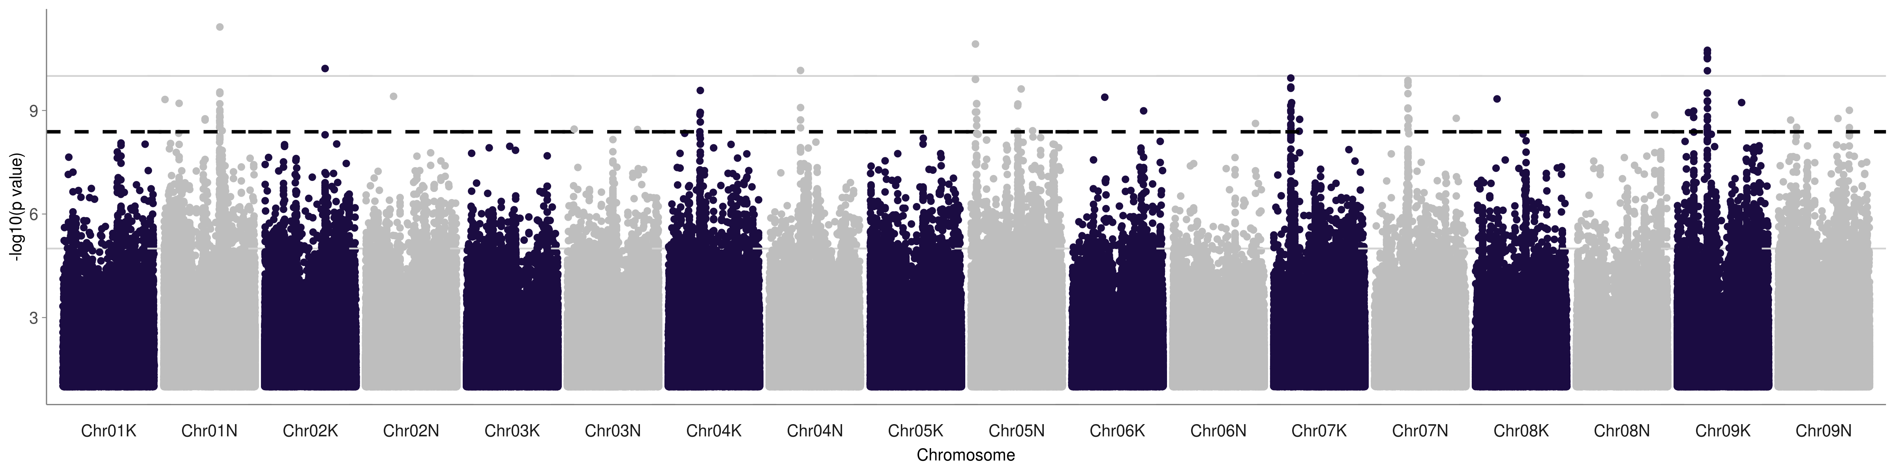
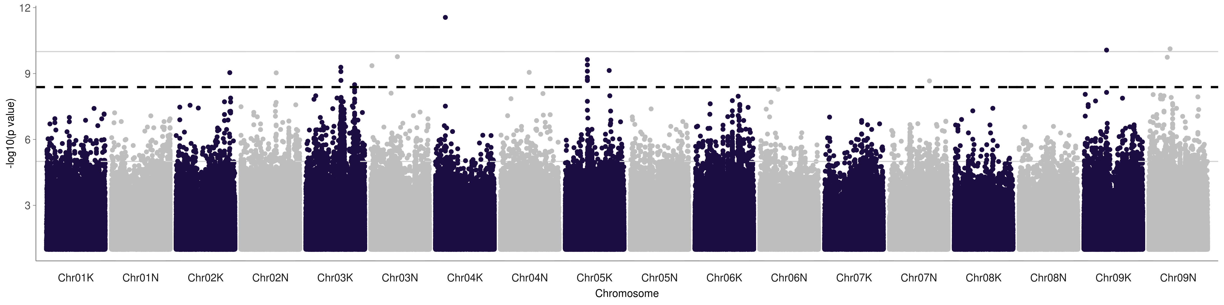
Gulf & Midwest FL50 North vs Texas gardens

Slide 4
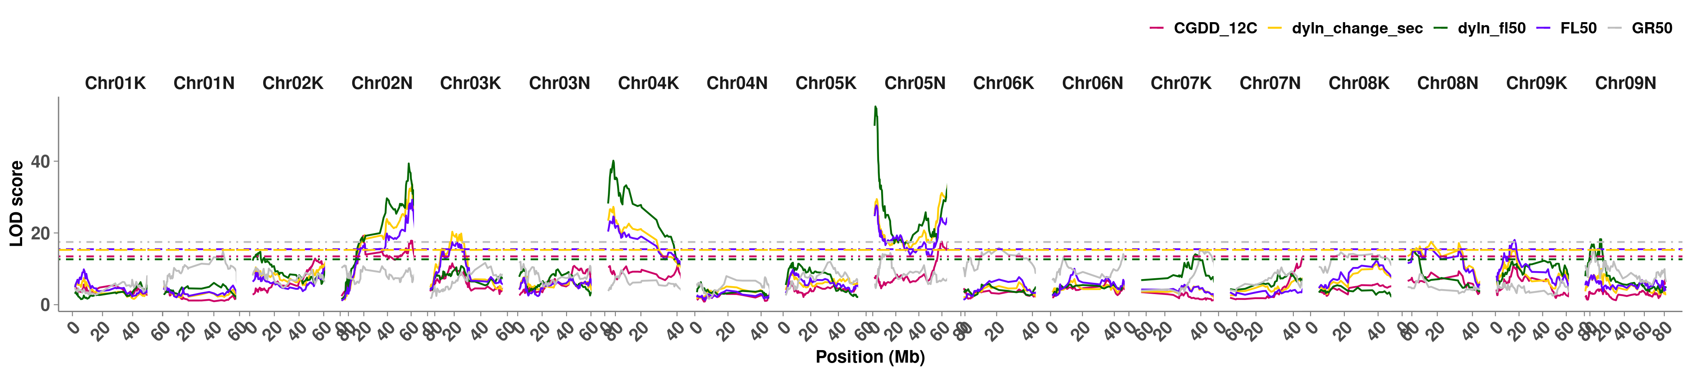
FL50 QTL Mapping in 2019

Slide 5
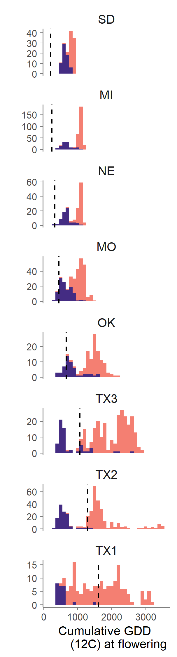
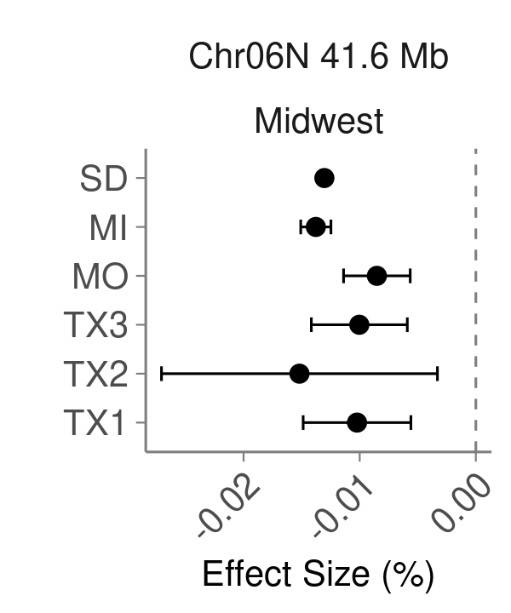
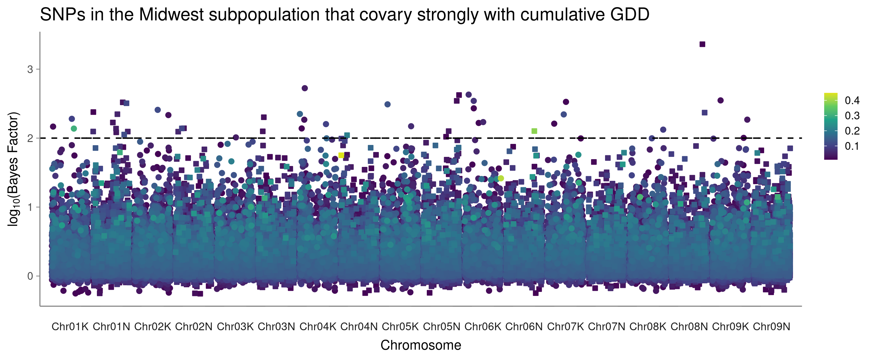
Midwest subpopulation flowering depends on cumulative growing degree days.
Pavir.6NG239800
OsPLS1

Slide 6
