Slide 1
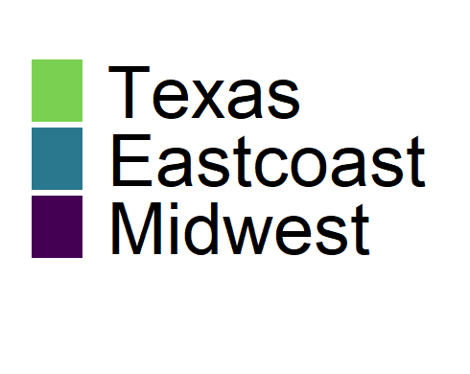
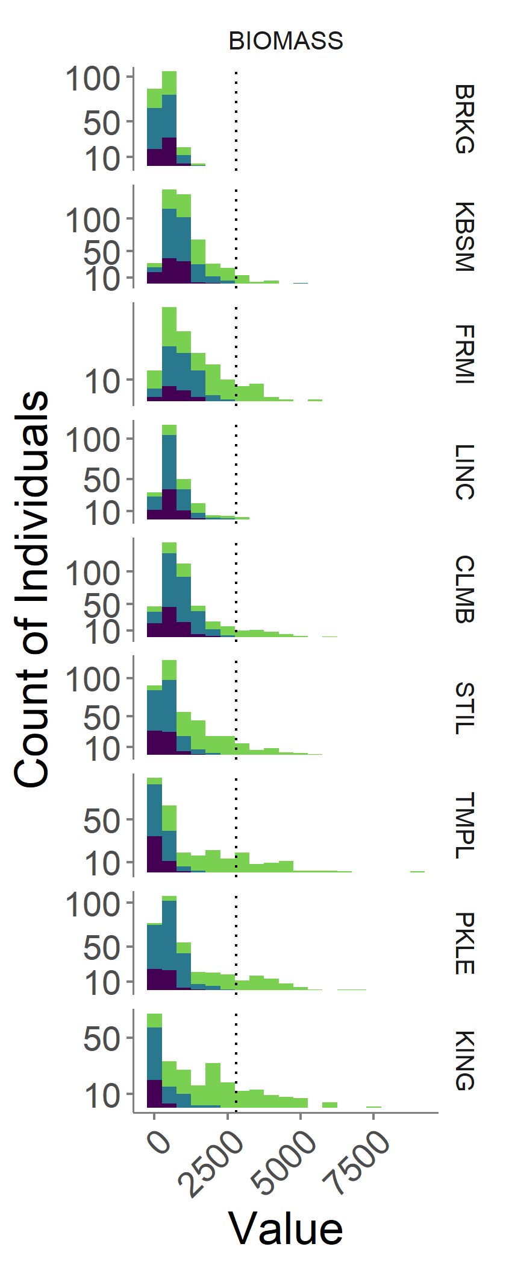
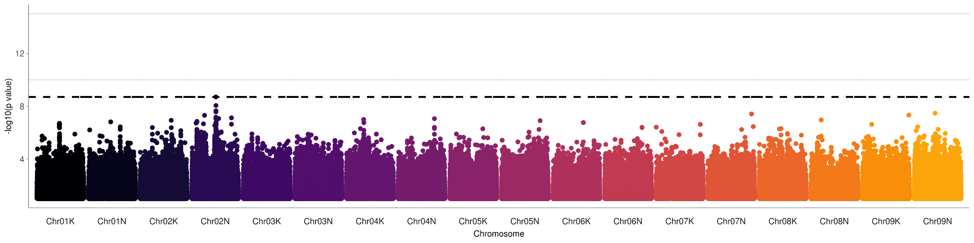
2019 Biomass
Ecotype
Brookings, South Dakota
Notes:
BRKG
Chr02N 36.3 5 genes Basic-leucine zipper (bZIP) transcription factor family protein
much more modest SNP effects (250 - 270 instead of 700-1000 in TMPL and KING)

Slide 2
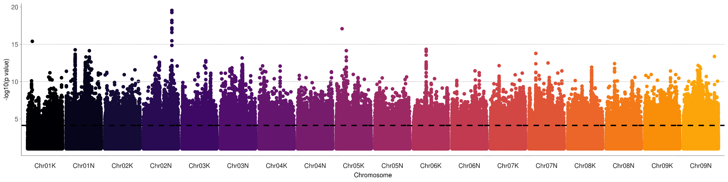
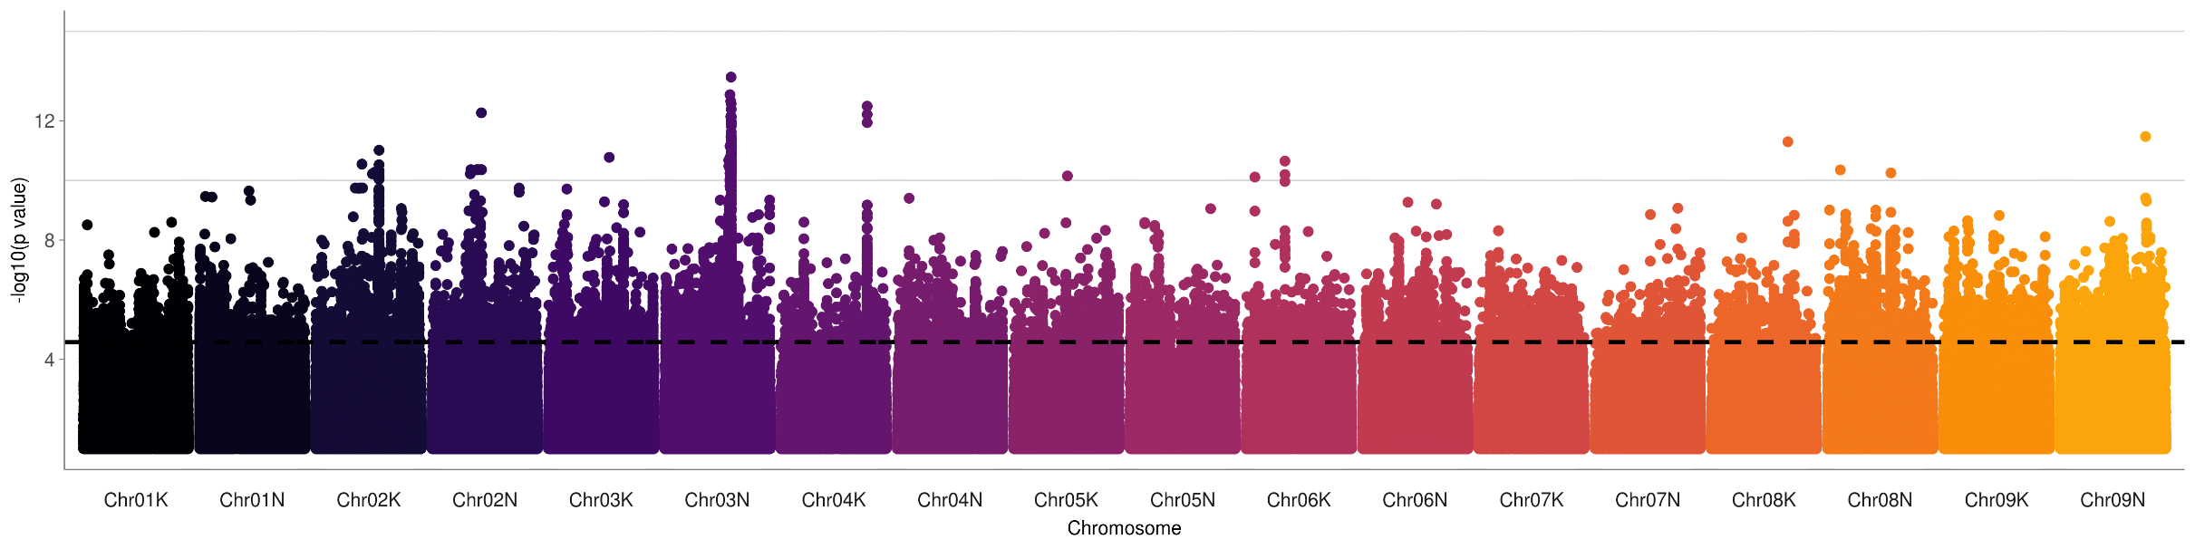
Ecotype
2019 Biomass
Temple, Texas
Kingsville, Texas
Notes:
TMPL
Chr02N 57.36 Pavir.2NG475000 DHHC-type zinc finger family protein
photosystem I P subunit Tetratricopeptide repeat (TPR)-like superfamily protein
Chr05K 10.51 Pavir.5KG145200 EXS (ERD1/XPR1/SYG1) family protein
Chr01K 7593673 Leucine-rich repeat protein kinase family protein
Chr06K 17.80 17804813 diacylglycerol kinase catalytic domain family protein, expressed
Chr05K 18083466 Pavir.5KG266100 Sec23/Sec24 protein transport family protein
Chr05K 18079422 Pavir.5KG266200 Albino or Glassy Yellow 1 preprotein translocase subunit secA, chloroplast precursor, putative, expressed
KING
Chr03N 43.99 within 20kb of 8 genes, unknown functions (e.g. "expressed protein")
Chr04K 39.29Mb Pavir.4KG313600 Histidine kinase-, DNA gyrase B-, and HSP90-like ATPase family protein and within 20kb of 3 other genes

Slide 3
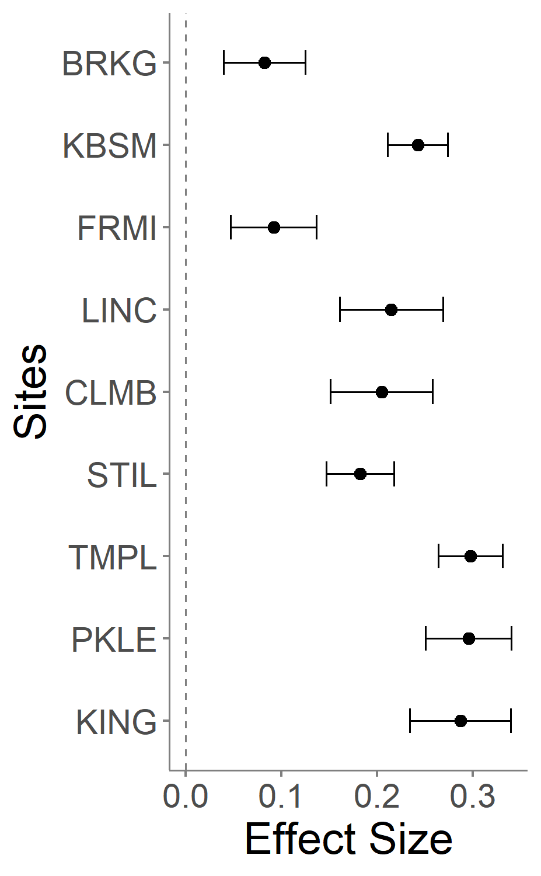
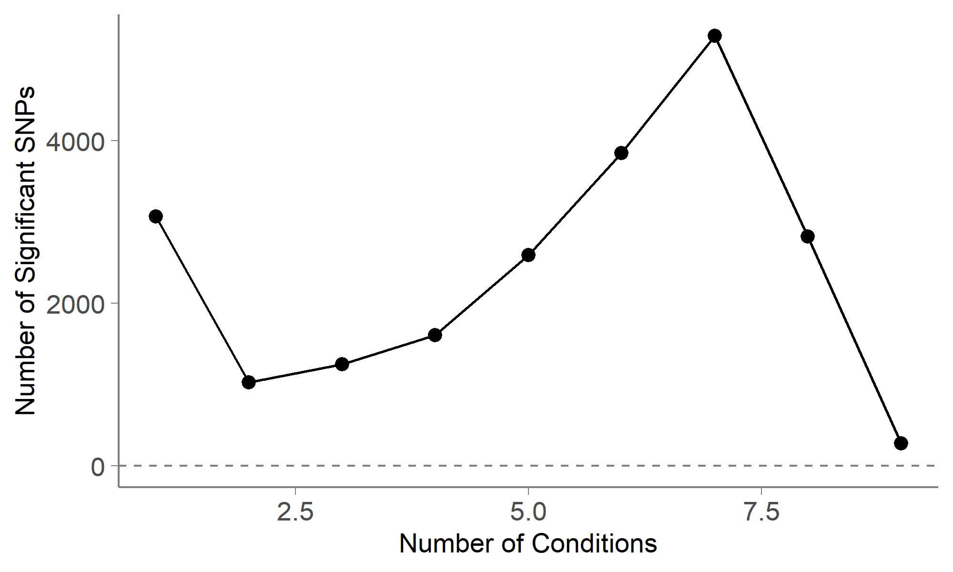
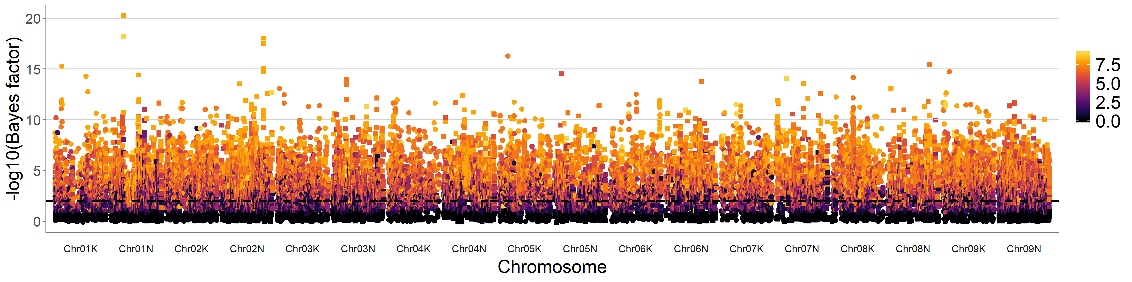
Ecotype
Chr01N 17 Mb
Notes:
Chr01N 17Mb Pavir.1NG148400
Arabidopsis thaliana gene annotation:
tocopherol cyclase, chloroplast / vitamin E deficient 1 (VTE1) / sucrose export defective 1 (SXD1)
Pavir.1NG148419 Rice gene annotation: ethylene-responsive protein related, putative, expressed

