Slide 1
Phenology on two populations in switchgrass
Li Zhang
Alice MacQueen

Slide 2
Possible structure of the paper?
Phenology (GR50, FL50, D2F=FL50-GR50
4way
GWAS
QTL mapping
GWAS analyses
QTLs
SNPs
Overlapped Candidate Genes
Genomic prediction for GXE
Genomic prediction for GXE

Slide 3
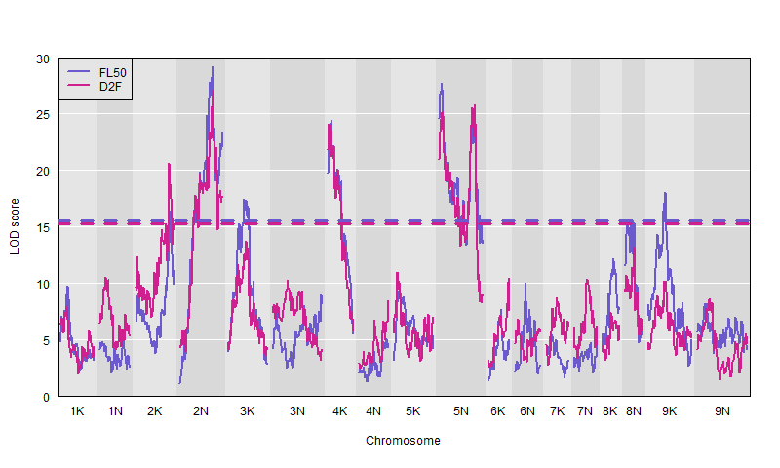
1. 4way phenology

Slide 4
1. 4way phenology
lodcolumn | chr | pos | lod | ci_lo | ci_hi | flank_lo | flank_hi
FL50 | 2K | 81.9047066 | 16.4578566 | 80.5437964 | 86.865107 | Chr02K_63.687871 | Chr02K_65.484856
FL50 | 2N | 78.7234996 | 29.1795949 | 70.3935394 | 80.7813049 | Chr02N_58.039498 | Chr02N_61.274395
FL50 | 3K | 39.4017978 | 17.4393757 | 37.2285477 | 49.9889913 | Chr03K_17.368264 | Chr03K_26.170048
FL50 | 4K | 8.8766183 | 24.4163406 | 1.3470216 | 9.964211 | Chr04K_2.280313 | Chr04K_5.499253
FL50 | 5N | 5.0372192 | 27.683124 | 0.1445308 | 9.3282408 | Chr05N_1.502713 | Chr05N_4.328965
FL50 | 5N | 84.7322801 | 24.4153452 | 76.5470331 | 87.9845479 | Chr05N_58.243942 | Chr05N_65.990782
FL50 | 8N | 17.3886695 | 15.6027282 | 2.7448619 | 22.8897186 | Chr08N_5.54356 | Chr08N_34.415808
FL50 | 9K | 41.5810369 | 18.0498319 | 37.9879471 | 44.4704567 | Chr09K_13.655791 | Chr09K_18.177373
D2F | 2K | 81.9047066 | 20.6489261 | 80.5437964 | 82.9410037 | Chr02K_63.687871 | Chr02K_64.419301
D2F | 2N | 78.7234996 | 27.0794048 | 76.3202164 | 80.7813049 | Chr02N_60.251689 | Chr02N_61.274395
D2F | 4K | 2.8842608 | 24.0755999 | 0.160073 | 9.964211 | Chr04K_1.959391 | Chr04K_5.499253
D2F | 5N | 7.8668229 | 25.1970605 | 1.6665841 | 9.3282408 | Chr05N_2.1318 | Chr05N_4.328965
D2F | 5N | 85.8462548 | 25.8464091 | 77.7184594 | 86.8593248 | Chr05N_58.916323 | Chr05N_65.255869
No significant QTLs for GR50

Slide 5
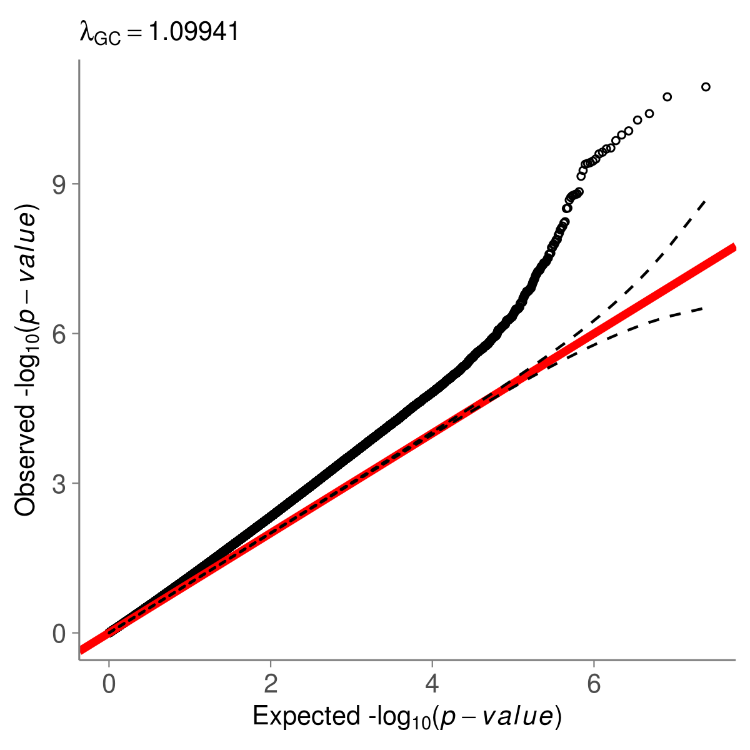
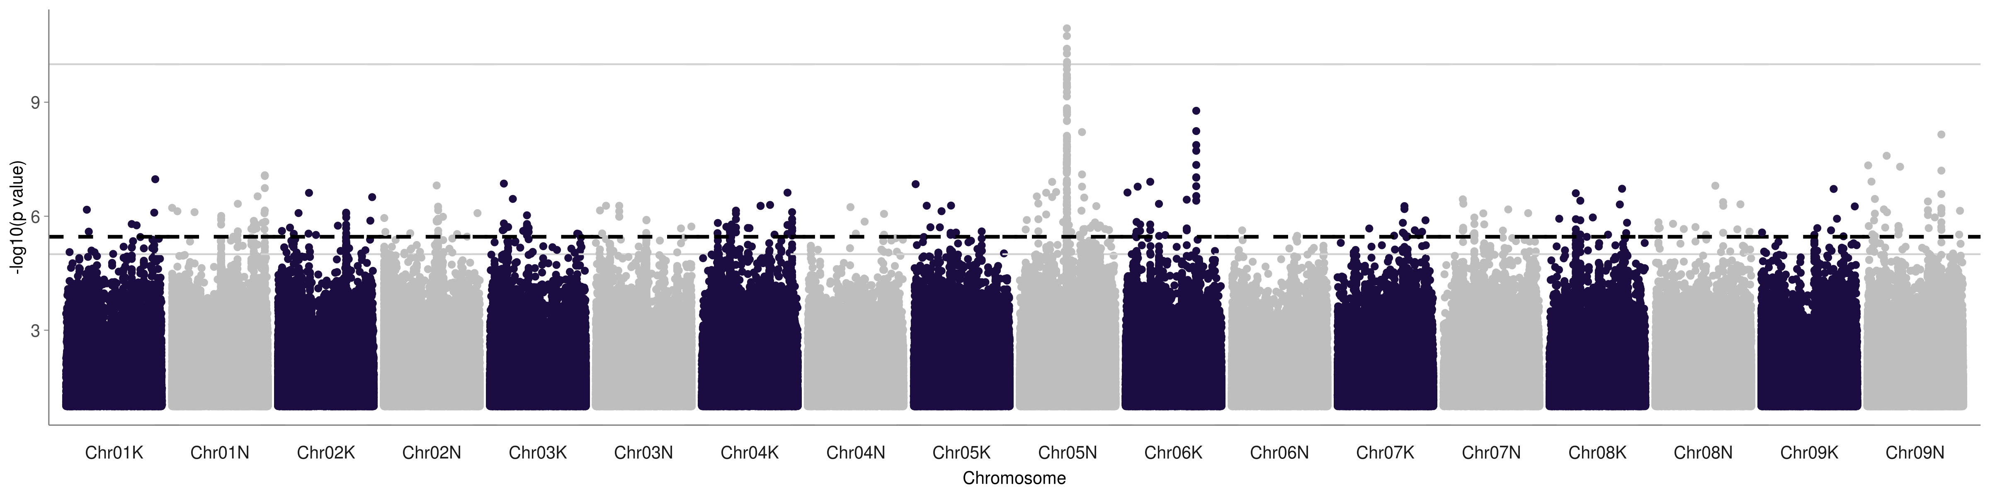
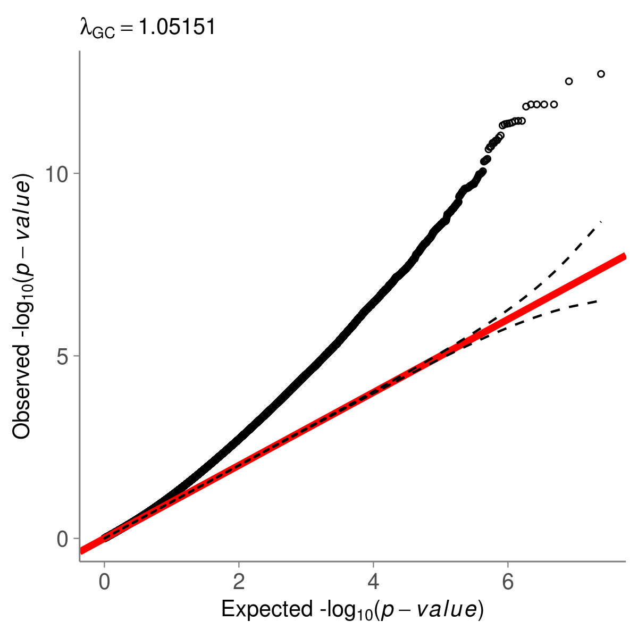
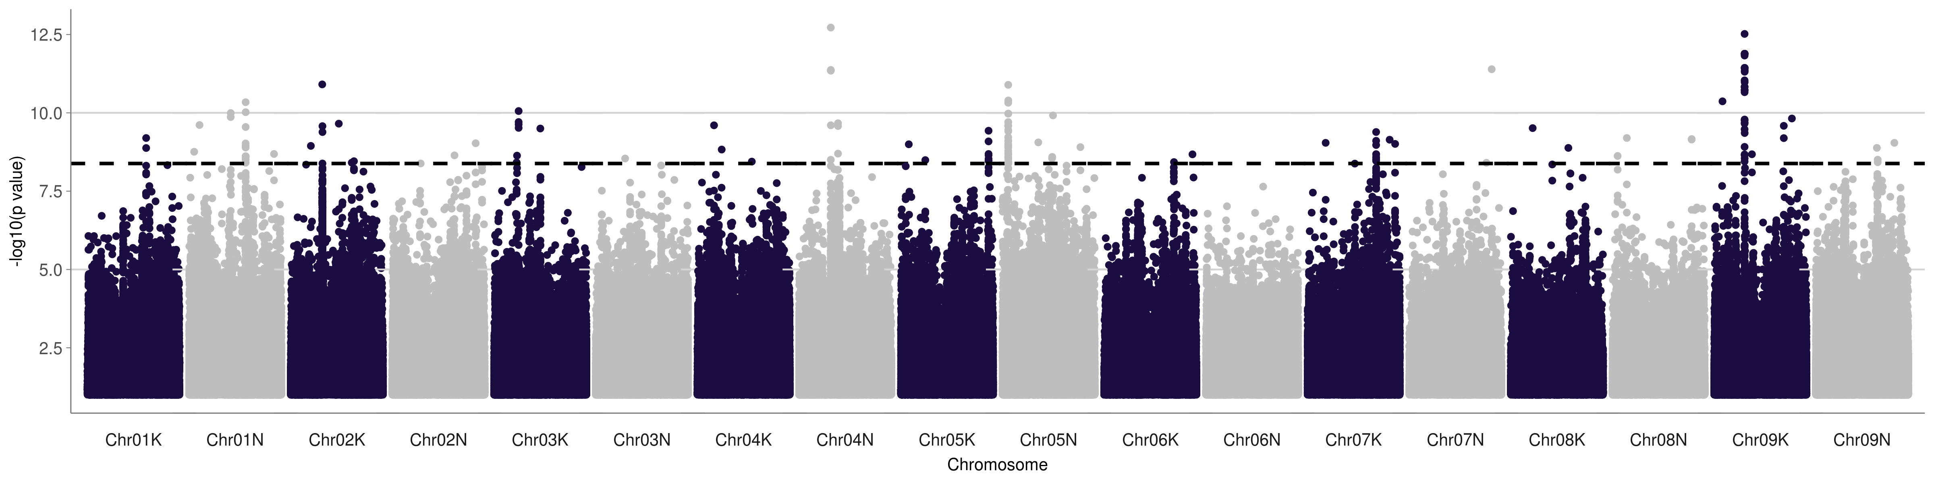
2. Univariate GWAS Phenology
CLMB
KBSM
Notes:
D2F at CLMB and KBSM. Leaving out all Atlantic individuals, so these associations have to be in either the Gulf or the Midwest population (thus, they’re more likely to be shared by the fourway).

Slide 6
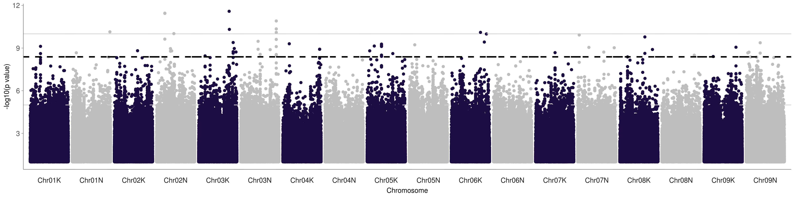
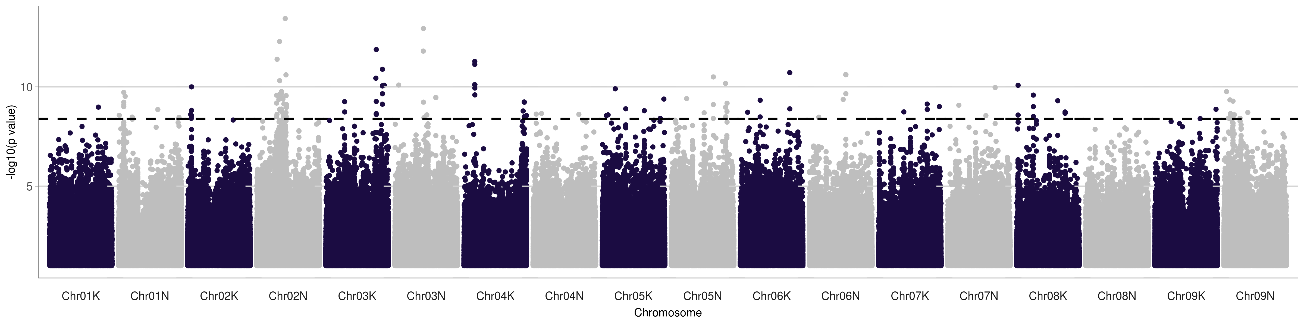
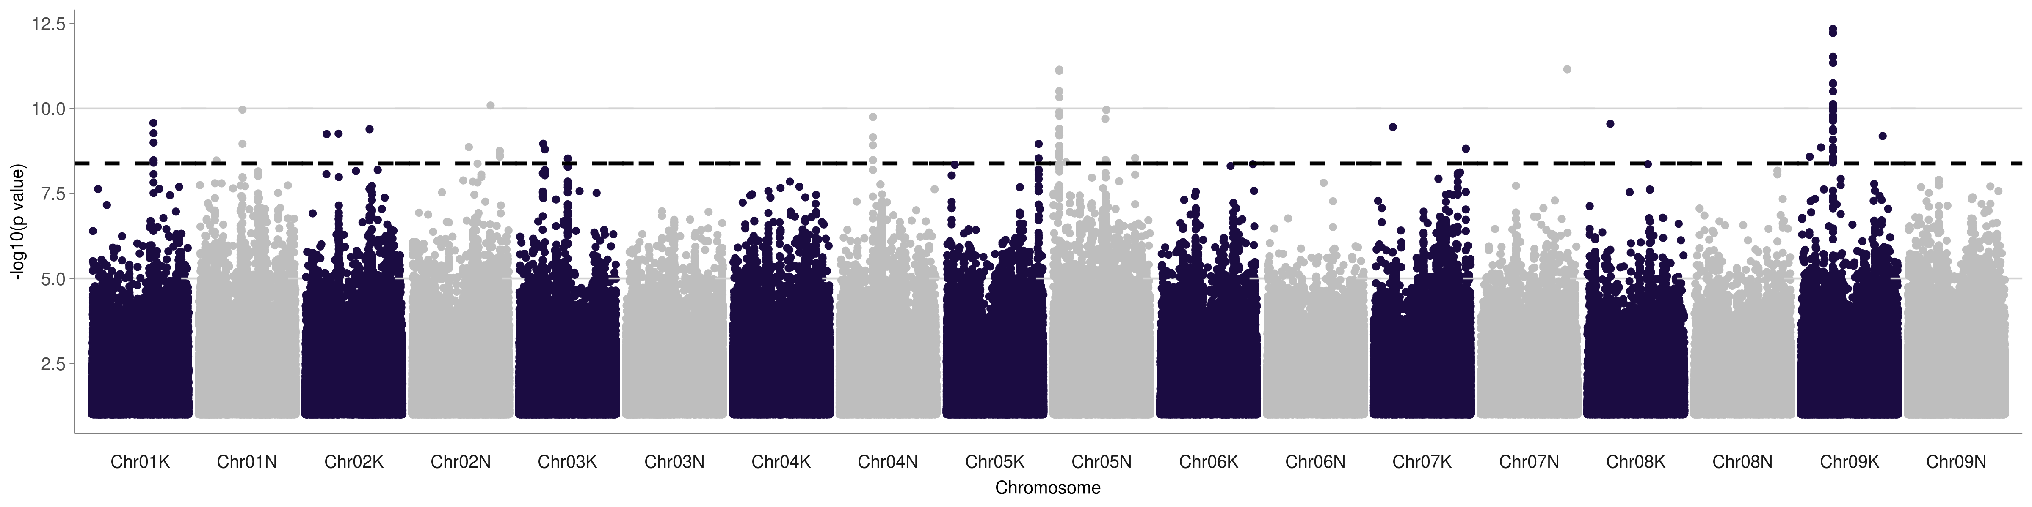
D2F and FL50 often have similar associations for GWAS, like they do for the fourway
PKLE D2F & FL50
KBSM D2F & FL50

Slide 7
3. Overlapped GWAS & Fourway regions
Hits in 100kb intervals in any subpop GWAS, including Atlantic
… and more but with fewer # sites in
univariate GWAS
Chromosome | Position (Mb) | N Sites with Sig. Association
Chr03K | 24.9 | 5
Chr04K | 3.7 | 5
Chr05N | 61.4 | 5
Chr05N | 65.9 | 5
Chr08N | 15.6 | 5
Chr08N | 17.7 | 5
Chr08N | 33.1 | 5
Hits in 100kb intervals in Midwest or Gulf subpops
Chromosome | Position (Mb) | N Sites with Sig. Association
Chr05N | 4.3 | 3
Chr05N | 59.1 | 5
Chr08N | 0.8 | 4
Chr08N | 15.6 | 3
Chr08N | 27.7 | 3
Notes:
There are associations for other 4way QTL too in the GWAS panel but for univariate GWAS these have significant associations at fewer sites
Overall there are many overlaps on Chr05N between the QTL and GWAS analyses for days to flowering (FL50 - GR50), and overlaps at single sites for Chr02K (TMPL) and Chr04K (KBSM).
Having issues with mash currently but planning on rerunning mash on D2F/FL50 for just the Midwest & Gulf subpop GWAS for the 7 fourway sites

Slide 8
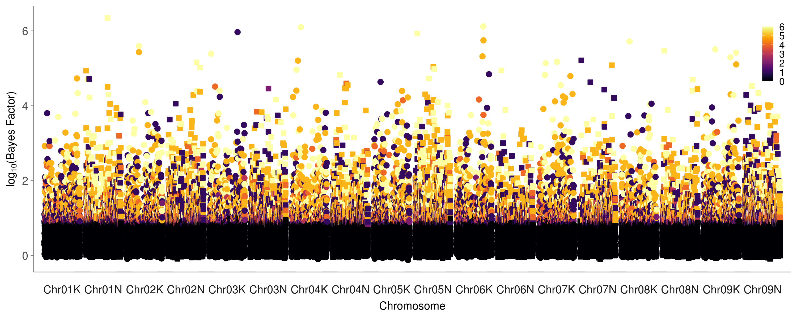
Mash D2F for Gulf & Midwest at six fourway sites

Slide 9
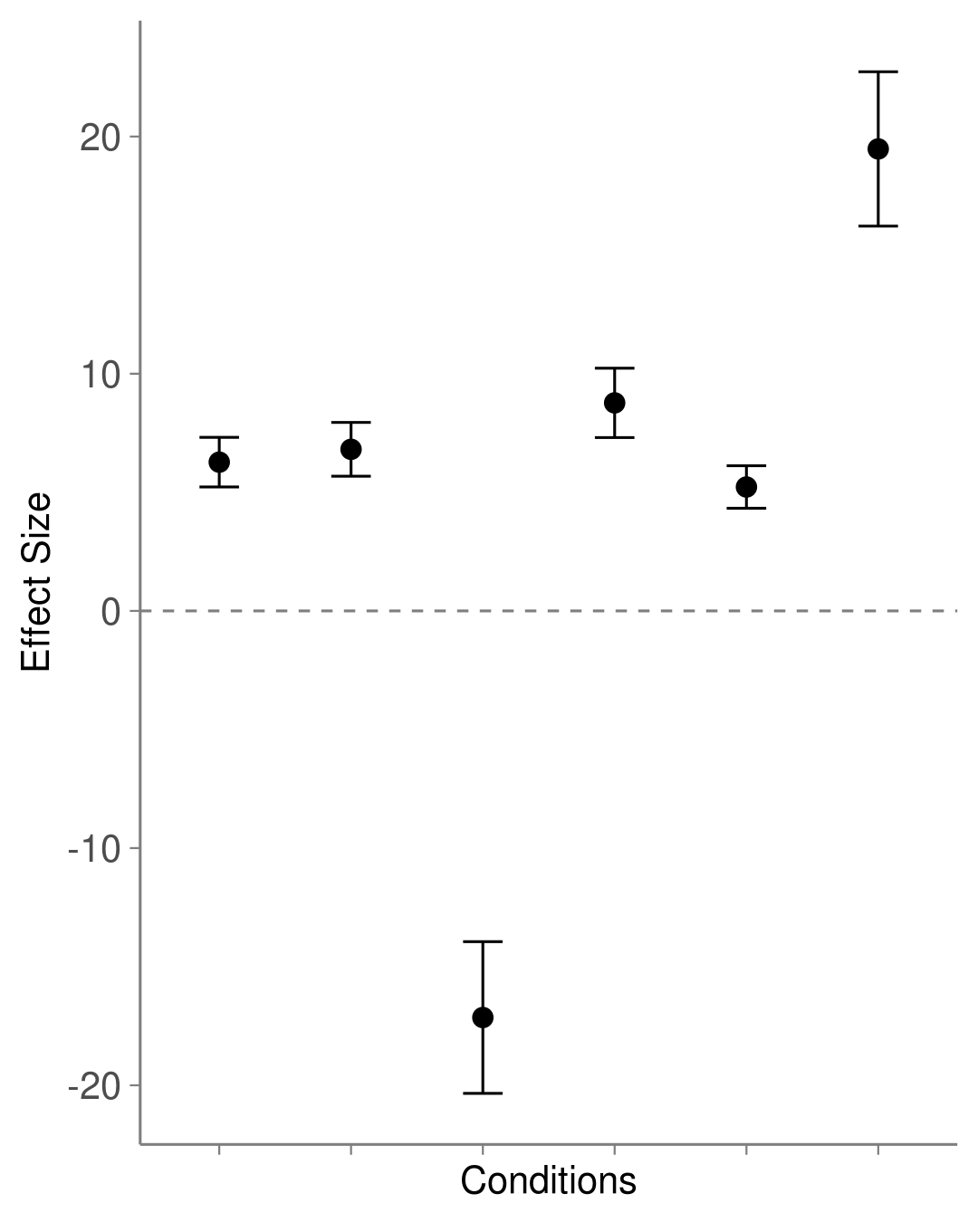
Top 10 Mash Hits
Chr06K 36.69 Mb
STIL
Chromosome | Position (Mb) | Near flanking markers for QTL?
Chr01N | 41.07 | No
Chr02K | 23.50 | No
Chr03K | 51.35 | No
Chr04K | 12.65 | Within 6Mb (top 25 within 3Mb)
Chr05N | 4.51 | Within 0.2Mb
Chr06K | 36.69 | No
Chr06K | 36.98 | No
Chr08K | 13.21 | No
Chr09K | 23.41 | Within 5Mb
Chr09N | 54.91 | No
KING
CLMB, KBSM, KING, LINC, PKLE, STIL
Effect size is in days
(effects are not scaled to -1,1 here)

Slide 10
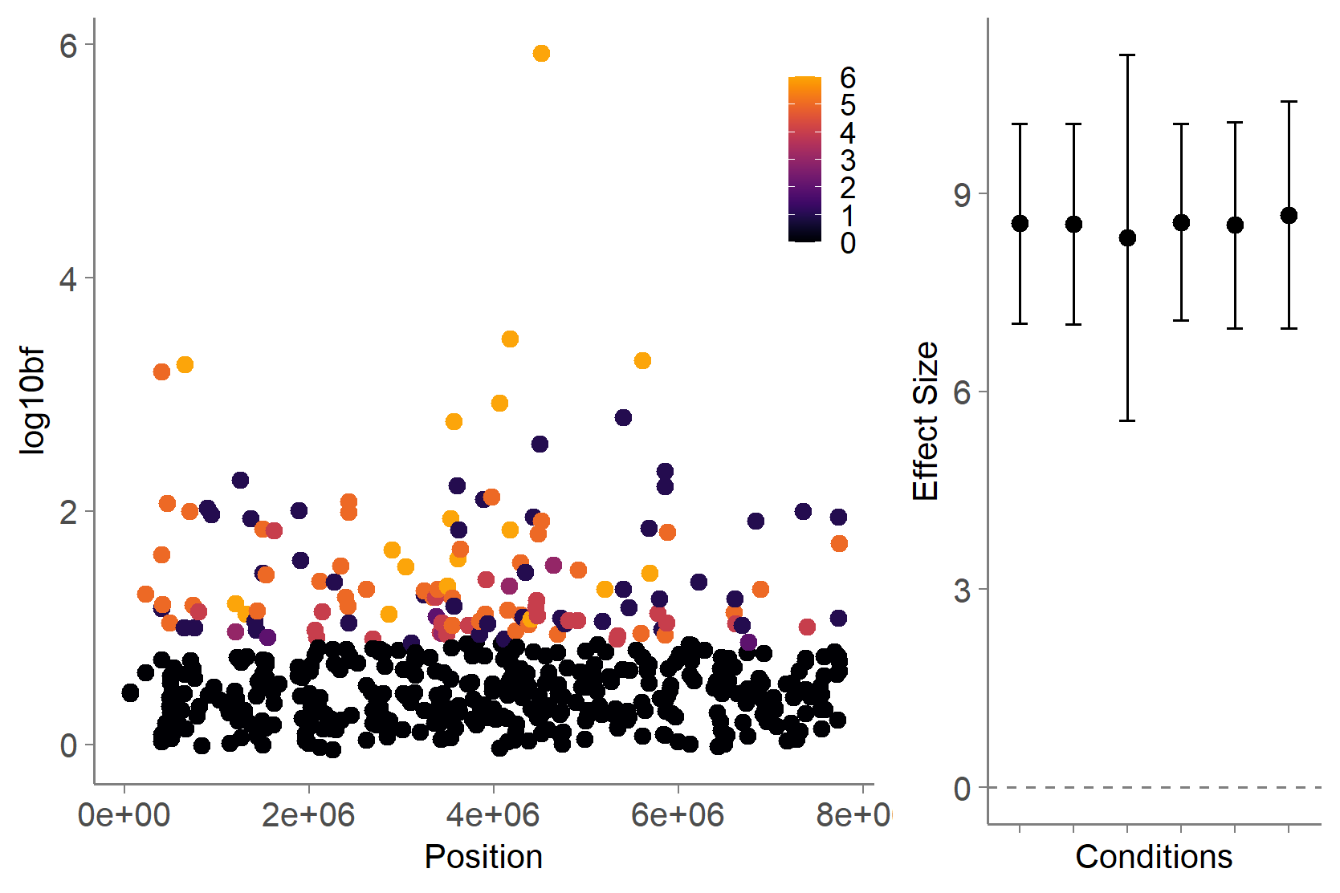
3. Overlapped candidate genes
Chr05N at 4.3 Mb (Pavir.5NG037100) Is significant in populations with Midwest plants and in univariate GWAS at TMPL, STIL, KING, and CLMB. The best candidate in this 100Kb region is Pavir.5NG037100, which is homologous to an Aurora kinase. In A. thaliana, highly expressed in the axis of inflorescence and in dividing cells. Plant Aurora kinases play a role in the maintenance of primary meristems and control of endoreduplication (Petrovska et al 2011 New Phytologist).
In top 10 mash hits
Chr05N 4.51Mb
QTL peak →
Notes:
For many of these hits I've been looking at, on many different chromosomes, not just these, I've been shocked by the number of hits that have very high gene expression in the axis of inflorescence (in Arabidopsis). I wonder if we have a similar meristem/axis of inflorescence expression dataset in switchgrass…

Slide 11
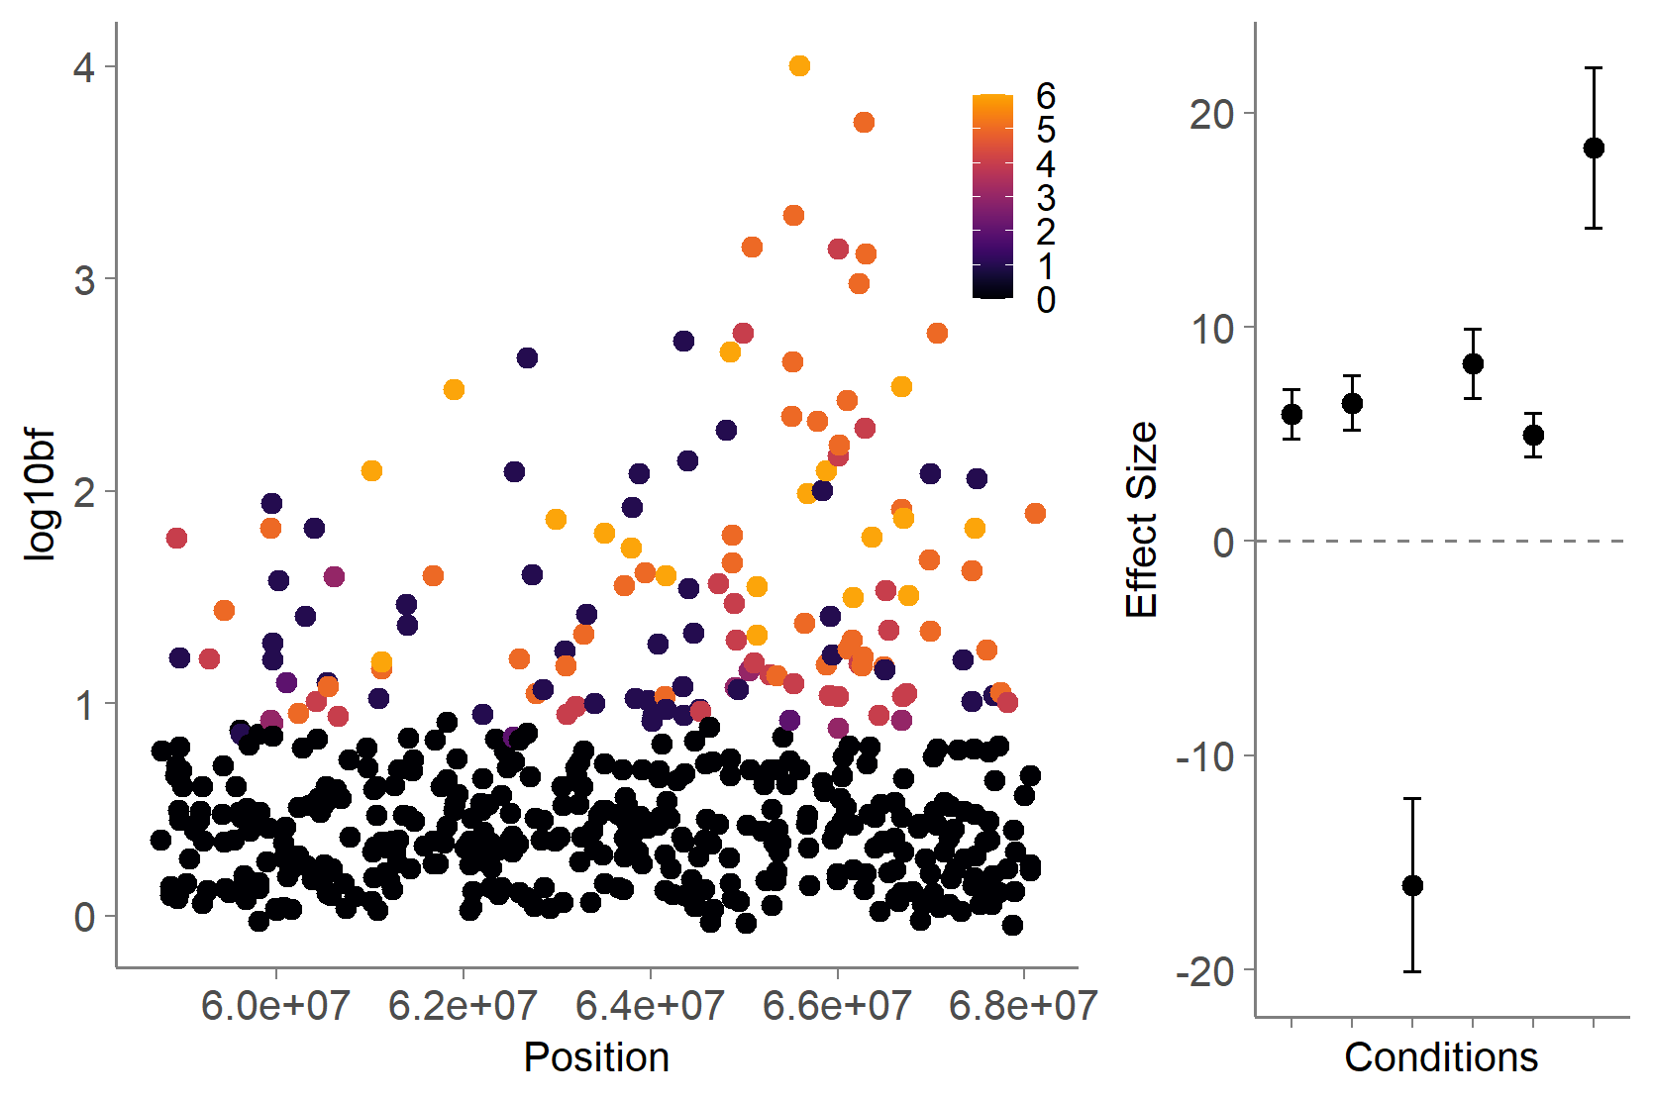
3. Overlapped candidate genes
In top 25 mash hits
Chr05N at 64.4 Mb (Pavir.5NG107400) is significant in GWAS of Gulf and Midwestern individuals in the diversity panel and has SNPs that fall within the gene at PKLE (28d effect) & CLMB (11d effect). Pavir.5NG107400 is homologous to ATCPL2, a carboxyl-terminal domain (CTD) phosphatase that regulates plant growth, stress, and auxin responses. In A. thaliana, mutants in CPL2 have early flowering, low fertility, and increased salt sensitivity. In this 100kb region of Chr05N, there are also associations in the top 500 SNPs by p-value for TMPL (13d effect size, 90kb away from this gene), LINC (-13d, 3kb), KING (34d, 61kb).
QTL peak
Chr05N 65.58 Mb
STIL
KING
Notes:
For many of these hits I've been looking at, on many different chromosomes, not just these, I've been shocked by the number of hits that have very high gene expression in the axis of inflorescence (in Arabidopsis). I wonder if we have a similar meristem/axis of inflorescence expression dataset in switchgrass…

Slide 12
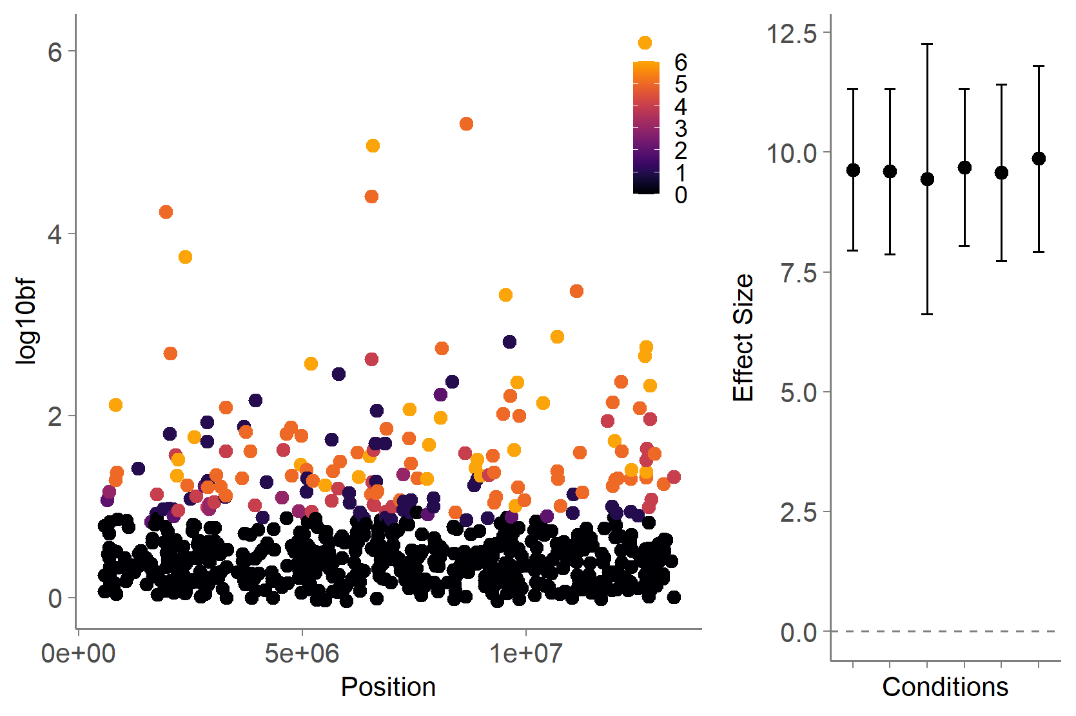
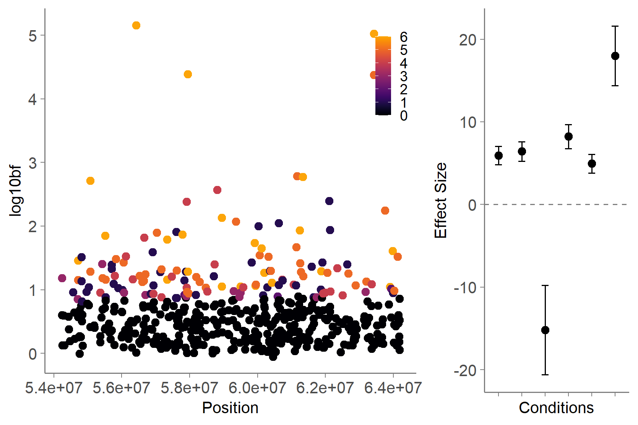
3. Overlapped candidate genes
Still want to look at Chr04K, Chr02N candidates
In top 10 mash hits
In top 25 mash hits
Chr04K 12.65 Mb
Chr02N 56.4Mb
QTL peak
Chr02N 56.4Mb
QTL peak →
Chr04K 6.5 Mb
Chr04K 1.9 Mb
Notes:
For many of these hits I've been looking at, on many different chromosomes, not just these, I've been shocked by the number of hits that have very high gene expression in the axis of inflorescence (in Arabidopsis). I wonder if we have a similar meristem/axis of inflorescence expression dataset in switchgrass…

Slide 13
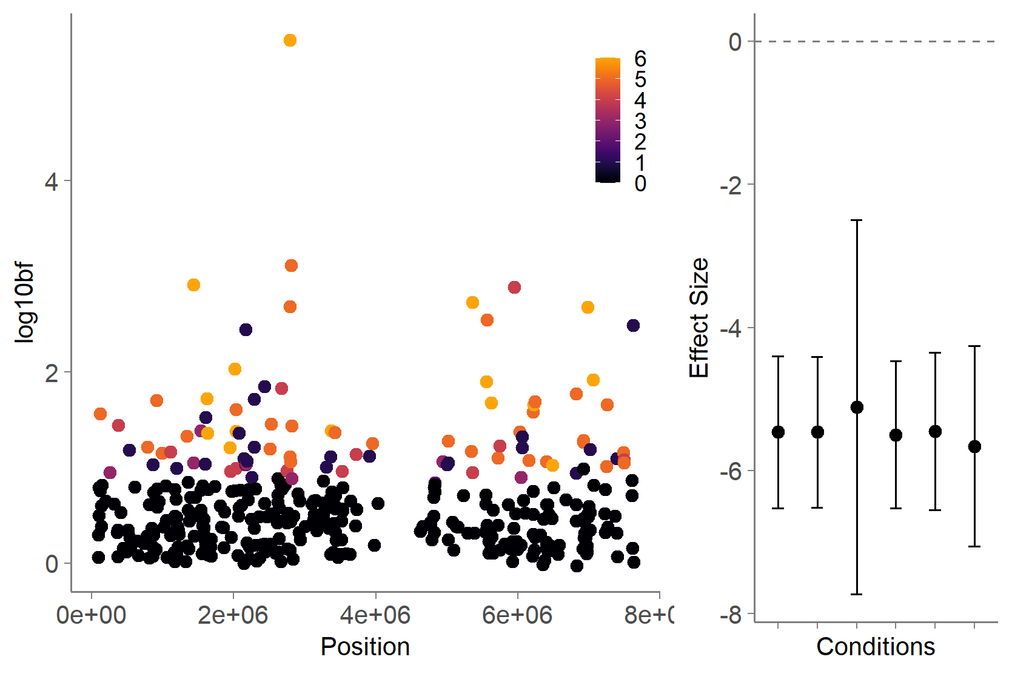
3. Overlapped candidate genes
Chr08N at 0.8Mb (Pavir.8NG002300) is significant in the Gulf or Midwest subpopulation, and affects flowering by 13 to 14 days at LINC, TMPL, STIL, and BRKG. There are four genes in this interval, the best candidate seems to be Pavir.8NG002300. Homologous to AT5G03610, which is highly expressed in axis of inflorescence, and a GDSL-motif esterase/acyltransferase/lipase, which is an enzyme group with broad substrate specificity that may catalyze acyltransfer or hydrolase reactions with lipid and non-lipid substrates.
Chr08N 2.79 Mb
In top 25 mash hits
Notes:
For many of these hits I've been looking at, on many different chromosomes, not just these, I've been shocked by the number of hits that have very high gene expression in the axis of inflorescence (in Arabidopsis). I wonder if we have a similar meristem/axis of inflorescence expression dataset in switchgrass…

Slide 14
4. Genomic Prediction of GXE_4way
BMTME (Bayesian multi-trait multi-environment) model:
trait: FL50, and D2F
environments: KING, PKLE, STIL, CLMB, KBSM, LINC, BRKG (7 Sites)

Slide 15
4. Genomic Prediction of GXE_4way

Slide 16
5. Genomic Prediction of GXE_GWAS
BMTME (Bayesian multi-trait multi-environment) model:
trait: FL50, and D2F
environments: Gulf: KING, PKLE, STIL, CLMB,
Midwest: CLMB, KBSM, LINC, BRKG

Slide 17
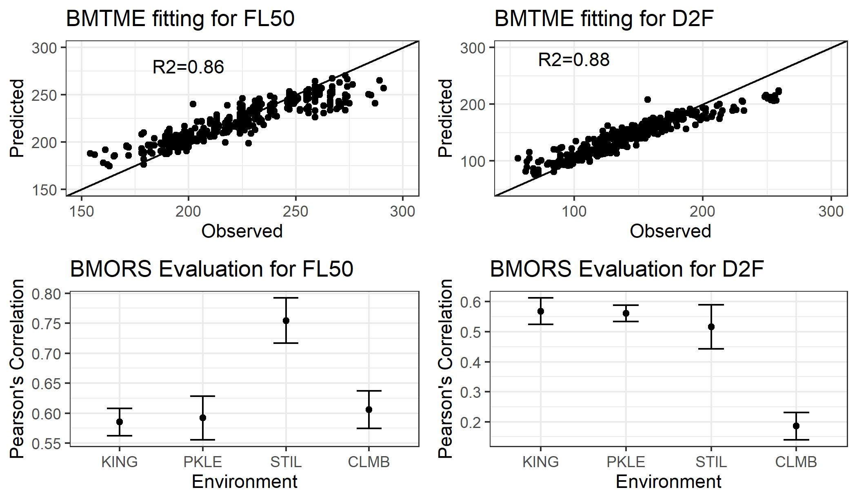
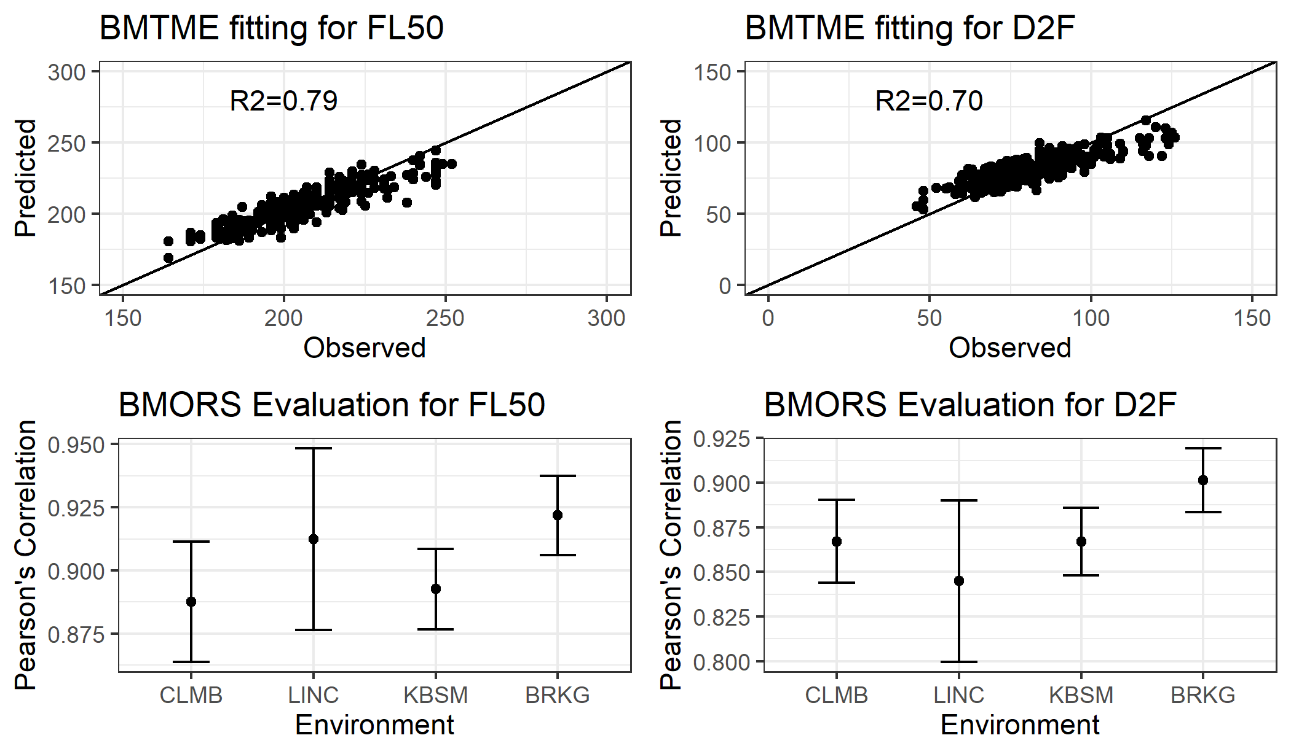
5. Genomic Prediction of GXE_GWAS
Gulf:
Midwest:

