Slide 1
Competitions & Datasets

Slide 2
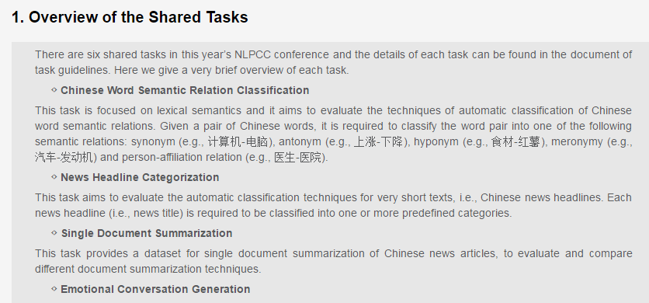
The Sixth Conference on Natural Language Processing and Chinese Computing (NLPCC 2017)
http://tcci.ccf.org.cn/conference/2017/cfpt.php
before April 30, 2017

Slide 3
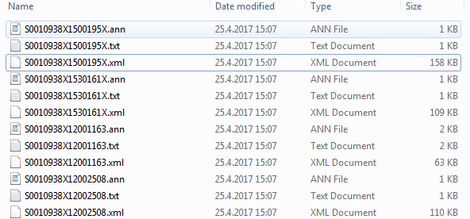
SemEval 2017 Task 10: Extracting Keyphrases and Relations from Scientific Publications
https://scienceie.github.io/example.html

Slide 4
Datasets overview
Children’s book test
predicting a blanked-out word of a sentence given the 20 previous sentences.
http://cs.rochester.edu/nlp/rocstories/

Slide 5
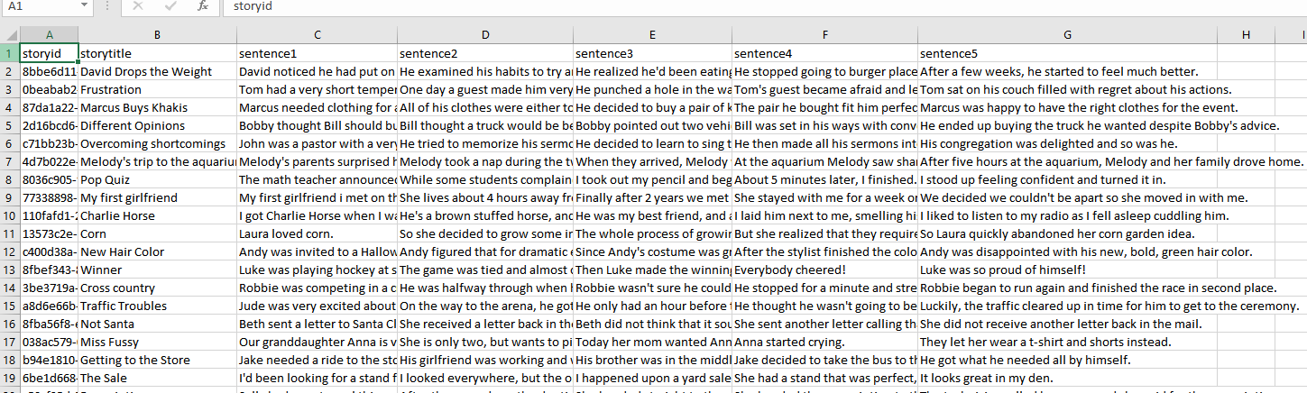

Slide 6
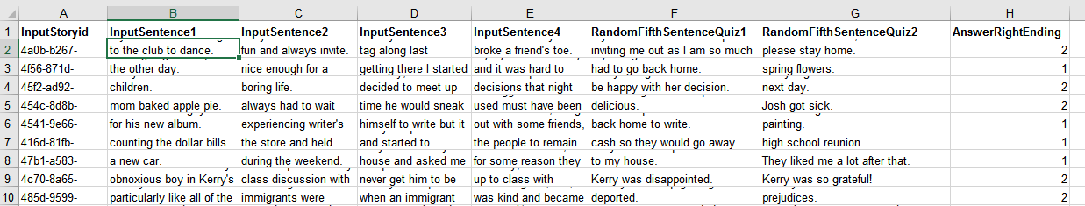
close_test

Slide 7
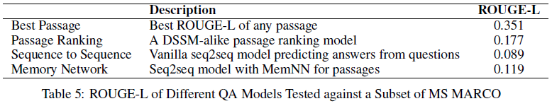
msmarco
http://www.msmarco.org/
The questions in the dataset are real anonymized queries issued through Bing or Cortana
the documents are related web pages which may or may not be enough to answer the question
every question in the dataset, we have asked a crowdsourced worker to answer it, if they can, and to mark relevant passages which provide supporting information for the answer. If they can’t answer it we consider the question unanswerable
Experiments
Use machine learning or deep learning, not only applying syntax and semantics

Slide 8
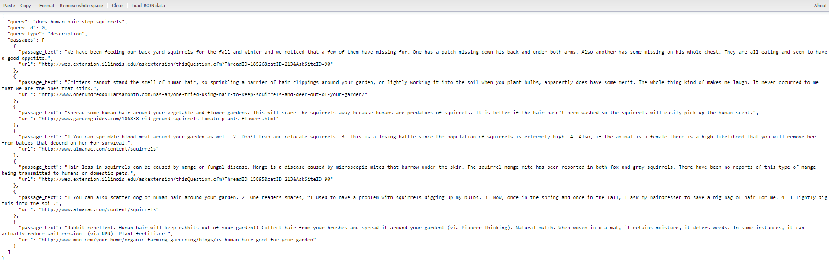

Slide 9
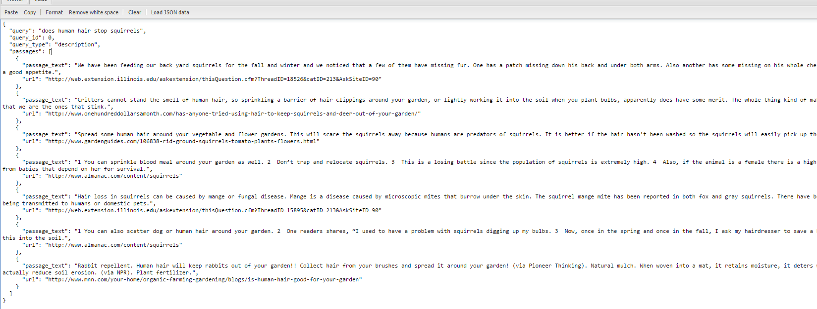
test

Slide 10
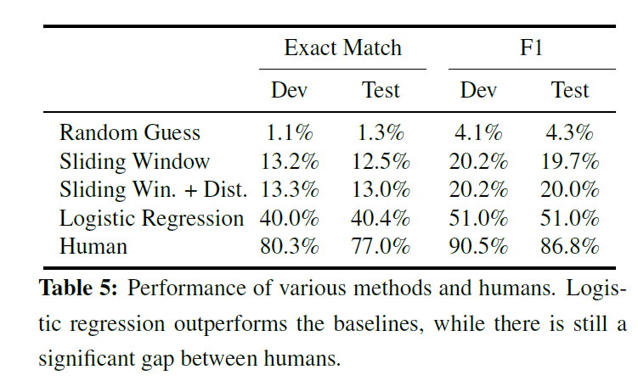
SquAD
Experiment method

Slide 11
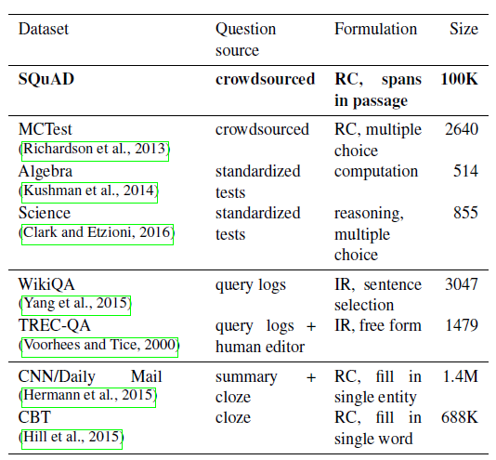

Slide 12
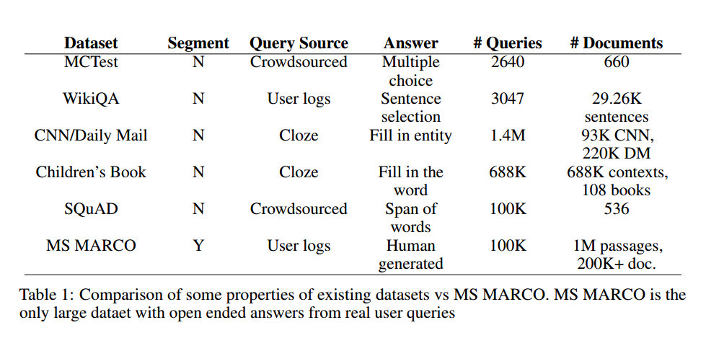

Slide 13
Teaching Machines to Read and Comprehend
Dataset
large scale supervised reading comprehension data
class of attention based deep neural networks, with minimal prior knowledge of language structure

