Slide 1
Machine Learning And Sentiment Analysis on Hotel reviews - Thesis idea presentation
Yi ZHOU (graduate)
Jryki & Kostas (Supervisors)

Slide 2
Content
Introduction to Natural Language Processing (NLP)
Machine Translation
Question & Answering
Speech recognition
…….
Introduction to Sentiment Analysis
Overview of my master thesis

Slide 3
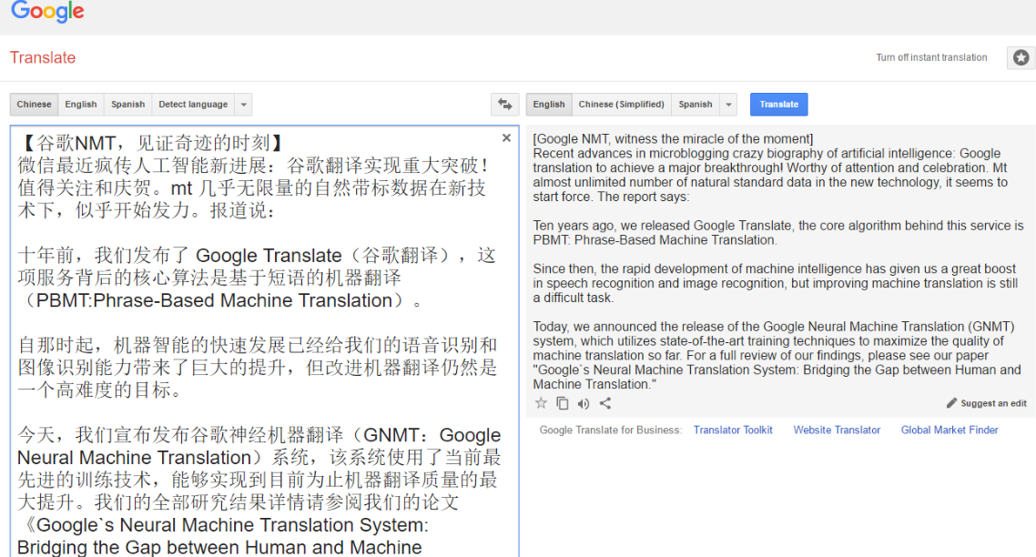
Machine Translation - NLP 1
translate text or speech from one language to another
Google translate, Microsoft Translator

Slide 4
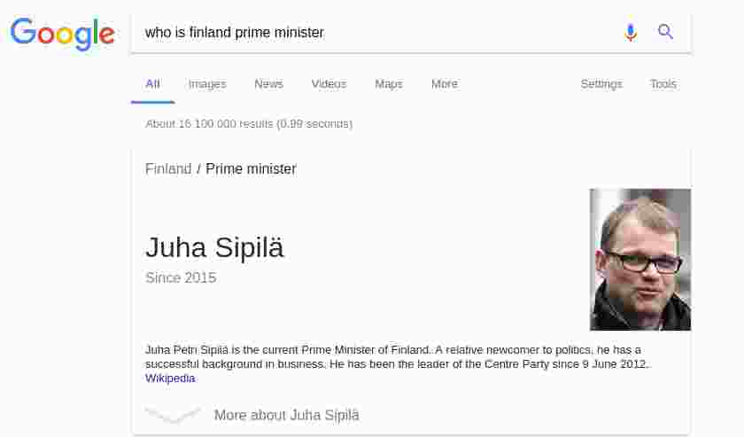
Question & Answering - NLP 2
building systems that automatically answer questions posed by humans in a natural language.

Slide 5

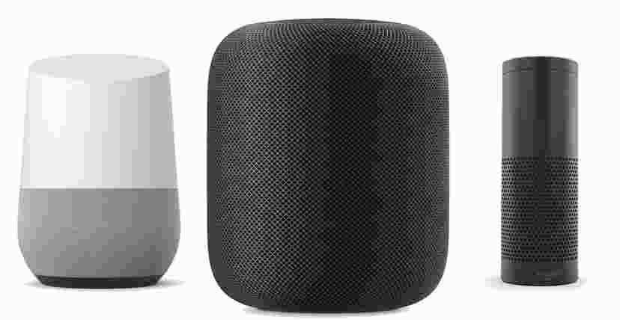
Speech recognition - NLP 3
recognize and translate spoken language into text
Amazon echo speaker & Google Home

Slide 6
Opinion Mining(Sentiment analysis)
Sentiment analysis is widely applied to voice of the customer materials such as reviews and survey responses, online and social media
“The strange thing is that it works”
“Shattered image isn’t complex, it’s just stupid and boring”
“Far from bewitching, the crucible tests the patience”

Slide 7
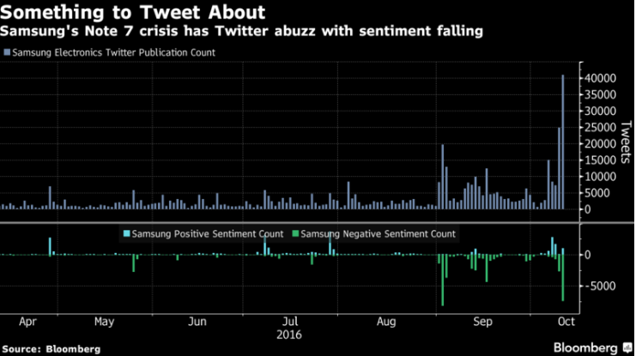
Twitter Sentiment And Stock Value
https://www.bloomberg.com/news/articles/2016-10-12/samsung-tweets-soared-sentiment-soured-amid-note-7-halt-chart

Slide 8
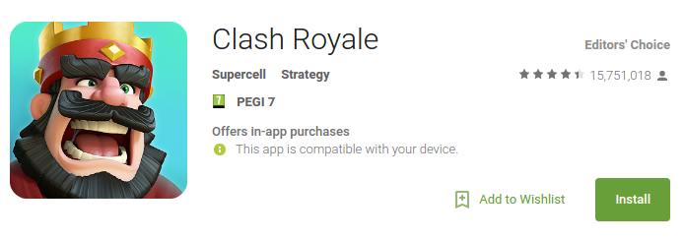
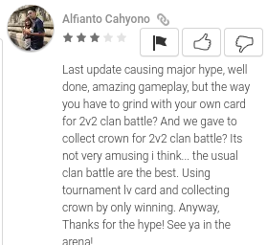
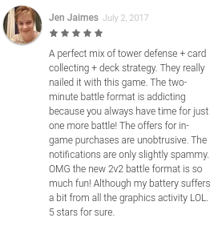
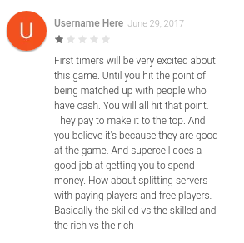
Analyzing App Popularity - Use case
https://play.google.com/store/apps/details?id=com.supercell.clashroyale&hl=en

Slide 9
Potential Use Cases
Prediction
Analyze market trends from Tweets/ Weibo or other news articles
Estimating movie success from reviews, blogs etc
Products
How do users like iOS update ? How do players think of apps updating ?
Politics
What do voters think about the a newly proposed policy ?

Slide 10
My master thesis
Agenda
Get hotel reviews data from Booking & tripadvisor
Apply NLP and Sentiment analysis on these reviews
Try to find some interesting results or combine methods to get high accuracy

Slide 11
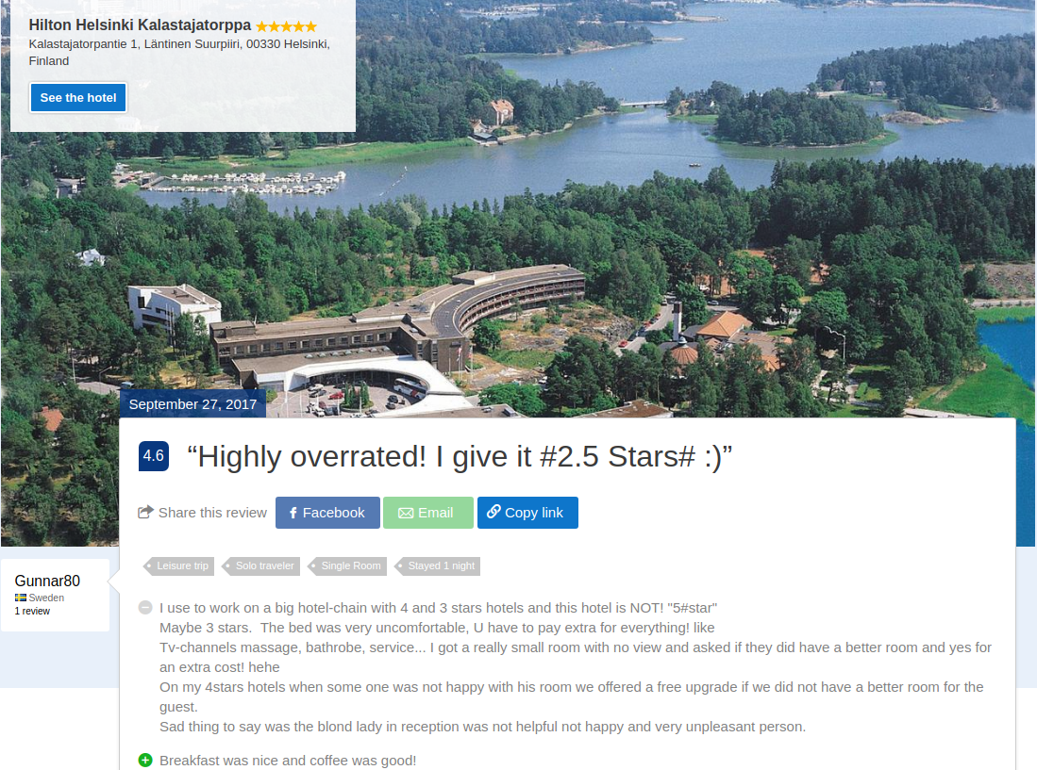
Booking.com - data sample
https://www.booking.com/reviews/fi/hotel/hilton-helsinki-kalastajatorppa/review/06442bde96176aa0.html?aid=304142;label=gen173nr-1FCAEoggJCAlhYSDNiBW5vcmVmaEiIAQGYATHCAQN4MTHIAQzYAQHoAQH4AQKSAgF5qAID;sid=397135e11a61b193e1ce926a2c22cc85

Slide 12
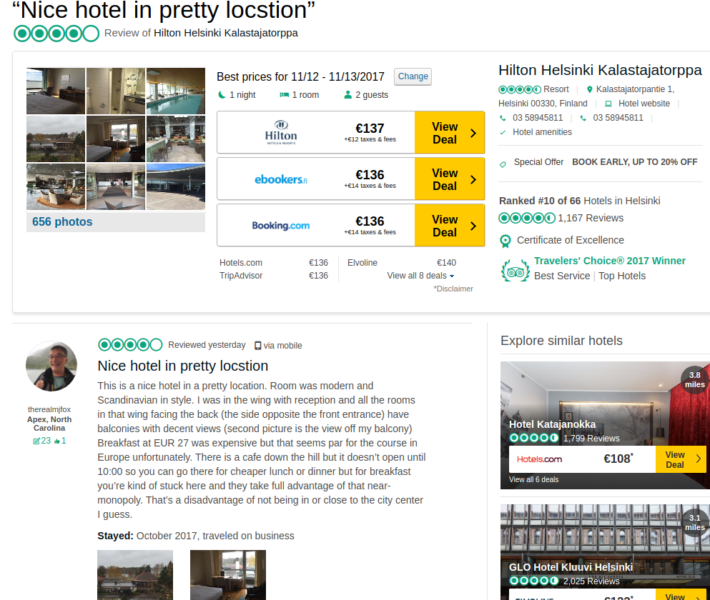
Tripadvisor - data sample
https://www.tripadvisor.com/ShowUserReviews-g189934-d228677-r537023114-Hilton_Helsinki_Kalastajatorppa-Helsinki_Uusimaa.html#CHECK_RATES_CONT

Slide 13
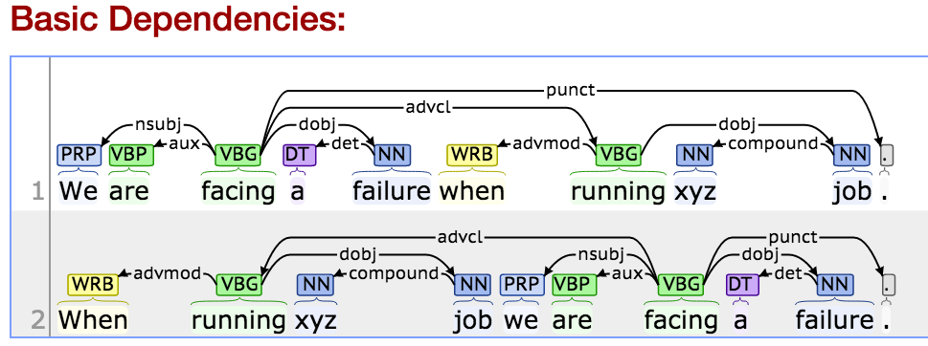
Dependency Parsing - NLP

Slide 14
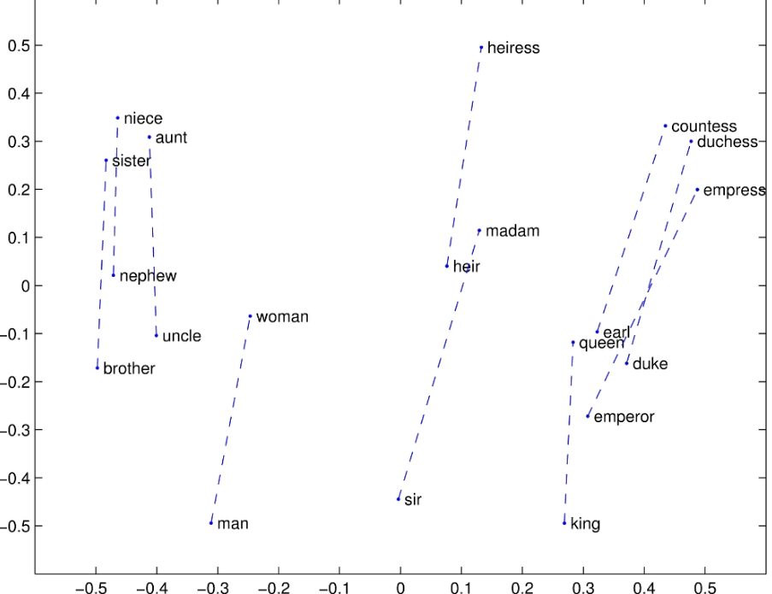
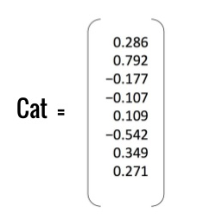
Word2vec(words -> vectors)

Slide 15
Questions ?

Slide 16
Thank you

