Slide 1


BANK LOAN
CASE STUDY
Final Project - 2

Slide 2


PROJECT DESCRIPTION
This project focuses on conducting Exploratory Data Analysis (EDA) on a dataset of loan applications to identify patterns that predict loan default. The objective is to help a finance company optimize its loan approval process by understanding the key factors influencing loan repayment ability.

Slide 3
APPROACH
Data Handling
Identify Missing Data: Use Excel functions (COUNT, ISBLANK, IF) to identify missing values in the dataset. Decide on imputation methods such as using AVERAGE or MEDIAN for numerical data or mode for categorical data.
Identify Outliers: Utilize Excel functions (QUARTILE, IQR) and conditional formatting to detect outliers in numerical variables. Apply business rules or thresholds to determine the validity of outliers.
Analyze Data Imbalance: Calculate class frequencies using COUNTIF and SUM to assess data imbalance between loan defaulters and non-defaulters.

Slide 4
APPROACH
Exploratory Data Analysis
Univariate Analysis: Using histograms, bar charts, and descriptive statistics (e.g., COUNT, AVERAGE, STDEV) to understand the distribution of individual variables such as loan amount, income, etc.
Segmented Univariate Analysis: Comparing variable distributions across different scenarios (e.g., defaulters vs. non-defaulters) using filters and pivot tables in Excel.
Bivariate Analysis: Exploring relationships between variables and the target variable (loan default) using scatter plots, correlation coefficients (CORREL), and pivot tables to understand which factors are correlated with loan default.
Identify Top Correlations: Segmenting the dataset by scenarios (e.g., payment difficulties vs. others) and calculate correlations to identify significant indicators of loan default.

Slide 5
A. IDENTIFY MISSING DATA AND DEAL WITH IT APPROPRIATELY

Slide 6
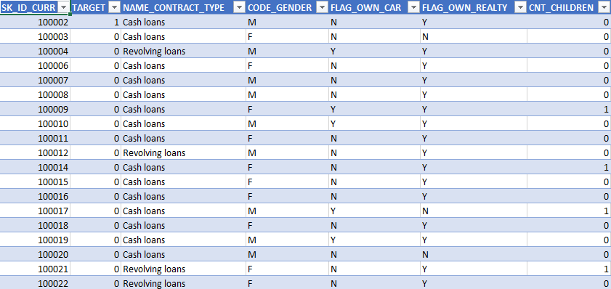
FIND NULL VALUES
Firstly, analyze the percentage of null values in each column. Drop columns that have more than 50% null data.
Using the formula:
=COUNTBLANK(A2:A5000)/COUNTA(A2:A5000)*100

Slide 7
REPLACE NULL VALUES
For columns with less than 50% null data, replace the null values with either the mean, median, or the most frequent categorical value.
Using the formula:
=IF(ISBLANK(A2), MEDIAN($A$2:$A$5000), A2)

Slide 8
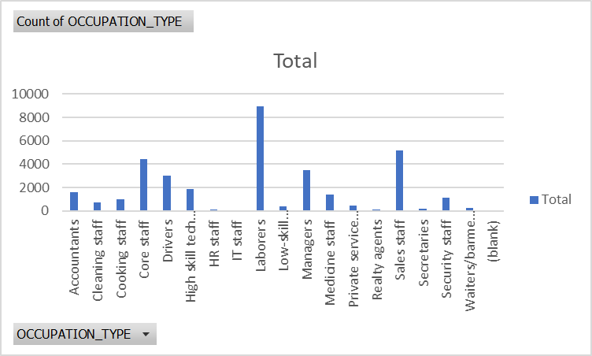
Replacing Blanks in Occupation_Type column of the Application Dataset with the highest occurring categorical variable
Highest occurring categorical variable is ‘Laborers’.

Slide 9
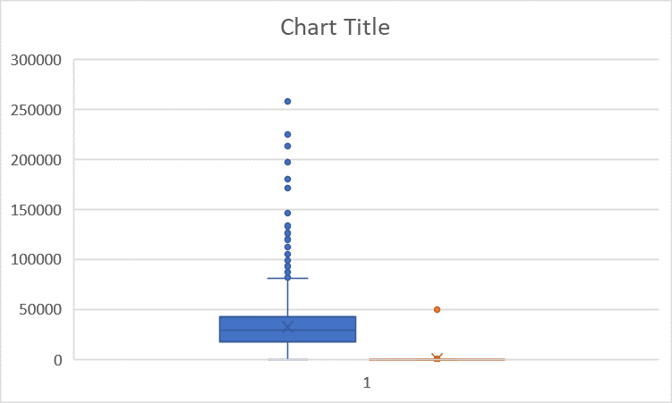
Replacing Blanks in AMT_ANNUTIY column of the Application Dataset with the median of the AMT_ANNUITY as there exists outliers in the AMT_ANNUITY column

Slide 10
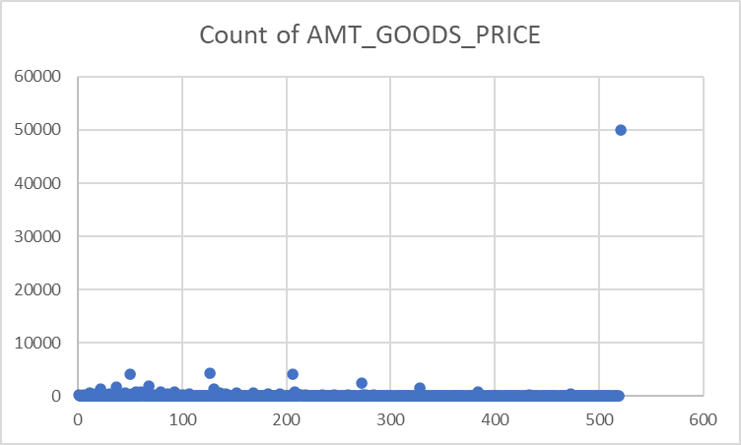
Replacing Blanks in AMT_ANNUTIY column of the Application Dataset with the median of the AMT_ANNUITY as there exists outliers in the AMT_ANNUITY column

Slide 11
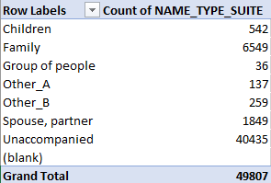
Replacing Blanks in Name_Type_Suite column of the Application Dataset with the highest occurring categorical variable

Slide 12
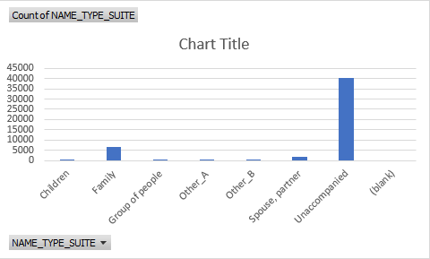
Replacing Blanks in Name_Type_Suite column of the Application Dataset with the highest occurring categorical variable
Highest occurring categorical variable is ‘Unaccompanied’

Slide 13
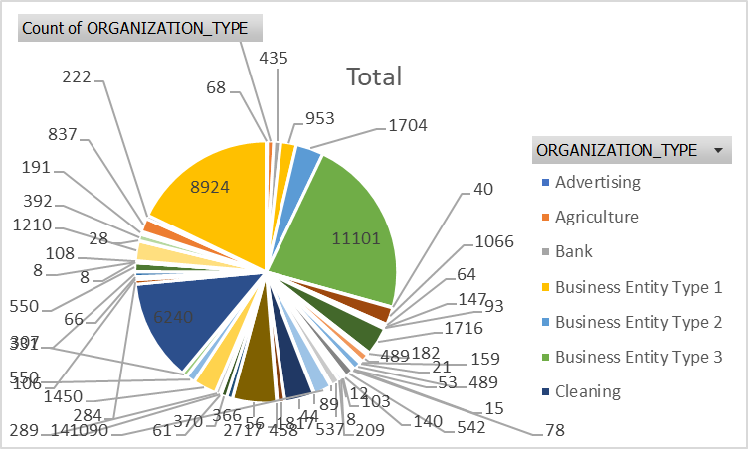
Replacing Blanks in Organization_type column of the Application Dataset with the highest occurring categorical variable
Highest occurring categorical variable is ‘Business Entity Type 3’

Slide 14
B. IDENTIFY OUTLIERS IN THE DATASET

Slide 15
First outlier is in AMT_ANNUITY which is greater than 250000 this outlier is replaced with 24903 median of AMT_ANNUITY

Slide 16
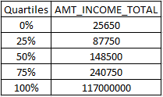
Here, a significant gap is noticeable between the 25%, 50%, and 75% quartiles, primarily because of outliers. However, given the varying total income amounts among individuals, we opt not to eliminate the outliers.
Formula used:=QUARTILE(A4:A800, 1)

Slide 17
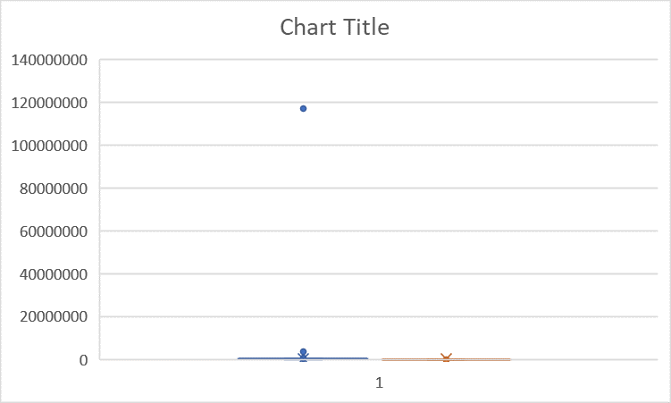
Graph:

Slide 18
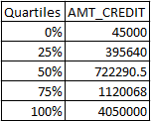
The chart shows outliers near the 98th percentile and close to the maximum in the box plot, causing a gap between the 75th percentile and the maximum due to the outliers. The outliers persist despite varying credit amounts.

Slide 19
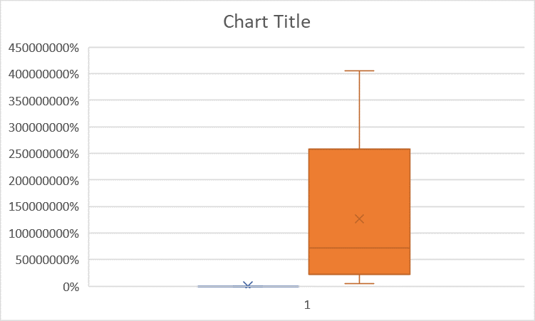

Slide 20
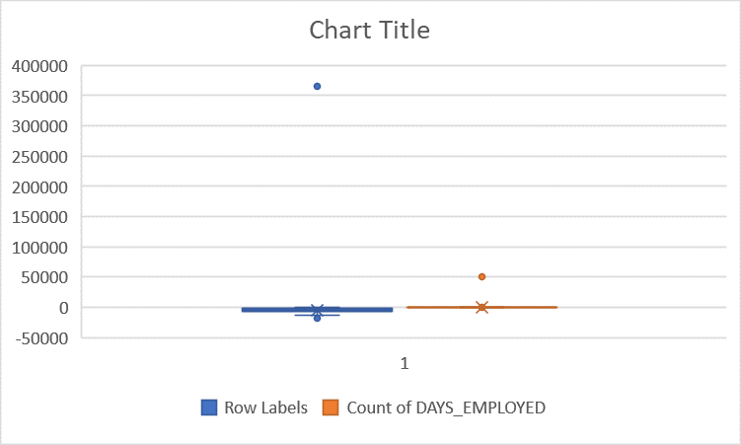
DAYS_EMPLOYED Outliers

Slide 21
C. ANALYZE DATA IMBALANCE

Slide 22
TARGET VARIABLE
The Target Variable Pie chart shows that almost 92% of the total clients had no problem during payment while 8% of the clients had some or the other problem.
Row Labels | Count of TARGET
0 | 45973
1 | 4026
Grand Total | 49999

Slide 23
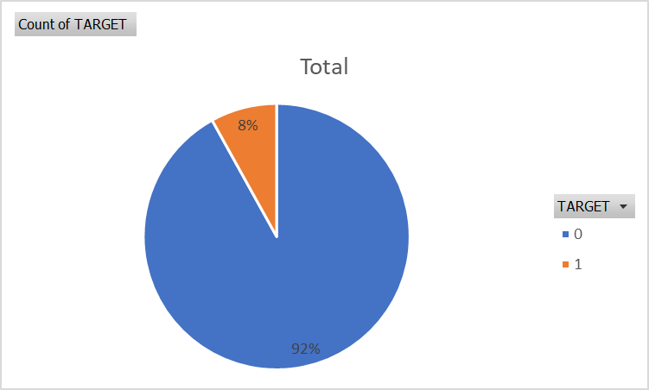
TARGET VARIABLE

Slide 24
GENDER VARIABLE
From the GENDER_VARIABLE pie chart we can infer that almost 66% of
the clients are female and 34% of the clients are Male. The 4 of the applicants have gender as XNA which can be ignored.
Row Labels | Count of CODE_GENDER
F | 32823
M | 17174
XNA | 2
Grand Total | 49999

Slide 25
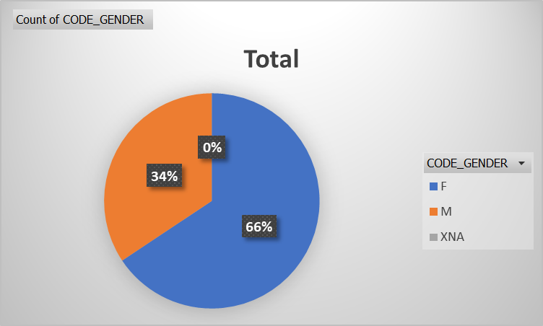
GENDER VARIABLE

Slide 26
NAME_HOUSING_TYPE
Row Labels | Count of NAME_HOUSING_TYPE
Co-op apartment | 191
House / apartment | 44368
Municipal apartment | 1845
Office apartment | 427
Rented apartment | 769
With parents | 2399
Grand Total | 49999

Slide 27
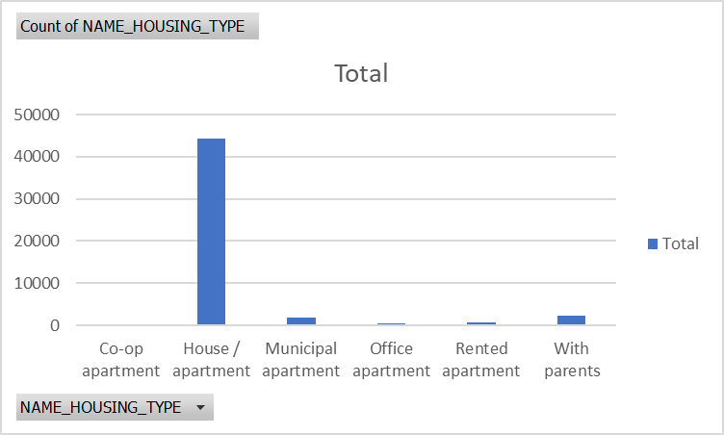
NAME_HOUSING_TYPE

Slide 28
NAME_HOUSING_TYPE AS PERCENTAGE
From the bar graphs of count and percentage: The bank can target those groups who do not have their own apartment i.e. the bank may consider the people living in Co op apartment, Municipal Apartment,
Rented Apartment and people living with their parents.
Row Labels | NAME_HOUSING_TYPE
Co-op apartment | 0.38%
House / apartment | 88.74%
Municipal apartment | 3.69%
Office apartment | 0.85%
Rented apartment | 1.54%
With parents | 4.80%
Grand Total | 100.00%

Slide 29
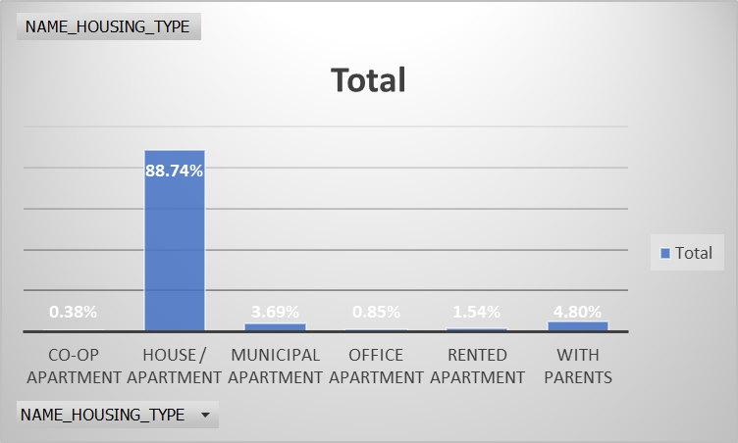
NAME_HOUSING_TYPE AS PERCENTAGE

Slide 30
D. PERFORM UNIVARIATE, SEGMENTED UNIVARIATE, AND BIVARIATE ANALYSIS

Slide 31
Univariate Analysis
AGE GROUP
From the bar plot on next page, we can infer that most of the applicants belong to the Age Group ’31 40’.
Row Labels | Count
20-30 | 1551
31-40 | 2671
41-50 | 2543
51-60 | 2193
61-70 | 1040
Grand Total | 9998

Slide 32
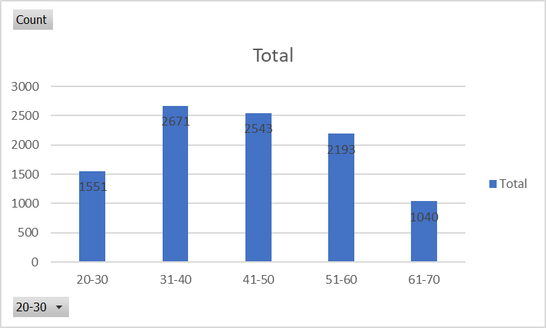
Univariate Analysis
AGE GROUP

Slide 33
Univariate Analysis
OCCUPATION_TYPE
Row Labels | Count of OCCUPATION_TYPE
Accountants | 1621
Cleaning staff | 739
Cooking staff | 963
Core staff | 4434
Drivers | 3044
High skill tech staff | 1852
HR staff | 101
IT staff | 80
Laborers | 8952
Low-skill Laborers | 357
Managers | 3489
Medicine staff | 1403
Private service staff | 447
Realty agents | 123
Sales staff | 5160
Secretaries | 212
Security staff | 1140
Waiters/barmen staff | 228
(blank)
Grand Total | 34345

Slide 34
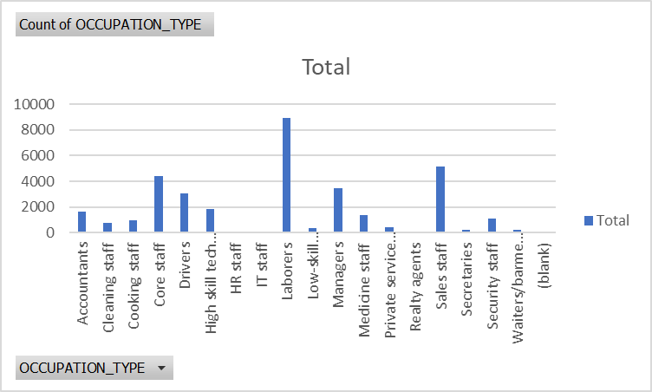
Univariate Analysis
OCCUPATION_TYPE
From the bar plot we can infer that clients with occupation_type ‘Laborers’ have the highest number of count when it comes to clients with no payment issues.

Slide 35
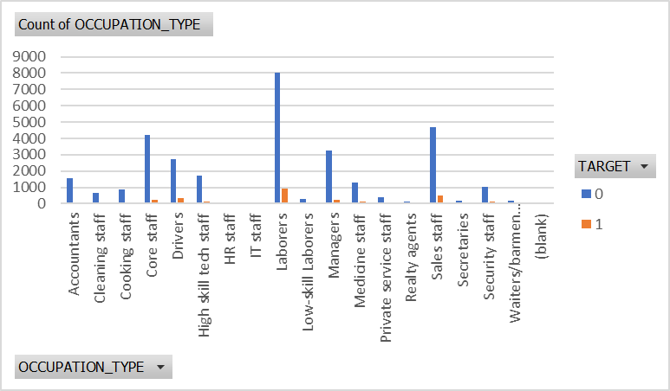
Univariate Analysis
OCCUPATION_TYPE

Slide 36
Univariate Analysis
NAME_INCOME_TYPE
From the bar plot we see that clients having income_type as ‘WORKING’ have the highest count when it comes to clients with payment issues.
Count of NAME_INCOME_TYPE | Column Labels
Row Labels | 0 | 1 | Grand Total
Businessman | 2 |  | 2
Commercial associate | 10679 | 864 | 11543
Maternity leave | 1 |  | 1
Pensioner | 8419 | 501 | 8920
State servant | 3314 | 198 | 3512
Student | 5 |  | 5
Unemployed | 4 | 2 | 6
Working | 23549 | 2461 | 26010
Grand Total | 45973 | 4026 | 49999

Slide 37
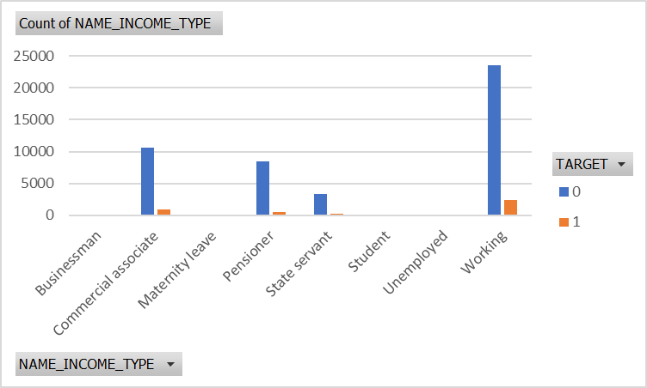
Univariate Analysis
NAME_INCOME_TYPE

Slide 38
Univariate Analysis
CNT_FAMILY_MEMBERS
In the bar plot, clients with 2 family members have the highest count of payment issues.
Count of CNT_FAM_MEMBERS | Column Labels
Row Labels | 0 | 1 | Grand Total
1 | 9951 | 922 | 10873
2 | 23901 | 1906 | 25807
3 | 7858 | 777 | 8635
4 | 3651 | 349 | 4000
5 | 538 | 54 | 592
6 | 55 | 13 | 68
7 | 9 | 3 | 12
8 | 6 |  | 6
9 | 2 |  | 2
10 | 1 | 1 | 2
13 |  | 1 | 1
(blank)
Grand Total | 45972 | 4026 | 49998

Slide 39
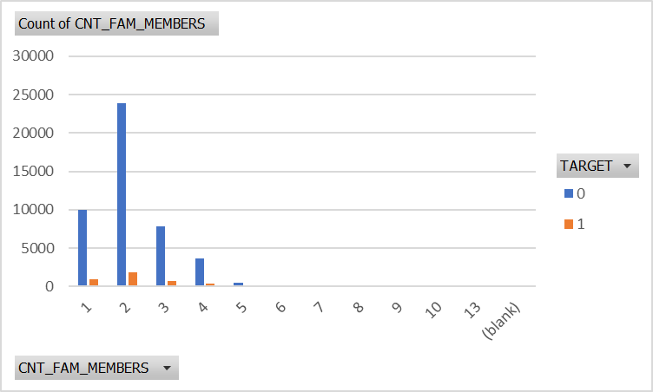
Univariate Analysis
CNT_FAMILY_MEMBERS

Slide 40
Univariate Analysis
CODE_GENDER
From the bar plot we can infer that Clients with CODE_GENDER = ‘F’ have the highest number of non defaulters.
Count of CODE_GENDER | Column Labels
Row Labels | 0 | 1 | Grand Total
F | 30559 | 2264 | 32823
M | 15412 | 1762 | 17174
XNA | 2 |  | 2
Grand Total | 45973 | 4026 | 49999

Slide 41
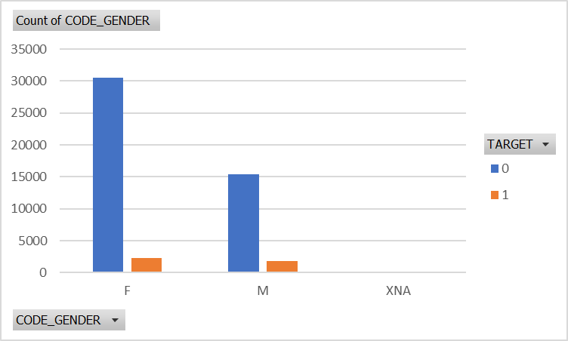
Univariate Analysis
CODE_GENDER

Slide 42
Univariate Analysis
NAME_INCOME_TYPE
The bar plot indicates that clients with the 'WORKING' income type have the highest count of non-defaulters.
Count of NAME_INCOME_TYPE | Column Labels
Row Labels | 0 | 1 | Grand Total
Businessman | 2 |  | 2
Commercial associate | 10679 | 864 | 11543
Maternity leave | 1 |  | 1
Pensioner | 8419 | 501 | 8920
State servant | 3314 | 198 | 3512
Student | 5 |  | 5
Unemployed | 4 | 2 | 6
Working | 23549 | 2461 | 26010
Grand Total | 45973 | 4026 | 49999

Slide 43

Univariate Analysis
NAME_INCOME_TYPE

Slide 44
Univariate Analysis
OCCUPATION_TYPE
Count of OCCUPATION_TYPE | Column Labels
Row Labels | 0 | 1 | Grand Total
Accountants | 1540 | 81 | 1621
Cleaning staff | 671 | 68 | 739
Cooking staff | 862 | 101 | 963
Core staff | 4184 | 250 | 4434
Drivers | 2706 | 338 | 3044
High skill tech staff | 1734 | 118 | 1852
HR staff | 92 | 9 | 101
IT staff | 76 | 4 | 80
Laborers | 8032 | 920 | 8952
Low-skill Laborers | 296 | 61 | 357
Managers | 3246 | 243 | 3489
Medicine staff | 1297 | 106 | 1403
Private service staff | 410 | 37 | 447
Realty agents | 110 | 13 | 123
Sales staff | 4668 | 492 | 5160
Secretaries | 203 | 9 | 212
Security staff | 1015 | 125 | 1140
Waiters/barmen staff | 203 | 25 | 228
(blank)
Grand Total | 31345 | 3000 | 34345

Slide 45
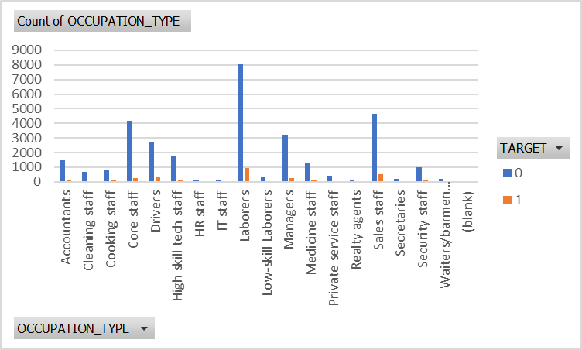
Univariate Analysis
OCCUPATION_TYPE

Slide 46
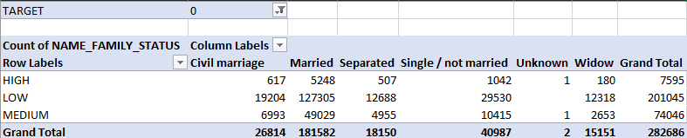
Bivariate Analysis
Target 0: Total Income vs Family status
In the bar plot, clients with low total income and married family status have the highest count of no payment issues.

Slide 47
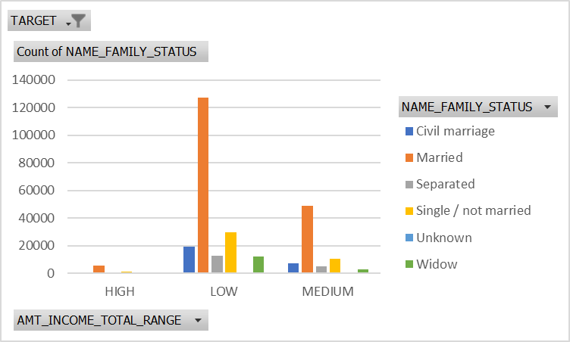
Bivariate Analysis
Target 0: Total Income vs Family status

Slide 48
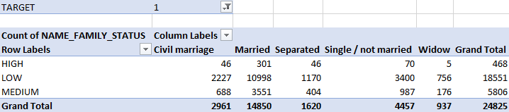
Bivariate Analysis
Target 1: Total Income vs Family status
Clients with low total income and a married family status have the highest count of payment issues, as shown in the adjacent bar plot.

Slide 49
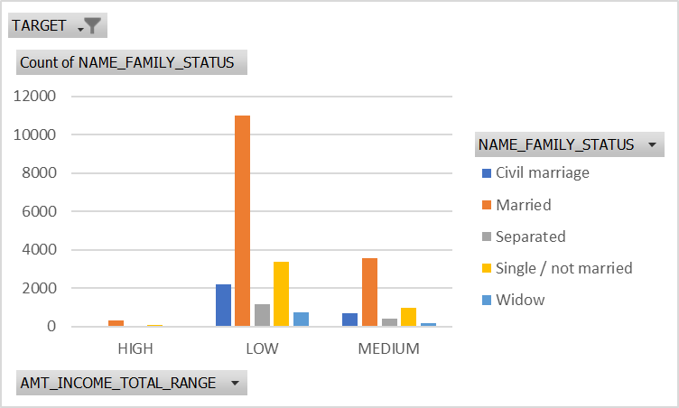
Bivariate Analysis
Target 1: Total Income vs Family status

Slide 50
E. IDENTIFY TOP CORRELATIONS FOR DIFFERENT SCENARIOS

Slide 51
DATA PREPROCESSING
The columns listed below from the previous application datasets should be removed as they are not necessary for data analysis:
HOUR_APPR_PROCESS_START
WEEKDAY_APPR_PROCESS_START_PREV
FLAG_LAST_APPL_PER_CONTRACT
NFLAG_LAST_APPL_IN_DAY
SK_ID_CURR
WEEKDAY_APPR_PROCESS_START

Slide 52
NAME_TYPE_SUITE
Row Labels | Count of NAME_TYPE_SUITE
Children | 993
Family | 6581
Group of people | 76
Other_A | 262
Other_B | 551
Spouse, partner | 2098
Unaccompanied | 15195
(blank)
Grand Total | 25756

Slide 53
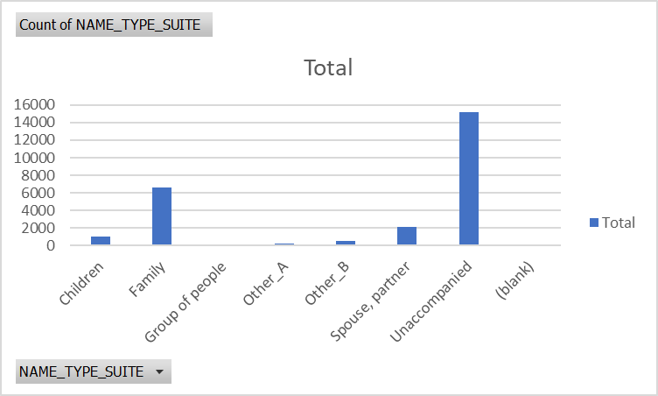
NAME_TYPE_SUITE

Slide 54
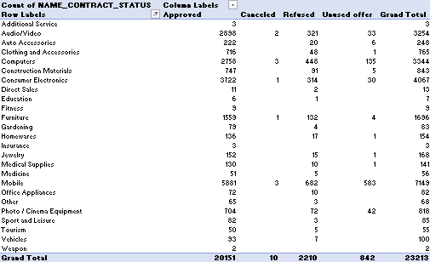
Distribution of Name Contract Status

Slide 55
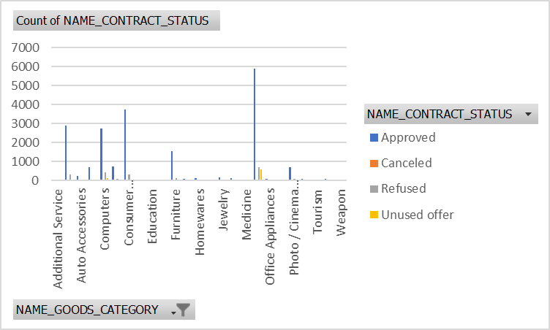
Distribution of Name Contract Status

Slide 56

1
Income Level Significantly Impacts Loan Default: Lower income correlates with higher default rates, suggesting stricter income criteria or differentiated interest rates.
INSIGHTS
2
Loan Amount and Default Risk Relationship: Higher loan amounts show a positive correlation with increased default rates, prompting potential adjustments to loan limits.
3
Effect of Payment History on Loan Default: Applicants with payment difficulties demonstrate higher default rates, emphasizing the importance of past payment behavior in risk assessment.
4
Impact of Loan Type on Default Rates: Different loan types exhibit varying default rates, with personal loans often showing higher defaults, influencing risk assessment strategies.
5
Demographic Insights and Default Patterns: Younger age and lower education levels correlate with higher loan default rates, suggesting targeted risk management and product offerings.

Slide 57

RESULT
This project has equipped the finance company with actionable insights into customer attributes and loan characteristics influencing loan default. By leveraging Excel's analytical tools, we have identified potential strategies to mitigate risks associated with loan approval while ensuring capable applicants are accepted unjustly. The findings are crucial for optimising business decisions and improving the overall loan approval process.

Slide 58

THANK YOU
Sakhi Patel
Link for the folder for cleaned data
sakhipatel20@gmail.com

