Slide 1


C Programing
Prof. John Y. Chiang
Dept. of Computer Science & Engineering
National Sun Yat-sen University
chiang@cse.nsysu.edu.tw
http://image.cse.nsysu.edu.tw

Slide 2
Contents
1 C Overview
2 Selection and Decision
3 Repetition and Loops
4 Function
5 Arrays
6 Pointers I
7 Pointers II
8 Structure
9 Link list
10 Class and object
I Number system

Slide 3

Lecture 10
Class and object

Slide 4

Procedural Programming
Applying procedural or structured concepts in a large, complex program may lead to a variety of problems such as :
    Difficultly in maintaining and modifying.
    Many details easily can disorganize and overload the programmer.
    Difficulty in debugging the program and following its logic.
    Creation of logic errors such as inadvertent data modification.

Slide 5
Object
An object is a single entity that groups together related data and functions that operate on that data.
Function 1
DATA
Function 2
…
Function 3

Slide 6
Communication
Some functions can be used as utility functions within the object while the others serve as interface functions to communicate with other objects within a program.
Data
Utility functions
Interface functions

Slide 7
Object-Oriented Programming
An OOP program can be described as a collection of objects that communicate with each other through their interface functions.
The communication between objects is commonly described as sending messages to objects.
Object 1
Object 2
Object n
Object 3

Slide 8
OOP Concept
Encapsulation is the concept of binding together data and function into one capsule or object :
    This concept is also known as data abstraction.
    Its implementation enables data hiding, with means an object can hide its data from the rest of the program and provide access to the data only through its interface functions.

Slide 9
OOP Concept
    This reduces the possibility of inadvertent data modification and various kinds of logic errors.
    OOP technology facilitates code reusability much more efficiently than procedural technology.

Slide 10
OOP Concept
Inheritance is one of the most important OOP tools in the implementation of code reusability :
    When using inheritance, new code can be derived or inherited from existing code.
    This reduces the amount of coding and the size of the program.

Slide 11
Structures
C : struct should be used to define the variable.
C++ : no need struct.
    //structure variable declarations in C
    struct circuit amplifier, speaker;
    //structure variable declarations in C++
    circuit amplifier, speaker;

Slide 12
Dot separator (.)
A dot separator (.) is used to separate the structure variable name from its member variable as shown in the following examples :
    Speaker.impedance = 8;
    amplifier.quantity = 1;
    cout << amplifier.description;

Slide 13
Accessing Members of Structures
Member access operators :
    Dot operator (.) for structures and objects
    Arrow operator (->) for pointers
    timePtr->hour is the same as (*timePtr).hour
    Parentheses is required because (*) has lower precedence than (.).

Slide 14
C vs. C++
A C++ structure may contain both functions and data, unlike C structures that contain data only.
Data can be protected or hidden by using the private access specifier.
It is not necessary to use the struct keyword when instantiating variables.

Slide 15
Class
The class is a foundation of OOP. It is very similar to the expanded structure that group related data and functions together :
    class class_name{
    public:
    // public data and functions
    private:
    //private data and functions
    } object_list;

Slide 16
Class
Class member
    Member variables, also called data members.
    Member functions.
Class is used to create object. Object is an instance of class.
    Data members can be viewed as the object’s attributes or properties.
    Member functions describe its behavior or methods.

Slide 17
Class
Classes :
    Model objects that have attributes (data members) and behaviors (member functions).
    Defined using keyword class.
    Have a body delineated with braces ({ and }).
    Class definitions terminate with a semicolon.

Slide 18
Class
Example 1:
    //擷取檔案名稱：d:\C++11\C1103.cpp p. 11-7
    #include <iostream>
    using namespace std;
    #include <math.h>
    #define PI 3.141593f
    class Cuboid //宣告長方體類別
    {
    public:
    int length; //Cuboid的資料成員1
    int width; //Cuboid的資料成員2

Slide 19
Class
    int height; //Cuboid的資料成員3
    int area() //計算長方體表面積函數
    {
    return 2 * (length * width+ width *height + height * length);
    }
    int volumn() //計算長方體體積函數
    {
    return length * width * height;
    }
    };

Slide 20
Class
int main(){
Cuboid rt = {6, 8, 10}; //建立Cuboid結構資料
cout << "Cuboid：\n";
cout << "Length = " << rt.length << endl;
cout << "Width = " << rt.width << endl;
cout << " Height = " << rt.height << endl;
cout << " Surface Area = " << rt.area() << "cm^2\n";
cout << " Volume = " << rt.volumn() << "cm^3\n";
return 0; //成功結束程式
}

Slide 21
Class
Example1 output:
    Cuboid:
    Length = 6
    Width = 8
    Height = 10
    Surface Area = 376cm^2
    Volume = 480cm^3

Slide 22
Class
Example 2:
    class time {
    public:
    Time();
    void setTime (int, int, int);
    void printMilitary();
    void printStandard();
    private:
    int hour; // 0 - 23
    int minute; // 0 - 59
    int second; // 0 - 59
    }

Slide 23
Accessing Class Members
C++ provides three ways of accessing class members.
The way a class member is accessed is specified by one of the following member access specifiers :
    Private : can only be accessed by other members of the same class.
    Public : can be accessed by any class and non-member functions.
    Protected : when dealing with inheritance.

Slide 24
Access Member
An access specifier followed by a colon (:) should be placed before a class member declaration.
Members with the same access should be grouped together and listed after their access specifier.

Slide 25
Class
Public class member can be accessed outside through a class object using their general format.
Object.class_member
It should be noted that an object is not needed to access a class member by another member of the same class.

Slide 26
Class
Class jet
{
private:
float acc, vel, dis;
//acceleration, velocity, dispalcement
float getTime(){ return vel/acc; }
public:
void setValues (float x, float y)
{
acc = x;
vel = y;
}
float getDisplacement(){
return (vel*getTime())/2;
}
};

Slide 27
Class
int main()
{
Jet plane;
plane.setValues (40, 65);
cout << “the time during which the plane”;
cout << “is been accelerated =” ;
cout << plane.getTime();// ERROR! (private)
cout << “\n the plane’s displacement =“;
cout << plane.getDisplacement();
return 0;
}

Slide 28
Member function
A member function is a function that is a member of a class.
Member functions are usually used to manipulate class data members, and in most cases provide the only way to access the private class data.
A member function can be either an inline or non-inline function.

Slide 29
Member function
To create an inline member function, it is only necessary to place the function’s definition inside the class.
    Long functions, recursive functions, and functions containing loops or static variables cannot be expanded inline.

Slide 30
Member function
If a member function falls into one of these categories (long, recursive,…) and its definition is placed within the body of the class, the compiler will usually issue a warning message and process the function as a non-inline member function.

Slide 31
Constructor and Destructor
Initializing variables before they are used in common programming practice.
Provides a special kind of member function called the constructor function, which is a more convenient tool to perform initialization than using functions.
A constructor function can perform any kind of operation just like any other member function.

Slide 32
Constructor and Destructor
A constructor function ahs the following properties of characteristics :
    It has the same name as the class for which it is designed.
    It has no return type, not even void.
    It can have arguments, including default arguments.
    A constructor function is automatically called whenever an object is declared.

Slide 33
Constructor
When using constructors, it is also important to know the following :
    Constructors should be public, so they can be called outside the class-including main().
    A class can have many constructors an necessary.
    Constructors cannot be inherited.
    Each class should have its own constructors.

Slide 34
Constructor
    class Battery
    {
    private:
    float voltage = 12.0; // error!
    float capacity;
    public:
    // member functions
    }
The initialization should be done by a constructor function.

Slide 35
Constructor
Example2 :
    Battery()
    { // default constructor
    voltage = 12.0;
    capacity = 30.0;
    }
    This constructor function is called a default constructor, because is assigns default values to the class data members.
        No parameters, no return types, name as class.

Slide 36
Constructor
When an object of the class is declared, the constructor is automatically called.
        Battery bt;//Calling default constructor
Constructor with parameters
        Battery (float v, float c)
        {
        voltage = v;
        capacity = c;
        }

Slide 37
Constructor
When calling this constructor, two arguments should be passed to the function.
        Battery bt(12.0, 30.0);// Overrides default values

Slide 38
Destructor
The destructor function is needed to clean up the class object when it goes out of scope.
Its name is the tilde(~) character followed by the class name.
It cannot have a return value.
It cannot have argument.
It is automatically called when an object goes out of scope.

Slide 39
Destructor
class ErrMessage
{
private:
char *mes;
public:
ErrMessage(char *em) {
mes = new char[strlen(em)];
strcpy (mes, em);
}
~ErrMessage() {delete []mes; }
// destructor
};

Slide 40
Constructor and Destructor
class Employee
{
private:
int EnpId;
char name[20];
public:
void inputEmp(){
cout << "Input EnpId:";
cin>> EnpId;
cout << "Input EnpName:";
cin>> name;
}

Slide 41
Constructor and Destructor
void outputEmp() {
cout << "EnpId:" << EnpId <<endl;
cout << "EnpName:" << name <<endl;
}
Employee() {
EnpId = 0;
strcpy(name,"zzz");
}
Employee(int id,char *n){
EnpId = id;
strcpy(name,n);
}
~Employee(){ }
};

Slide 42
Constructor and Destructor
int main()
{
Employee emp1;
Employee emp2(23,"TOM");
Employee emp3;
emp1.outputEmp();
emp2.outputEmp();
cout<<endl;
emp3.inputEmp();
emp3.outputEmp();
system("PAUSE");
return 0;
}

Slide 43
Constructor and Destructor
output :
EnpId : 0
EnpName : zzz
EnpId : 23
EnpName : TOM
Input EnpId : 456
Input EnpName : JOE
EnpId : 456
EnpName : JOE

Slide 44
Copy Constructor
C++ provides a special type of constructor function called the copy constructor.
This constructor overloads a regular class constructor.
Unlike the regular constructor, which is called when a new object is instantiated, the copy constructor is called when object is copied.

Slide 45
Copy Constructor
The copy constructor is automatically called to initialize an object if one of the following three situations occurs:
    An object is used to initialize another object in a declaration statement.
    An object is passed to a function.
    An object is returned from a function.

Slide 46
Copy Constructor
Pixel class.
Pixel p1; // Calls the default constructor to
// initialize
Pixel p2 = p1; // p1 initialize p2, p2 initialize p3
Pixel p3(p2); // Calls the copy constructor
fun1(p1); // p1 is passed to fun1()
// Calls the copy constructor
p2 = fun2(); // return an object to p2
// Calls the copy constructor
p3 = p2; // The copy constructor is not
// called here

Slide 47
Copy Constructor
A copy constructor has one parameter, which is a reference to the object to be copied.
The const keyword precedes the reference because the original object should not be changed.
class_name (const class_name & object_name){
// Body of the copy constructor
}

Slide 48
Copy Constructor
class Pixel{
int x, y;
public:
Pixel(int a, int b){
x = a; y = b;
cout<<“Normal Constructor”<<endl;
}
Pixel(const Pixel &p){
x=p.x; y=p.y;
cout<<“Copy Constructor”<<endl;
}

Slide 49
Copy Constructor
~Pixel(){
cout<<“Destructor”<<endl;
}
void setX(int x1) {x = x1;}
void setY(int y1) {y = y1;}
void showXY() {
cout<<“X=“<<x;
cout<<“ Y=“<<y<<endl;
}
};

Slide 50
Copy Constructor
Pixel center(Pixel tp){
tp.setX(512); tp.setY(512); return tp;
}
int main(){
Pixel p1(10, 20); //Calls regular constructor
p1.showXY();
Pixel p2 = p1; // Calls copy constructor
p2.showXY();
p2=center(p1);// Calls copy constructor twice
p2.showXY();
return 0;
}

Slide 51
Copy Constructor
Normal Constructor
X = 10 Y = 20
Copy Constructor
X = 10 Y = 20
Copy Constructor
Copy Constructor
Destructor
Destructor
X = 512 Y = 512
Destructor
Destructor

Slide 52
Static Members
Unlike regular data members, static data members do not belong to any particular object of a class. They belong, instead, to the class itself.
C++ creates one copy of each static data member in memory, no matter how many class objects are instantiated.
All object of the class therefore share the same copy of a static member.

Slide 53
Static data member
All static data members exist in memory before any object of their class is instantiated.
Being independent from objects, they are good candidates for the following:
    Counters that count the number of objects instantiated or destroyed
    Totals that accumulate values stored in objects
    Variables that control access to the devices shared by all objects, such as servers, printers, and disk drives.

Slide 54
Static data member
class Node {
int num; //node number
public:
static int ncount; //counts nodes
static int pcount;
//counts how many nodes used printer
Node(){ num=1; ncount++; } //constructor #1
Node(int x){ num=x; ncount++; } //constructor #2

Slide 55
Static data member
~Node(){ ncount--; } //destructor
void printer();
};
void Node::printer()
{
pcount++;
cout<<"\nThere are "<<ncount<<" nodes."<<endl;
cout<<"\t\t\tNode #"<<num<<" uses printer now!"<<endl;
cout<<pcount<<" node(s) used printer so far."<<endl;
}

Slide 56
Static data member
int Node::ncount=0;
//Allocates memory for static data members
int Node::pcount=0;
//and explicitly initializes to 0 (clearer)
int main(){
cout<<"There are "<<Node::ncount<<" nodes."<<endl;
Node n1, n2(2), n3(3); //n1 invokes constructor #1
n2.printer();
cout<<"There are "<<Node::ncount<<" nodes."<<endl;
return 0;
}

Slide 57
Static data member
Output:
    There are 0 nodes.
    There are 3 nodes.
    Node #2 uses printer now!
    1 node(s) used printer so far.
    There are 3 nodes.

Slide 58
Static Member Function
A member function can be declared static simply by preceding the function return type with the static keyword in a class definition.
It is important to know that static member functions can be called from across different programs that are linked together.
Static member functions are used and processed in a different way than non-static functions.

Slide 59
Static Member Function
The most important differences between static and non-static member functions are the following :
    A static member function is not attached to any object.
    A static member function does not have direct access to the private class data members. A pointer or a reference to an object should be passed to the function to enable access to the object’s private data.

Slide 60
Static Member Function
class Node
{
private:
int num; //node number
public:
static int ncount; //counts nodes
static int pcount; //counts printer's usage
Node(){ num=1; ncount++; }
Node(int x){ num=x; ncount++; }
~Node() { ncount--; }
static void printer(Node &n);
//static function prototype
}; //pass a reference to access private data

Slide 61
Static Member Function
void Node::printer(Node &n) //static function definition
{
pcount++;
cout<<"\nThere are "<<ncount<<" nodes."<<endl;
cout<<"\t\t\tNode #"<<n.num<<"uses printer now!"<<endl;
cout<<pcount<<" node(s) used printer so far."<<endl;
}

Slide 62
Static Member Function
int Node::ncount=0;
int Node::pcount=0;
int main()
{
cout<<"There are "<<Node::ncount<<" nodes."<<endl;
Node n1, n2(2), n3(3);
Node::printer(n2); //static function call
cout<<"There are "<<Node::ncount<<" nodes."<<endl;
return 0;
}

Slide 63
Static Member Function
Output:
    There are 0 nodes.
    There are 3 nodes.
    Node #2 uses printer now!
    1 node(s) used printer so far.
    There are 3 nodes.

Slide 64
Inheritance
Implementing inheritance promotes code reusability because new classes are created from existing classes
Inheritance is also called derivation or an is a relationship.
It enables a hierarchy of classes to be designed.

Slide 65
Inheritance
Data members and number functions from one class can become properties of another class.
A class that is inherited is called a base class or a parent class. A class that inherits properties of another class is called a derived class or child class.

Slide 66
Inheritance
class OPAMP : Amplifier
{
// members specific to OPAMP
}
class Amplifier { // base class
public :
float gain; // gain
float involt, outvolt; // input and output voltag
void setGain(); // sets gain
void setInvold(); // sets input voltage
void getOutvolt(); // computes and display
// output
}

Slide 67
Type of Inheritance
Single inheritance :
    A class is derived from only one base class (a child class has only one parent class).
    A parent class, however, can have many child classes.
Multiple inheritance :
    A class have more than one parent class

Slide 68
The protected Access Specifier
The protected access specifier is used only when implementing inheritance. To enable a derived class to access members of a base class while keeping these members hidden from the rest of the program.
Members of a base class that are specified as protected can be access directly by
    Any non-static member function of a base class.
    Any non-static member function of a class derived from the base class.

Slide 69
The protected Access Specifier
Example :
    class Amplifier { // base class
    private :
    float involt, outvolt;
    // input and output voltage
    protected :
    float gain; // gain
    public :
    void setGain(); // sets gain
    void setInvold(); // sets input voltage
    void getOutvolt(); // computes and display
    // output
    }

Slide 70
The protected Access Specifier
Example :
    class OPAMP : public Amplifier { // base class
    private :
    float rin; // input resistor
    float rout; // output resistor
    public :
    void setResist(); // sets resistors
    void getGain(); // computes and display
    // output
    }

Slide 71
The protected Access Specifier
Members of the OPAMP class :
Member
Rin
Rout
Gain
setResist()
getGain()
setGain()
setInvolt()
getOutvolt()
Access Status
private
private
protected
public
public
public
public
public

Slide 72
The protected Access Specifier
When defining a derived class, protected can also be used to specify a type of inheritance. The type of inheritance is specified by the access specifier.
All public and protected members inherited from the base class with the protected access specifier will be protected in the derived class.

Slide 73
The protected Access Specifier
The three types of inheritance and how each type affects the status of inherited members within a derived class :
Type of Inheritance
Access status with Base-Class
protected public
Access status with Derived-Class
private
protected
public
private private
protected protected
protected public

Slide 74
Polymorphism Introduction
Polymorphism with inheritance hierarchies
    “Program in the general” vs. “program in the specific”
    Process objects of classes that are part of the same hierarchy as if they are all objects of the base class
    Each object performs the correct tasks for that object’s type
        Different actions occur depending on the type of object
    New classes can be added with little or not modification to existing code

Slide 75
Polymorphism
Polymorphism:
    Ability for objects of different classes to respond differently to the same function call
    Base-class pointer (or reference) calls a virtual function
        C++ chooses the correct overridden function in object
    Suppose print not a virtual function
    Employee e, *ePtr = &e;
    HourlyWorker h, *hPtr = &h;
    ePtr->print(); //call base-class print function
    hPtr->print(); //call derived-class print function
    ePtr=&h; //allowable implicit conversion
    ePtr->print(); // still calls base-class print

Slide 76
Virtual Functions
virtual functions
    Define a method as virtual, and the subclass method overrides the base class method
    Declaration:
        Keyword virtual before function prototype in base class
        virtual void draw() const;
    A base-class pointer to a derived class object will call the correct draw function
    If a derived class does not define a virtual function it is inherited from the base class

Slide 77
Virtual Functions
E.g.,
    class Shape {
    public:
    virtual void Rotate();
    virtual void Draw();
    ...
    }
    class Line: public Shape {
    public:
    void Rotate();
    //Use base class Draw method
    ...
    }
This tells the compiler to add
internal pointers to every object
of class Shape and its derived
classes, so that pointers to
correct methods can be stored
with each object..

Slide 78
Virtual Functions
ShapePtr->Draw();
    Compiler implements dynamic binding
    Function determined during execution time
ShapeObject.Draw();
    Compiler implements static binding
    Function determined during compile-time

Slide 79
Abstract and Concrete Classes
Abstract Classes
    Classes from which it is never intended to instantiate any objects
        Incomplete—derived classes must define the “missing pieces”.
        Too generic to define real objects.
    Normally used as base classes and called abstract base classes
        Provide appropriate base class frameworks from which other classes can inherit.
Definitions

Slide 80
Abstract and Concrete Classes
Concrete Classes
    Classes used to instantiate objects
    Must provide implementation for every member function they define
Definitions

Slide 81
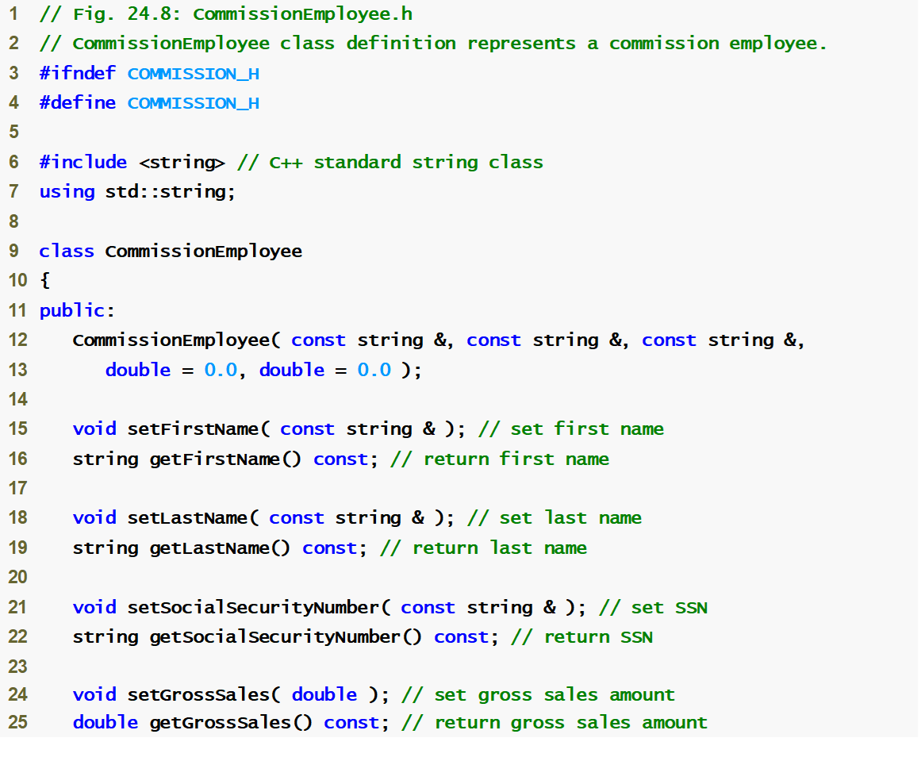
Commission
Employee.h
(1 of 2)

Slide 82
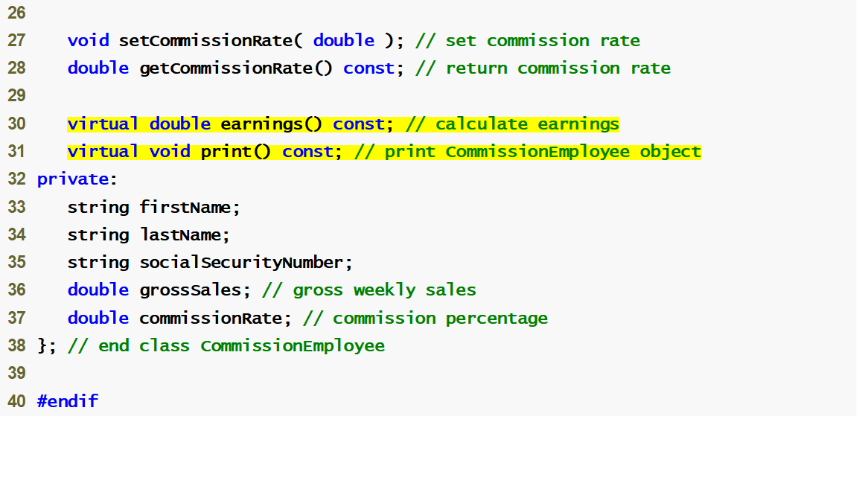
Commission
Employee.h
(2 of 2)
Declaring earnings and print as virtual allows them to be overridden, not redefined

Slide 83
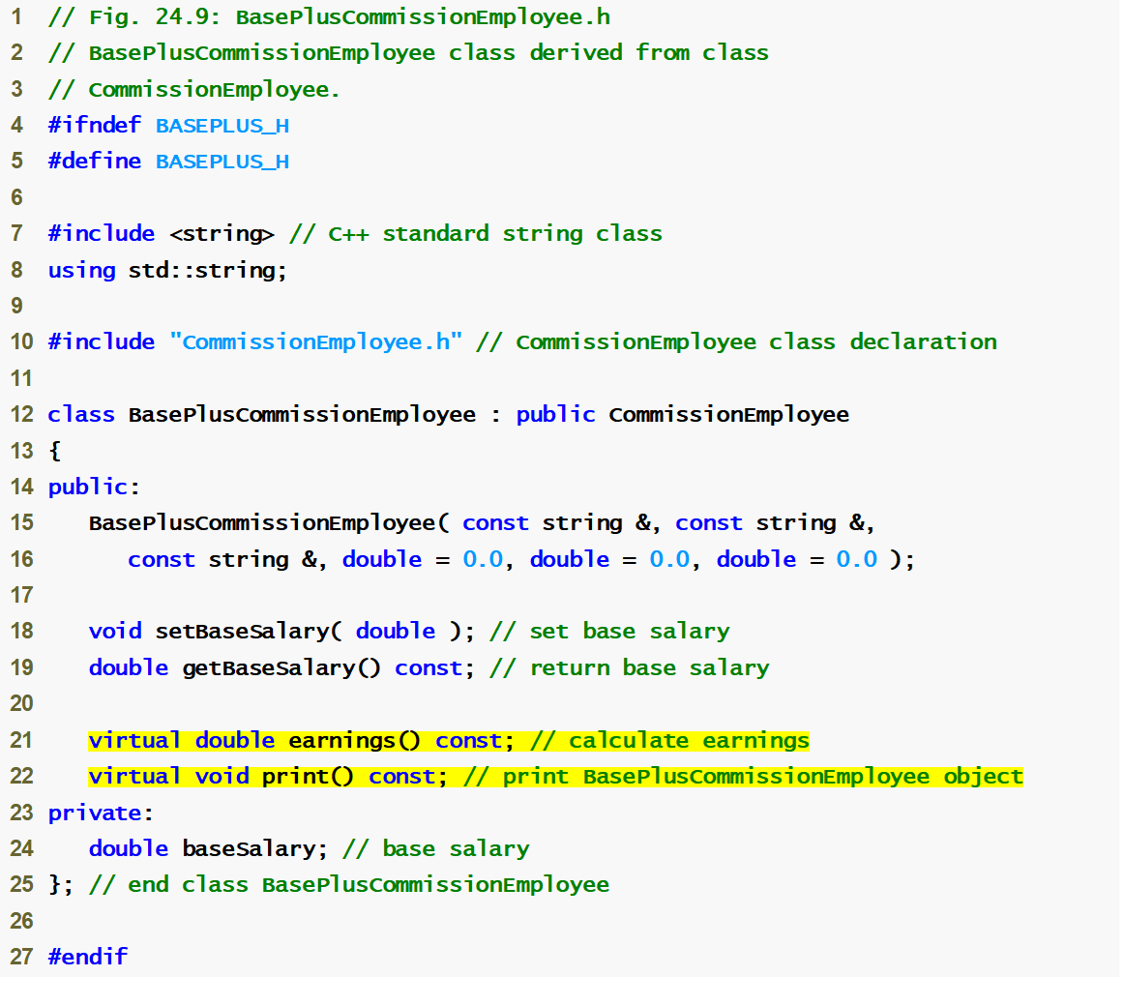
BasePlus
Commission
Employee.h
(1 of 1)
Functions earnings and print are already virtual – good practice to declare virtual even when overriding function

Slide 84
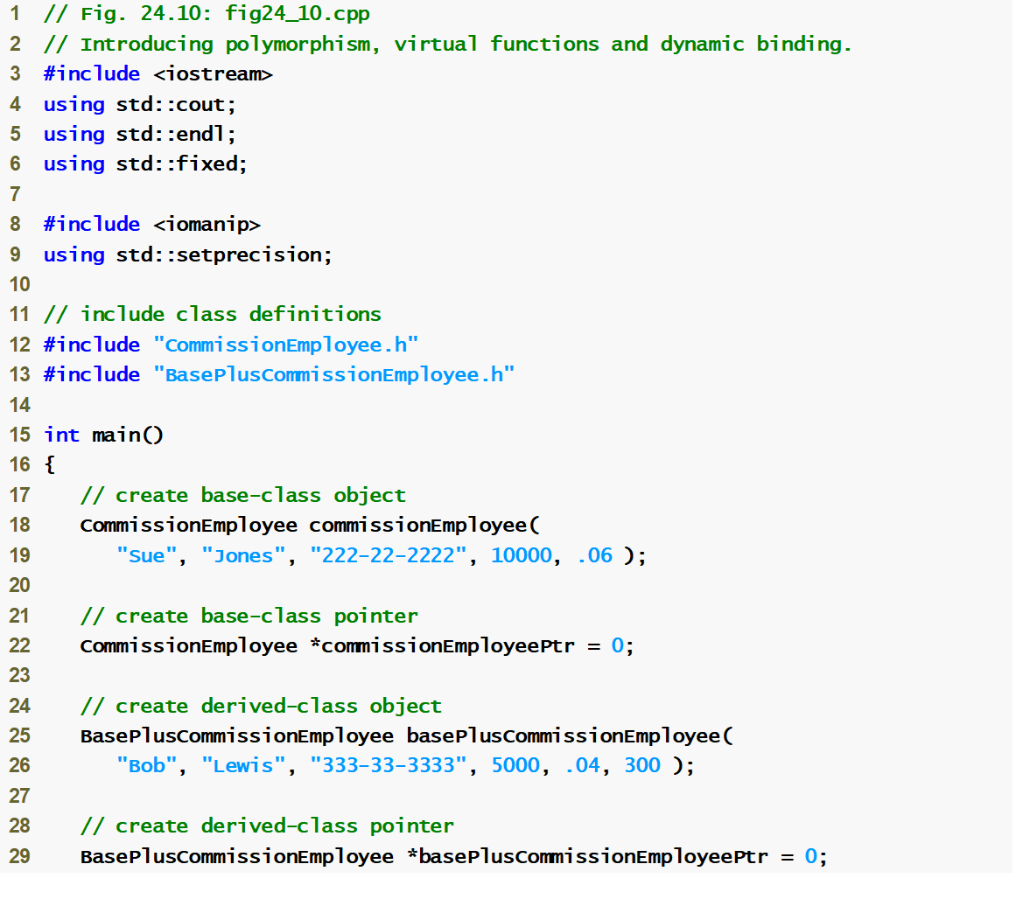
fig24_10.cpp
(1 of 5)

Slide 85
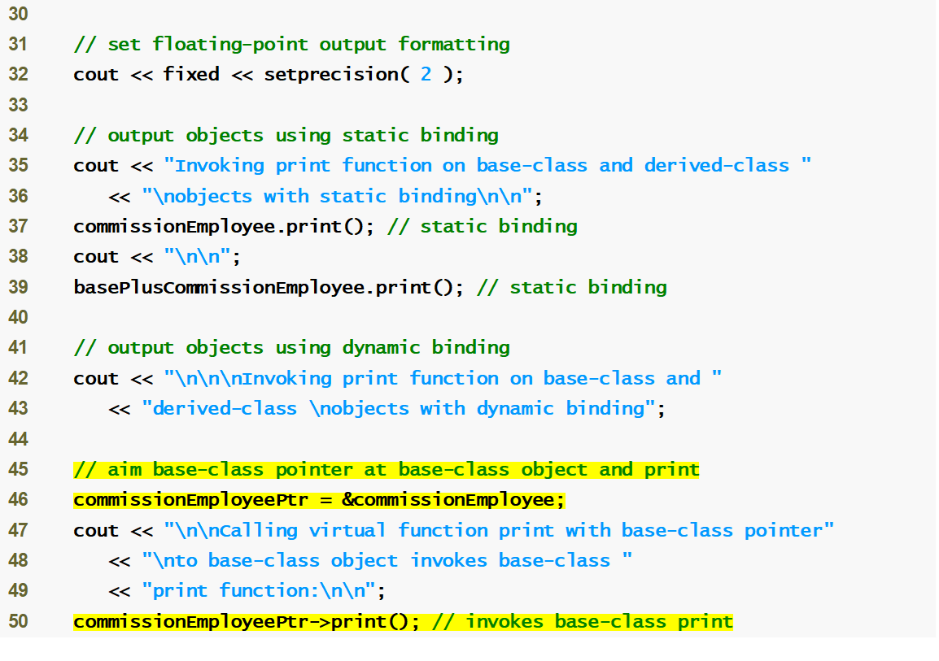
fig24_10.cpp
(2 of 5)
Aiming base-class pointer at base-class object and invoking base-class functionality

Slide 86
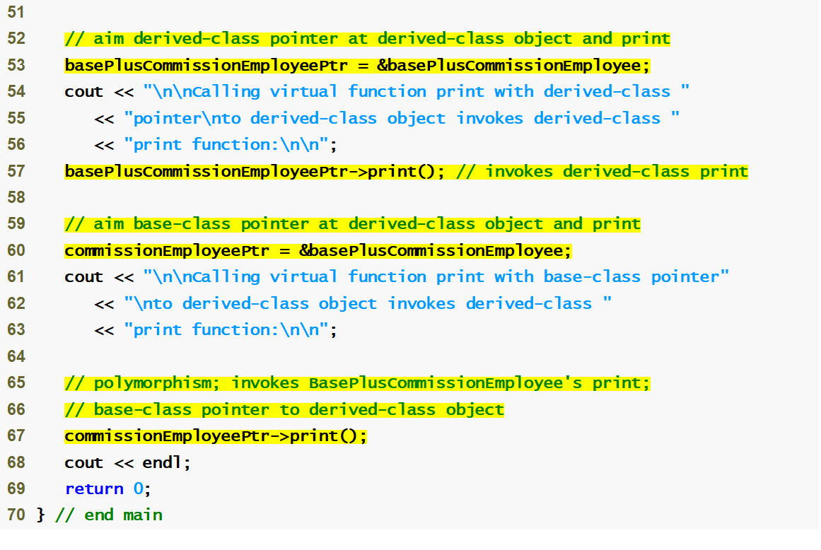
fig24_10.cpp
(3 of 5)
Aiming derived-class pointer at derived-class object and invoking derived-class functionality
Aiming base-class pointer at derived-class object and invoking derived-class functionality via polymorphism and virtual functions

Slide 87
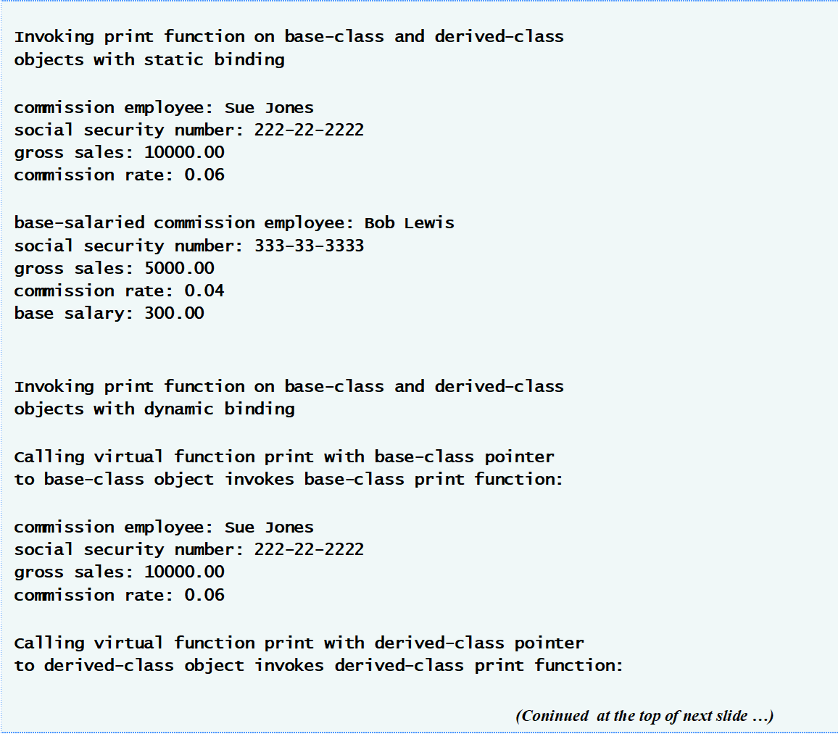
fig24_10.cpp
(4 of 5)

Slide 88
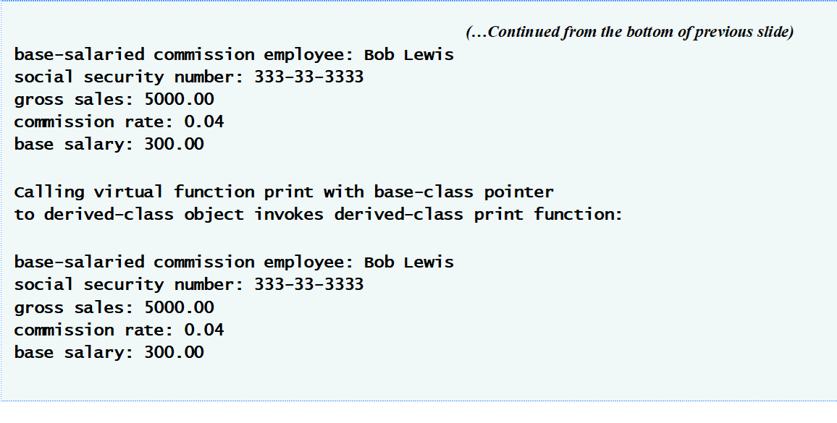
fig24_10.cpp
(5 of 5)

