Slide 1
C程式設計實驗(二)
Chapter10. Pointers and Strings

Slide 2
Pointers Variables
Pointer definition :
Memory address of a variable.
Pointers are “typed”
Can store pointer in variable.
Not int,double,etc.
Example. (double *p;)
P is declared a “pointer to double” variable.
Can hold pointer to variables of type double
Not other types!

Slide 3
Declaring Pointers Variables
Pointers declared like other types
Example. (int *p1, *p2, v1, v2;)
p1, p2 hold pointers to int variables.
v1, v2 are ordinary int variables.
Add “ * ” before variable name.
p1 = &v1; // p1 = address of v1.

Slide 4
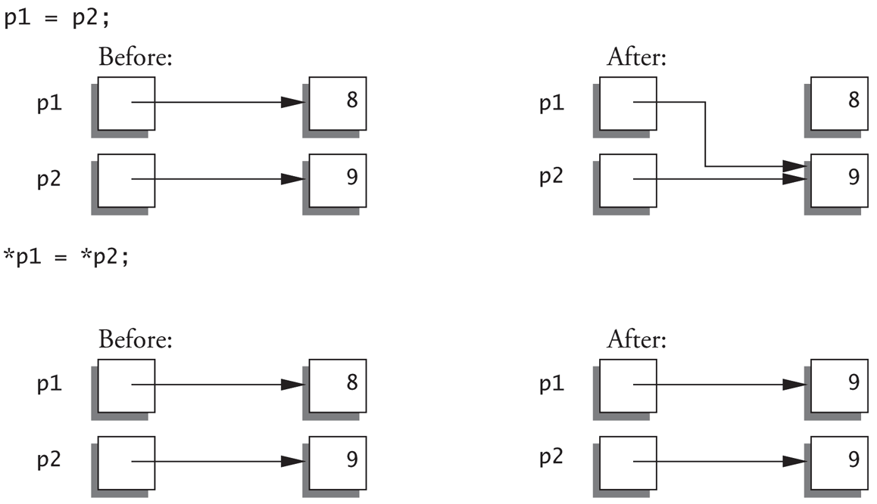
Pointer Assignments
int *p1, *p2;
p1 = p2; //Assigns one pointer to another.
*p1 = *p2; //Assigns “value pointed to” by p1. to “value pointed to” by p2.

Slide 5
Dynamic Arrays
Create
Use new operator
Dynamically allocate with pointer variable.
Treat like standard arrays.
Example.
Typedef double *DoublePtr;
DoublePtr d;
d = new double[10]; //Size in brackets .
Delete
Example.
delete[] d; //de-allocates all memory for dynamic array;

Slide 6
C - String
Array with base type “char”
One character per indexed variable.
End of string marked with null, “\0” → null character
Example.

Slide 7
C - String Variable
Typically “partially - filled” array
Declare large enough to hold max-size string.
Indicate end with null.
Only difference from standard array :
Must contain null character.
Example. (char s[10])
Declares a c-string variable to hold up to 9 characters.
The last : null character “\0”.

Slide 8
C - String initialization
Two way to initialize c-string
char Message[20]
Need not fill the entire array.
Initialization places “\0” at end.
char shortString[] = “abc”;
Can omit array-size.
Automatically makes size one more than length of quoted string.
NOT same as :
char shortString[] = {‘a’, ’b’, ’c’};

Slide 9
C - String Storage
char s[10];
If s contains string : “Hi Mom!”, store as :

Slide 10
Library <cstring> : strlen( )
“String length”
Useful to know string length.
The null character is not counted in the length.

Slide 11
Library <cstring> : strcat( )
“String concatenate”
Be careful !
Incorporate spaces as needed.

Slide 12


Library <cstring> : strcat( )
Core Dumped!

Slide 13
Library <cstring> : strcpy( )
“String copy”
strcpy(Target_string , Src_string)
strncpy(Target_string , Src_string , limit)

Slide 14
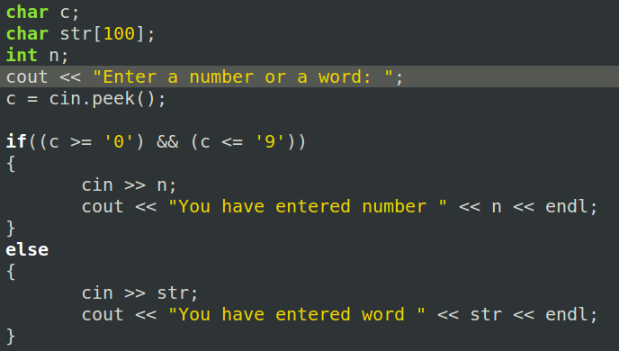


Member Function peek( )
Return next char, but leaves it there.
peekchar = cin.peek();

Slide 15
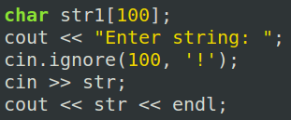

Member Function ignore( )
Skip input, up to designated character.
cin.ignore(100, ‘!’);
Skips at most 100 characters until ‘!’ .

