Slide 1
C程式設計實驗(二)
Chapter11. Pointer

Slide 2
Learning Objectives
Class, Pointers, Dynamic Arrays
The this pointer
Destructors, copy constructors

Slide 3
Dynamic Arrays
Standard array
Fixed size
Dynamic array
Size not specified at programming time
Determined while program running

Slide 4
The this Pointer
Member function definitions might need to refer to calling object
Using predefined this pointer
Automatically points to calling object:
class Simple
{ public :
void showStuff() const;
private :
int stuff; };
Two ways for member functions to access:
cout << stuff;
cout << this -> stuff;

Slide 5
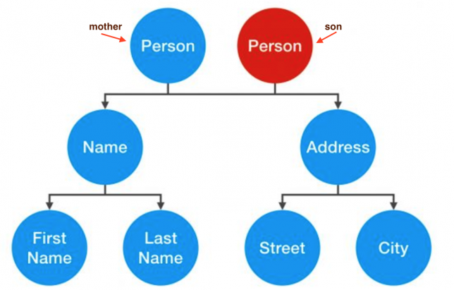
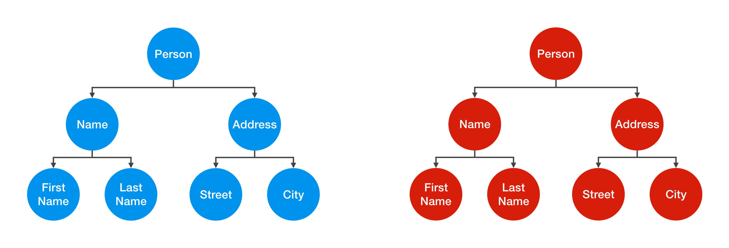
Shallow and Deep Copies
Shallow copy
Assignment copies only member variable contents over
Default assignment and copy constructors
Deep copy
Pointers, dynamic memory involved
Must dereference pointer variables to “get to” data for copying
Write your own assignment overload and copy constructor in this case

Slide 6
Destructor Need
Dynamically-allocated variables
Do not go away until “deleted”
If pointers are only private member data
They dynamically allocate “real” data
In constructor
Must have means to “deallocate” when object is destroyed
Answer : destructor!

Slide 7
Destructors
Opposite of constructor
Automatically called when object is out-of-scope
Default version only removes ordinary variables, not dynamic variables
Defined like constructor, just add ~
MyClass :: ~MyClass()
{ // perform delete clean-up duties }

Slide 8
Copy Constructors
Automatically called when :
Class object declared and initialized to other object
When function returns class type object
When argument of class type is “plugged in” as actual argument to call-by-value parameter
Requires “temporary copy” of object
Copy constructor creates it
Default copy constructor
Like default “ = ”, performs member-wise copy
Pointers → write own copy constructors !

