Slide 1
C程式設計實驗(二)
Chapter12. Separate Compilation and Namespaces

Slide 2
Learning Objectives
Separate Compilation
Encapsulation reviewed
Header and implementation files
Namespaces
Using directives
Creating a Namespace

Slide 3
Separate Compilation
Program Parts
Kept in separate files
Compiled separately
Linked together before program runs
Class definitions
Separate from “using” programs
Build library of classes
Re-used by many different programs
Just like predefined libraries

Slide 4
Class Separation
Class independence
Separate class definition / specification (interface)
Separate class implementation
Place in two files
If implementation changes → only that file need be changed
Class specification need not change
“User” programs need not change

Slide 5
Encapsulation Reviewed
Encapsulation principle :
Separate how class is used by programmer from details of class’s implementation
“Complete” separation
Change to implementation → NO impact on any other programs
Basic OOP Principle

Slide 6
Encapsulation Rules
Rules to ensure separation :
All member variables should be private
Basic class operations should be :
Public member functions
Friend or ordinary functions
Overloaded operators
Group class definitions and prototypes together
Called “interface” for class
Make class implementation unavailable to users of class

Slide 7
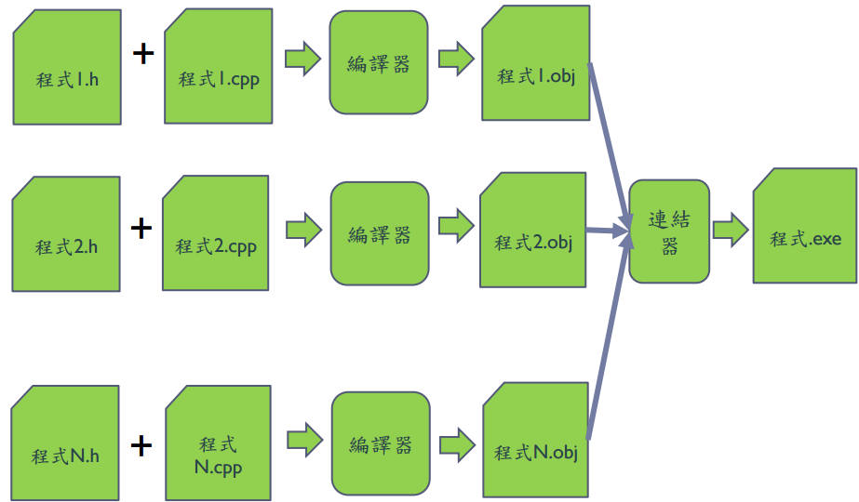
Separate Compilation

Slide 8
Namespaces
Namespace defined :
A collection of name definitions
Class definitions
Variable declarations
Programs use many classes, functions
Commonly have same names
Namespaces deal with this
Can be “on” or ”off”
If names might conflict →turn off

Slide 9
Using Directive
Using namespace std;
Makes all definitions in std namespace available
Why might you NOT want this ?
Can make cout, cin have non-standard meaning
Perhaps a need to redefine cout, cin
Can redefine any others

Slide 10
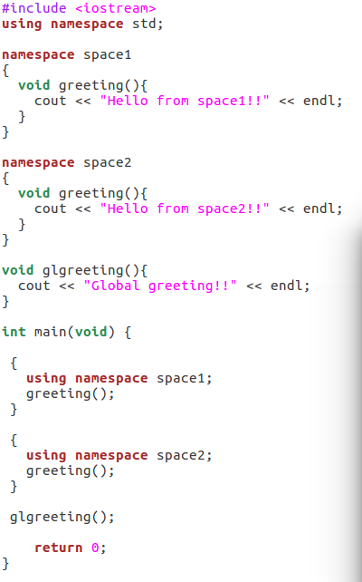

Creating a Namespace
Example.

