Slide 1
C程式設計實驗(二)
Chapter13. Streams & File I/O

Slide 2
Learning Objectives
I/O Streams
File I/O
Character I/O
Tools for Stream I/O
File names as input
Formatting output, flag settings

Slide 3
Streams
Input stream
Flow into program
Can come from keyboard
Can come from file
Output stream
Flow out of program
Can go to screen
Can go to file

Slide 4
Stream Usage
We’ve used streams already
cin
input stream object connected to keyboard
cout
Output stream object connected to screen
Can define other steams
To / from files
Used similarly as cin , cout

Slide 5
File Connection
Must first connect file to stream object !
For input :
file → ifstream object
For output :
File → ofstream object
Classes ifstream and ofstream
Defined in library <fstream>
Named in std namespace

Slide 6
File I/O Libraries
To allow both file input and output in your program :
#include <fstream>
using namespace std;
or
#include <fstream>
using std :: ifstream;
using std :: ofstream;

Slide 7
Declaring Streams
Stream must be declared like any other class variable :
ifstream inStream;
ofstream outStream;
Must then “connect” to file :
inStream.open(“infile.txt”);
Called “opening the file”
Used member function open
Can specify complete pathname
Can pass as argument to constructor :
ifstream inStream(“infile.txt”);

Slide 8
Closing Files & File Flush
Files should be closed
Disconnects stream from file
In action :
inStream.close();
outStream.close();
Output often “buffered”
Written in “groups”
Occasionally might need to force writing :
outStream.flush(); //all buffered output is physically written

Slide 9
Appending to a file
Standard open operation begins with empty file
Open for append :
ofStream outStream;
outstream.open(“important.txt” , ios :: app);
If file doesn’t exist → creates it
If file exists → appends to end
2nd argument is class ios defined constant
In <iostream> library , std namespace

Slide 10
Checking End Of File (EOF)
Member function eof()
inStream.get(next);
while(!inStream.eof()) // eof() returns bool
{
cout << next;
instream.get(next); // Reads each character until file ends
}

Slide 11
Inheritance Basics
New class inherited from another class
Base class
"General" class from which others derive
Derived class
New class
Automatically has base class’s:
Member variables
Member functions
Can then add additional member functions and variables

Slide 12
Derived Classes
Consider example: Class of "Employees"
Composed of:
Salaried employees
Hourly employees
Each is "subset" of employees
Another might be those paid fixed wage each month or week

Slide 13
Inheritance Terminology
Common to simulate family relationships
Parent class
Refers to base class
Child class
Refers to derived class
Ancestor class
Class that’s a parent of a parent …
Descendant class
Opposite of ancestor

Slide 14
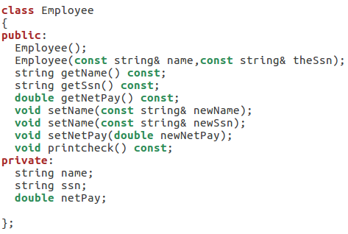
Employee class
.

Slide 15
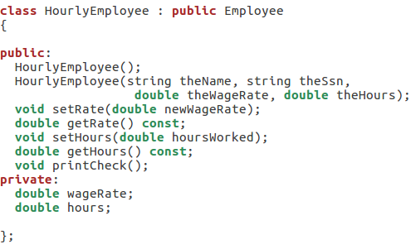
HourlyEmployee class
Derived class
Base class

Slide 16
HourlyEmployee Class Additions
Derived class interface only lists new or "to be redefined" members
Since all others inherited are already defined
i.e.: "all" employees have ssn, name, etc.
HourlyEmployee adds:
Constructors
wageRate, hours member variables
setRate(), getRate(), setHours(), getHours() member functions

Slide 17
HourlyEmployee Class Redefinitions
HourlyEmployee redefines:
printCheck() member function
This "overrides" the printCheck() function implementation from Employee class
It’s definition must be in HourlyEmployee class’s implementation
As do other member functions declared in HourlyEmployee’s interface
New and "to be redefined"

Slide 18
Constructors in Derived Classes
Base class constructors are NOT inherited in derived classes!
But they can be invoked within derived class constructor
Which is all we need!
Base class constructor must initialize all base class member variables
Those inherited by derived class
So derived class constructor simply calls it
"First" thing derived class constructor does

Slide 19
Derived Class Constructor Example
Consider syntax for HourlyEmployee constructor: HourlyEmployee::HourlyEmployee(string theName, string theNumber, double theWageRate, double theHours) : Employee(theName, theNumber), wageRate(theWageRate), hours(theHours) { //Deliberately empty }

Slide 20
Another HourlyEmployee Constructor
A second constructor: HourlyEmployee::HourlyEmployee() : Employee(), wageRate(0), hours(0) { //Deliberately empty }
Default version of base class constructor is called (no arguments)
Should always invoke one of the base class’s constructors

Slide 21
Constructor: No Base Class Call
Derived class constructor should always invoke one of the base class’s constructors
If you do not:
Default base class constructor automatically called
Equivalent constructor definition: HourlyEmployee::HourlyEmployee() : wageRate(0), hours(0) { }

