Slide 1
Obama Speech NLP Analysis
Yitong Li

Slide 2
Speech Analytics Pipeline
Topic Modeling
Data Preprocessing
Time Series Mapping
Result Interpretation
Data Collection
Train a topic model
Load topic distribution for each document
Sentiment Analysis
Compute polarity score
Inspective the emotion of each speech
Use spaCy to do named entity recognition
Produce the data for sentiment analysis and topic modeling respectively
Web crawling

Slide 3
Data Collecting
Package: urlopen, BeautifulSoup
Link of each individual speech
BeautifulSoup(webpage, ‘lxml’)
soup.find_all(‘a’, href=TRUE) with a_href[‘href’]
The complete website url format
Text, date and title of the speech
BeautifulSoup.get_text()
BeautifulSoup.find_all(‘b’)
BeautifulSoup.find_all(‘title’)

Slide 4
Data pre-processing
Step 1
Remove heading and useless words from title and content
Step 2 Named Entity Recognition
spaCy
Remove words labeled by ‘ORG’, ‘DATE’ and ‘Person’
Step 3 Sentiment Analysis
Keep the words tagged as ‘ALPHA’ and not tagged as ‘STOP’
Step 4 Topic Modeling
Remove words such as ‘ADV’, ‘PRON’, and ‘CCONJ’
Remove the most frequent words like ‘everyday’ and the least frequent words

Slide 5
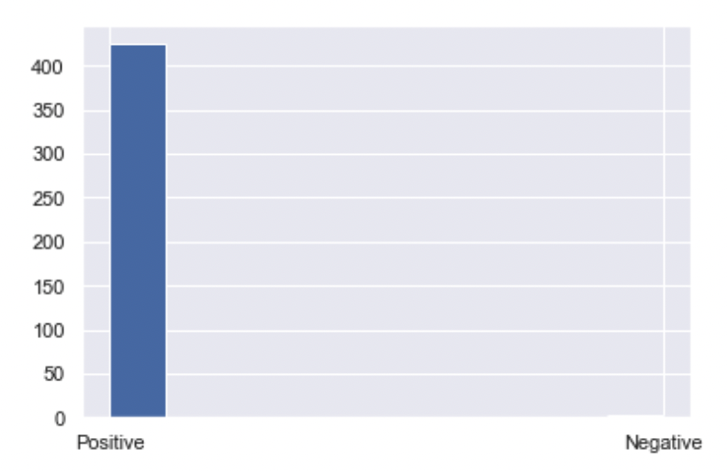
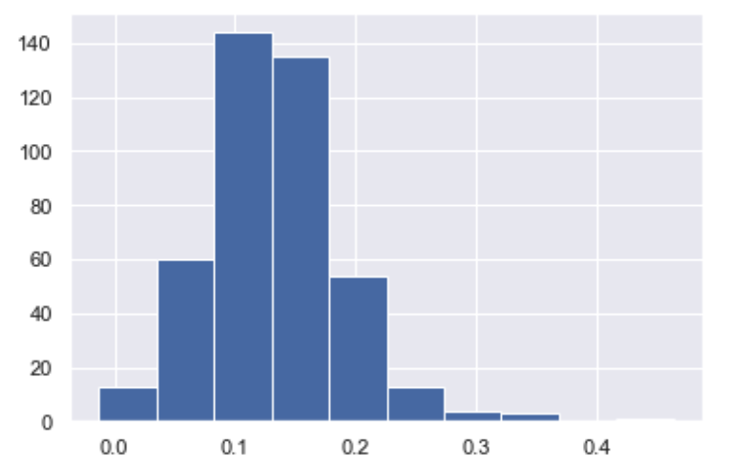
Sentiment Analysis
Package: TextBlob
Positive or Negative
Polarity distribution

Slide 6
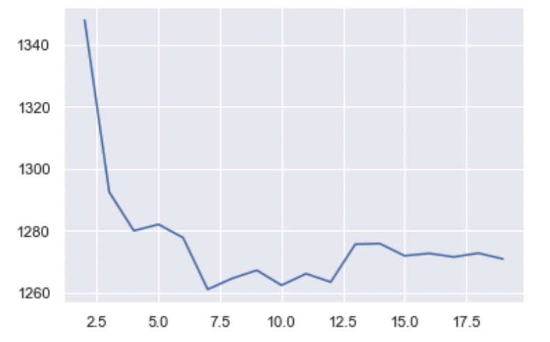
Latent Dirichlet Allocation (LDA)
Package: sklearn
Perplexity

Slide 7
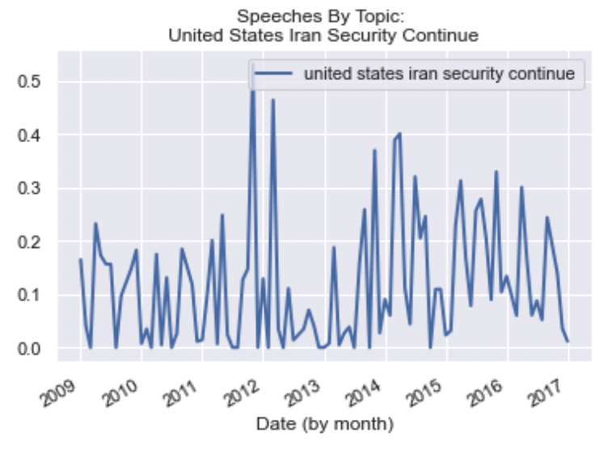
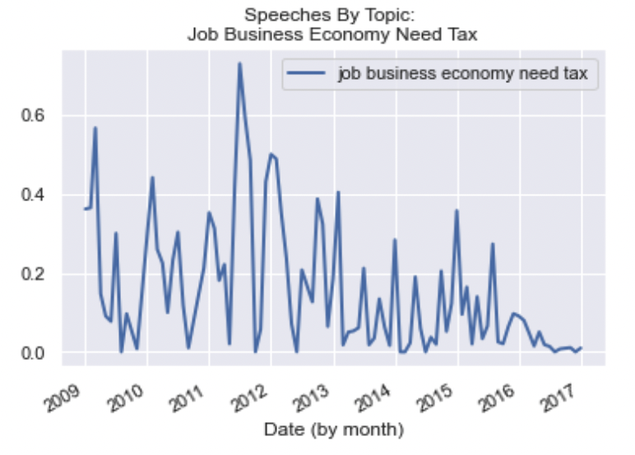
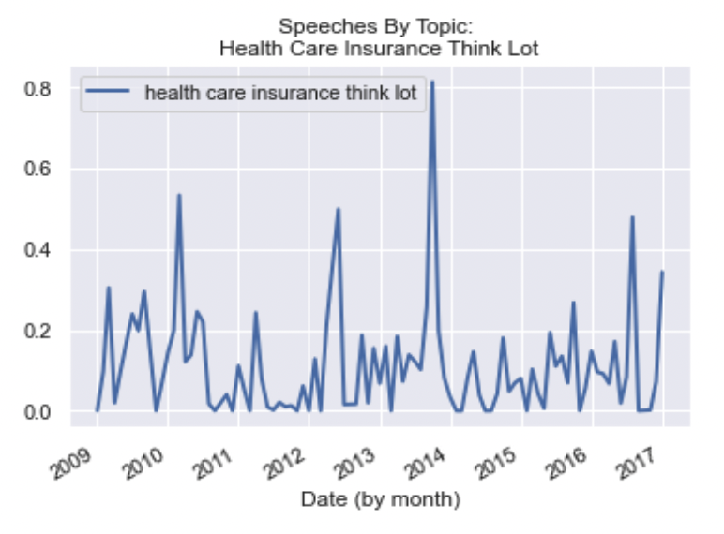
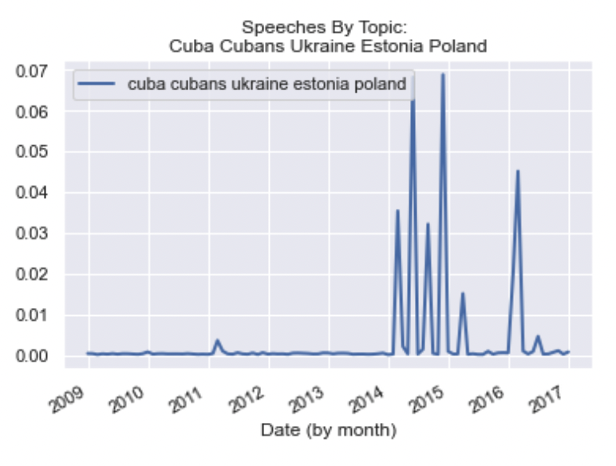
Topics
We concluded the following topics:
War/violence
Health care
Foreign relation
Economy/employment

Slide 8
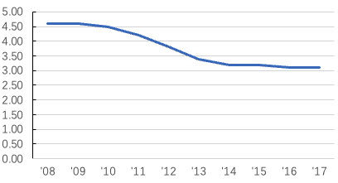
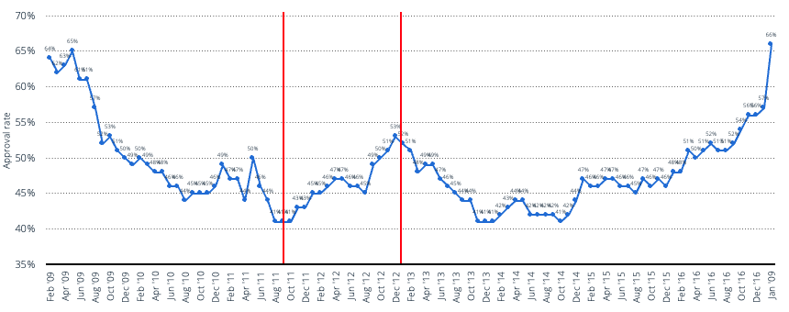
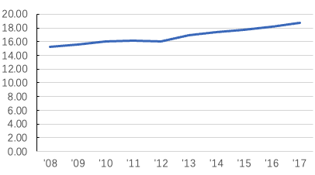
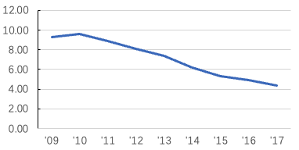
Interpretation
Defense outlays (of GDP) 2009-2017
Obama Presidential Job Approval 2009-2017
GDP 2009-2017
50%
Unemployment Rate 2009-2017
08/2011
12/2012
1.Approval rating rose relatively quickly from 41% in August 2011 to 53% in December 2012,other periods was relatively flat

Slide 9
Interpretation
During this period, his speeches’ main topics : war(55%), economy(68%)
F1:Proportion of War
F2:Proportion of Work
Cause(War)
Ended the war in Iraq
Cause(Economy)
Cut Tax
Motivated the American Jobs Act

Slide 10
General conclusion
​​
Obama's speeches reflect the country’s social, political and economic events and policies, which is correlated with Approval Ratings.
End War/Gun Control/Peace ….
Approval
Ratings
Obama’s Speeches
correlate
Employment/Job….
Work/Cut Tax….
reflect

