Slide 1


2026 Data and Innovation for refugees and Inclusion hackathon
Keep the human override alive in AI-assisted cash targeting
Team Rocket
-Alice Sedioli
-Nicola Raul Battiston
-Mattia Cotilli
-Mirko Lana
-Marco Fienili
-Anna Giulia Carloni
Trento, 2 October 2026
1

Slide 2
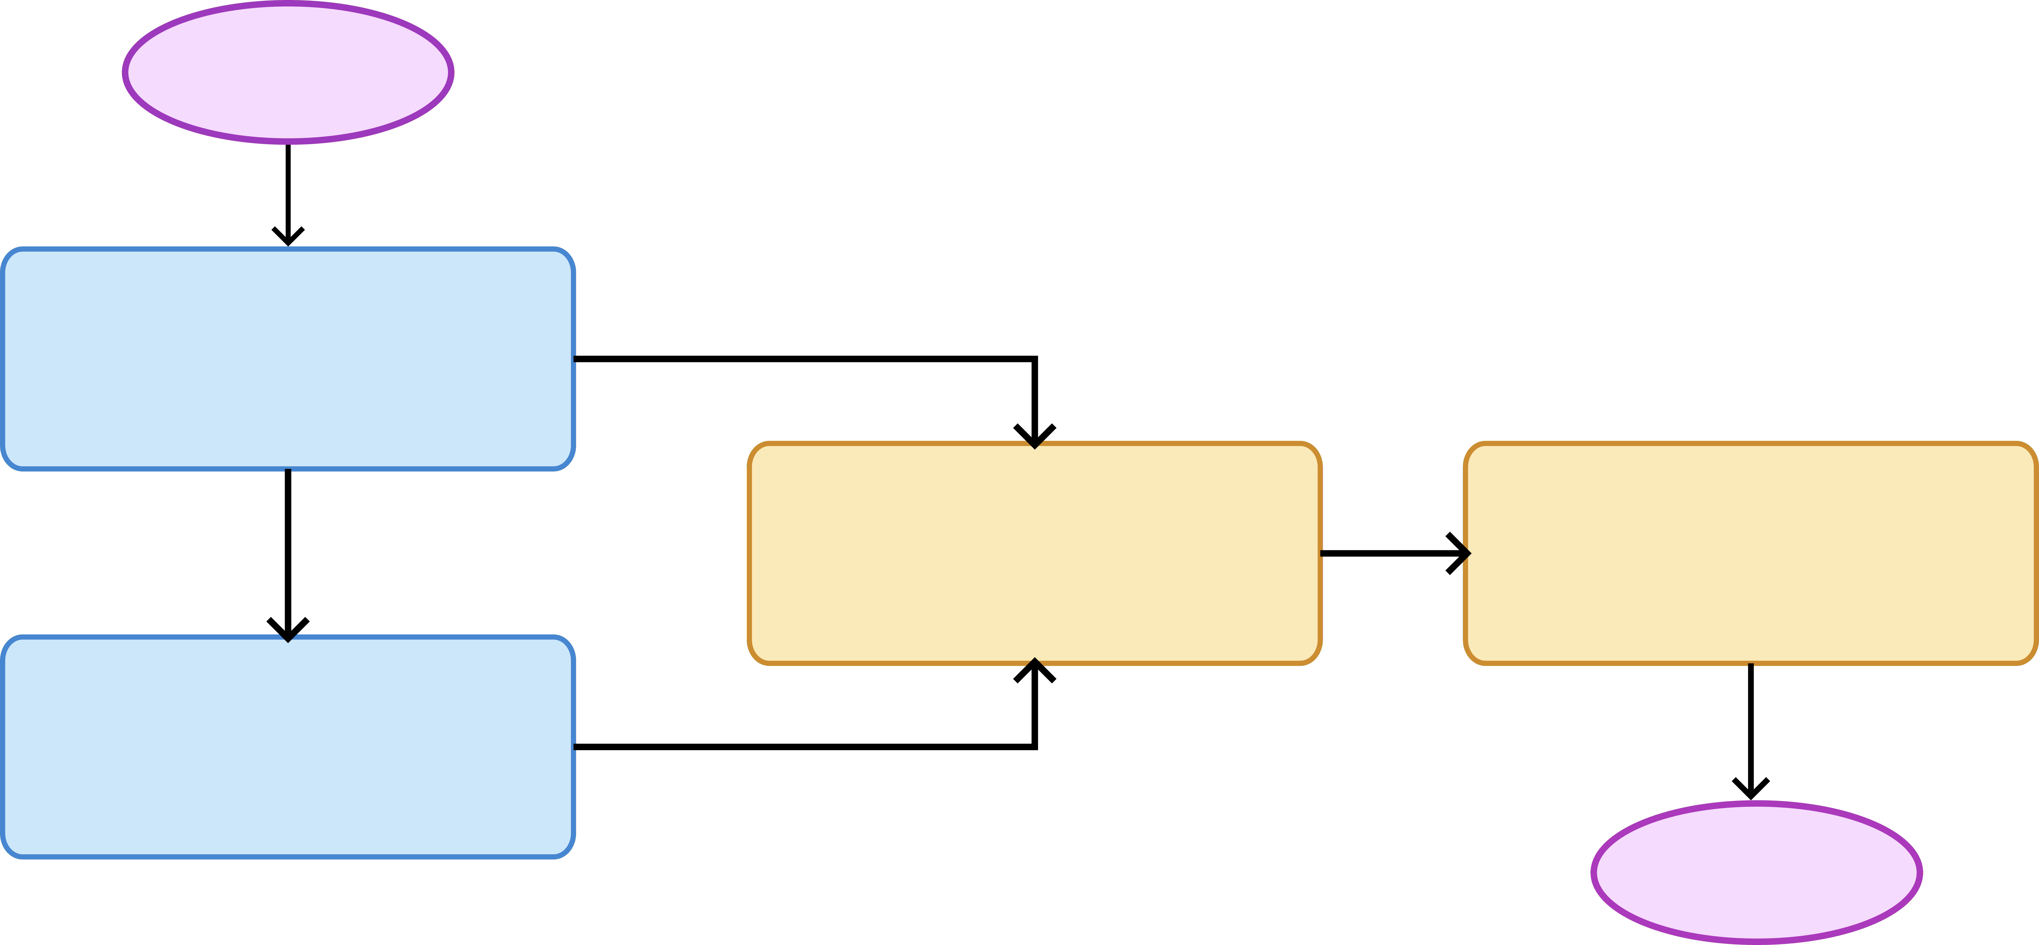


How we addressed the problem
Our idea: a new workflow that includes a dashboard prototype and an interaction protocol
START
Scorecard
Interview
Data + opinion
Judgement
process
Operator
survey
Cashy
Score + motivation
END
We propose a solution that is based on the currently used workflow, with a couple of modifications centered on the human operator’s impact.
1
Notes:
The AI model developed by UNHCR (Cashy) is not fully reliable, given the complexity of each real-life case.
Our proposal is to modify the current process by adding a dashboard that helps the operator to take a decision, without fully relying on the machine.

Slide 3


Our solution
Machine reliability calculator
The dashboard is both data and psychology driven (bibliography below).
Judgement
process
Operator
survey
Matching
function
criticality level (%)
References:
O'Brien, H.L. and Toms, E.G. (2008), What is user engagement? A conceptual framework for defining user engagement with technology. J. Am. Soc. Inf. Sci., 59: 938-955. https://doi.org/10.1002/asi.20801
Dietvorst, Simmons & Massey (2015), Algorithm aversion: People Erroneously Avoid Algorithms after Seeing Them Err
Yu, L., Li, Y., & Fan, F. (2023). Employees' Appraisals and Trust of Artificial Intelligences' Transparency and Opacity. Behavioral sciences (Basel, Switzerland), 13(4), 344. https://doi.org/10.3390/bs13040344
Logg, J. M., Minson, J. A., & Moore, D. A. (2019). Algorithm appreciation: People prefer algorithmic to human judgment. Organizational Behavior and Human Decision Processes, 151, 90–103. https://doi.org/10.1016/j.obhdp.2018.12.005
2
Notes:
Il processo di judgement prende in input l’uscita di Cashy che verrà data all’operatore e poi prende l’output dell’intervistatore. Viene valutata la discrepanza tra I due input tramite una tecnica di machine learning.
Quindi la percentuale di similitudine che abbiamo ottenuto viene utilizzata per la gestione della dashboard.

Slide 4
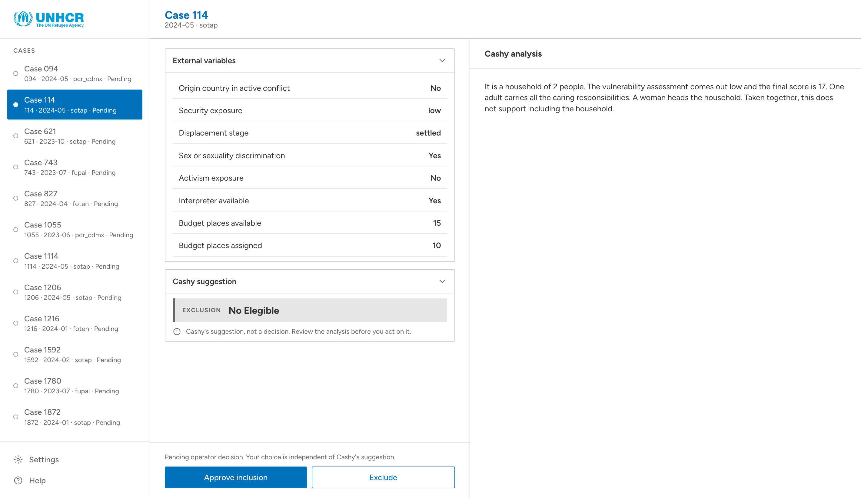

Our solution
Dashboard example
Judgement
process
Operator
survey
3
Notes:
La prima parte dell’operator survey consiste in una dashboard dove imbase all’output del judgment vengono mostrati dei pop up di alert all’operatore in modo da aumentare la sua attenzione. Questa scelta è stata fatta sulla base di studi di psicologia (biblio sotto).

Slide 5
Our solution
Improvement of the survey system
Judgement
process
Operator
survey
New survey questions:
Rate the effectiveness of Cashy-AI for identifying and selecting the “right” individuals for the assistance.
Why do you agree or disagree? Select all that apply.
Does Cashy-AI provide content that is relevant to help you make an informed decision?
4
Notes:
La seconda parte dell’operator survey consiste in un feedback attivo sull’operato di cashy basato sul questionario di verifica(The review screen and the items answered after each assessment) fornitoci da UNHCR.Il questionario viene presentato all’operatore per spingerlo a leggere in maniera critica l’output di cashy senza affidarsi troppo alla macchina.

Slide 6
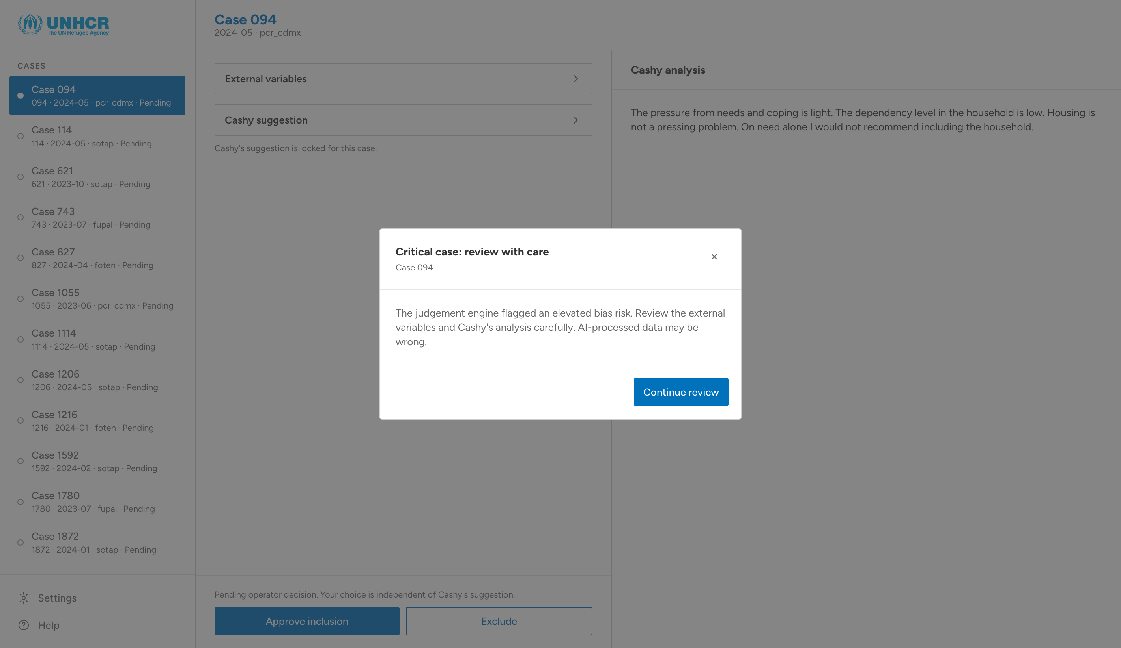
Use case scenario
Responsive pop-ups and alerts
5

Slide 7
Wrapping up…
Our solution works because:
it keeps the final decision on the caseworker
it avoids the caseworker to rely excessively on the machine
Possible future improvements:
adding more context to the dataset
implementation of more psychology-driven features
6

Slide 8
Thank you for the attention!
Our solution works because:
it keeps the final decision on the caseworker
it avoids the caseworker to rely excessively on the machine
Possible future improvements:
adding more context to the dataset
implementation of more psychology-driven features
7

