Slide 1
Why?
Why does onboarding need a new app?
1 in 5
18th of 20
3.5x
new joiners leave within 12 months of starting
where preboarding ranks among new starter experience scores
higher new hire satisfaction when line managers play an active role
Figures from our challenge briefing notes
OUR MISSION
“Safety is not the absence of threat, it’s the presence of connection.”
Notes:
Why? That's where we want to start. Why does Lloyds Banking Group need an onboarding app at all?
Because right now, around one in five people who join us leave within twelve months. Preboarding, the stretch between accepting the offer and day one, ranks 18th out of 20 measures of the new starter experience. And we already know what works: when line managers play an active role in onboarding, new hire satisfaction is three and a half times higher.
So the problem isn't a shortage of content. It's a shortage of connection. That gave us our mission statement for this challenge: "Safety is not the absence of threat, it's the presence of connection."
A new colleague feels safe when they know who is around them, what is coming next, and who to ask. Everything we've built follows from that.

Slide 2

Forget choreography. We’ve got dressage
The Product Owner’s brief: across 1,500 comments, new joiners don’t want more content. They want better choreography and a guided journey.
WHAT WE WERE ASKED FOR
WHAT WE BUILT FOR
Choreography
Dressage
“The coordinated arrangement or manipulation of complex actions.”
“The training of a horse to develop maximum suppleness, flexibility, balance, and strength, allowing it to perform precise, coordinated movements.”
Choreography arranges the steps.
Dressage builds the strength to perform them.
Notes:
In the Product Owner's presentation on the existing journey, one message stood out. Across 1,500 comments, new joiners said they don't want more content. They want better choreography and a guided journey.
So we looked up choreography. It's defined as "the coordinated arrangement or manipulation of complex actions". That's fine, but it's something done to you. Somebody else arranges the steps.
And we decided: forget choreography, we've got dressage. Dressage is defined as "the training of a horse to develop maximum suppleness, flexibility, balance, and strength, allowing it to perform precise, coordinated movements".
That's the difference. Choreography arranges the steps. Dressage builds the strength to perform them. We don't just want to move a new colleague through a process. We want them to come out of their first ninety days balanced, confident and ready to perform. And for a bank with a black horse as its emblem, it felt like the right discipline.

Slide 3
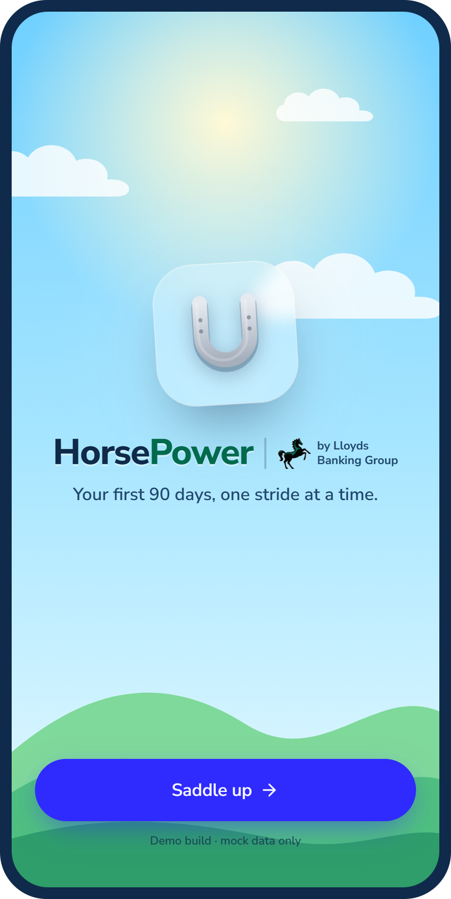



Why a horseshoe, and why HorsePower
Luck, protection and prosperity
The horseshoe gives your journey at Lloyds Banking Group the best start.
Shoes on before the road
A horse needs horseshoes before it can canter or gallop on the road.
HorsePower means momentum
Chosen so that the colleague can gain momentum in their new career.
It starts in the kit box
A large QR code on the inside of the lid opens the HorsePower app.
Notes:
That thinking gave us our symbol and our name.
The symbol is the horseshoe. A horseshoe is a symbol of good luck, protection and prosperity, and that's what we want to hand every new colleague: the best start to their journey at Lloyds Banking Group. There's a practical side too. You need to put horseshoes on a horse's feet before it can canter or gallop on the road. Onboarding is the shoeing. Get it right, and everything after it is faster and safer.
The name is HorsePower. We chose it so that the colleague can gain momentum in their new career, from their first day and not their first quarter.
And it starts before day one. The kit box that's sent out to each new starter will have a large QR code on the inside of the lid. Open the box, scan the code, and you're in the HorsePower app.

Slide 4
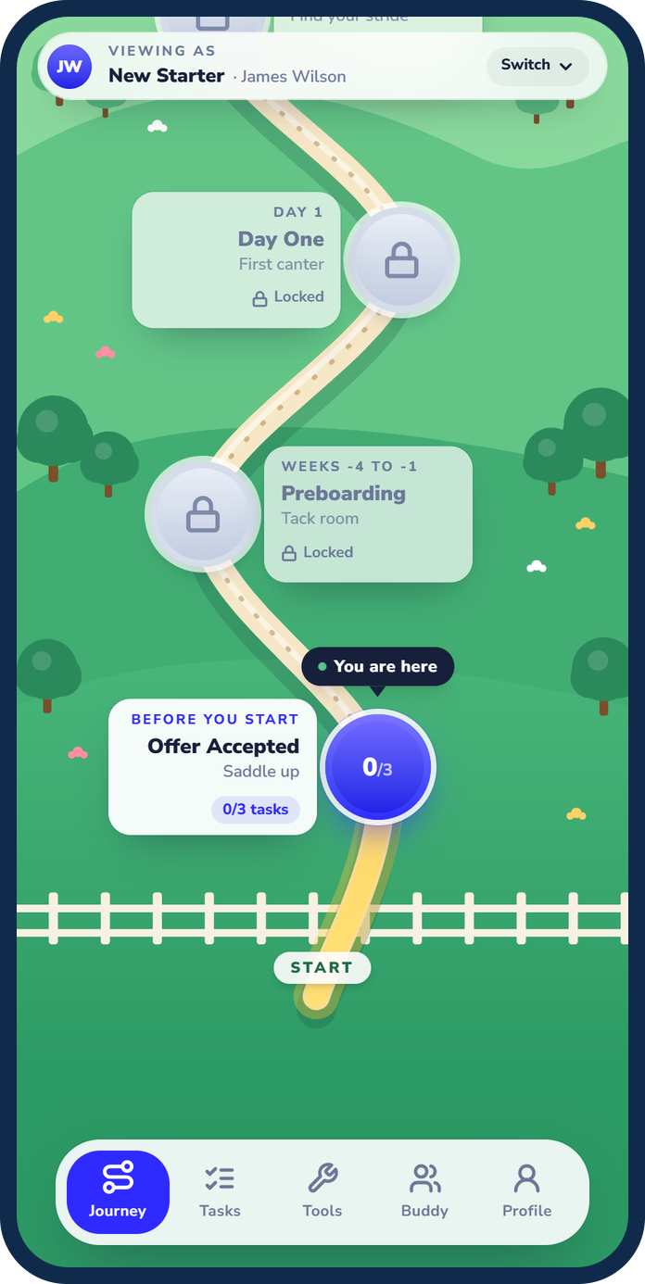
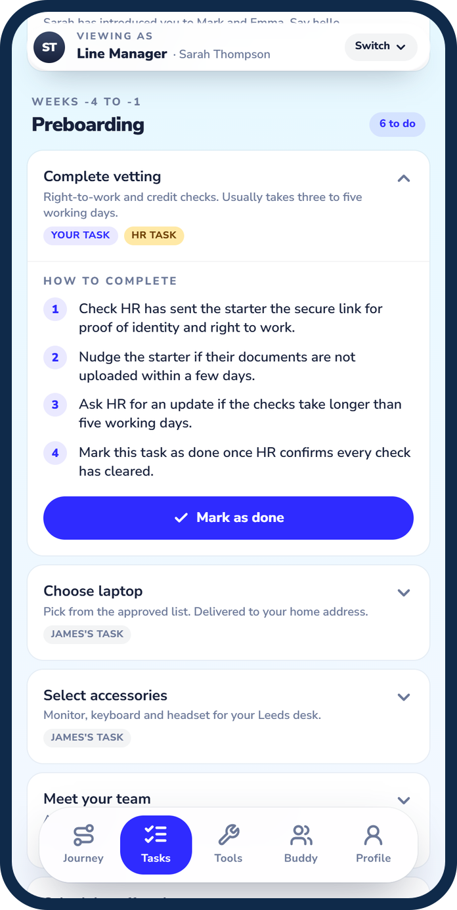




One guided journey, from offer to day 90
A guided path
Six stages from Offer Accepted to day 90, each unlocking as tasks are done.
Four views, one journey
Starter, line manager, team buddy and job family buddy each see their tasks.
Line manager as middleman
They own the HR and IT tasks, so the starter never has to chase them.
Connection built in
Two buddies before day one, plus an AI buddy for HR questions.
Notes:
So what do you get when you scan it? One guided journey, from offer accepted to day ninety. It's laid out as a path through six stages, with names like Saddle Up, First Canter and Gallop, and each stage unlocks as tasks are completed.
It isn't only for the new starter. There are four views: the new starter, the line manager, a team buddy, and a job family buddy who joined recently themselves. Everyone sees the same journey, with their own tasks marked as theirs and step-by-step guidance on how to complete each one. The new starter can also choose their laptop and kit, and browse an app store of the tools they'll be using.
One deliberate design choice: the line manager is responsible for the HR and IT tasks, things like vetting and system set-up, because they are the middleman. They already have the relationships with HR and IT, so they chase those tasks and the new starter never has to work out who to call. The tasks are still tagged as HR or IT, so it's clear where the work is being done.
And connection is built in. There are two buddies to say hello to before day one, and an AI chat buddy for questions about pay, benefits and policies at any time, including weekends.

Slide 5
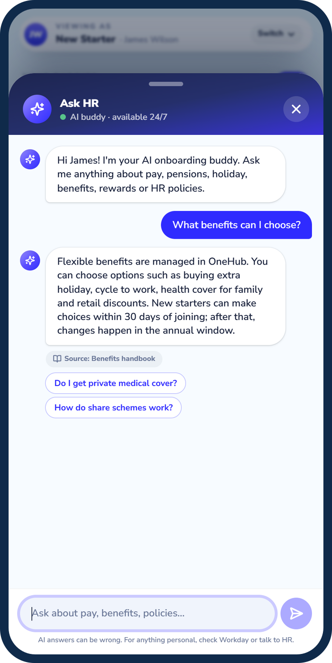

Prototype today, production tomorrow
TODAY
NEXT
Prototype
Production
APP
APP
Clickable web prototype
Native iOS, built using Swift
DATA
DATA
Mock data only
Backend and databases hosted in Azure
AI BUDDY
AI BUDDY
Answers from a built-in knowledge base of placeholder HR content
Draws on approved HR policy sources
Notes:
Finally, the build. What you've seen is just a prototype: a clickable web prototype running on mock data, built to show the experience end to end. The real app would be a native iOS app built using Swift, with the backend and databases hosted in Azure.
The same goes for the AI buddy. In the prototype, the AI chat buddy answers from a built-in knowledge base of placeholder HR content. In production it would draw on approved HR policy sources, so colleagues get answers they can rely on.
So that's HorsePower: a lucky horseshoe, a guided journey, and people around you from the day you accept the offer. Forget choreography. We've got dressage. Thank you. We'd welcome your feedback.

