Slide 1

@MMU

Slide 2

What are we doing today?
Image credit: Tory Townsend

Slide 3
Today
Today we demonstrate tools and platforms that let you focus on the job in hand.
These tools remove boiler-plate coding and configuration effort.
They aren’t a substitute for understanding!
They need investigation before being used.

Slide 4
Today
Tools Two:
JAM – Javascript, APIs, Markup - new Stack!
Javascript throughout the stack
API fronts server-side functionality
Single Page Web App / Progressive Web App / Cordova App
Introducing REST APIs – make micro services in seconds! (small lie)
RESTful Web Services
IDLs and the Open API Specification
IDL Tools
Security
Introducing PaaS – people making amazing useful stuff for free, so you don’t have to!
GitHub Pages
Restlet
Heroku
Auth0
Introducing your Case Studies - look at amazingly useful examples!
The Urban Wild
Time Series Data Capture
LittleList

Slide 5
Let’s Fly!
Image credit: Tory Townsend

Slide 6
JAM Stack
Yet another way to develop web applications:
Javascript, APIs, Markup

Slide 7
JAM Stack
A single set of Markup files (a web app) is served to a browser
Or
Client is pre-built (mobile app)
Javascript is used to control the application and its UI.
The web app gets its data from web services, via their APIs

Slide 8

JAM Stack
Static site host
A service
An API
An API
Another service
Browser
An API

Slide 9
JAM Stack
What’s an API?
Application Programming Interface
Sits between a service and its clients
Imposes a predictable communication between them
More here!

Slide 10


JAM Stack
What’s an API?
Quick example
The Urban Wild - Wildlife logging app
User logs wildlife sightings at their location
User searches wildlife sightings at other locations

Slide 11
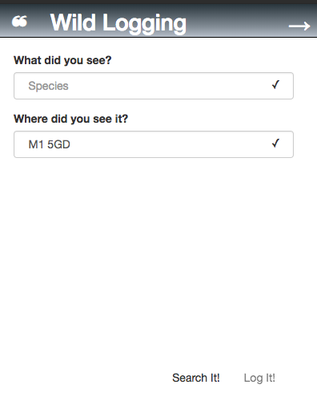
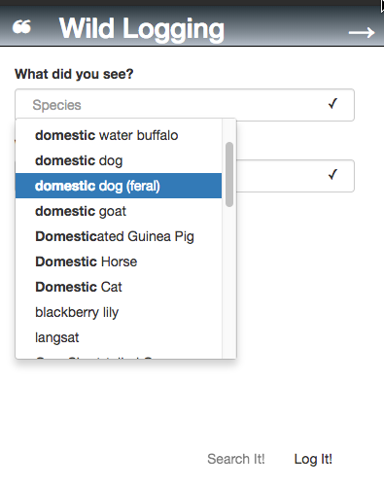
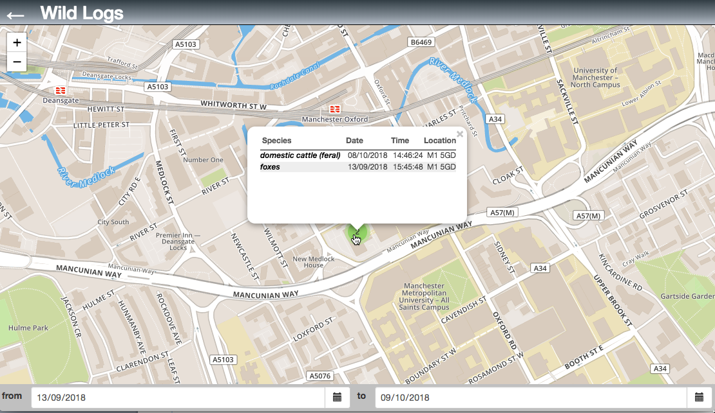
JAM Stack
What’s an API?
Quick example
The Urban Wild - Wildlife logging app

Slide 12
JAM Stack
Static site host (Git Hub Pages)
Postcode and location service
Location to postcode API
Browser downloads webapp (Markup and Javascript)
4. Script wants post code from location
Postcode to location API
Datalogging service
Postcode to data API
2. Browser runs Script
5. Script wants all items at this postcode
6. Script displays wildlife sightings on a map
3. Script gets location from browser

Slide 13
JAM Stack
What makes a ‘Good’ API?
Efficient
Minimise calls
Minimise bandwidth
Scalable
Larger datasets
Many users
Well documented
Essential
Accurate
Easy to use
KISS *
APIs are designed:
Operations
Data
*Keep It Simple Stupid. Attributed to Kelly Johnson, Lead Engineer at Lockheed Martin’s Skunk Works

Slide 14
Introducing REST APIs
Communicating with the Service
Clients communicate with a service via a protocol:
REST (Representational State Transfer)
SOAP (Simple Object Access Request Protocol)
Lots of Others
Pass data over the API as a payload of the protocol:
JSON
XML
Lots of Others
(you can even use CSV)

Slide 15
Introducing REST APIs
RESTful Web Services
There are lots of protocols which can be used to communicate between clients and web services.
We use REST, because it makes development easier:
Simple, yet rich
Everywhere
Well-tooled
Not fast, not slow
Not too verbose
Easily debugged

Slide 16
Introducing REST APIs
RESTful Web Services
What’s REST?
REST (Representational State Transfer)
set of architectural principles
Sits on HTTP 1.1
Developed with HTTP 1.1 in 2000 by Roy Feilding
Clients interact with the service, using links and operations
A URL points to a resource:
Here’s one for a collection:
https://www.cars.com/registrations/
Here’s one for an item:
https://www.cars.com/registrations/AB45PRZ/
How about a postcode lookup?
https://postcodesrus.com/postcodes/

Slide 17
Introducing REST APIs
RESTful Web Services
HTTP used to interact with service’s resources
Request methods used to do this:
POST – creates
PUT – updates completely
GET (safe method)
DELETE – removes
PATCH – changes
Standard HTTP responses returned

Slide 18
Introducing REST APIs
RESTful Web Services
The MIME type tells the client what data to expect in the response.
Often:
application/json
application/xml

Slide 19
Introducing REST APIs
RESTful Web Services
POST http://postcodesrus.com/postcodes
Request Body:
{
"lat":"53.474300",
"lon":-2.246820"
}
Response Header:
{
"content-type": "application/json"
}
Response Body:
{
"composite”:"M1 5GD”
}

Slide 20
Introducing REST APIs
RESTful Web Services
Q: How did I know the service would do that?

Slide 21
Introducing REST APIs
RESTful Web Services
Q: How did I know the service would do that?
A: It was documented, using an Interface Definition Language
IDL

Slide 22
Introducing REST APIs
REST IDL
Interface Definition Language
Formal definition of an API
Operations
Data
Accompanies the protocol
SOAP -> WSDL
REST -> OAS (swagger)
gRPC -> Protocol Buffers
Lots of others!
Advertises the capabilities of a service
Enables generation of boiler-plate code

Slide 23
Introducing REST APIs
REST IDL
Example
Postcode and Location Service
Location to Postcode API
Defines the data types
‘location’
‘postcode’
Advertises resources
/postcode
Advertises parameters
Location
Advertises responses
Postcode
Postcode and location service
Location to postcode API

Slide 24
Introducing REST APIs
---
swagger: "2.0"
info:
description: "A simple API for looking -up postcodes, given a location"
version: "1.0.0"
title: "Postcode Lookup”
host: "postcodesrus.com"
schemes:
- "https"
consumes:
- "application/json"
produces:
- "application/json"
paths:
/postcodes:
post:
summary: "lookup request"
description: "creates a request to lookup a postcode"
consumes: []
parameters:
- name: "body"
in: "body"
required: true
schema:
$ref: "#/definitions/Location"
responses:
200:
description: "Lookup successful"
schema:
$ref: "#/definitions/Postcode"
400:
description: "Not a recognised location"
404:
description: "No postcode at this location"
definitions:
Postcode:
type: "object"
required:
- "composite"
properties:
composite:
type: "string"
description: "the postcode as seen on an address"
description: "A UK Postcode"
Location:
type: "object"
required:
- "lat"
properties:
lat:
type: "number"
description: "Latitude"
lon:
type: "number"
description: "Longitude"
description: "A geographical location”
REST IDL
OAS
Open API Specification
Previously called Swagger 2.0
Based on YAML
(YAML Ain’t Markup Language)
Postcode and location service
Location to postcode API

Slide 25
Introducing REST APIs
Tools
swagger.io
OpenAPI GUI V2
These will help you define an API, using an IDL.
These will generate code from an IDL.
You can create a Java EE / NodeJS server from an interface definition.
OpenAPI GUI V2 lets you define your API graphically

Slide 26
Introducing REST APIs
Security
HTTP supports authentication
HTTPS allows secure transmission
IDL allows definition and advertising of the security scheme

Slide 27
Introducing REST APIs
Security
HTTP supports authentication
HTTPS allows secure transmission
IDL allows definition and advertising of the security scheme
A properly defined and constructed API will ensure:
secure transmission of data
immediate rejection of unauthorised requests

Slide 28
Introducing REST APIs
Security
Why do I need security?
If you deal with any kind of user data, then you need to be aware of:
The Information Commissioner’s Office (ICO)
The Data Protection Act
The General Data Protection Regulations
If you don’t need to, don’t store personally attributable / identifiable information AT ALL. EVER.

Slide 29
Introducing REST APIs
Security
Securing websites and databases is tricky
It is an arms race.
Use Platforms As A Service to delegate:
Complex configuration
User Authentication

Slide 30
Introducing PaaS
Platform as a Service
A server system which provides a set of services, accessible online.
In particular for us:
Database Hosting (Mongo, MySQL, Postgres…)
API services hosting
User accounts and authentication

Slide 31

Introducing PaaS
We use Heroku as our easy-to-use service provider.
Why?
Much of the configuration previously seen with webservers is hidden.
That means it’s more difficult to make mistakes

Slide 32
Introducing PaaS
We use Auth0 as our easy-to-use authentication provider.
Why?
We can delegate all user accounts to experts
They provide a robust method by which we can authenticate users.
That means it’s more difficult to make mistakes

Slide 33
Introducing PaaS
We use GitHub Pages as our easy-to-use front-end provider.
Why?
It’s easy.
We can host static web pages which authenticate through a third-party, and then access data via an API. Oo! JAM!
Pushed immediately from our GitHub repo

Slide 34
Introducing PaaS
GitHub Pages
3rd Party Service
3rd Party API
3rd Party API
Restlet
Generated API
We need work only on the database definition in Restlet, and the actual app.

Slide 35
Case Studies
We have produced a set of Case Studies and example code to help you as you design and construct your Live Project:
The Urban Wild
Project: Github
Diary: DigitalLabs Post
Web App: Angular JS
Host: GitHub Pages
APIs
Postcode
IT IS
Restlet PaaS
Time Series Data Capture
LittleList
The Urban Wild
Demo Project
Let’s try and push the limits of what we can do without creating our own server, just using PaaS.
Allow casual users to add wildlife sightings to a map.
Allow them to search on location and date for other sightings.
65 Hour rush job.

Slide 36
Case Studies
We have produced a set of Case Studies and example code to help you as you design and construct your Live Project:
The Urban Wild
Time Series Data Capture
Project: Github
Diary: DigitalLabs Post
Web App: Angular JS, D3
Host: GitHub Pages
APIs
TimeSeriesDataCapture_ImportSource
TimeSeriesDataCapture_BrowseData
Microsoft OneDrive
Auth0
LittleList
Time Series Data Capture
Scientists like to save their data in CSV files
Then they put it on OneDrive
… can’t find anything!
This system imports data to Mongo DB
Adds preview, tagging, annotation, search, visualisation.
This was a 60 Day project, by a Mentored Summer Student

Slide 37
Case Studies
We have produced a set of Case Studies and example code to help you as you design and construct your Live Project:
The Urban Wild
Time Series Data Capture
LittleList
Project: Github
Mobile App: GitHub, Ionic1, Cordova
Web App: GitHub, Angular JS, Ionic1,
Host: GitHub Pages
APIs
LittleList
A tiny project for you to fork
Use it as a basis for anything which gets a bunch of items from a search
Easy demo of concepts like
Changing UI States
Asynchronous calls
How-to for mobile works out-of-the box on Lab PCs.

Slide 38

Things To Do
Image credit: Fabi Fliervoet

Slide 39
@MMU
SustainableCreativeAmbitiousSuccessful

