Slide 1
62.Unique Paths
https://leetcode.com/problems/unique-paths/

Slide 2
A robot is located at the top-left corner of a m x n grid (marked 'Start' in the diagram below).
The robot can only move either down or right at any point in time. The robot is trying to reach the bottom-right corner of the grid (marked 'Finish' in the diagram below).
How many possible unique paths are there?
Note: m and n will be at most 100.

Slide 3
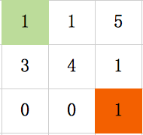
Input：
Matrix m*n
Output:
Minimized Sum
top left to bottom right
down or right
Sum1 = 7
Sum2 = 5
MinSum = Sum2 = 5

Slide 4
Edge & Test Cases
Input Output
None 0
Empty 0
Regular min

Slide 5
Brainstorming
Sum
Sum+1
Dynamic Programming
Sum+3

Slide 6
Dynamic Programming
Recursive amount:
Minimum Sum at [i][j]
Recurrence Formula:
dp[i][j]=min(dp[i-1][j],dp[i][j-1])+grid[i][j]
Initial conditions:
dp[0][i]=dp[0][i-1]+grid[0][i]
dp[j][0]=dp[j-1][0]+grid[j][0]

Slide 7
Recursive amount:
Minimum Sum at [i][j]
Dp[1][1] = 6

Slide 8
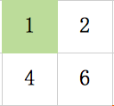
Recurrence Formula:
dp[i][j]=min(dp[i-1][j],dp[i][j-1])+grid[i][j]
Dp[0][1] = 2
Dp[1][0] = 4
Dp[1][1] = 6

Slide 9
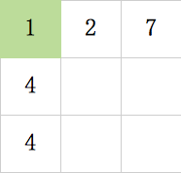
Initial conditions:
dp[0][i]=dp[0][i-1]+grid[0][i]
dp[j][0]=dp[j-1][0]+grid[j][0]
Runtime: O(m*n)

Slide 10
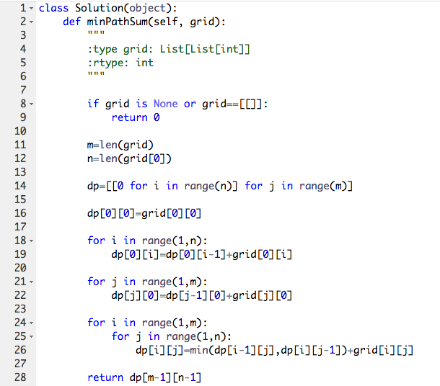
Coding

Slide 11
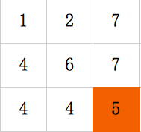
Debugging
Input Output
None 0
Empty 0
Regular min
Sum2 = 5
MinSum = Sum2 = 5
Return dp[2][2] = 5

