Slide 1
64.Minimum Path Sum
https://leetcode.com/problems/minimum-path-sum/

Slide 2
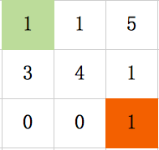
Given a m x n grid filled with non-negative numbers, find a path from top left to bottom right which minimizes the sum of all numbers along its path.
Note: You can only move either down or right at any point in time.
Input：
Matrix m*n
Output:
Minimized Sum
top left to bottom right
down or right
Sum1 = 7
Sum2 = 5
MinSum = Sum2 = 5

Slide 3
Edge & Test Cases
Input Output
None 0
Empty 0
Regular min

Slide 4
Brainstorming
Sum
Sum+1
Dynamic Programming
Sum+3

Slide 5
Dynamic Programming
Recursive amount:
Minimum Sum at [i][j]
Recurrence Formula:
dp[i][j]=min(dp[i-1][j],dp[i][j-1])+grid[i][j]
Initial conditions:
dp[0][i]=dp[0][i-1]+grid[0][i]
dp[j][0]=dp[j-1][0]+grid[j][0]

Slide 6
Recursive amount:
Minimum Sum at [i][j]
Dp[1][1] = 6

Slide 7
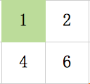
Recurrence Formula:
dp[i][j]=min(dp[i-1][j],dp[i][j-1])+grid[i][j]
Dp[0][1] = 2
Dp[1][0] = 4
Dp[1][1] = 6

Slide 8
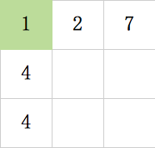
Initial conditions:
dp[0][i]=dp[0][i-1]+grid[0][i]
dp[j][0]=dp[j-1][0]+grid[j][0]
Runtime: O(m*n)

Slide 9
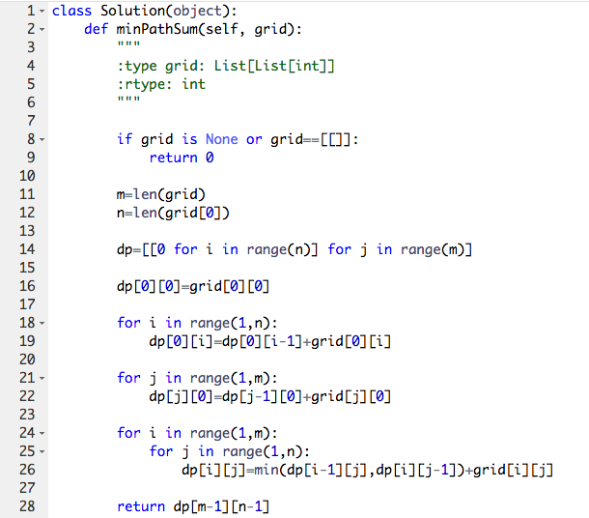
Coding

Slide 10
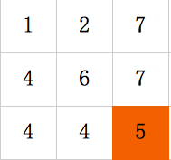
Debugging
Input Output
None 0
Empty 0
Regular min
Sum2 = 5
MinSum = Sum2 = 5
Return dp[2][2] = 5

