Slide 1
174.Dungeon Game
https://leetcode.com/problems/dungeon-game/

Slide 2
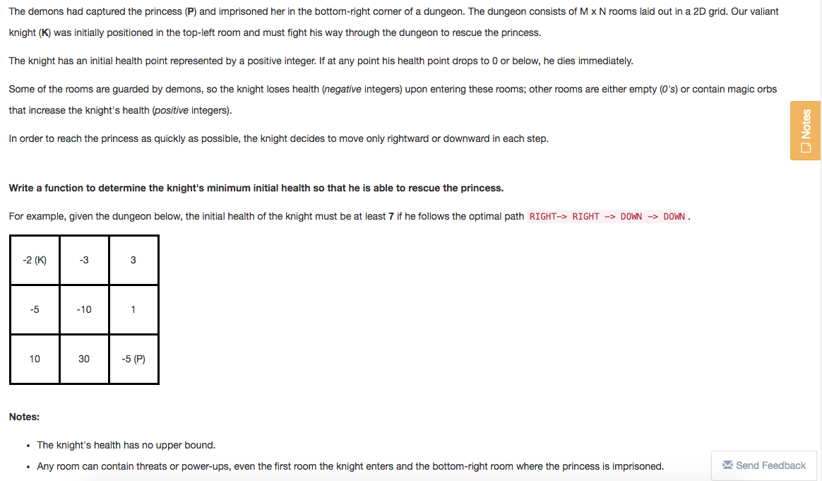
Question

Slide 3
From top-left to down right
Down or Right
“Sum” along the path
Initial health point>=1, will immediately die when hp<=0
Target:
Minimum initial health point (>=1 and minimum)
Initial health point + sum(values along path to down right) >=1

Slide 4
Input & Output
Input：
Matrix m*n
Output:
A positive integer
Edge & Test Cases
Input Output
None 0
Empty 0
Regular min

Slide 5
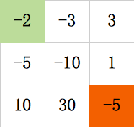
Brainstorming
Initial
max(1,5)
max(1,-24)
6
6
Sum(path) >= 0，
then minimum_initial=1
Sum(path) < 0，
sum_path1=-3, sum_path2=-10,
ini_hp=4, ini_hp=11
then minimum_initial=4

Slide 6
All paths，
Then, result =1 or 1-max(lower0_sum_path)
Runtime is large

Slide 7


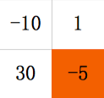
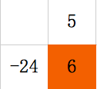
Init+(-5)>=1
Dynamic Programming
min_init_hp_-5=1-(-5)=6
Init+(1)>=min_init_hp_-5
min_init_hp_1=6-(1)=5
Init+(-10)>= min ( min_init_hp_1, min_init_hp_30 )
Init >=max( 1, min ( min_init_hp_1, min_init_hp_30 )-(-10) )

Slide 8
Dynamic Programming
Recursive amount:
dp[i][j=离开这个点时，要活着走完后面的路程，所需要最小的 hp
Recurrence Formula:
dp[i][j]=max( 1, min(dp[i+1][j],dp[i][j+1])-grid[i][j] )
Initial conditions:
dp[m-1][j]=max(1, dp[m-1][j+1]-grid[m-1][j] )
dp[i][n-1]=max(1, dp[i+1][n-1]-grid[i][n-1] )
Result:
dp[0][0]
Runtime: O(m*n)

Slide 9
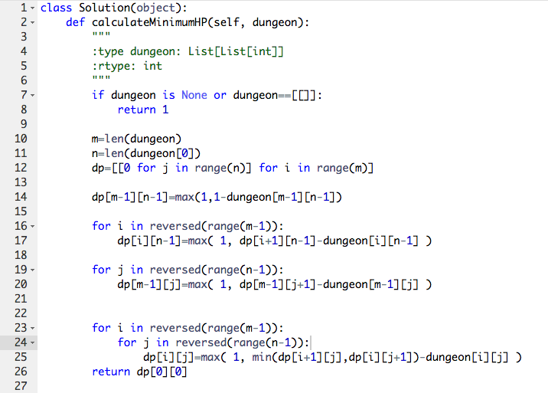
Coding

Slide 10
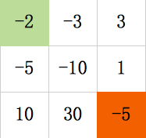
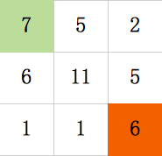
Debugging
Input Output
None 1
Empty 1
Regular min
path
Return dp[0][0] = 7

