Slide 1
AI-MCN: Replacing Traditional MCN Matching with an AI Decision System
MSIS 521 Course Project | 15-minute Presentation
Client case: Beauty of Joseon (BOJ), U.S. sunscreen campaign
Goal: help brands find best-fit influencers directly with transparent AI logic
Team: [Add names]
Sources: GitHub repo | EMARKETER 2025
Section 1 | Title and Team

Slide 2
Agenda and Timing (Professor Guide)
1) Title and team (1 min)
2) Business context and problem (2-3 min)
3) Data and features (1-3 min)
4) AI/ML approach (3-4 min)
5) Prototype demo (3-4 min)
6) Impact, limitations, next steps (2-3 min)
7) How we used AI tools (1-2 min)
Sources: MSIS 521 assignment/rubric (internal PDFs)
Section 2 | Roadmap

Slide 3
Business Context and Problem
Current MCN-Style Workflow
Decision We Improve
MCNs aggregate influencer data and broker brand-creator matching.
Brands pay agency/management fees plus campaign budget.
Matching logic is often hard to audit for brand teams.
From manual or popularity-led creator selection
To evidence-based, product-specific creator ranking
Goal: reduce expensive mismatch risk before launch
Sources: YouTube Content Manager | YouTube MCN setup | IAB Creator Economy
Section 3 | Context and Decision

Slide 4
Why Now: Market Evidence
US influencer marketing spend is projected at $10.52B in 2025 (EMARKETER, Mar 13, 2025).
YouTube influencer use among US marketers is projected to exceed 50% in 2025 (EMARKETER).
Global beauty grew 7.3% YoY in 2025; US beauty sales are 41% e-commerce (NIQ, Feb 25, 2025).
McKinsey projects core beauty segments to reach about $590B by 2030, with skincare as the largest segment (Aug 28, 2025).
Sources: EMARKETER | NIQ Beauty 2025 | McKinsey 2025
Section 3 | External Industry Context

Slide 5
Why Beauty and Why BOJ
Case Fit
Dataset Feasibility Signals
Beauty creator marketing is large and highly content-driven.
BOJ has visible social momentum and a product-specific campaign story.
BOJ U.S. expansion + sunscreen focus make a practical demo scenario.
(Fashionista coverage, Nov 13, 2024)
Source file: videos_text_ready_combined.csv (n=67,283 videos)
sunscreen: 3,981 videos | 340 channels
spf: 3,850 videos | 344 channels
beauty of joseon: 286 videos | 69 channels
cerave: 747 videos | 118 channels
Sources: Fashionista BOJ | BOJ Rice Wonderland | FDA SIA
Section 3 | Client and Case Selection

Slide 6
Data and Features
Data Used
Feature Groups
Team-collected YouTube API exports (videos/comments/channel fields)
Videos analyzed (full run): 42,750
Channels scored: 1,089
Main files: videos_text_ready, comments_raw, master_prd_slim
Network features: centrality + community
Text features: TF-IDF + semantic/tone alignment
Behavioral features: views/likes/comments/engagement
Reliability features: evidence score + credibility multiplier
Sources: YouTube Data API | Project data files (internal)
Section 4 | Data and Feature Engineering

Slide 7
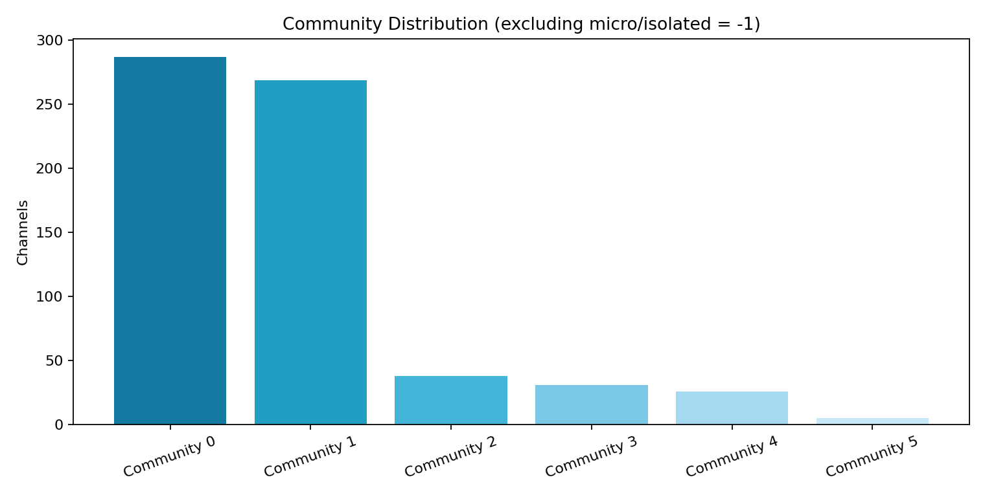
Preprocessing and EDA
What we did
Deduplication + type normalization
Beauty include filter + non-beauty noise exclusion
Channel-level aggregation and recency features
EDA confirmed cluster concentration -> diversity guardrail needed
Sources: Preprocessing pipeline (internal) | EDA plots (internal)
Section 4 | Data Understanding

Slide 8
AI/ML Approach (Class-Learned Methods Focus)
1) Social Network Analysis: creator graph, centrality, communities
2) Text Analytics: TF-IDF relevance + semantic/tone enrichment
3) Supervised Regression: Linear, LASSO, Ridge, CART, RandomForest, LightGBM
4) Validation: GroupKFold(5) by channel to reduce leakage
5) Explainability: SHAP for feature contribution
Extensions shown in demo: ROI simulator, strategy and memo generation
Sources: GroupKFold | LightGBM | SHAP
Section 5 | Methods

Slide 9
Why This Method Mix
Why not follower-count only
Hybrid ranking logic
Misses campaign-language fit
Misses network position and community overlap
Misses quality/reliability signals
High chance of expensive creator mismatch
Network influence + text fit + engagement potential
Reliability multiplier to penalize low-signal channels
Diversity constraint for healthier final shortlist
More robust than single-signal ranking
Sources: FTC Influencers | FTC Endorsement Guides | YouTube MCN reference
Section 5 | Method Choice Rationale

Slide 10
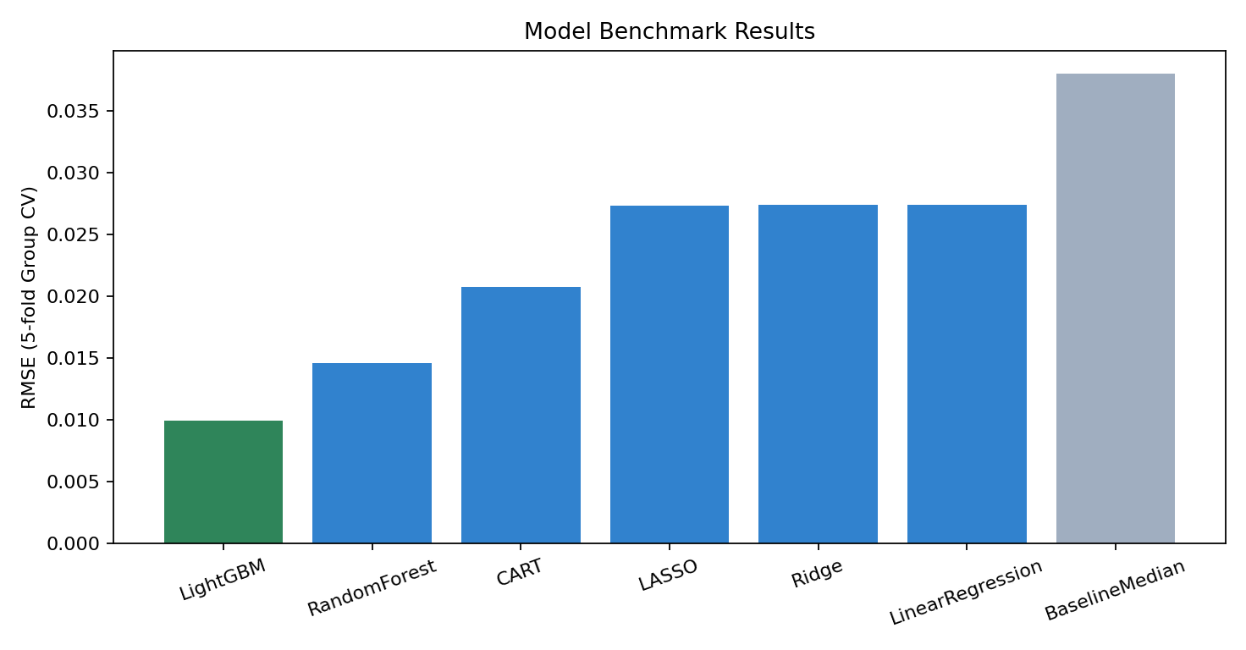
Model Results and Validation
Best model: LightGBM
Best RMSE: 0.00996
Baseline RMSE: 0.03800
Relative RMSE reduction: 73.8%
Interpretation: meaningful uplift over naive baseline
Sources: ML CV outputs (internal) | LightGBM docs
Section 5 | Validation Output

Slide 11
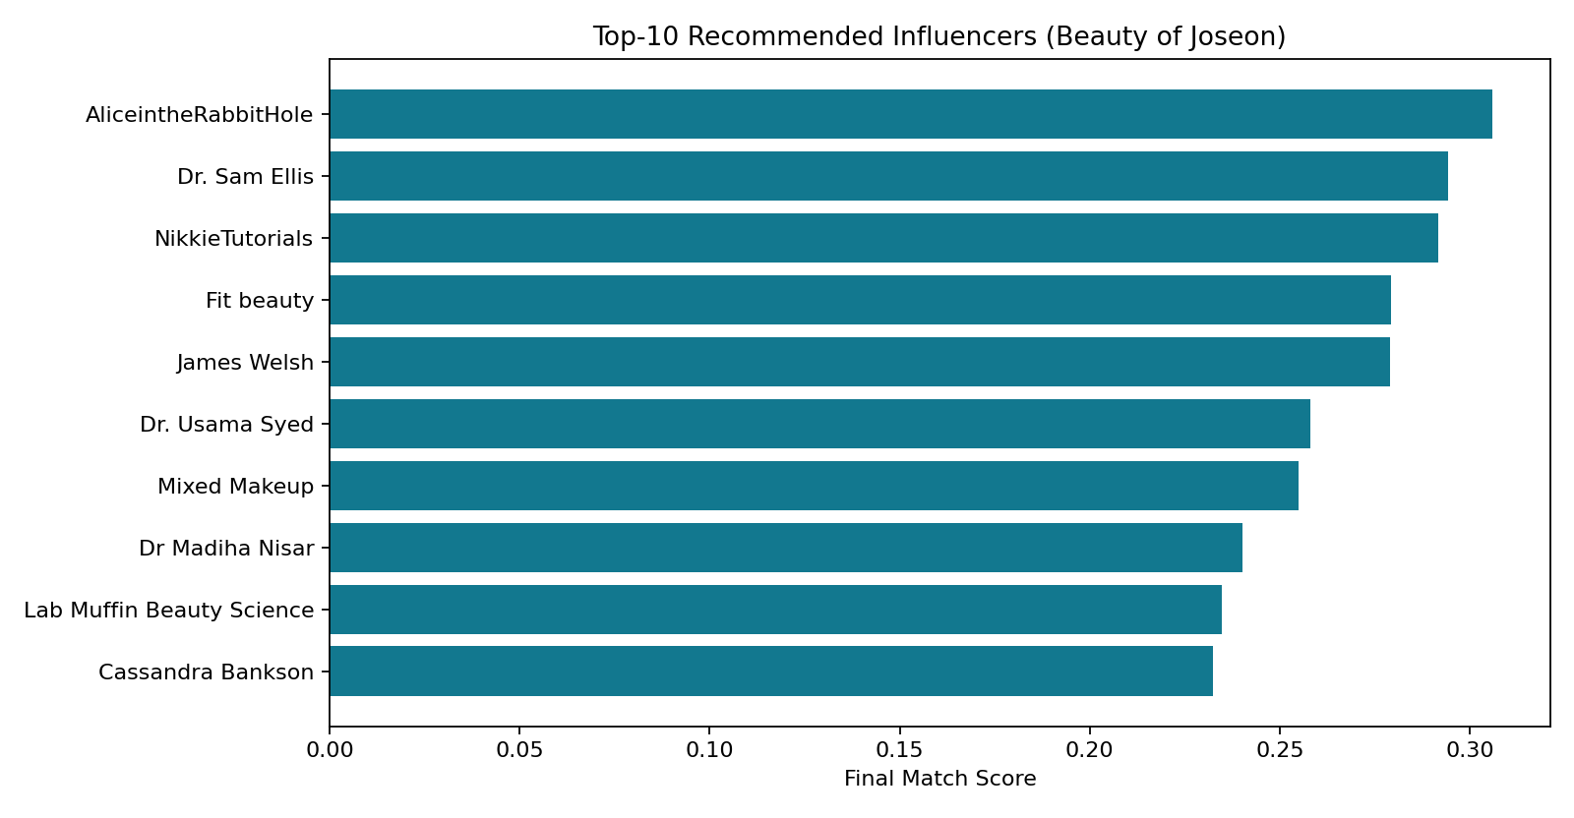
Prototype Demo: Input to Output
Live flow: campaign input -> Top-N shortlist -> rationale/risk
Interactive tabs: Network, Text Intelligence, ML, ROI
Use case A: BOJ sunscreen launch planning
Use case B: CeraVe benchmark for shortlist calibration
Decision output: ranked creators + risk notes + memo export
Sources: Streamlit docs | Prototype app/pipeline (internal)
Section 6 | Live Demo

Slide 12
Business Impact
How this helps the client
Decisions improved
Faster influencer shortlisting and campaign planning
Transparent recommendation logic for stakeholder trust
Reduced mismatch risk before spending budget
Scenario-based ROI planning and expectation setting
Who to prioritize in outreach
How many creators to activate by objective
How much budget risk is acceptable
Base ROI scenario in run: 1.14x expected ROAS
Sources: IAB Creator Economy | YouTube U.S. Impact 2024
Section 7 | Business Value

Slide 13
Limitations, Ethics, and Next Steps
Current limitations
Ethics and roadmap
Pre-collected YouTube dataset (not live cross-platform feed)
ROI is scenario estimate, not causal proof
Remaining cluster concentration in skincare niches
Need larger-scale operational monitoring
Bias checks: degree-overlap diagnostics + evidence penalty
Privacy: no sensitive personal profiling in prototype
Next: live connectors + fairness constraints + pilot calibration
Target: weekly decision-support workflow for brand teams
Sources: FTC Influencer Disclosures | SAFE Sunscreen (House) | FDA SIA
Section 7 | Caveats and Roadmap

Slide 14
How We Used AI Tools
Where AI tools helped
Human responsibility
Ideation and scope refinement
Implementation acceleration and debugging
Documentation and memo drafting
Slide polishing and presentation prep
Problem framing and business assumptions
Model choice, validation, and guardrail design
Result interpretation and recommendation decisions
Final accountability stayed with the team
Sources: Project commits/artifacts (internal) | OpenAI platform docs
Section 8 | AI Tooling Disclosure

Slide 15
Conclusion, References, and Q&A
Conclusion: AI-MCN can reduce manual MCN dependence and improve influencer decision quality.
EMARKETER (Mar 13, 2025): US influencer spend and YouTube marketer adoption
NIQ (Feb 25, 2025): beauty growth and e-commerce/social commerce indicators
McKinsey (Aug 28, 2025): beauty market outlook to 2030
Fashionista (Nov 13, 2024): BOJ virality and U.S. market context
Technical refs: YouTube API, scikit-learn, LightGBM, SHAP, Streamlit
Thank you. Q&A
Sources: EMARKETER | NIQ | McKinsey
AI-MCN | MSIS 521

Slide 16
Backup: Model Performance Snapshot
BOJ Full-Run Metrics
Best model: LightGBM
Best RMSE: 0.00996
Baseline RMSE: 0.03800
Relative RMSE reduction: 73.8%
Best model selected by 5-fold GroupKFold RMSE.
BaselineMedian retained as reference in output table.
Sources: ml_cv_results.csv (internal) | presentation_summary_boj.json (internal) | GroupKFold docs
Backup 16 | Model Results Detail

Slide 17
Backup: Top-Match Recommendation Anatomy
What Each Recommendation Card Includes
How to Read It for Decision-Making
Final Match Score (current ranking score in the tab)
Signal breakdown: SNA, TF-IDF, Semantic, Tone, Engagement, ML
Score controls: Base score, reliability multiplier, community id
Evidence label (High/Medium/Low) and fit label (Very Strong to Exploratory)
Channel snapshot, keyword summary, best/recent videos, recent comments
Red flags and rationale text for reviewer transparency
Start with Final Match Score and Evidence together.
Check reliability multiplier before trusting high base scores.
Review red flags for exclusions, low semantic fit, low activity.
Use video/comment context to verify qualitative brand fit.
Compare component mix by objective (awareness vs conversion).
Use diversity settings to avoid over-concentrated shortlist.
Sources: Top Matches tab code (app.py) | channel_details.py (internal) | ranking.py (internal)
Backup 17 | Recommendation Interpretation

Slide 18
Backup: Network Studio Interpretation Guide
What the Network View Represents
How Bias Diagnostics Are Used
Node = creator channel; edge = shared-tag relationship.
Edge weight = count of shared tags above threshold.
Node color = community cluster id.
Node size increases with final score in graph view.
Over-common tags are dropped to reduce graph noise.
Micro communities can be separated as community -1.
Degree Top Overlap compares centrality-only vs hybrid ranking.
Lower overlap suggests reduced popularity-only bias.
Unique communities in Top-N reflects portfolio diversity.
Community distribution chart reveals concentration risk.
Min edge / node sliders help stress-test shortlist stability.
Use diagnostics before final outreach decisions.
Sources: network_scoring.py (internal) | orchestrator.py bias report (internal) | Network Studio UI (app.py)
Backup 18 | Network Diagnostics

Slide 19
Backup: Text Intelligence Interpretation Guide
Charts and Metrics
How to Use in Client Reviews
Text Match Map: X=TF-IDF, Y=Semantic, color=Evidence, size~views.
Top Terms: frequent words in top candidate text corpus.
Keyword Coverage: share of channels containing each tracked keyword.
Leaderboard: TF-IDF, Semantic, Tone, Final score side-by-side.
Campaign words from audience/USP/must-keywords shape query vector.
Exclude words can directly lower relevance scores.
Upper-right map region = strongest language + meaning fit.
High TF-IDF but low semantic means superficial keyword overlap.
Low must-keyword coverage indicates query or data-gap issue.
Term chart validates whether shortlist matches campaign language.
Use with Top-Match evidence labels for safer final picks.
Document rationale from this tab in client memo.
Sources: text_scoring.py (internal) | semantic_enrichment.py (internal) | Text Intelligence UI (app.py)
Backup 19 | Text Diagnostics

Slide 20
Backup: ROI Lab Interpretation Guide
ROI Simulator Mechanics
Business Use and Caveats
Inputs: Budget, CPM, CTR, CVR, AOV
Impressions = (Budget / CPM) * 1000
Clicks = Impressions * CTR
Conversions = Clicks * CVR
Revenue = Conversions * AOV
ROAS = Revenue / Budget (plus low/high range)
Use for scenario planning, not causal proof.
Budget-sensitivity chart shows efficiency vs scale tradeoff.
Useful for pre-campaign expectation setting with finance teams.
Can compare assumptions across shortlist compositions.
Actual performance still depends on creative and execution quality.
Should be recalibrated with real campaign outcomes.
Sources: roi_simulation.py (internal) | ROI tab UI (app.py) | IAB creator spend context
Backup 20 | ROI Interpretation

Slide 21
Backup: Business Impact Detail
Expected Impact for Brand Teams
Why the Timing Is Urgent
Shortens creator research-to-shortlist cycle.
Converts opaque creator selection into transparent scorecards.
Adds reliability penalties to reduce false-positive picks.
Supports benchmark-based discussions with stakeholders.
Enables repeatable weekly operating rhythm.
Improves auditability for campaign post-mortems.
Creator budget scale is increasing rapidly.
Teams still report time and ROI measurement friction.
Beauty category adds extra pressure via high social influence.
Higher CAC increases cost of poor creator matching.
Brands need decision systems, not one-off creator lists.
AI-MCN framing reduces dependency on opaque intermediaries.
Sources: IAB Creator Economy 2025 | EMARKETER 2025 | Sprout workload findings
Backup 21 | Impact Detail

Slide 22
Backup: Limitations and Governance Detail
Current Technical Constraints
Governance and Compliance Controls
Dataset is pre-collected, not full live multi-platform ingestion.
Coverage depends on available YouTube data and keyword filters.
ROI output is assumption-based simulation.
Semantic enrichment quality depends on text richness.
Community structure may still be concentrated in sub-niches.
Cloud demo mode can use reduced snapshot data.
FTC disclosure and endorsement compliance must be enforced.
Claim safety checks needed for product-specific messaging.
Brand safety workflow should include human reviewer checkpoints.
Bias checks should be monitored as data evolves.
Recommendation logs should be retained for auditability.
Legal/marketing sign-off needed before launch decisions.
Sources: FTC Influencers | FTC Endorsement Guides | FDA SIA
Backup 22 | Limitations & Compliance

Slide 23
Backup: 90-Day Operational Roadmap
Phase 1 (0-30 Days)
Phase 2-3 (31-90 Days)
Lock weekly pipeline schedule and dashboard review cadence.
Define reviewer checklist for low-evidence channels.
Standardize export package for brand decision meetings.
Set benchmark brands by category for context comparison.
Track turnaround time and reviewer agreement metrics.
Add live connectors and larger benchmark panel coverage.
Run pilot with real outreach and campaign outcomes.
Compare predicted vs realized metrics and recalibrate model.
Add fairness constraints and stronger monitoring alerts.
Finalize operating playbook for in-house AI-MCN workflow.
Sources: orchestrator.py (internal) | app.py workflow (internal) | AI_MCN_Analysis_Explainer_EN.md (internal)
Backup 23 | Roadmap

Slide 24
Backup: AI Tool Usage Detail
Where AI Tools Accelerated Work
Human-Owned Responsibilities
Research synthesis and structuring references for slides.
Implementation support across data, ML, and UI modules.
Debugging support for pipeline/runtime issues.
Documentation drafting and bilingual explainer production.
Presentation refinement and narrative iteration.
Client problem framing and objective definition.
Method selection and validation logic design.
Quality control on model outputs and interpretation.
Risk/compliance framing and stakeholder communication.
Final recommendation accountability remained with team.
Sources: OpenAI docs | Internal repo artifacts
Backup 24 | AI Tooling Detail

Slide 25
Backup: Research Library for Team Follow-up
Market spend: EMARKETER (Mar 13, 2025), IAB (Nov 20, 2025), Goldman Sachs creator economy outlook.
Operational pain: Sprout Social workload findings; Linqia 2023/2026 benchmark reports.
Beauty context: NIQ global beauty growth + K-beauty landscape; McKinsey 2025 beauty outlook.
Client context: BOJ official campaign pages + public U.S. strategy coverage.
Governance: FTC influencer disclosures/endorsement guides, YouTube MCN documentation, FDA sunscreen policy context.
All links are included in slide markdown and sources footer for teammate reading.
Sources: EMARKETER | IAB | NIQ | McKinsey
Backup 25 | References

