Slide 1
Predicting the next NBA Championship Team
HAC Team
Harri, Alice and Chris

Slide 2
Content
Motivation and Summary
Model Summary
Data Cleanup & Model Training
Model Evaluation
Discussion
Portmortem
Questions

Slide 3
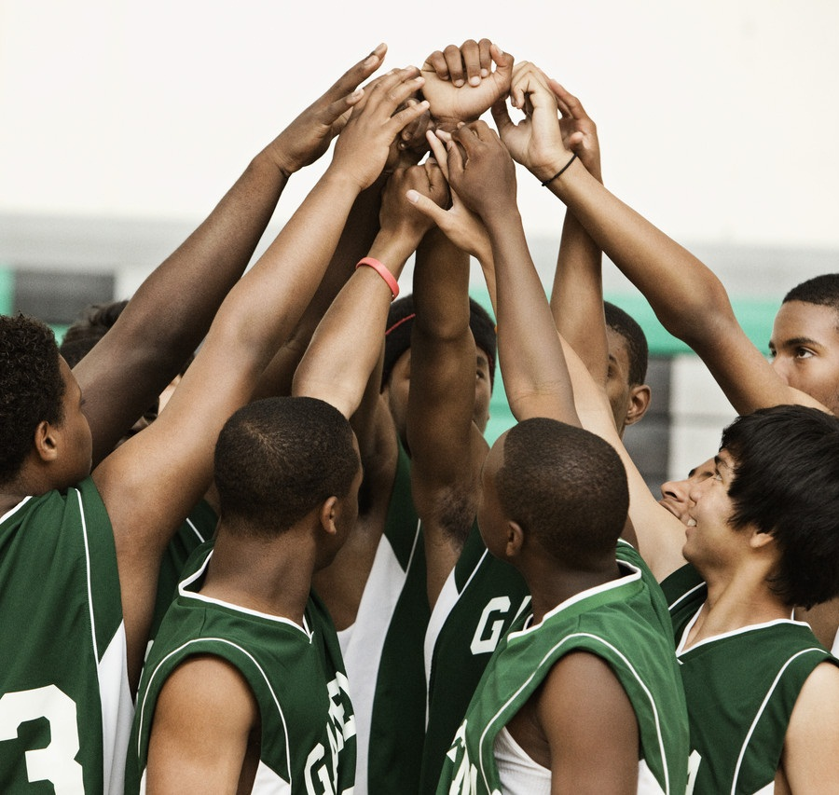
Motivation and Summary
Can we use machine learning to predict the next NBA Champion utilizing key season stats?

Slide 4
Motivation and Summary
National Basketball Association (NBA) is internationally influential
Founded in 1946 by owners of the major ice hockey arenas in the North-eastern and Midwestern United States and Canada;
•
Composed of 30 teams (29 in the United States and 1 in Canada);
One of the four major professional sports leagues in the United States and Canada;
An increasing number of international players have moved directly from playing elsewhere in the world to starring in the NBA.
It brought in 13.51 million viewers in 2019, according to The Hollywood Reporter.

Slide 5
Motivation and Summary
Can we use machine learning to predict the next NBA Champion utilizing key season stats?
It has been 74 years since NBA’s foundation in 1946. We can easily access to its historical season data using the NBA’s API stats.
15 teams‘ data have been chosen Initially to be trained and evaluated, then we predict which team is likely to win a championship based on their performance.
Then, selected 8 teams in playoffs to predict the winner only in this season (2020-2021)
Amazon SageMaker and Scikit-Learn libraries are the two main libraries that have been employed to do this project,

Slide 6
Model Summary
SKlearn based
Evaluate the importance of different metrics to win a NBA championship
Making championship prediction using trained data

Slide 7
Data Cleanup & Model Training
Only capture team data from API when FGA information is detected
Numericalize finals appearance indication
Create new column for championship using integer data generated previously
Drop unnecessary columns like team name that might harm the result
Use scaled data for more accuracy

Slide 8
Model Evaluation
The model was well built from SKlearn
Balanced accuracy score 0.72
High precision number
Occurrence of Type 2 error
Space of improvement
Data selection and model improvement for better result!

Slide 9
Discussion – Did the model work?
Surprisingly Field Goal % (% of shots made) and Rebounds had the biggest impact
FG3M - 3 points made play a surprisingly low influence on championship
Defense does not win games - Steals and Blocks importance totals 6.3%
It did not pick a winner out of all the playoffs team this season :(

Slide 10
Postmortem - Challenges
API inconsistent - timeout error locally sometimes, Sagemaker most times
Picking the right information - every team wins a different way
Amazon Sagemark slow to get up and running
Sample size not big enough potentially
Utilising other metrics and player information as part of the prediction model
Learning how to code utilising git hub/lab to colloborate at the same time

Slide 11
Q&A

