Slide 1
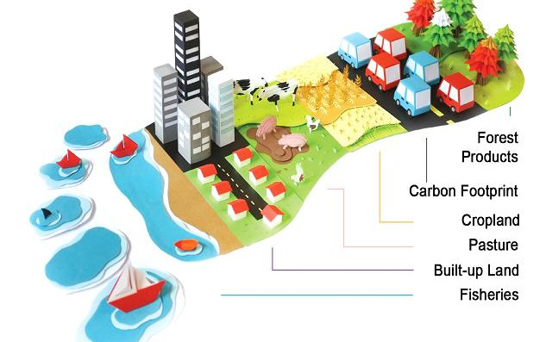
###
ECOLOGICAL FOOTPRINT APP
DEVELOPMENT
This mobile app aims to help user’s discover their ecological footprint, as well as providing local recommendations and suggestions to improve their score.
PROBLEM STATEMENT:
The integrated development environment we used is Android Studio. It is based on the community created IntelliJIDEA. Some of the benefits of using this platform include faster deployment of fresh builds, more accurate programming, faster programming and testing, inclusive application development, better app indexing to name a few.
In order to calculate the ecological footprint score certain type of data will be pulled from a third party application programming interface. This data is crucial in allowing us to compute the ecological footprint score for the mobile
application we are developing. Finding reliable data that can be utilized to calculate the footprint score is a challenging task.
The ecological footprint score is calculated using a complex equation that requires several inputs of data. Some of this data will be entered by the user via a questionnaire that we will be displayed and the other pieces of data will be gathered by pulling the relevant data from the application programming interface.
Contact Info
Sathya Ramanathan
ramanats@oregonstate.edu
Rohan Barve
barver@oregonstate.edu
Dominic Wasco
waskod@oregonstate.edu
Ann Scheerer
Ann.Scheerer@oregonstate.edu
We live in a world where everything is finite. All resources are shared among us all. On top of that, we have rising environmental concerns such as air/water pollution. However, a great deal of this per say is caused by none other than humans. From the vehicles we drive to the food we eat, every action we take has a consequence on the environment in the long run. It is therefore important that we take care of our planet by making more sustainable choices. The underlying idea for our project is to promote a sustainable community through certain actions; and a great way to know one’s impact is by evaluating oneself. This awareness combined with the right choices can lead to a better planet for all.
PROPOSED SOLUTION:
Our proposed solution is to create an ecological footprint calculator, so we can create awareness for the user. This calculator will ask a set of questions that will then be used to formulate an individual footprint score. To do this, we need to compare the user’s entered data with the national average footprint data. Ecological data is primarily collected by offices in each city that monitors economic activities, agricultural productivity, energy consumption, and other related information. This data can then be used for example to determine how much of a certain food was consumed, what kind of wood is used to construct furniture, and how much energy a typical household uses. This data in return is compared with the country’s average consumption profile to create an ecological footprint for the user. For example, the calculator will ask the user how much meat they consume. If they answer none, this will greatly reduce their overall score. On the other-hand, if they answered that they eat meat frequently, this will bump up their overall footprint score.
Corvallis Recommendations
Track your score
Users within the corvallis area will be able to view local services available to help reduce their score
Services such as waste collection, recycling, garden centers may be suggested to help reduce the amount of goods consumed
Information will be made available for learning more about ecological footprints as well as guides on some of the most impactful areas on consumption
Keep track of your score as it changes over time
Use the information that you learn to improve your score
Learn about which areas of your your life contribute most to your score
Learn more about how your score breaks down and areas you consume more or less than average
View a history of your previous scores to guage your progress

