Slide 1
Chapter 2: Operating-System Structures

Slide 2
Chapter 2: Operating-System Structures
操作系统结构
Operating System Services
User Operating System Interface
System Calls
Types of System Calls
Operating System Structure
Operating System Generation
System Boot

Slide 3
Objectives
To describe the services an operating system provides to users, processes, and other systems介绍操作系统为用户、进程和其他系统提供的服务
System call 系统调用

Slide 4

A View of Operating System Services

Slide 5
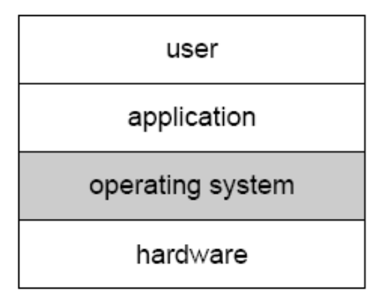
User Operating System Interface – CLI操作系统的用户界面
CLI allows direct command entry命令行界面允许直接命令操作
    Sometimes implemented in kernel, sometimes by systems program有的在内核中实现，有的做成系统程序
    Sometimes multiple flavors implemented – shells
    Primarily fetches a command from user and executes it主要是获取一条命令并执行它
      Sometimes commands built-in, sometimes just names of programs一种方法是命令解释程序本身包含代码以执行这些命令；另一种是系统程序实现大部分命令，命令解释程序只要用命令来识别文件以装入内存并运行
        If the latter, adding new features doesn’t require shell modification第二种方法增加新的命令不需要更改shell
User Interface of OS

Slide 6
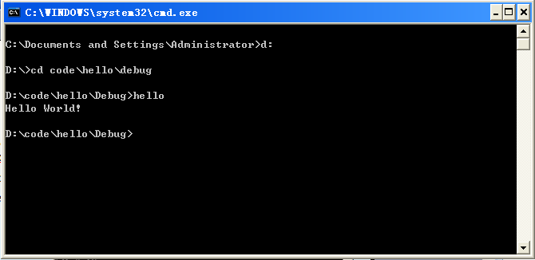
Command-line UI
Command-line interface
  User changes to the directory contains the executable “hello.exe”
  User type in the command “hello”
  Run the executable

Slide 7
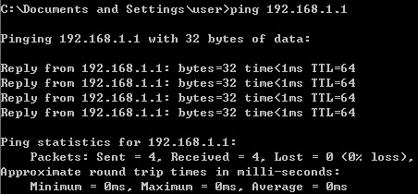
Windows command
最基本、最常用的测试物理网络连通性的命令Ping
ping 192.168.0.8 –t -l 2048 –n 8

Slide 8
Linux Shell command
文件与目录的操作 :ls
以长格式显示当前目录中所有文件的详细信息：
#ls –l
cp（拷贝文件）
将当前目录下的文件file1.txt复制成file2.txt：
#cp file1.txt file2.txt
mv（文件或目录更名或将文件由一个目录移到另一个目录）
将当前目录下的文件file1更名为file2:
#mv file1 file2
rm（删除文件或目录）
交互式删除当前目录下的所有非隐藏文件
#rm –i *
chmod（改变文件或目录的访问权限） chmod [who] [+| - | = ] [mode] 文件或目录
取消其他用户对目录xh的读，写和执行权限：
#chmod go-rwx xh

Slide 9
User Operating System Interface - GUI
User-friendly desktop metaphor interface桌面
  Usually mouse, keyboard, and monitor
  Icons represent files, programs, actions, etc图标代表文件、程序、系统功能等
  Various mouse buttons over objects in the interface cause various actions (provide information, options, execute function, open directory (known as a folder)
  Invented at Xerox PARC首次出现
Many systems now include both CLI and GUI interfaces
  Microsoft Windows is GUI with CLI “command” shell
  Apple Mac OS X as “Aqua” GUI interface with UNIX kernel underneath and shells available
  Solaris is CLI with optional GUI interfaces (Java Desktop, KDE)

Slide 10
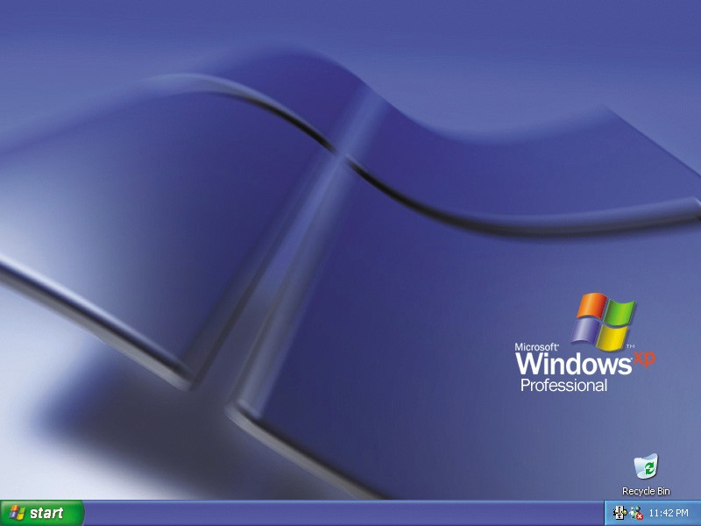
Graphical User Interface(GUI)
Graphical User Interface
  What you see is what you get

Slide 11
System Calls系统调用
Programming interface to the services provided by the OS操作系统提供的编程接口。
Typically written in a high-level language (C or C++)高级语言编写
Mostly accessed by programs via a high-level Application Program Interface (API) rather than direct system call use一般使用更高级的应用程序接口设计程序
Three most common APIs are Win32 API for Windows, POSIX API for POSIX-based systems (including virtually all versions of UNIX, Linux, and Mac OS X), and Java API for the Java virtual machine (JVM)常用API

Slide 12

API – System Call – OS Relationship

Slide 13

Standard C Library Example
C program invoking printf() library call, which calls write() system call

Slide 14
Types of System Calls系统调用类型
Process control进程控制
File management文件管理
Device management设备管理
Information maintenance信息维护
Communications通信

Slide 15

Examples of Windows and Unix System Calls

Slide 16
Operating System Structure
Simple Structure
Layered Approach
Microkernels
Modules

Slide 17
操作系统结构-Simple Structure 简单结构
MS-DOS – written to provide the most functionality in the least space MS-DOS：利用最小的空间提供最多的功能
  Not divided into modules没有划分成模块
  Although MS-DOS has some structure, its interfaces and levels of functionality are not well separated没有很好的区分接口和功能层次
  一组过程集，各过程可相互调用，也叫整体系统结构。
  缺点：逻辑复杂，维护困难.

Slide 18

MS-DOS Layer Structure

Slide 19
Layered Approach分层方法
The operating system is divided into a number of layers (levels), each built on top of lower layers. The bottom layer (layer 0), is the hardware; the highest (layer N) is the user interface.操纵系统被分成若干层（级），最低层（0层）是硬件，最高层（N层）是用户接口
With modularity, layers are selected such that each uses functions (operations) and services of only lower-level layers模块性，每层只能利用较低层的功能和服务
有序分层的基本概念
  可简化设计的复杂度
  下层为上层提供服务
层次的设置应考虑的因素
  程序嵌套：各模块间嵌套关系复杂
  运行频率：随层次的增高，相应软件的运行速度就随之下降
  公用模块：低层
  用户接口：高层

Slide 20

Layered Operating System

Slide 21

Traditional UNIX System Structure

Slide 22
Microkernel System Structure微内核
Moves as much from the kernel into “user” space把内核空间的东西尽可能移到用户空间
Communication takes place between user modules using message passing在用户模块间利用消息传递来通信
Benefits:好处
  Easier to extend a microkernel很容易扩展系统
  Easier to port the operating system to new architectures很容易移植平台
  More reliable (less code is running in kernel mode)高可靠性
  More secure高安全性
Detriments:缺点
  Performance overhead of user space to kernel space communication用户空间与内核空间通信带来的性能影响

Slide 23
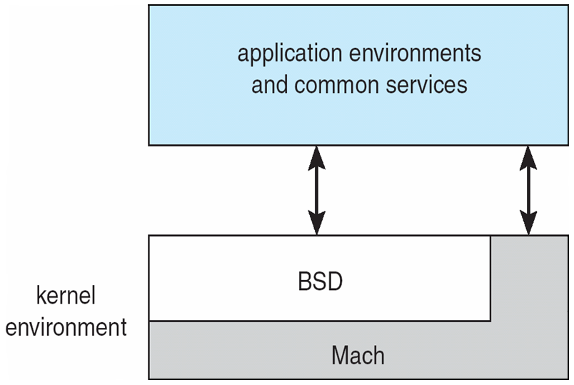
Mac OS X Structure

Slide 24
Modules模块
Most modern operating systems implement kernel modules很多现在操作系统实现了模块化的内核
  Uses object-oriented approach面向对象方法
  Each core component is separate内核的核心部件是分开的
  Each talks to the others over known interfaces通过接口通信
  Each is loadable as needed within the kernel可动态的加载给内核
Overall, similar to layers but with more flexible与分层方法类似，但更灵活

Slide 25
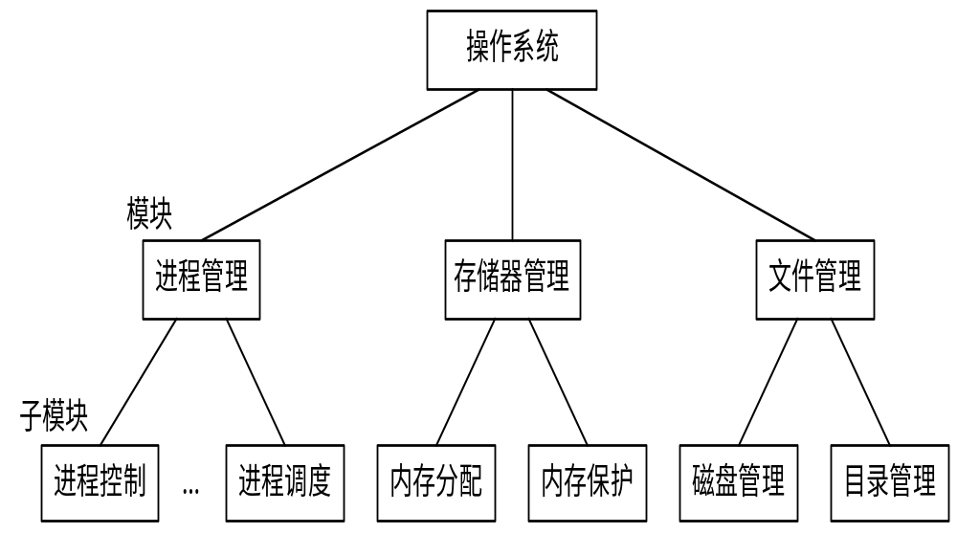
Modules模块

Slide 26
System Boot系统启动
Operating system must be made available to hardware so hardware can start it操作系统必须为硬件所使用
bootstrap program（引导程序） is loaded at power-up or reboot
  Typically stored in ROM or EPROM, generally known as firmware（固件）
  Initializes all aspects of system
  Loads operating system kernel and starts execution
Notes:
Pc上的加载：第一步运行ROM中的BIOS程序，做硬件自检以及确定启动顺序等工作.
第二步BIOS加载位于磁盘上的MBR（主引导记录）中的bootloader程序加载内存，该引导程序负责找到OS内核并执行。

Slide 27
Keywords
User interface(UI)
Command-line interface(CLI)
Graphical user interface(GUI)
Command interpreter
Shell
Desktop
System call
bootstrap program

Slide 28
End of Chapter 2

