Slide 1
Chapter 5: CPU Scheduling

Slide 2
Chapter 5: CPU Scheduling
Basic Concepts
Scheduling Criteria
Scheduling Algorithms

Slide 3
Objectives
To introduce CPU scheduling, which is the basis for multiprogrammed operating systems
To describe various CPU-scheduling algorithms
To discuss evaluation criteria for selecting a CPU-scheduling algorithm for a particular system
Notes:
CPU scheduling is the basis of multiprogrammed operating system, By switching the CPU among processes, the operating system can make the computer more productive.
In this chapter, we introduce basic CPU-scheduling concepts and present several CPU-scheduling algorithms, we also consider the problem of selecting an algorithm for a particular system.

Slide 4
Schedulers调度程序
Long-term scheduler (or job scheduler) – selects which processes should be brought into the ready queue长期调度（作业调度）：选择一批进程进入内存的就绪队列
Short-term scheduler (or CPU scheduler) – selects which process should be executed next and allocates CPU短期调度（CPU调度）：从就绪队列中选择一个进程，并为之分配CPU
Medium Term Scheduling （Swapping）
将内存中暂时不能运行的进程，或暂时不用的数据和程序，换出到外存，以腾出足够的内存空间，把已经具备运行条件的进程，或进程需要的数据和程序，换入内存。

Slide 5
CPU Scheduler Basic Concepts
Scheduling is a fundamental OS function. Almost all computer resources are scheduled before use, the CPU is one of the primary computer resources, thus , its scheduling is central to operating-system design.
In a single-processor system, only one process can run at a time; any others must wait until the CPU is free and can be scheduled.
Process execution consists of a cycle of CPU execution and I/O wait.
Notes:
In a single-processor system, only one process can run at a time; any others must wait until the CPU is free and can be scheduled.
Several processes are kept in memory at one time. When one process has to wait, the OS takes the CPU away from that process and give CPU to another process. This pattern continues, every time one process has to wait, another process can take over use of CPU.
Scheduling of this kind is a fundamental OS function. Almost all computer resources are scheduled before use, the CPU is one of the primary computer resources, thus , its scheduling is central to operating-system design.
Process execution consists of a cycle of CPU execution and I/O wait.
CPU burst 中央处理器突发时间 是指CPU从接到命令到开始处理命令所需时间

Slide 6
CPU Scheduler
CPU scheduler selects from among the processes in memory that are ready to execute, and allocates the CPU to one of them
  从就绪队列中选择一个进程执行，把CPU分给它
CPU scheduling decisions may take place when a process:
  1. Switches from running to waiting state
  2. Switches from running to ready state
  3. Switches from waiting to ready
  4. Terminates
Scheduling under 1 and 4 is nonpreemptive 非抢占调度
All other scheduling is preemptive 抢占调度
Notes:
Preemptive scheduling 抢占式调度 reluctantly,unwillingly. A process still wanted to use CPU, but because of timeout, it have to give up CPU.
Nonpreemptive scheduling: give up CPU voluntarily. Once the CPU has been allocated to a process, the process keeps the CPU until it release the CPU either by terminating or by switching to the waiting state.
I am not willing to give up.
（1）非抢占方式：进程占用处理机直至自愿放弃或发生某事件被阻塞时，在把处理机分配给其他进程。
（2）抢占方式：允许暂停某个正在执行的进程，将处理机重新分配给另一个进程。
抢占必须遵循一定的原则：优先权原则，时间片原则等

Slide 7
Dispatcher 分派程序
Dispatcher module gives control of the CPU to the process selected by the short-term scheduler; this involves:将CPU控制交给由短期调度程序选择的进程，包括
  switching context 上下文切换
  jumping to the proper location in the user program to restart that program跳转到用户程序的合适位置，以重新执行程序
Dispatch latency– time it takes for the dispatcher to stop one process and start another running
  分派延时：分派进程停止一个进程而启动另一个进程所花的时间
Notes:
Dispatch latency 调度延迟

Slide 8
Scheduling Criteria 调度准则
CPU utilization – keep the CPU as busy as possible CPU
  利用率
Throughput – # of processes that complete their execution per time unit 吞吐量：一个时间单元内完成进程的数量
Turnaround time – amount of time to execute a particular process 周转时间：从进程提交到进程完成的时间
Waiting time – amount of time a process has been waiting in the ready queue 等待时间：进程在就绪队列中等待所花时间之和
Response time – amount of time it takes from when a request was submitted until the first response is produced, not output (for time-sharing environment) 响应时间：对于分时系统，从提交请求到第一次响应的时间
Notes:
Scheduling criteria调度准则
Different CPU scheduling algorithms have different properties, and the choice of a particular algorithm may favor one class of processes over another.
In choosing which algorithm to use in a particular situation, we must consider the properties of the various algorithms.
Many criteria have been suggested for comparing CPU scheduling algorithms.
Throughput:吞吐量 one measure of work is the number of processes that are completed per time unit.
Turnaround time: the interval from the time of submission of a process to the time of completion is the 周转时间

Slide 9
Scheduling Algorithm Optimization Criteria
Max CPU utilization 最大化CPU利用率
Max throughput 最大化吞吐量
Min turnaround time 最小化周转时间
Min waiting time 最小化等待时间
Min response time 最小化响应时间
Notes:
选择算法的最佳准则
What are your main concerns when you select scheduling algorithm?

Slide 10
Scheduling Algorithms
FCFS (First come, first served ) 先来先服务
SJF (shortest Job first ) 短作业优先
HRRN（Priority） 高优先权优先
RR( round robin) 时间片轮转
Multilevel queue 多级反馈队列
Notes:
You should draw the dispatch flow chart

Slide 11
Preparation concepts
    （1）served time (execution time ):Ts 服务时间
    （2） Turnaround time (waiting time +served time): T 周转时间
    （3） weighted turnaround time :T/Ts 带权周转时间
Notes:
The ratios of 1 to 5 and 20 to 100 are the same

Slide 12
First-Come, First-Served (FCFS) Scheduling
Non-preemptive scheduling method（非抢占调度）
Select the process waiting for the longest time in ready queue
The process requests the CPU first is allocated the CPU first.
The implementation of the FCFS policy is easily managed with a FIFO queue, when a process enters the ready queue, its PCB is linked onto the tail of the queue. When the CPU is free, it is allocated to the process at the head of the queue.
Notes:
Gantt Chart 甘特图，线条图
Weighted 带权

Slide 13
First-Come, First-Served (FCFS) Scheduling
Process Arrival Time Served Time
A 0.0 3
B 2.0 6
C 4.0 4
D 6.0 5
E 8.0 2
FCFS scheduling chart
0
C
5
D
E
10
15
20
A
B
A3
B6
C4
D5
E2
Notes:
If the processes arrive in the order A B C D E
As an example, consider the following four processes, with the length of the CPU burst( served time) given in milliseconds:
If the processes arrive at the ready queue at the times shown , process A is started at time 0; since it is the only process in the queue, B arrives at time 2,…..

Slide 14
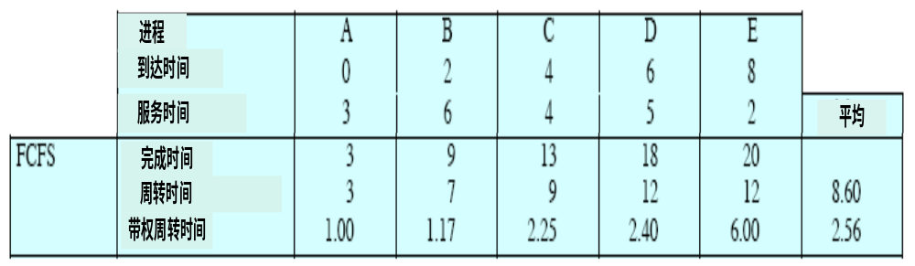
FCFS Scheduling (Cont)
Algorithm performance
Notes:
It is good for long process.
As far as the weighted turnaround time is concerned, the shorter the better

Slide 15
FCFS
优点：
  实现简单。
缺点:
  （1）对于执行时间较短的作业来说，如果它们在某些执行时间很长的作业之后到达，则它们将等待很长时间。
（2）周转时间与响应时间无法保证。

Slide 16
Shortest-Job-First (SJF) Scheduling
Non-preemptive scheduling method （非抢占调度）
Select the process with the shortest serverd time in ready queue
SJF is optimal – gives minimum average waiting time for a given set of processes
Notes:
我去银行办业务 即使even 虽然although
I went to the bank to do business
Big customer saving business
The weather, even for January, was exceptionally cold
The kitchen was compact but well equipped

Slide 17
Example of SJF
Process Arrival Time Served Time
A 0.0 3
B 2.0 6
C 4.0 4
D 6.0 5
E 8.0 2

Slide 18
SJF scheduling chart
A
B
C
D
E
0
1
2
3
4
5
6
7
8
9
10
11
12
13
14
15
16
17
18
19
20
3
A
6
B
4
C
5
D
2
E
B
C
D
E
C
D
D

Slide 19
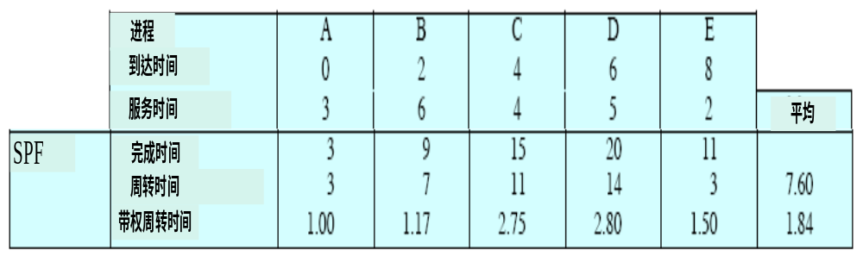
SJF（SPF） Scheduling (Cont)
Algorithm performance
Notes:
It is not good for long process.
As long as there are short processes, the long process request may be postponed.

Slide 20
SJF（SPF）
优点：
(1) SJF对短作业有利，明显的作业E提前接受了服务。
(2)整体性能也得到了提高；
缺点:
  （1） SJF需要事先估计每个作业所需的处理机时间。
（2） 只要不断的有短作业进入系统，就有可能使长作业长期得不到运行而“饿死”。

Slide 21
HRRN (Highest Response Ration Next) Scheduling
Non-preemptive scheduling method （非抢占调度）
Select the process with the highest response ratio in ready queue
dynamic priority algorithm :Priority can increase along with the progression of the process or the increasing of waiting time.
Wait time + served time
Response Ratio = --------------------------------
served time
式中R 既考虑了在系统的等待时间，又考虑了作业自身所需的运行时间，综合了FCFS与SJP各自特点。在进行进程调度时，从中选择响应比高者的进程投入运行。
Notes:
In operating system task scheduling, aging is the process of gradually increasing the priority of a task, based on its waiting time. The aging technique estimates the time a process will run based on a weighted average of previous estimates and measured values.[1] Aging can be used to reduce starvation of low priority tasks.[2] Aging is used to ensure that jobs in the lower level queues will eventually complete their execution.

Slide 22
Example of HRRN
Process Arrival Time Served Time
A 0.0 3
B 2.0 6
C 4.0 4
D 6.0 5
E 8.0 2

Slide 23
HRRN scheduling chart
A
B
C
D
E
0
5
10
15
20
A 3
B 6
C 4
D 5
E 2
C(1+5/4)
D(1+3/5)
E(1+1/2)
B(1+1/6)
D(1+7/5)
E(1+5/2)

Slide 24
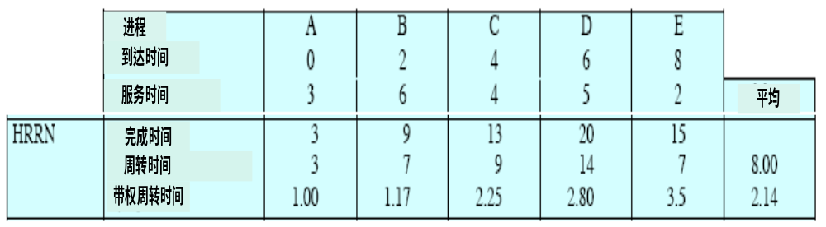
HRRN Scheduling (Cont)
Algorithm performance
It is good for short process when the waiting time is equal.
It changes into FCFS, when the served time is equal
There is no chance for starvation.
The disadvantage is the time for calculating priority is overhead.
Notes:
等待时间相同时，有利于短作业
要求服务时间相同时，先来先服务
长作业随着等待时间优先级增加，从而可以获得处理机。
折中算法，但每次调度前要计算响应比，增加系统开销。

Slide 25
Round Robin (RR)轮转法
Each process gets a small unit of CPU time (time quantum), usually 10-100 milliseconds. After this time has elapsed, the process is preempted and added to the end of the ready queue.为每一个进程定义了一个时间片
轮转法的实现过程
    如果一个进程在被调度程序选中之后用完了系统规定的时间片，但未完成要求的任务，则它自行释放自己所占有的CPU而排到就绪队列的末尾，等待下一次调度。
    同时，进程调度程序又去选择当前就绪队列中的第一个进程。
    轮转法是一种基于时间片的抢占策略，它主要用于分时系统中。

Slide 26
Round Robin (RR)轮转法
调度契机：
  (1)进程完成：启动新的时间片，调度另一个进程运行。
  (2)进程未完成：进程的执行被时钟中断，排到就绪队列尾部，调度另一个进程运行。
时间片长度的选择:
  （1）时间片长度过短，进程上下文切换次数增多，导致系统开销增大。
  （2）时间片长度过长，如每个时间片能保证就绪队列中所需执行时间最长的进程执行完毕，轮转法变成先来先服务法。
  （3）时间片应略大于一次典型交互的时间。

Slide 27
Example of RR with Time Quantum = 4
Proces Arrival Time served Time
A 0.0 3
B 2.0 6
C 4.0 4
D 6.0 5
E 8.0 2

Slide 28
Scheduling flow chart (Time Quantum = 4)
A
B
C
D
E
0
1
2
3
4
5
6
7
8
9
10
11
12
13
14
15
16
17
18
19
20
3
A
6
B
4
C
5
D
2
E
B
C
D
B
D
B
E
BED
ED
D
Notes:
Process B is preempted, and process C is scheduled.
Which processes are in the ready queue?
If the process can be finished within a time-slice, this process can finish its work after its serverd time.

Slide 29
Time Quantum = 4 & Time Quantum = 1
0
5
10
15
20
四个单位
A
B
C
D
E
0
5
10
15
20
一个单位
A
B
C
D
E
Time Quantum =1，平均带权周转时间：2.71

Slide 30
Round Robin (RR)轮转法
优点：
  (1)占用CPU先后及时间长短公平。
  (2)不需要预估进程的执行时间。
缺点:
  （1）时间片过短时,上下文切换造成系统开销大
  （2）时间片过长时,对短作业不公平

Slide 31
Multilevel Feedback Queue
A process can move between the various queues; aging can be implemented this way 进程可以在队列之间移动，可实现老化
Multilevel-feedback-queue scheduler defined by the following parameters: 用下列参数定义
  number of queues 队列数量
  scheduling algorithms for each queue每个队列的调度算法
  method used to determine when to upgrade a process用以确定何时升级到更高优先级队列的方法
  method used to determine when to demote a process用以确定何时降级到更低优先级队列的方法
  method used to determine which queue a process will enter when that process needs service用以确定进程在需要服务时应进入哪个队列的方法

Slide 32
Example of Multilevel Feedback Queue
Three queues:
  Q₀ – RR with time quantum 8 milliseconds
  Q₁ – RR time quantum 16 milliseconds
  Q₂ – FCFS
Scheduling
  A new job enters queue Q₀ which is served FCFS. When it gains CPU, job receives 8 milliseconds. If it does not finish in 8 milliseconds, job is moved to queue Q₁.
  At Q₁ job is again served FCFS and receives 16 additional milliseconds. If it still does not complete, it is preempted and moved to queue Q₂.

Slide 33
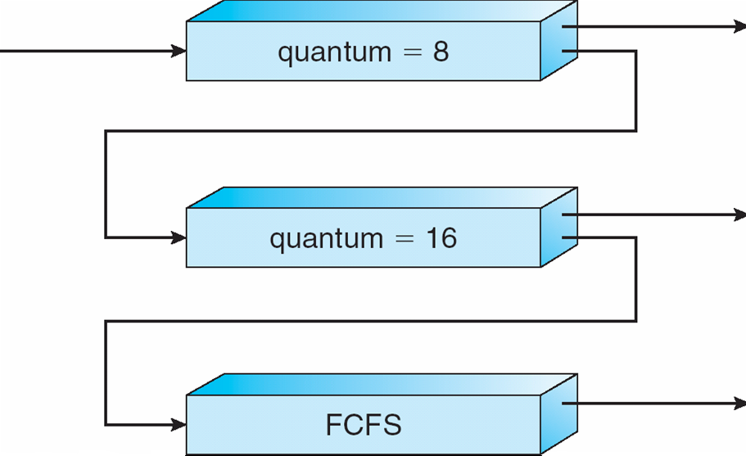
Multilevel Feedback Queues

Slide 34
Exercises
Please draw the scheduling flow chart for the following processes according to FCFS、SJF、HRRN、RR(2) algorithms.
process | Arrived time | Served time
A | 0 | 3
B | 2 | 4
C | 3 | 7
D | 6 | 2
E | 9 | 4

Slide 35
FCFS
B
C
D
E
0
1
2
3
4
5
6
7
8
9
10
11
12
13
14
15
16
17
18
19
20
3
A
4
B
7
C
2
D
4
E
B
C
C
D
D
E
E

Slide 36
SJF
B
C
D
E
0
1
2
3
4
5
6
7
8
9
10
11
12
13
14
15
16
17
18
19
20
3
A
4
B
7
C
2
D
4
E
B
C
C
D
C
E
C

Slide 37
HRRN
B
C
D
E
0
1
2
3
4
5
6
7
8
9
10
11
12
13
14
15
16
17
18
19
20
3
A
4
B
7
C
2
D
4
E
B(1/4)
C(0/7)
C(4/7)
D(1/2)
D(8/2)
E(5/4)
E

Slide 38
RR（2）
B
C
D
E
0
1
2
3
4
5
6
7
8
9
10
11
12
13
14
15
16
17
18
19
20
3
A
4
B
7
C
2
D
4
E
B
A
A
C
B
C
B
BD
C
D
CE
CE
EC
CE
EC
C

Slide 39
调度算法总结
先来先服务
最高响应比
多级反馈轮转法
最短作业优先
轮转法
优先级法
只考虑每个
作业的等待
时间
响应比R=
(1+W/T)
划分不同队列，
给予不同的优先
级和时间片。
静态优先级
动态优先级
只考虑每个
作业的执行
时间
等待时间与执行时间成
比例。时间片长度q值
的选择。
性能衡量指标：周转时间、带权周转时间、响应时间

Slide 40
summary
Scheduler: long-term scheduler ;short term scheduler
Dispatcher
dispatch latency
scheduling criteria
non-preemptive scheduling
preemptive scheduling
scheduling algorithms: FCFS, SJF, HRRN, RR
Multilevel Feedback Queues algorithm
Notes:
It is enough to understand the principle of this algorithm

Slide 41
End of Chapter 5

