Slide 1
Chapter 7: Deadlocks

Slide 2
Chapter 7: Deadlocks
The Deadlock Problem
Deadlock Characterization
Methods for Handling Deadlocks
Deadlock Prevention 预防死锁
Deadlock Avoidance（banker’s algorithm）避免死锁
Deadlock Detection 检测死锁
Recovery from Deadlock 恢复

Slide 3
Chapter Objectives
To develop a description of deadlocks, which prevent sets of concurrent processes from completing their tasks
  描述死锁现象，即使得一组并发进程不能完成其任务的现象
To present a number of different methods for preventing or avoiding deadlocks in a computer system.
  提供一些方法以预防或避免计算机系统内的死锁

Slide 4
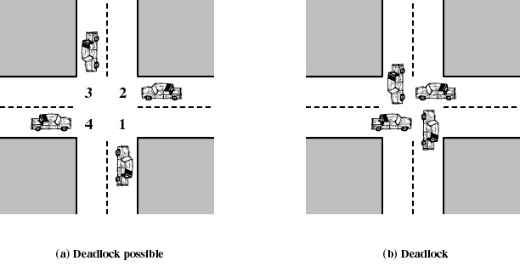
CrossRoad Example
Traffic only in one direction
Each section of a crossroad can be viewed as a resource
If a deadlock occurs, it can be resolved if one car backs up (preempt resources and rollback)

Slide 5
The Deadlock Problem
A set of blocked processes each holding a resource and waiting to acquire a resource held by another process in the set。
一组等待态进程每个占用部分资源并申请其他进程拥有的资源。（因竞争资源而相互无限等待）
Example 1
  System has 2 disk drives.
  P₁ and P₂ each hold one disk drive and each needs another one.
同种资源，数量不足
进程推进速度不当

Slide 6
The Deadlock Problem
Example 2
  semaphores A and B, initialized to 1
        P₀ P₁
        get (A); get(B)
        get (B); get(A)
        Release（A） release（B）
        Release（B） release（A）
不同种资源，
数量不足
进程推进速度不当

Slide 7
The Deadlock Problem
Deadlock: a waiting process is never again able to change state, because the resources it has requested are held by other waiting processes. This situation is called a deadlock.（由于进程申请的资源被其他进程保持，出现的进程间的无限等待，称为死锁）

Slide 8
Deadlock Characterization（死锁特性）
Deadlock can arise if four conditions hold simultaneously.
Mutual exclusion: only one process at a time can use a resource
互斥：一次只有一个进程可以使用一个资源
Hold and wait: a process holding at least one resource is waiting to acquire additional resources held by other processes
占有并等待：一个至少持有一个资源的进程等待获得额外的由其他进程所持有的资源
No preemption: a resource can be released only voluntarily by the process holding it, after that process has completed its task
不可抢占：一个资源只有当持有它的进程完成任务后，主动的释放

Slide 9
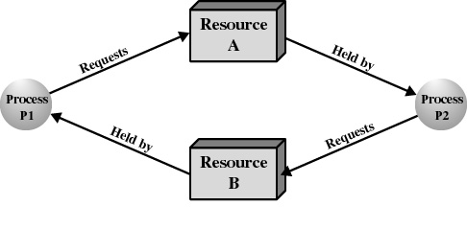
Deadlock Characterization
Circular wait: there exists a set {P₀, P₁, …, P₀} of waiting processes such that P₀ is waiting for a resource that is held by P₁, P₁ is waiting for a resource that is held by
P₂, …, P_{n–1} is waiting for a resource that is held by
P_{n}, and P₀ is waiting for a resource that is held by P₀.
等待资源的进程之间存在环路

Slide 10
Methods for Handling Deadlocks
Ensure that the system will never enter a deadlock state
预先采取措施可保证不死锁
Allow the system to enter a deadlock state and then recover
当死锁时采取措施恢复
Ignore the problem and pretend that deadlocks never occur in the system; used by most operating systems, including UNIX（好多系统不采取任何措施：鸵鸟法则）
死锁恢复
死锁预防
死锁避免
死锁检测
执行前
开始执行
发生死锁
死锁解除

Slide 11
Deadlock Prevention（预防死锁）
Restrain the ways request can be made（抑制死锁发生的必要条件）
Mutual Exclusion –must hold for nonsharable resources
互斥：共享资源必须保持互斥
Hold and Wait – must guarantee that whenever a process requests a resource, it does not hold any other resources
  Require process to request and be allocated all its resources before it begins execution
  要求进程在执行前一次申请全部的资源，只有没有占有资源时才可以分配资源
  Low resource utilization; starvation possible
  （利用率低，可能出现饥饿）

Slide 12
Deadlock Prevention （预防死锁）
No Preemption –
  If a process that is holding some resources requests another resource that cannot be immediately allocated to it, then all resources currently being held are released
  如果一个进程的申请没有实现，它要释放所有占有的资源--被抢占。
  导致前端工作失效。
Notes:
semaphores A and B, initialized to 1
P₀ P₁
wait (A); wait(B)
wait (B); wait(A)
Release（A） release（B）
Release（B） release（A）

Slide 13
Deadlock Prevention （预防死锁）
Circular Wait – impose a total ordering of all resource types, and require that each process requests resources in an increasing order of enumeration
将所有的资源类型放入资源列表中，并且要求进程按照资源表中递增的顺序申请资源（资源有序分配法）
  semaphores A and B, initialized to 1
        P₀ P₁
        get (A); get(A)
        get (B); get(B)
        Release（A） release（A）
        Release（B） release（B）
Notes:
semaphores A and B, initialized to 1
P₀ P₁
wait (A); wait(B)
wait (B); wait(A)
Release（A） release（B）
Release（B） release（A）

Slide 14
Deadlock Avoidance（避免死锁）
Requires that the system has some additional a priori information
available：系统需要额外做一些前期准备工作
Simplest and most useful model requires that each process declare the maximum number of resources of each type that it may need（进程事先声明最多所需的资源数）
The deadlock-avoidance algorithm dynamically examines the resource-allocation state to ensure that there can never be a circular-wait condition（死锁避免算法动态检测资源分配状态，保证没有环路产生）
Resource-allocation state is defined by the number of available and allocated resources, and the maximum demands of the processes（资源分配状态用当前可用资源、已分配资源、和进程所需的最大资源三个向量来定义）

Slide 15
Safe State（安全状态）
When a process requests an available resource, system must decide if immediate allocation leaves the system in a safe state
分配资源时,看系统是否安全
System is in safe state if there exists a sequence <P₁, P₂, …, P_{n}> in which all the processes can obtain all their resources and execute successfully.
Unsafe state： if there is no such sequence, system is in unsafe state.
系统安全：指存在一个执行序列,所有进程按照这个顺序都能完成。
系统不安全：找不到安全序列。

Slide 16
Example1 for Safe State
There are 10 R resources in system, three processes ABC, process A need 6 R during its execution, process B need 5 R during its execution, process C need 4 R during its execution. The usages of R for each process are as following：
  If the first step is finished, is the system in safe state?
  If we can find a safe sequence, then the system is safe.
Exist a safe sequence: A->B->C or B->A->C, so the system is in safe state.
Note: Sequence is not necessarily the only one（安全序列不一定唯一）
Process A
Process B
Process c
Request 4 R
Request 3 R
Request 1 R
Request 1 R
Request 2 R
Request 2 R
Request 2 R
end
end
end
Notes:
Sequence is not necessarily the only one. It may examine whether has the safe sequence
假设A，B，C三个进程都已经进行了第一次申请，并获得了相应的资源，现在进程C要进行第二次申请（申请1个资源），而此时系统中还有2个可用资源，但如果给C分配了这1个资源后，就会导致死锁，因此系统拒绝给C分配资源，进程C阻塞。
如果此时进程A或B申请2个资源，则分配后不会导致死锁，因此可以分配
假设A，B，C三个进程都已经进行了第一次申请，并获得了相应的资源，现在进程C要进行第二次申请（申请1个资源），而此时系统中还有2个可用资源，但如果给C分配了这1个资源后，就会导致死锁，因此系统拒绝给C分配资源，进程C阻塞。
如果此时进程A或B申请2个资源，则分配后不会导致死锁，因此可以分配

Slide 17
Example2 for Safe State
is the system in safe state?
process | Maximum requirements | Allocation | Available
P1 P2 P3 | 10 4 9 | 5 2 2 | 3
Exist a safe sequence: p2->p1->p3 ,so the system is in safe state.
T0时刻，系统是安全的。

Slide 18
Basic Facts
If a system is in safe state ⇒ no deadlocks.
If a system is in unsafe state ⇒ possibility of deadlock.
Avoidance ⇒ ensure that a system will never enter an unsafe state.

Slide 19

Safe, Unsafe , Deadlock State

Slide 20
Banker’s Algorithm
假定银行100万，P,Q两个顾客。P需要80万，分两次贷；Q需要50万，分两次贷。
顾客 目前已贷 还需要贷款
P 50 30
Q 30 20
当前还剩余额？当P申请第二次贷款时，银行能满足他的要求吗？
R申请第二次呢？

Slide 21
Banker’s Algorithm
假定银行可以分期贷款10法郎给顾客，P,Q,R
顾客 目前已贷法郎 所需最大法郎
P 9
Q 5
R 3
5
2
2
当前还剩几个？当P申请一个法郎时，银行能满足他的要求吗？
R申请一个呢？

Slide 22
Banker’s Algorithm
Multiple instances(多种资源，多个进程)
Each process must a priori claim maximum use(进程事先声明资源的最大需求量)
When a process gets all its resources it must return them in a finite amount of time(进程资源满足后，一定能在有限时间内完成，最后将资源全部归还给系统)
  进程可以分期请求资源，但请求的总数不能超过最大需求量

Slide 23
Data structure in Banker’s Algorithm
系统中有n个进程和m种不同类型的资源
Available=（V1，V2，…，Vm）可用资源数
Max ：各进程对各类资源的需求
Allocation：各进程已经获得的各类资源数
Need：各进程还需要的各类资源数
注：Need=Max-Allocation

Slide 24
Example
假定系统中有五个进程｛P₀, P₁, P₂, P₃, P₄｝和 三类资源｛A, B, C｝，各种资源的数量分别为10、5、7，在T₀时刻的资源分配情况如图所示。
  judge the current state is safe or not? 判断当前T0时刻是否安全？
资源情况 进程 | Max A B C | Allocation A B C | Need A B C | Available A B C
P0 | 7 5 3 | 0 1 0 | 7 4 3 | 3 3 2
P1 | 3 2 2 | 2 0 0 | 1 2 2
P2 | 9 0 2 | 3 0 2 | 6 0 0
P3 | 2 2 2 | 2 1 1 | 0 1 1
P4 | 4 3 3 | 0 0 2 | 4 3 1

Slide 25
Example of Banker’s Algorithm
假定系统中有五个进程｛P₀, P₁, P₂, P₃, P₄｝和 三类资源｛A, B, C｝，各种资源的数量分别为10、5、7，在T₀时刻的资源分配情况如图所示。
  （1）Judge the current state is safe or not? 判断当前T0时刻是否安全？
资源情况 进程 | Max A B C | Allocation A B C | Need A B C | Available A B C
P0 | 7 5 3 | 0 1 0 | 7 4 3 | 3 3 2
P1 | 3 2 2 | 2 0 0 | 1 2 2
P2 | 9 0 2 | 3 0 2 | 6 0 0
P3 | 2 2 2 | 2 1 1 | 0 1 1
P4 | 4 3 3 | 0 0 2 | 4 3 1

Slide 26
Example of Banker’s Algorithm
  各种资源的数量分别为10、5、7（available-need+max）
  （1） T0: system is in safe state, safe sequence is <P1,P3,P4,P2,P0>
  安全。可以找到安全序列<P1,P3,P4,P2,P0>
资源情况 进程 | Max A B C | Allocation A B C | Need A B C | Available A B C
P0 | 7 5 3 | 0 1 0 | 7 4 3 | 3 3 2
P1 | 3 2 2 | 2 0 0 | 1 2 2
P2 | 9 0 2 | 3 0 2 | 6 0 0
P3 | 2 2 2 | 2 1 1 | 0 1 1
P4 | 4 3 3 | 0 0 2 | 4 3 1

Slide 27
Example of Banker’s Algorithm
  各种资源的数量分别为10、5、7
  （2） P1请求(1,0,2)，能否分配？
  Request P1（1 0 2）<Need P1（1 2 2）
  Request P1（1 0 2）< available(3 3 2) 所以p1的请求合法。
资源情况 进程 | Max A B C | Allocation A B C | Need A B C | Available A B C
P0 | 7 5 3 | 0 1 0 | 7 4 3 | 3 3 2
P1 | 3 2 2 | 2 0 0 | 1 2 2
P2 | 9 0 2 | 3 0 2 | 6 0 0
P3 | 2 2 2 | 2 1 1 | 0 1 1
P4 | 4 3 3 | 0 0 2 | 4 3 1

Slide 28
Example of Banker’s Algorithm
  各种资源的数量分别为10、5、7
  （2） P1请求(1,0,2)，能否分配？
  新状态安全吗？安全则同意刚才的假设，否则不同意。
  可以找到一个安全序列<p1,p3,p4,p2,p0>，所以安全，可以将P1申请的资源分配给它。
资源情况 进程 | Max A B C | Allocation A B C | Need A B C | Available A B C
P0 | 7 5 3 | 0 1 0 | 7 4 3 | 3 3 2
P1 | 3 2 2 | 2 0 0 | 1 2 2
P2 | 9 0 2 | 3 0 2 | 6 0 0
P3 | 2 2 2 | 2 1 1 | 0 1 1
P4 | 4 3 3 | 0 0 2 | 4 3 1
3 0 2
0 2 0
2 3 0

Slide 29
Example of Banker’s Algorithm
  各种资源的数量分别为10、5、7
  （3）在此基础上，若P0请求资源：020，能否分配？
  新状态安全吗？安全则同意刚才的假设，否则不同意。
  可用资源数 Available已不能满足任何进程的需求，系统进入不安全状态。
  故，P0请求的资源不能分配。
资源情况 进程 | Max A B C | Allocation A B C | Need A B C | Available A B C
P0 | 7 5 3 | 0 3 0 | 7 2 3 | 2 1 0
P1 | 3 2 2 | 3 0 2 | 0 2 0
P2 | 9 0 2 | 3 0 2 | 6 0 0
P3 | 2 2 2 | 2 1 1 | 0 1 1
P4 | 4 3 3 | 0 0 2 | 4 3 1

Slide 30
Banker’s Algorithm(银行家算法)
Banker’s algorithm
  At the current state, if a process request resources
  System assumes that allocate the resources to the process and satisfy the requirement of the process
  System checks the state is safe or not, if safe, system ensures this allocation, if unsafe, system cancels this allocation and blocks the process.
  银行家算法是一个非常经典的避免死锁的算法，某进程申请资源，系统假设将资源分给该进程，满足它的需求；检查分配后的系统状态是否是安全的，如果是安全，就确认本次分配；如果系统是不安全的，就取消本次分配并阻塞该进程。

Slide 31
Deadlock Detection
Allow system to enter deadlock state (允许进入死锁状态 )
Detection algorithm (检测)
Recovery scheme（恢复）

Slide 32
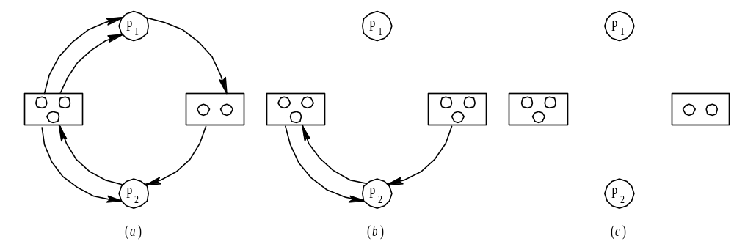
检测死锁：死锁定理
若能消去资源分配图中所有结点的连接边，使得全部结点都成为孤立结点，则称该图是可完全简化图；若不能使该图完全简化，则称该图是不可完全简化图。
当且仅当系统某状态S所对应的资源分配图是不可完全简化的，则S是死锁状态。该充分条件称为死锁定理。

Slide 33
Recovery from Deadlock: Process Termination
Restart computer system
重启系统
Abort one or all deadlocked processes until the deadlock cycle is eliminated
终止一个或几个进程的执行以破坏循环等待
Rollback – return to some safe state, restart process for that state
回退：返回到安全的状态，然后重新开始进程

Slide 34
summary
Deadlock
Deadlock characterization
mutual exclusion
hold and wait
no preemptition
circular wait
Methods for handling deadlock
Deadlock prevention
Deadlock avoidance
safe state
banker's algorithm
Deadlock detection and recovery

Slide 35
End of Chapter 7

