Slide 1
Part four—storage management
Since main memory is too small to accommodate all the data and programs permanently, the computer system must provide the secondary storage to back up main memory, modern computer use disks as primary on-line storage medium for information.
The file system provide the mechanism for on-line storage of and access to both data and programs residing on the disks. A file is a collection of related information defined by its creator. The files are normally organized into directories for ease of use.

Slide 2
文件和文件系统
文件是记录在外存的一组赋名的相关联字符流的集合，或者是相关联记录（一个有意义的信息单位）的集合。
操作系统中与管理文件有关的软件和数据称为文件系统。
文件系统提供了在线存储和访问计算机操作系统和所有用户的程序与数据的机制。负责为用户建立、撤销、读写、修改和复制文件，还负责完成对文件的按名存取和进行存取控制。
文件系统的目标：便于查找与访问。

Slide 3



User’s View of FileSystem
用户眼中的文件系统是什么样子的呢？
  需要取某个文件file1
  File1在文件夹F中，我翻开文件夹，打开之
文件

Slide 4
外部文件接口与系统内部结构
文件系统描述如下
User’s View
用户视角
OS Implementation
操作系统内部实现
文件
文件访问接口：
open
close
read
write

Slide 5
外部文件接口与系统内部结构
应用层观点：逻辑抽象
物理层观点：空间管理
安全、保护
磁盘设备防护
映 射
文件访问控制
磁盘数据存取
数据文件
磁盘空间
文件结构定义
磁盘空间分配
文件系统服务器

Slide 6
Chapter 10: File-System Interface

Slide 7
Chapter 10: File-System Interface
File Concept 文件的概念
Access Methods 访问方法
Directory Structure 目录结构
Protection 保护

Slide 8
File Concept
A file is a named collection of related information that is recorded on secondary storage.
The information in a file is defined by its creator. Many different types of information may be stored in a file—source programs, object programs, executable programs, numeric data, text, payroll records, graphic images, sound recordings, and so on.
A file has a certain defined structure, which depends on its types.

Slide 9
File Structure
None structure - sequence of words, bytes
  Such as C source file.
Simple record structure (typical database file)
  Lines
  Fixed length
  Variable length
  For example, we can use a database table to record student’s information. We can use student ID to identify an unique line. The student ID is called primary key.

Slide 10
File Attributes 文件属性
Name – only information kept in human-readable form 文件名
Identifier – unique tag (number) identifies file within file system 标识符：标识文件的唯一标签（数字），不可读
Type – needed for systems that support different types 类型
Location – pointer to file location on device 位置：指向设备上文件的指针
Size – current file size 大小
Protection – controls who can do reading, writing, executing 保护
Time, date, and user identification – data for protection, security, and usage monitoring 时间、日期和用户标识：用于保护、安全和系统追踪
Information about files are kept in the directory structure, which is maintained on the disk 所有文件的信息都保存在目录结构中，而目录结构又保存在外存上

Slide 11
文件的组成
从文件管理角度看
  文件＝文件说明＋文件体
文件体指文件本身的信息，包括记录式文件或字符流式文件。
文件说明也称文件控制块(FCB)

Slide 12
FCB
File control block (FCB) – storage structure consisting of information about a file
文件控制块是操作系统为管理文件而设置的数据结构。
In order to manage and control files, file system allocate a FCB to each file, this is an important data structure for file management.
为了管理控制文件，文件系统为每个文件分配一个FCB，它是文件管理的重要数据结构
contains the information as following:
FCB中包含如下信息
  file name, file type, position on disk, file size, file permissions, use count, file dates.
  文件名，文件类型，存储位置，文件大小，文件权限，使用数量，日期等。

Slide 13

A Typical File Control Block
文件说明(FCB)组成目录文件。文件系统利用目录文件完成按名存取和对文件信息的共享与保护。
Notes:
In order to manage and control files, file system allocate a FCB to each file, this is an important data structure for file managing.
FCB contains the information as following: file name, file type, position on disk, file size, file permissions, use count, file dates.
Kernel uses this structure to manage files, for example, when we access file according to file name, we should find the corresponding FCB, verify permission, and then we can get the position on disk for the file.
了便于对文件进行控制和管理，在文件系统内部，给每个文件惟一地设置一个文件控制块，这种数据结构通常由下列信息项组成：
（1）文件名——符号文件名，如 files，mydata，ml.c等。
（2）文件类型——指明文件的属性，是普通文件，还是目录文件，特别文件，是系统文件还是用户文件等。
（3）位置——指针，它指向存放该文件的设备和该文件在设备上的位置，如哪台设备的哪些盘块上。
（4）大小——当前文件的大小（以字节、字或块为单位）和允许的最大值。
（5）保护信息——对文件读、写及执行等操作的控制权限标志。
（6）使用计数——表示当前有多少个进程在使用（打开了）该文件。
（7）时间——日期和进程标志，这个信息反映出文件有关创建、最后修改、最后使用等情况，可用于对文件实施保护和监控等。
核心利用这种结构对文件实施各种管理。例如，按名存取文件时，先要找到对应的控制块，验证权限。仅当存取合法时，才能取得存放文件信息的盘块地址。Kernel uses this structure to manage files, for example, when we access file according to file name, we should find the corresponding FCB, verify permission, and then we can get the position on disk for the file.

Slide 14
文件目录
文件目录 ：文件控制块(FCB)的有序集合，用于文件描述和文件控制，实现按名存取和文件信息共享与保护。
目录项：构成文件目录的项目（目录项就是FCB）
目录文件：为了实现对文件目录的管理，通常将文件目录以文件的形式保存在外存，这个文件就叫目录文件

Slide 15
File Operations 文件操作
File is an abstract data type 文件属于抽象数据类型
Create
Write
Read
Reposition within file 文件内重定位
Delete
Truncate 截短文件
Open(F_{i}) – search the directory structure on disk for entry F_{i}, and move the content of entry to memory 在外存中搜索目录条目，并将其移动到内存
Close (F_{i}) – move the content of entry F_{i} in memory to directory structure on disk 将条目从内存转移到外存的目录结构中

Slide 16

File Types – Name, Extension
The name is split into two parts—a name and an extension, In this way, the user and the OS can tell from the name alone what the type of a file is.
Notes:
The name is split into two parts—a name and an extension, In this way, the user and the OS can tell from the name alone what the type of a file is.

Slide 17
Access Methods
Files store information. When it is used, this information must be accessed and read into computer memory. The information can be accessed in several ways.
  Sequential Access (simplest access method)顺序存取法
read next
write next
reset
no read after last write
(rewrite)
Direct Access (a file is made up of fixed-length logical records that allows programs to read and write records rapidly in no particular order)随机存取法(直接存取法)
read n
write n
position to n
read next
write next
rewrite n
n = relative block number

Slide 18

Sequential-access File
文件中的信息被按记录的顺序依次访问。
顺序访问方式基于文件的磁带模型
通常提供的操作包括：
  read next（读下一记录）
  write next（写下一记录）
  reset (跳到文件头)

Slide 19
Direct-access File
直接访问(又称相对访问)
  允许程序快速读或者写记录，而不需要按照特定的顺序。
  基于文件的磁盘模型
    磁盘允许任意的物理块进行读或写
通常提供的操作包括：
  read n（读取第n个记录）
  write n（写第n个记录）
  position to n（跳到第n个记录）
  read next（读取下一个记录）
  write next （写下一个记录）
  rewrite n（重写第n个记录）
  n = 信息存放的块号

Slide 20
Directory Structure
The files are normally organized into directories for ease of use.
A collection of nodes containing information about all files
目录 是一个包含着所有文件信息的节点的集合
Directory
Files
F 1
F 2
F 3
F 4
F n
Both the directory structure and the files reside on disk
Backups of these two structures are kept on tapes
目录结构和文件都驻留在磁盘上

Slide 21
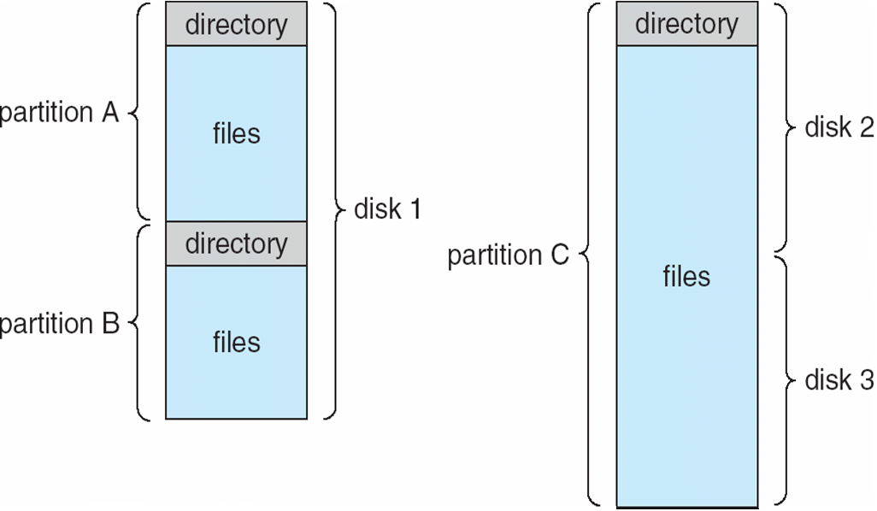
A Typical File-system Organization
左图：多个分区可共享一个磁盘
右图：一个分区可以跨多个磁盘

Slide 22
Operations Performed on Directory
目录的相关操作
Search for a file 搜索文件
Create a file 创建文件
Delete a file 删除文件
List a directory 遍历目录
Rename a file 重命名文件
Traverse the file system 遍历文件系统

Slide 23

Single-Level Directory
A single directory for all users (the simplest directory structure)
一个目录对应所有用户
Naming problem: to create a new file, we must search the directory to be sure that no existing file has the same name, then we add a new entry at the end of the directory.
命名问题
  不允许有同名的文件

Slide 24

Two-Level Directory 双层结构目录
Separate directory for each user
不同用户可以为文件取相同名字
有效搜索
没有分组功能

Slide 25

Tree-Structured Directories
树状结构目录

Slide 26
Tree-Structured Directories (Cont)
Efficient searching 有效的搜索
Grouping Capability 支持分组
Current directory (working directory) 当前目录：文件路径名一般较长，而用户总是局部地使用文件，为了方便起见，可把经常使用的文件所在的目录指定为工作目录(或称当前目录)。
  cd /spell/mail/prog
  type list

Slide 27
Tree-Structured Directories (Cont)
Absolute or relative path name
绝对路径 从根路径开始,相对路径 从当前路径开始
Creating a new file is done in current directory
Delete a file
rm <file-name>
Creating a new subdirectory is done in current directory
  mkdir <dir-name>
Example: if in current directory /mail
mkdir count
mail
prog
copy
prt
exp
count
Deleting “mail” ⇒ deleting the entire subtree rooted by “mail”
删除“mail”目录 ⇒ 表示删除从“mail”开始的所有子目录.

Slide 28
Protection 保护
File owner/creator should be able to control:
文件所有者/创建者应当能够控制:
  what can be done 可以对文件做什么（读、写…)
  by whom 哪些人拥有权限
Types of access 访问类型
  读read
  写write
  执行execute
  扩展append
  删除delete
  显示列表list
Notes:
Access permissions

Slide 29
Access Lists and Groups
Mode of access 访问模式: read, write, execute
Three classes of users 三类用户
RWX
a) owner access 7 ⇒ 1 1 1
RWX
b) group access 6 ⇒ 1 1 0
RWX
c) public access 1 ⇒ 0 0 1
Ask manager to create a group (unique name), say G, and add some users to the group.
For a particular file (say game) or subdirectory, define an appropriate access.

Slide 30

A Sample UNIX Directory Listing

Slide 31
summary
File concept
File attribute
File operations
Directory structure
Protection
Everything is a file in OS.

Slide 32
End of Chapter 10

