Slide 1
Chapter 12: Mass-Storage Systems
Disk Structure 磁盘结构
Disk Scheduling 磁盘调度
Disk Management 磁盘管理
RAID Structure RAID结构
Tertiary Storage Devices 三级存储结构

Slide 2
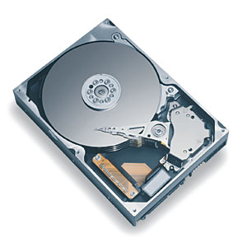
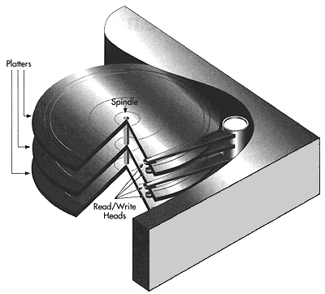
Disk structure 磁盘结构

Slide 3

Disk structure 磁盘结构
Notes:
7200rpm

Slide 4
Disk Structure 磁盘结构
Disk drives are addressed as large 1-dimensional arrays of logical blocks, where the logical block is the smallest unit of transfer.
Disk drives 磁盘驱动器可以看作是一个一维的逻辑块的数组，逻辑块是最小的传输单位

Slide 5
Disk Structure 磁盘结构
The 1-dimensional array of logical blocks is mapped into the sectors of the disk sequentially.
一维逻辑块数组按顺序映射到磁盘的扇区
  Sector 0 is the first sector of the first track on the outermost cylinder.
  Sector 0 扇区0是最外面柱面的第一个磁道的第一个扇区
  Mapping proceeds in order through that track, then the rest of the tracks in that cylinder, and then through the rest of the cylinders from outermost to innermost.
  Mapping 映射顺序是先按磁道内扇区顺序，再按柱面内磁道顺序，最后按从外到内的柱面顺序来排序的。

Slide 6
Disk Scheduling 磁盘调度
The operating system is responsible for using hardware efficiently — for the disk drives, this means having a fast access time.
操作系统的任务之一就是有效的使用硬件。对于磁盘驱动器来说，意味着较快的访问速度。
Access time has two major components访问时间分两部分
  Seek time is the time for the disk are to move the heads to the cylinder containing the desired sector.寻道时间
  Rotational latency is the additional time waiting for the disk to rotate the desired sector to the disk head.旋转延迟
Minimize seek time：Seek time ≈ seek distance
Notes:
Rotational latency is determined by rotational speed

Slide 7


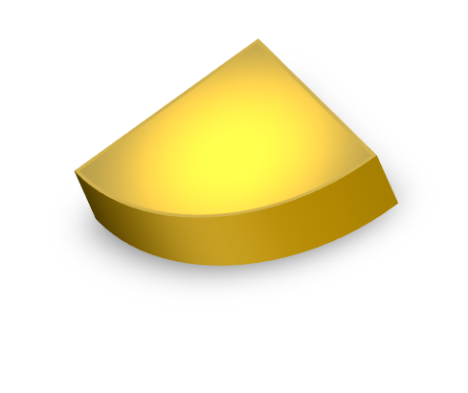
磁盘访问时间
  磁盘访问时间＝寻道时间+旋转延迟时间+数据传输时间
寻道时间
数据传输时间
旋转延迟时间

Slide 8
Disk Scheduling (Cont.)
Several algorithms exist to schedule the servicing of disk I/O requests.
  FCFS
  SSTF
  SCAN
  C-SCAN
  C-LOOK
There is a disk request queue for I/O to blocks on tracks: 98, 183, 37, 122, 14, 124, 65, 67, if the disk head is initially at track 53.
Describe the disk head movement using disk algorithms.

Slide 9

FCFS—first come first serve
Illustration shows total head movement of 640 cylinders.
Notes:
The simplest form of disk scheduling
The algorithm is fair, but it generally does not provide the fastest service.
If the disk head is initially at track 53, it will first move from 53 to 98, then to 183, 37,122,14,124, 65, and finally to 67, for the total movement of 640 tracks.

Slide 10
SSTF---shortest seek time first
最短寻道时间优先算法
  Selects the request with the minimum seek time from the current head position.
    选择与磁头位置最近的待处理请求
  SSTF scheduling is a form of SJF scheduling; may cause starvation of some requests.
    基本上是一种短作业有线调度，可能会产生饥饿
Illustration shows total head movement of 236 cylinders.

Slide 11

SSTF调度
初始情况：
磁头位于53号磁道
当前请求队列中离
磁头位置最近的IO
请求： 磁道65
磁头移动距离
= 65-53
= 12
当前总移动距离
=12

Slide 12
SSTF调度
磁头位于65号磁道
当前请求队列中离
磁头位置最近的IO
请求： 磁道67
磁头移动距离
= 67-65
= 2
当前总移动距离
=12 + 2
= 14

Slide 13
SSTF调度
磁头位于67号磁道
当前请求队列中离
磁头位置最近的IO
请求： 磁道37
磁头移动距离
= 67-37
= 30
当前总移动距离
=14+30
= 44

Slide 14
SSTF调度
磁头位于37号磁道
当前请求队列中离
磁头位置最近的IO
请求： 磁道14
磁头移动距离
= 37-14
= 23
当前总移动距离
=44+23
= 67

Slide 15
SSTF调度
磁头位于14号磁道
当前请求队列中离
磁头位置最近的IO
请求： 磁道98
磁头移动距离
= 98-14
= 84
当前总移动距离
=67+84
= 151

Slide 16
SSTF调度
磁头位于98号磁道
当前请求队列中离
磁头位置最近的IO
请求： 磁道122
磁头移动距离
= 122-98
= 24
当前总移动距离
=151 + 24
= 175

Slide 17
SSTF调度
磁头位于122号磁道
当前请求队列中离
磁头位置最近的IO
请求： 磁道124
磁头移动距离
= 124-122
= 2
当前总移动距离
=175+2
= 177

Slide 18
SSTF调度
磁头位于124号磁道
当前请求队列中离
磁头位置最近的IO
请求： 磁道183
磁头移动距离
= 183-124
= 59
当前总移动距离
=177+59
= 236

Slide 19
SCAN
The disk arm starts at one end of the disk, and moves toward the other end, servicing requests until it gets to the other end of the disk, where the head movement is reversed and servicing continues.
磁臂从磁盘的一端向另一端移动，当磁头移过每一个柱面时，处理位于该柱面上的请求服务。当到达另一端时，改变方向继续处理。
Sometimes called the elevator algorithm.
Illustration shows total head movement of 208 cylinders.
We should know the moving direction(maybe towards tack number increasing, maybe descreasing)
Notes:
Elevator algorithm

Slide 20

SCAN (Cont.)

Slide 21
C-SCAN
Provides a more uniform wait time than SCAN.
提供了一种更均匀的等待时间
The head moves from one end of the disk to the other. servicing requests as it goes. When it reaches the other end, however, it immediately returns to the beginning of the disk, without servicing any requests on the return trip.
C-SCAN也是将磁头从磁盘一端移到另一端，随着移动不断的处理请求。但是，当磁头移到另一端时，会马上返回到磁盘开始，返回时不处理请求
Notes:
On this direction, the I/O requests are satisfied. On the other direction, without servicing any request.

Slide 22

C-SCAN (Cont.)

Slide 23
C-LOOK
Version of C-SCAN
C-SCAN的改进版
Arm only goes as far as the last request in each direction, then reverses direction immediately, without first going all the way to the end of the disk.
磁头只移动到一个方向上最远的请求为止，接着马上返回，而不是移动到磁盘的尽头

Slide 24

C-LOOK (Cont.)

Slide 25
Selecting a Disk-Scheduling Algorithm
SSTF is common and has a natural appeal
SSTF较为普通且有吸引力
SCAN and C-SCAN perform better for systems that place a heavy load on the disk.
SCAN and C-SCAN 对于负荷较大的系统执行的好（无饥饿）
Performance depends on the number and types of requests.
性能主要依赖于请求的数量和类型
Either SSTF or CLOOK is a reasonable choice for the default algorithm.
SSTF和CLOOK是比较合理的默认算法

Slide 26
Disk Management
Low-level formatting, or physical formatting — Dividing a disk into sectors that the disk controller can read and write.低级格式化（物理格式化）：把磁盘分成扇区，以便于磁盘控制器读和写
每个扇区都有其数据结构
  头：包括组成扇区三维地址的三个数字：扇区所在的磁头（或盘面）、磁道（或柱面号）以及扇区在磁道上的位置即扇区号。扇区头标以循环冗余校验（CRC）值作为结束，以供控制器检验扇区头标的读出情况， 确保准确无误。
  数据区域
  尾：保护数据的纠错码（ECC）。
To use a disk to hold files, the operating system still needs to record its own data structures on the disk.
  Partition the disk into one or more groups of cylinders.----fdisk()
  Logical formatting or “making a file system”.
  ----format a partition to a “FAT”,or “NTFS”

Slide 27
Disk Management

Slide 28
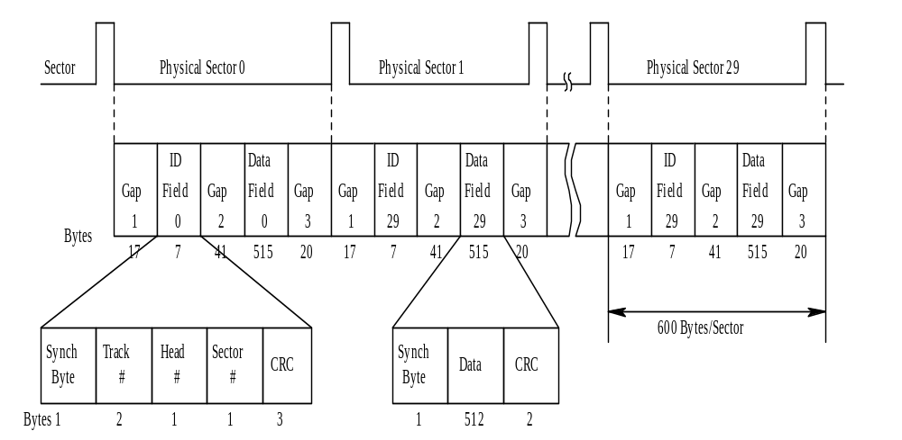
Disk Management
Operating System Concepts

Slide 29
RAID –Redundant Arrays of Inexpensive Disks
RAID – multiple disk drives provides reliability via redundancy.
from cost-effective to reliability
  In early time, people use RAID because RAID is cost-effective very much, for example, a disk size of 1GB is more cheaper than a disk size of 10GB, we can use 10 disks size of 1GB to build a disk size of 10GB.
  Now, disk is never too expensive, people use RAID because RAID is reliable.
Notes:
In early time, people use RAID because RAID is cost-effective very much, for example, a disk size of 1GB is more cheaper than a disk size of 10GB, we can use 10 disks size of 1GB to build a disk size of 10GB.
Now, disk is never too expensive, people use RAID because RAID is reliable.

Slide 30

RAID Levels
mirroring
striping at block level
striping at bit level
parity
distributed parity
Notes:
Independent Data disks with distributed parity blocks独立的数据磁盘与分布式校验块

Slide 31
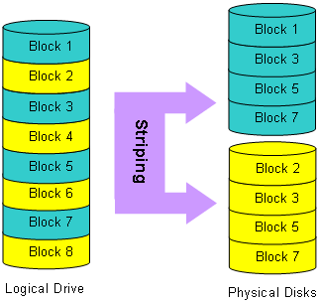
Raid 0
Notes:
RAID 0 can accomplish reading and writing in parallel in order to increase the I/O speed.
We can implement parallel reading and writing by using RAID.RAID 0 has the highest speed. If we do not have RAID 0, we have to accomplish serial reading and writing.
Because there is no redundancy, if there is something wrong with one of disk, the data cannot be used again.

Slide 32
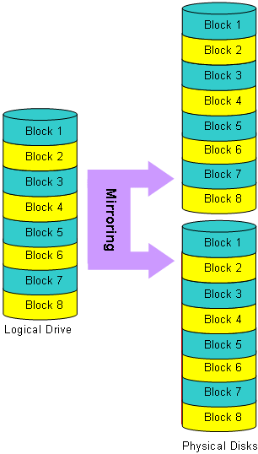
Raid 1
Notes:
Mirroring: a disk is a backup (or copy) for another disk. RAID controller should be able to make some operations on two disks at the same time. This kind of RAID has a high security.
In bank system, the data is important very much, the database system saved on disk uses RAID 1 in order to avoid the loss of data.

Slide 33
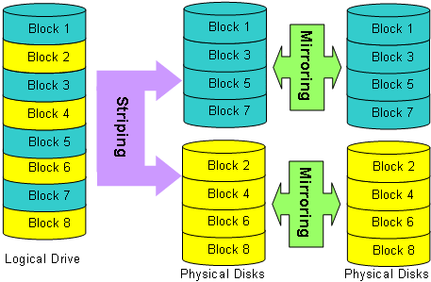
Raid 0+1
Notes:
We can combine the two kinds of RAID in order to accomplish high reading and writing speed and data backup.

Slide 34
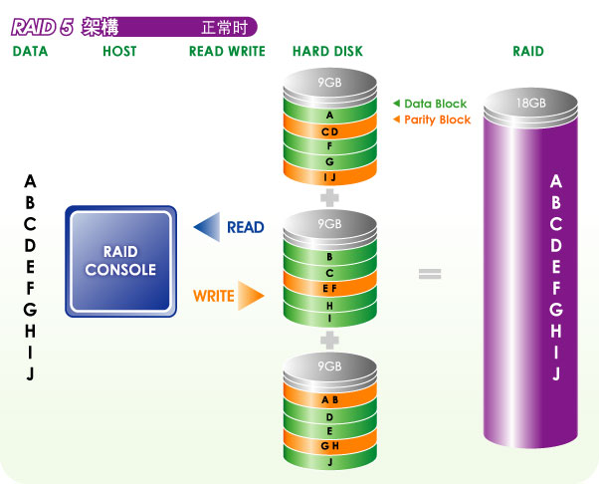
RAID 5
Notes:
RAID 5 use some blocks to save parity information, it can make error correction use parity block. This parity check blocks scatter on the disk.

Slide 35
Tertiary Storage Devices
Low cost is the defining characteristic of tertiary storage.
Generally, tertiary storage is built using removable media
Common examples of removable media are floppy disks and CD-ROMs; other types are available.

Slide 36
Removable Disks
Floppy disk — thin flexible disk coated with magnetic material, enclosed in a protective plastic case.
  Most floppies hold about 1 MB; similar technology is used for removable disks that hold more than 1 GB.
  Removable magnetic disks can be nearly as fast as hard disks, but they are at a greater risk of damage from exposure.

Slide 37
Removable Disks (Cont.)
A magneto-optic disk records data on a rigid platter coated with magnetic material.
  Laser heat is used to amplify a large, weak magnetic field to record a bit.
  Laser light is also used to read data (Kerr effect).
  The magneto-optic head flies much farther from the disk surface than a magnetic disk head, and the magnetic material is covered with a protective layer of plastic or glass; resistant to head crashes.
Optical disks do not use magnetism; they employ special materials that are altered by laser light.
Notes:
磁光盘

Slide 38
WORM Disks
The data on read-write disks can be modified over and over.
WORM (“Write Once, Read Many Times”) disks can be written only once.
Thin aluminum film sandwiched between two glass or plastic platters.
To write a bit, the drive uses a laser light to burn a small hole through the aluminum; information can be destroyed by not altered.
Very durable and reliable.
Read Only disks, such ad CD-ROM and DVD, come from the factory with the data pre-recorded.

Slide 39
Tapes
Compared to a disk, a tape is less expensive and holds more data, but random access is much slower.
Tape is an economical medium for purposes that do not require fast random access, e.g., backup copies of disk data, holding huge volumes of data.
Large tape installations typically use robotic tape changers that move tapes between tape drives and storage slots in a tape library.
A disk-resident file can be archived to tape for low cost storage; the computer can stage it back into disk storage for active use.

Slide 40
Reliability
A fixed disk drive is likely to be more reliable than a removable disk or tape drive.
An optical cartridge is likely to be more reliable than a magnetic disk or tape.
A head crash in a fixed hard disk generally destroys the data, whereas the failure of a tape drive or optical disk drive often leaves the data cartridge unharmed.
固定硬盘中的磁头崩溃通常会破坏数据，而磁带驱动器或光盘驱动器的故障通常会使数据盒不受伤害。

Slide 41
Summary
Disk Structure: sectorS扇区, track磁道, cylinder柱面, platter盘片;
Disk Scheduling algorithms磁盘调度算法: fcfs,sstf,scan,c-scan,c-look
Disk management磁盘管理: physical formatting物理格式化, logical formatting逻辑格式化
RAID Structure: Raid 0-Raid 6;磁盘冗余阵列
Tertiary storage: floppy disk; optical disk; WORM; Tapes
Operating System Concepts

