Slide 1
Chapter 13: I/O Systems

Slide 2
Chapter 13: I/O Systems
I/O Hardware
Kernel I/O Subsystem 子系统 内核

Slide 3
I/O Hardware
Incredible variety of I/O devices
Devices have address每个设备都有对应的地址
Common concepts
  Port 端口
  Bus (daisy chain or shared direct access)总线
  Controller (host adapter适配器)设备控制器
I/O instructions control devices
Devices have addresses, used by
  Direct I/O instructions
  Memory-mapped I/O

Slide 4
I/O Controller
IO devices cannot communicate with CPU directly
each device has a device controller which is able to exchange information between CPU and IO device.
Such as sound card, display card, and so on.
Register寄存器Control存储cpu指令（读写），做数据缓冲，，报告状态
CPU
I/O
Control
Logical
circuit
Control register
Status register
Data register

Slide 5
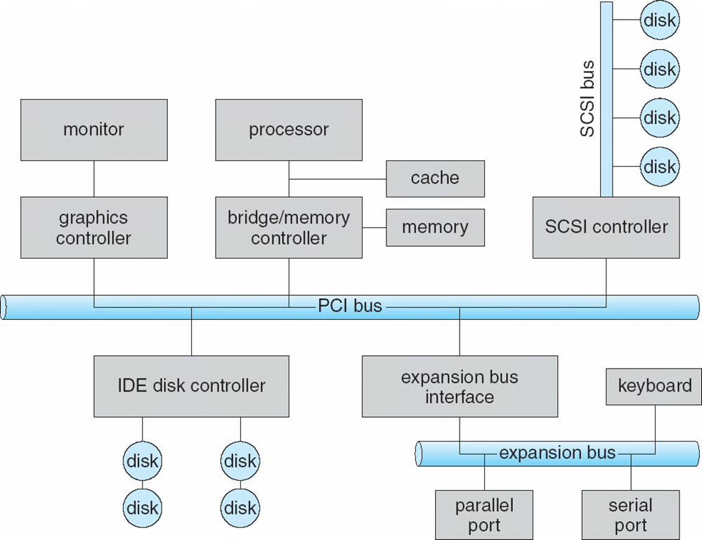
A Typical PC Bus Structure
Notes:
The bus can contact many computer components and make them communicate with each other.
IO devices cannot communicate with CPU directly, each device has a device controller which is able to exchange information between CPU and IO device. Such as sound card, display card, and so on.

Slide 6
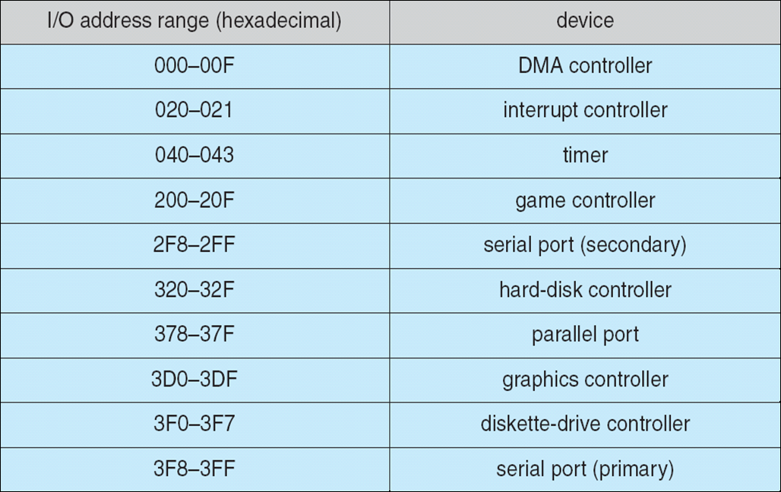
Device I/O Port Locations on PCs (partial)

Slide 7
I/O control methods
Polling轮询方式（忙等待）
Interrupts中断方式（适用于字符设备，传输的数据量不大的场合）
DMA（direct memory access）直接存储器访问方式（适用于数据块的传输，磁盘设备会采用DMA的控制方式）
单片机取代DMA（单片机可以执行简单的指令）
Cpu和DMA控制器争用总线，周期挪用技术来解决总线争用的问题，会降低CPU的执行速度
总线周期：

Slide 8
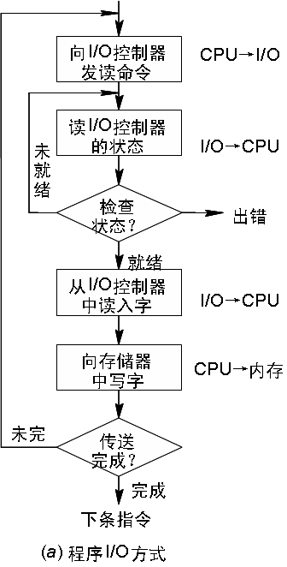
Polling（轮询，效率低）
Determines state of device 暂停状态
  command-ready请求就绪
  busy
  Error
Busy-wait cycle to wait for I/O from device

Slide 9
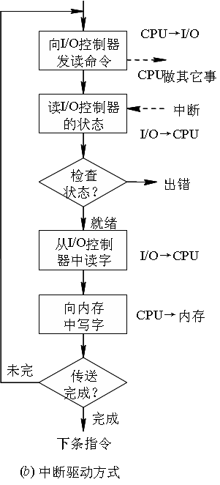
Interrupts
CPU Interrupt-request line triggered by I/O device
Interrupt handler receives interrupts
Maskable to ignore or delay some interrupts
Interrupt vector to dispatch interrupt to correct handler
  Based on priority
  Some nonmaskable
Interrupt mechanism also used for exceptions
Notes:
kindergarten candy

Slide 10
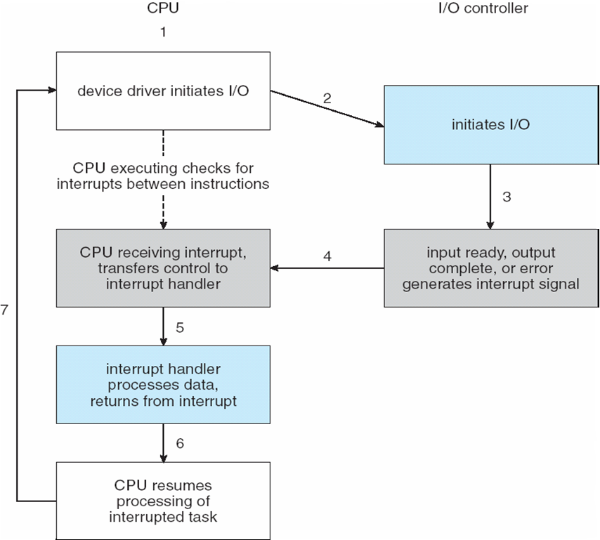
Interrupt-Driven I/O Cycle

Slide 11
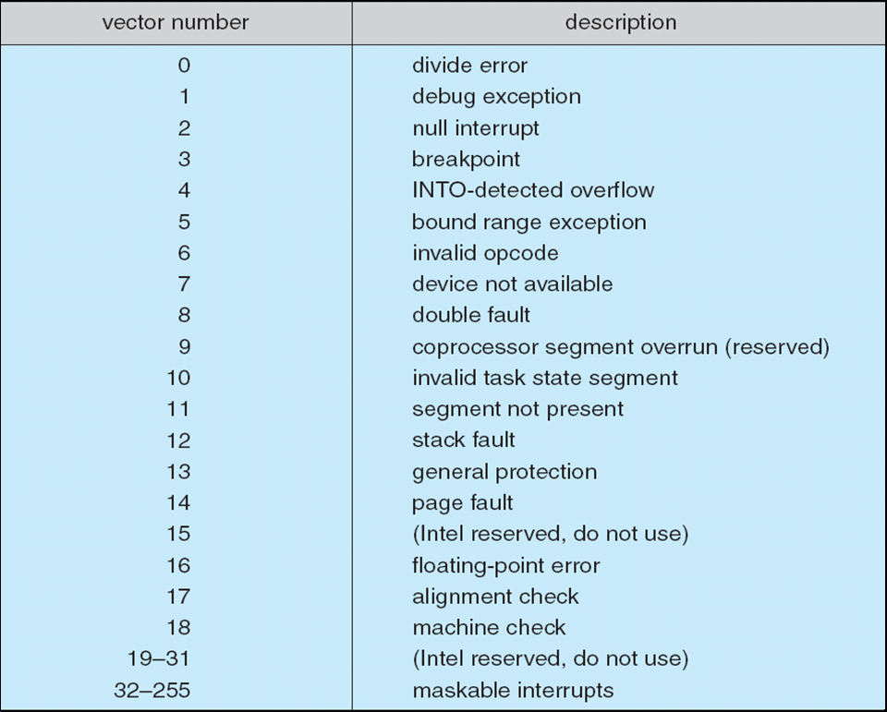
Intel Pentium Processor Event-Vector Table

Slide 12
Direct Memory Access
Used to avoid programmed I/O for large data movement
Requires DMA controller
Bypasses 绕过CPU to transfer交换 data directly between I/O device and memory

Slide 13
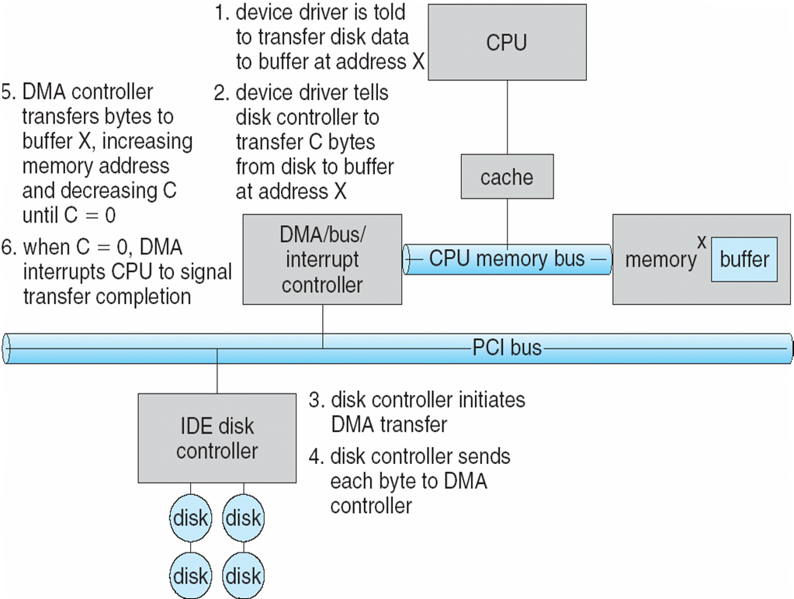
Six Step Process to Perform DMA Transfer

Slide 14
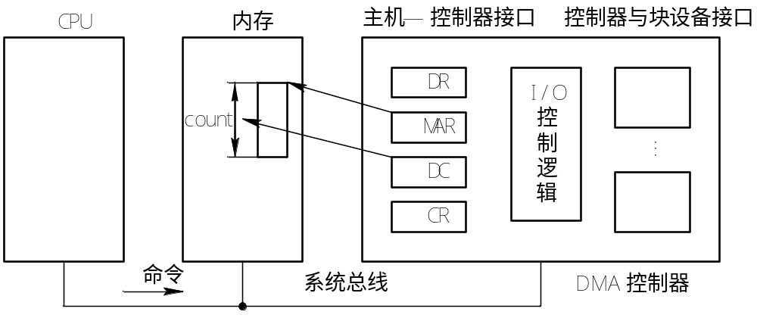
DMA controller

Slide 15
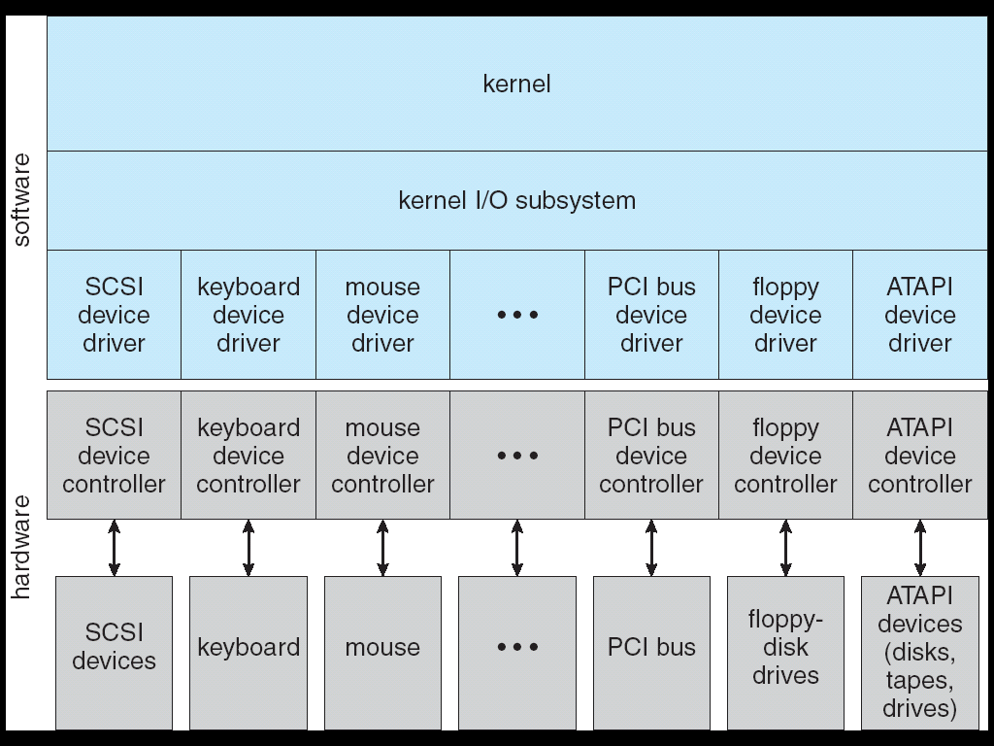
A Kernel I/O Structure

Slide 16
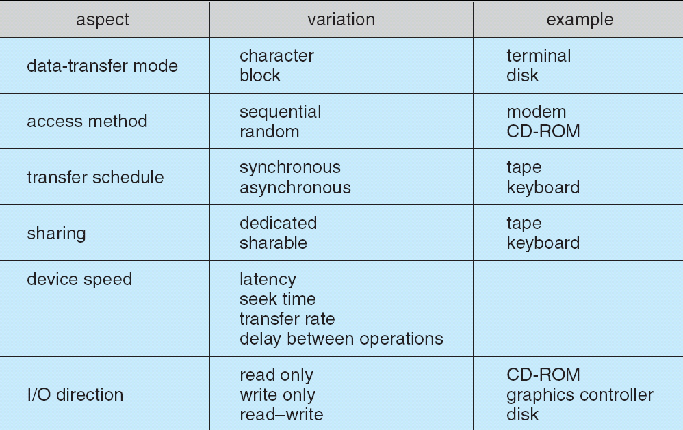
Characteristics of I/O Devices

Slide 17
Block and Character Devices
Block devices include disk drives
  Commands include read, write, seek
  Raw I/O or file-system access
  Memory-mapped file access possible
Character devices include keyboards, mice, serial ports
  Commands include get, put
  Libraries layered on top allow line editing

Slide 18
Kernel I/O Subsystem
Scheduling
  Some I/O request ordering via per-device queue
  Some OSs try fairness
Buffering - store data in memory while transferring between devices
  To cope with device speed mismatch
  To cope with device transfer size mismatch
  To maintain “copy semantics”
Buffering 设备缓冲区（引入目的：减少速度差异）is in order to reduce the speed difference between CPU （高速）and IO device（）低速.

Slide 19
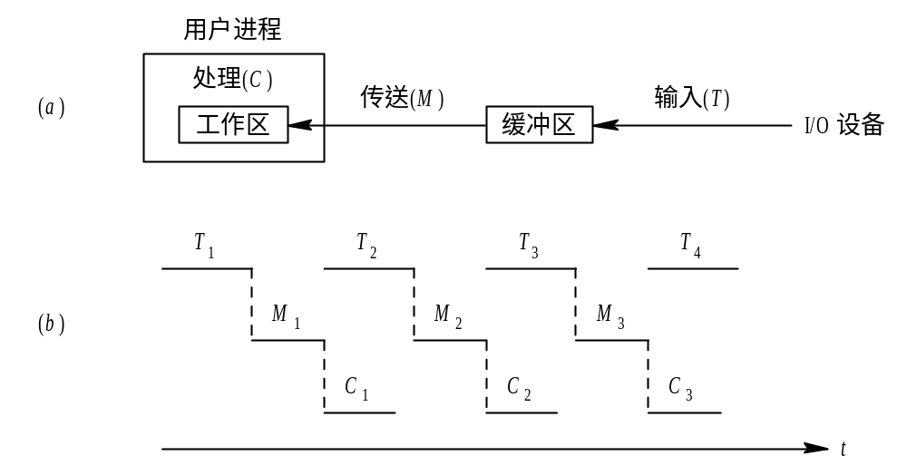
Single buffer
Notes:
The time for inputing data is T, the time for transfering data from buffer to process space is M, the time for processing data by user process is c.
The handling time of one block data is Max ( t,c) +M

Slide 20
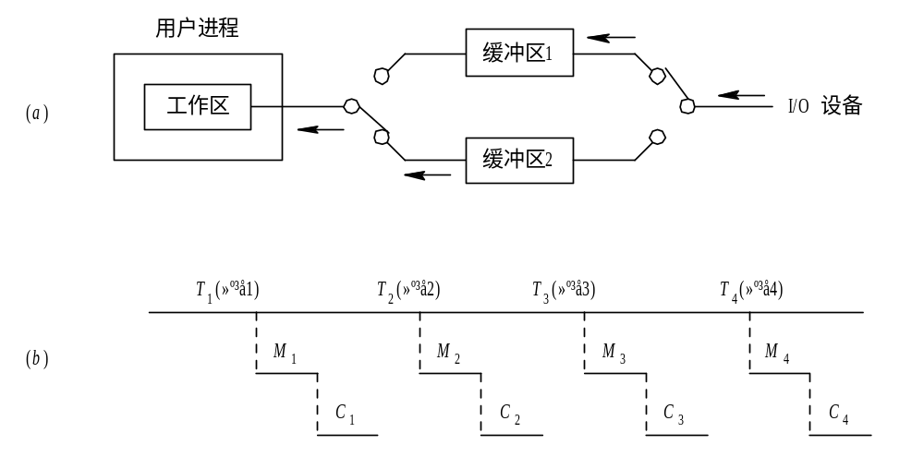
Double buffer
Notes:
The handling time of one block data is Max ( t,c+M)

Slide 21
Kernel I/O Subsystem
Caching - fast memory holding copy of data
  Always just a copy
  Key to performance
Spooling - hold output for a device
  If device can serve only one request at a time
  i.e., Printing
Device reservation - provides exclusive access to a device
  System calls for allocation and deallocation
  Watch out for deadlock

Slide 22
spooling (Simultaneaus Periphernal Operating On-Line)
In order to make the dedicated I/O device become sharing I/O device.
For example: sharing printer
Spooling system
Input process
Output process
SP_{i}
SP_{o}
disk
o
Input device
Input buffer
B
Input blocks
i
Output device
B
Output buffer
o
Output blocks
Notes:
1 user send the document to printer server;
2 output process put the document into the disk
and record the print requirement on the print queue;
3 when printer is free and you are the first node in the print queue,
output process can send the document to main memory;
4 printer can print the document for you.

Slide 23
Spooling- sharing printer
SPOOLing technology can convert a printer to a device shared by multiple users.
When the user process requests print task, SPOOLing system agreed to print for it, but don't really assign the printer to the user process immediately, but to do two things:
(1) output process allocates free zone on the disk for your task, and put the document of your task into this zone;
(2) the output process requests a blank print table for your task, and then fill your printing requirements into the table, such as document name,document size, and so on, and then put the table onto the print queue.
If the printer is idle, the output process takes the first requirement from the print queue. then transmits it to the memory buffer according to the requirements in the table and wait printing.

Slide 24
summary
IO controller
IO control methods（polling interrupt DMA）
The objective for Buffer (single buffer , double buffer)
Spooling technology( sharing printer example)

Slide 25
End of Chapter 13

