Slide 1
Chapter 3: Processes

Slide 2
Chapter 3: Processes
Process Concept进程的概念
Process Scheduling进程调度的概念
Operations on Processes进程的操作
Cooperating Processes进程协作
Interprocess Communication进程间通信

Slide 3
Objectives
To introduce the notion of a process -- a program in execution, which forms the basis of all computation
To describe the various features of processes, including scheduling, creation and termination, and communication

Slide 4
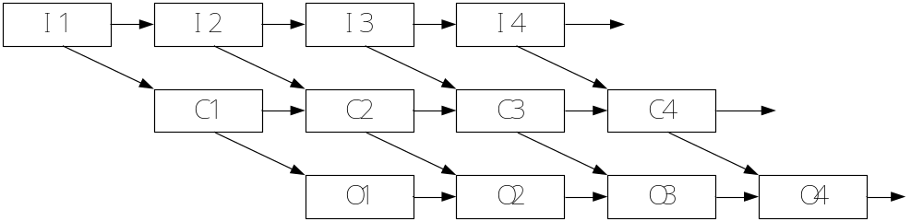
Concurrency（并发）
Current-day computer systems allow multiple programs to be loaded into memory and executed concurrently.

Slide 5
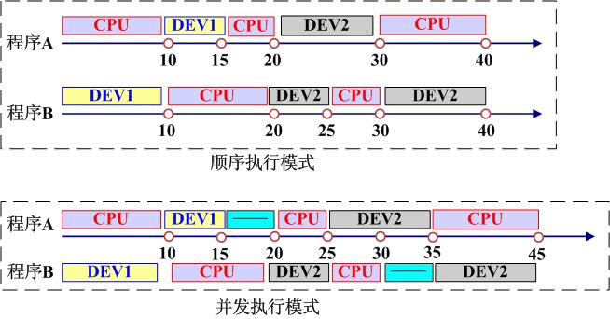
Efficiency

Slide 6
Efficiency
sequential execution:
  Cumulative Time：80
  CPU Efficiency：40/80 = 50%
  DEV1 Efficiency ：15 / 80 ＝ 18.75%
  DEV2 Efficiency ：25 / 80 = 31.25%
Concurrence
  Cumulative Time ：45
  CPU Efficiency ：40 / 45 = 89%
  DEV1 Efficiency ：15 / 45 = 33%
  DEV2 Efficiency ：25 / 45 ＝ 55.6%

Slide 7
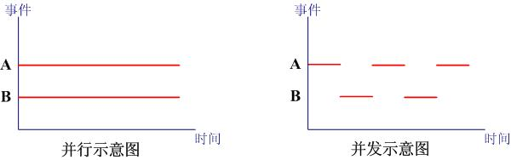
并行（Parallel）vs 并发（Concurrency）
Notes:
Single processor and multiple processors

Slide 8
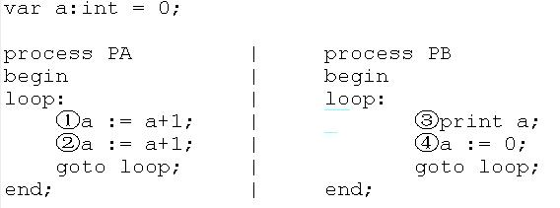
Programs concurrency Problem
①②③④ ①②③④ ①②③④… 2222…
①③②④ ①③②④ ①③②④… 1111…
This is the reason of
Why we use process?

Slide 9
Process Concept进程的概念
Textbook uses the terms job and process almost interchangeably 本书中作业=进程
Process
  Process is a program in execution;
  Process has its own life period;
  Process can be created, can be terminated, can be scheduled.
  Process is a dynamic entity.
Process and program
  Program is passive entity(static entity),process is a dynamic entity.
  Process spawns(creates) many processes when it runs, but program cannot do it.

Slide 10

Process Concept进程的概念
A process includes:
  Text section 文本段（代码段）
  program counter 程序计数器
  Stack 栈
  Heap 堆
  data section数据段
  PCB(Process Control Block)

Slide 11

Process Control Block (PCB)
Container for the unique information for each process when they are running in the operating system
PCB用来保存程序运行期间的重要信息
  (1)进程存在的唯一标识
  (2)记录了OS所需的用于描述进程及控制进程所需的全部信息
Information associated with each process
Process state进程状态
Program counter程序计数器
CPU registers CPU寄存器
CPU scheduling information CPU调度信息
Memory-management information 内存管理信息
Accounting information 记账信息
I/O status information I/O状态信息
进程与PCB是一一对应的

Slide 12

CPU Switch From Process to Process
CPU在进程间的切换

Slide 13
Context Switch上下文切换
When CPU switches to another process, the system must save the state of the old process and load the saved state for the new process当CPU切换到另一个进程的时候，系统需要保存老进程的状态，并且加载新进程的状态
Context-switch time is overhead; the system does no useful work while switching 上下文切换的时间是系统的额外开销，切换时系统不做任何有用的工作
Time dependent on hardware support时间与硬件支持密切相关

Slide 14
Process State进程状态
As a process executes, it changes state
  new: The process is being created新建
  running: Instructions are being executed运行
  Waiting（block）: The process is waiting for some event to occur等待
  ready: The process is waiting to be assigned to a processor就绪
  terminated: The process has finished execution终止

Slide 15

Diagram of Process State进程状态图

Slide 16
进程状态转换
就绪 --> 运行
    调度程序选择一个新进程执行
运行 --> 就绪
    时间片用完
运行 --> 等待(阻塞)
    遇到I/O操作且必须等待结果
等待 --> 就绪
    当所等待的I/O事件发生时

Slide 17
Process Scheduling Queues进程调度队列
Ready queue – set of all processes residing in main memory, ready and waiting to execute就绪队列
Device queues – set of processes waiting for an I/O device设备队列：等待I/O设备的进程
Processes migrate among the various queues进程在不同的队列间移动

Slide 18
Schedulers调度程序
Long-term scheduler (or job scheduler) – selects which processes should be brought into the ready queue长期调度（作业调度）：选择一个进程进入内存的就绪队列
Short-term scheduler (or CPU scheduler) – selects which process should be executed next and allocates CPU短期调度（CPU调度）：从就绪队列中选择一个进程，并为之分配CPU
两者区别：执行的频率

Slide 19

Addition of Medium Term Scheduling
中期调度（交换）
对换技术、交换技术（Swapping）
将内存中暂时不能运行的进程，或暂时不用的数据和程序，换出到外存，以腾出足够的内存空间，把已经具备运行条件的进程，或进程需要的数据和程序，换入内存。

Slide 20
Process Creation进程创建
Parent process create children processes, which, in turn create other processes, forming a tree of processes父进程创建子进程，子进程继续创建，从而形成一棵进程树
Generally, process identified and managed via a process identifier (pid)
Resource sharing 资源共享
  Parent and children share all resources父子进程共享所有资源
  Children share subset of parent’s resources子进程共享部分父进程的资源
  Parent and child share no resources父子进程不共享任何资源
Execution
  Parent and children execute concurrently子进程和父进程并发执行
  Parent waits until children terminate父进程等待直到子进程终止

Slide 21

A tree of processes on a typical Solaris

Slide 22

Process Creation (Cont.)
Address space地址空间
  Child duplicate of parent 子进程是父进程的复制品
  Child has a program loaded into it 子进程装入另一个新程序
UNIX examples
  fork system call creates new process
  exec system call used after a fork to replace the process’ memory space with a new program
Notes:
阅读以下文档，了解进程创建是如何实现的。
在Linux中运行里面的代码并理解。
http://blog.csdn.net/jason314/article/details/5640969

Slide 23
Process Creation (Cont)
A new process is created by the fork() system call. The new process consists of a copy of the address space of the parent process.
Child processes continue execution at the instruction after the fork().
The return value of fork() for child process is 0, but that for parent is an integer value greater than 0. The integer value is his child PID.
it is meaningless to create two same processes. so the child should be allocated a new task to do, we can use exec() system call to accomplish it in child process.
exec() can replace a process’s memory space with a new program(executable file).
Notes:
A new process is created by the fork() system call. The new process consists of a copy of the address space of the original process. Both processes continue execution at the instruction after the fork();, with one difference, the return code for the fork() is zero for the child process, whereas the process identifier of the child is returned to the parent.
The exec() system call is used after a fork() system call by one of the two processes to replace the process’s memory space with a new program. In this manner, the two processes are able to go their separate way and communicate with each other.
The parent can issue a wait() system call to move itself off the ready queue until the termination of the child.

Slide 24
Process Creation (Cont)
The exec() system call is used after a fork() system call by one of the two processes to replace the process’s memory space with a new program. In this manner, the two processes are able to go their separate way and communicate with each other.
Notes:
A new process is created by the fork() system call. The new process consists of a copy of the address space of the original process. Both processes continue execution at the instruction after the fork();, with one difference, the return code for the fork() is zero for the child process, whereas the process identifier of the child is returned to the parent.
The exec() system call is used after a fork() system call by one of the two processes to replace the process’s memory space with a new program. In this manner, the two processes are able to go their separate way and communicate with each other.

Slide 25
C Program Forking Separate Process
int main()
{
pid_t pid;
/* fork another process */
pid = fork();
if (pid < 0) { /* error occurred */
fprintf(stderr, "Fork Failed");
exit(-1);
}
else if (pid == 0) { /* child process */
execlp("/bin/ls", "ls", NULL);
}
else { /* parent process */
/* parent will wait for the child to complete */
wait (NULL);
printf ("Child Complete");
exit(0);
}
}

Slide 26
Process Termination进程终止
Process executes last statement and asks the operating system to delete it (exit)进程完成执行最后的语句并使用系统调用exit请求操作系统删除自身
  Output data from child to parent (via wait)进程可以返回状态值给父进程（通过wait）
  Process’ resources are deallocated by operating system进程的资源被操作系统释放
Parent may terminate execution of children processes (abort)父进程能够中止子进程的执行
  Child has exceeded allocated resources子进程使用了超过它所分配到的一些资源
  Task assigned to child is no longer required 子进程的任务不再需要
  If parent is exiting如果父进程结束了
    Some operating system do not allow child to continue if its parent terminates一些操作系统不允许子进程继续执行
      All children terminated - cascading termination级联终止

Slide 27
Interprocess Communication
Processes within a system may be independent or cooperating
Cooperating process can affect or be affected by other processes, including sharing data
Reasons for cooperating processes:
  Information sharing
  Computation speedup
  Modularity
  Convenience
Cooperating processes need interprocess communication (IPC)
Three models of IPC
  pipe
  Shared memory
  Message passing
Notes:
Independent process cannot affect or be affected by the execution of another process
Cooperating process can affect or be affected by the execution of another process
Several users may be interested in the same of piece of information. Such as a shared file. We must provide an environment to allow concurrent access to such information.
Cooperating processes require an IPC mechanism that will allow them to exchange data and information.
Pipe is not concluded in text book, you should take notes in your textbook.

Slide 28
Interprocess Communication – pipe
pipe is a type of interprocess communication in early time.
processes can exchange data through pipe.
pipe can be used between parent and child processes or between brother processes.
pipe is a piece of memory(4096B).
发送进程
字符先进先出
接收进程

Slide 29
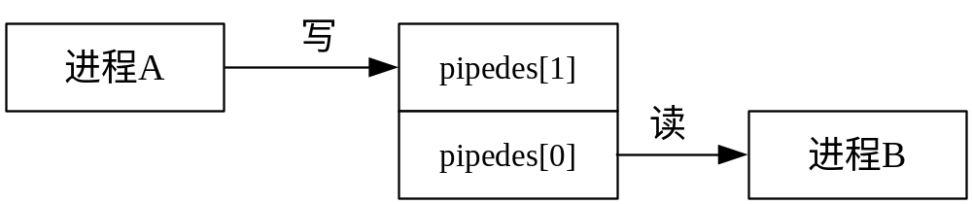
Interprocess Communication – pipe
#include <unistd.h>
int pipe(int pipedes[2]); //create a pipe
pipedes[2]:file descriptor array.
pipedes[1] is the file descriptor for writing,
pipedes[0] is the file descriptor for reading.
Notes:
you can use system call read and write to achieve communication.
sender process can write data into a pipe through pipedes[1], receiver process can read data from pipe through pipedes[0].
pipedes[1] represent the writing end of pipe, pipedes[0] represent the reading end of pipe.

Slide 30
Interprocess Communication – pipe
exercise：pipefork1.c

Slide 31
Interprocess Communication – shared memory
Interprocess communication using shared memory requires communicating processes to establish a region of share memory.
A shared-memory region resides in the address space of the process creating the shared-memory segment.
Other processes that wish to communicate using this shared-memory segment must attach it to their address space.
They can exchange information by reading and writing data in the shared areas.
The processes are also responsible for ensuring that they are not writing to the same location simultaneously.
You will explore the contents of shared memory in <Linux programming> in more details.
Notes:
Any two processes which want to exchange informations with each other can perform the communication.

Slide 32
Interprocess Communication – Message Passing
Mechanism for processes to communicate and to synchronize their actions
Message system – processes communicate with each other without resorting to shared variables
IPC facility provides two operations:
  send(message) – message size fixed or variable
  receive(message)
If P and Q wish to communicate, they need to:
  establish a communication link between them
  exchange messages via send/receive
Implementation of communication link
  physical (e.g., shared memory, hardware bus)
  logical (e.g., logical properties)

Slide 33
Direct Communication
Processes must name each other explicitly:
  send (P, message) – send a message to process P
  receive(Q, message) – receive a message from process Q
Properties of communication link
  Links are established automatically
  A link is associated with exactly one pair of communicating processes
  Between each pair there exists exactly one link
  The link may be unidirectional, but is usually bi-directional

Slide 34
Indirect Communication
Messages are directed and received from mailboxes (also referred to as ports)
  Each mailbox has a unique id
  Processes can communicate only if they share a mailbox
Properties of communication link
  Link established only if processes share a common mailbox
  A link may be associated with many processes
  Each pair of processes may share several communication links
  Link may be unidirectional or bi-directional

Slide 35
Indirect Communication
Operations
  create a new mailbox
  send and receive messages through mailbox
  destroy a mailbox
Primitives are defined as:
send(A, message) – send a message to mailbox A
receive(A, message) – receive a message from mailbox A

Slide 36
summary
A process is a program in execution. As a process executes, it changes state. The state of process is defined by that process’s current activity. Each process may be in one of the following states: new, ready, running, waiting, or terminated.
A process, when it is not executing, is placed in some waiting queue. (device queue or ready queue).
Each process is represented by a PCB.
Long-term scheduling is the selection of processes that will be allowed to contend for the CPU.
Short-term scheduling is the selection of one process from the ready queue.
OS must provide a mechanism for parent processes to create child processes. The parent may wait for its children to terminate before proceeding, or the parent and child may execute concurrently.
Cooperating processes require an IPC mechanism to communicate with each other.

Slide 37
summary
Process state
concurrently
Process Control Block(PCB)
Process scheduling
ready queue, device queue
Long-term scheduler, short-term scheduler, medium-term scheduler
Swapping
Context switch
Process creating, process termination
Parent process, child process
Tree of processes
IPC

Slide 38
End of Chapter 3

