Slide 1
Operating System
Lecture 1: Introduction
Lecturer: ZhouHaibo（周海波，计算机系）
  Email: zhouhaibo@neusoft.edu.cn
  Room: A3-118
  Tel:84835205

Slide 2
outline
Course Introduction
  Grading policy
  Book
Introduction to Operating System

Slide 3
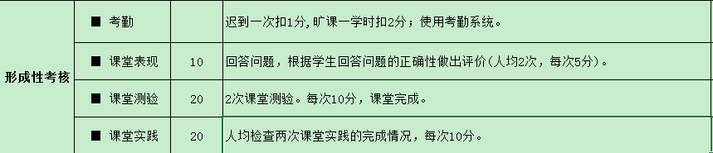
Course Introduction
Grading Policy
  Exam 50%（ Closed book exam， 120 minutes ）
  Regular Grade 50%

Slide 4
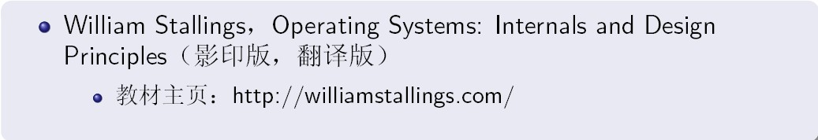
Course Introduction
Text Book
  Abraham Silberschatz, et. , Operating System Concepts(7th Edition), John Wiley & Sons, Inc., 2007
Reference books
Experiment Environment
  Vmware workstation
  red hat Linux

Slide 5
Course Introduction
Prerequisite（先修课）
  Data Structure
  Computer hardware
  Program language: C
Sharing reference resources（参考资料）
  习题，课件，实验资源，视频等
  QQ群共享

Slide 6
Objective for OS
2W+H：
  What: What is OS? Do what?
  Why: Why need OS?
  How: How to work? How to use?

Slide 7
outline
Course Introduction
  Grading policy
  Book
Introduction to Operating System
  List some OS examples？

Slide 8
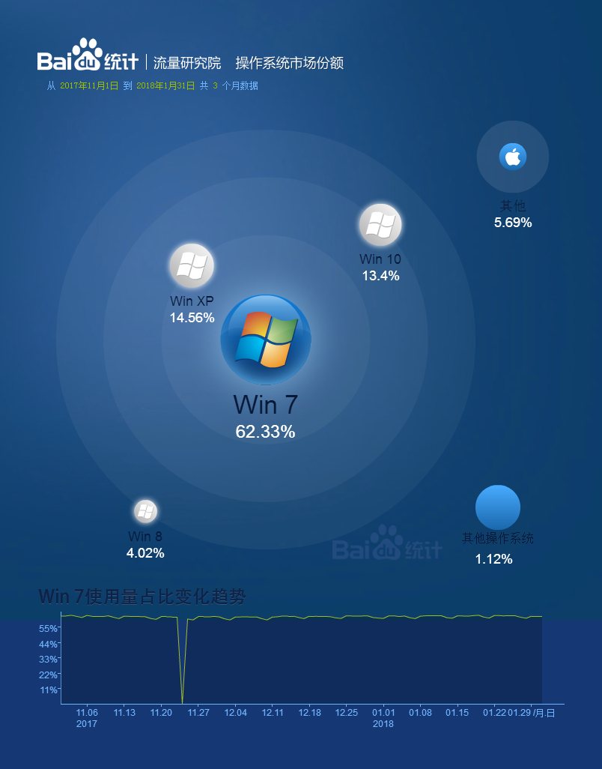
Some Operating Systems
直观概念
  三足鼎立
    Windows
    Apple Mac OS X
    Linux/Unix
  适者生存
    台式机/笔记本
    嵌入式平台：iOS Android ucOSII
http://tongji.baidu.com/data/os

Slide 9
outline
Introduction to Operating System
  What is OS? Do what?
  Why need OS?
Questions
  什么是程序？
  程序由什么组成？
  正在运行的程序存储在什么位置？
  计算机的哪个部件负责执行程序？
  计算机系统中有哪些资源？

Slide 10
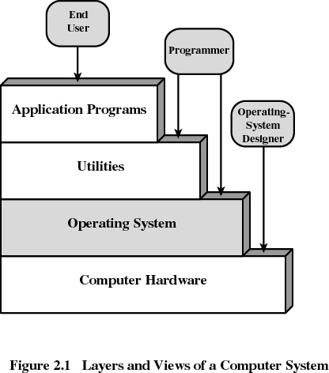
Notes:
Position of OS in a computer system

Slide 11
outline
Introduction to Operating System
  What is OS? Do what?
  Why need OS?

Slide 12
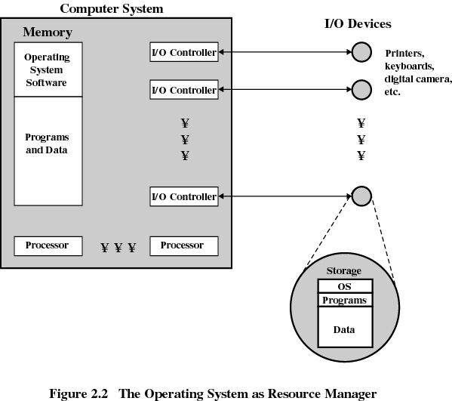

Slide 13

操作系统的定义、发展历史 chapter1
命令接口、图形接口和程序接口（系统调用）chapter2
进程概念，进程调度、进程间通信以及线程 chapter3,4,5,6,7
内存分配、保护和扩充技术；地址映射 chapter8,9
缓冲区管理、设备分配等 chapter12,13
文件管理
基本概念
I/O设备管理
OS
用户接口
存储器管理
处理器管理
文件存储空间管理、目录管理 chapter 10,11

Slide 14
Course Content
13 chapters
Chapter 1: Introduction
Chapter 2: OS Structure
Chapter 3: Process
Chapter 4: Thread

Slide 15
Chapter 5: CPU Scheduling
Chapter 6: Process Synchronization
Chapter 7: Deadlock
Chapter 8: Memory Management
Chapter 9: Virtual Memory
Chapter 10:File system Interface
Chapter 11: File System Implementation
Chapter 12: Mass-Storage Management
Chapter 13 I/O System

Slide 16
Experiments
Linux Platform.
Basic Operating Command
Process Create
Multiple Threads Create
Process intercommunication
Process Synchronization and mutex

Slide 17
Chapter 1: Introduction
What Operating Systems Do
Computer-System Organization
Computer-System Architecture
Operating-System Structure
Operating-System Operations
Process Management
Memory Management
Storage Management
Protection and Security
Distributed Systems
Special-Purpose Systems
Computing Environments

Slide 18
Objectives
To provide a grand tour of the major operating systems components提供对操作系统主要部件的浏览
To provide coverage of basic computer system organization提供基本的计算机系统体系结构的概述
Notes:
P3 line 5-9 有很多操作系统分类比如大型机操作系统，PC操作系统，手持式设备OS，本课程介绍各类操作系统中比较基础的理论和实现方法。

Slide 19
What is an Operating System?
A program that acts as an intermediary between a user of a computer and the computer hardware.在计算机用户和计算机硬件之间起媒介作用的一种程序
Operating system goals:
  Execute user programs and make solving user problems easier.执行用户程序，更容易的解决用户问题----------》对用户
  Make the computer system convenient to use.使计算机系统更容易使用 -------------》对硬件
Use the computer hardware in an efficient manner.以一种更有效的方式使用硬件
Notes:
教材P1 第1段的前两句话

Slide 20
Operating System Definition
OS is a resource allocator资源分配者
  Manages all resources 管理所有资源
  Decides between conflicting requests for efficient and fair resource use 有效、公平的使用资源
OS is a control program控制程序
  Controls execution of programs to prevent errors and improper use of the computer管理程序的执行，防止计算机资源的错误使用或使用不当

Slide 21
Operating System Definition (Cont.)
“The one program running at all times on the computer” is the kernel. Everything else is either a system program (ships with the operating system) or an application program
操作系统是一直运行在计算机上的程序（通常称为内核），其他程序则为系统程序和应用程序。
操作系统是一种管理计算机系统资源、控制系统工作流程，方便用户使用计算机的系统软件

Slide 22
Computer System Structure
Computer system can be divided into four components（计算机系统可被大致分为4个主要部分）
  Hardware – provides basic computing resources
    CPU, memory, I/O devices
  Operating system – Controls and coordinates use of hardware among various applications and users（控制和协调用户和应用程序对硬件资源的使用）
  Application programs – define the ways in which the system resources are used to solve the computing problems of the users(定义如何利用底层的硬件资源解决用户的计算问题)
    Word processors（文本编辑器）, compilers,
    web browsers（浏览器）, database systems, video games
  Users
    People
    other computers

Slide 23

Computer System Structure
Position of OS in a computer system
Notes:
计算机系统中被明显被划分出

Slide 24

Computer System Organization
Computer-system operation
  One or more CPUs, device controllers connect through common bus providing access to shared memory 一个或多个CPU和若干设备控制器通过共同的总线相连，该总线提供了对共享内存的访问
  Concurrent execution of CPUs and devices competing for memory cycles CPU与设备控制器并发工作，竞争内存周期

Slide 25

Simple Batch Systems 简单批处理系统
Operating System Development操作系统的发展
单道批处理
  Automatic job sequencing 自动作业调度– automatically transfers control from one job to another. 自动把（计算机的）控制从一个作业转到另一个作业。
A Resident monitor常驻内存管理程序
  用监督程序（或管理程序monitor）来实现作业的自动转换处理
。
Memory Layout

Slide 26
Simple Batch Systems 简单批处理系统
Operating System Development操作系统的发展
特点
  解决了人工干预过长的问题，但仍然是单道顺序的处理作业，资源容易造成空闲，即利用率不高。
  为了解决该问题，OS将进入了多道程序阶段。

Slide 27

Multiprogramming Batch Systems 多道程序批处理系统
Operating System Development操作系统的发展
60年代中 ~ 70年代中（集成电路）--现代意义上的操作系统出现
主存中可同时有若干个作业， CPU在其中进行切换。
优点
  资源利用率高：CPU和内存利用率较高；
  作业吞吐量大：单位时间内完成的工作数量多；
Memory Layout

Slide 28
Multiprogramming Batch Systems 多道程序批处理系统
Operating System Development操作系统的发展
  OS Features Needed for multiprogramming（多道程序对OS特点的要求）
  Memory management(存储管理)– the system must allocate the memory to several jobs.系统必须为若干作业分派空间
  CPU scheduling (CPU调度) – the system must choose among several jobs ready to run. 系统必须在就绪作业中挑选
  Allocation of devices (设备分配)

Slide 29
比较单道批处理系统和多道程序批处理系统
Operating System Development操作系统的发展
  Single user cannot keep CPU and I/O devices busy at all times单独的用户不能总使得CPU和I/O忙碌
  A subset of total jobs in system is kept in memory多道作业同驻内存
  One job selected and run via job scheduling 作业调度
  When it has to wait (for I/O for example), OS switches to another job 当一个作业等待时，CPU转去执行其它的作业

Slide 30
比较单道批处理系统和多道程序批处理系统
Operating System Development操作系统的发展
 | 作业1 | 作业2 | 作业3
作业类型 | 大量计算 | 大量I/O | 大量I/O
持续时间 | 5分钟 | 15分钟 | 10分钟
需要的内存 | 50k | 100k | 80k
是否需要磁盘 | 否 | 否 | 是
是否需要终端 | 否 | 是 | 否
是否需要打印机 | 否 | 否 | 是

Slide 31
Time sharing (分时系统)
Operating System Development操作系统的发展
Timesharing (multitasking) is logical extension in which CPU switches jobs so frequently that users can interact with each job while it is running, creating interactive computing分时系统（或多任务）切换频率很高，用户可以在程序运行期间与之交互，创建了一种可交互式计算
  Response time should be < 1 second 响应时间小于1秒
  Each user has at least one program executing in memory process每个用户在内存中至少有一个程序——进程
  If several jobs ready to be loaded to main memory-Job Scheduling
  If several jobs ready to run at the same time  CPU scheduling如果同时多个作业要执行——CPU调度

Slide 32

Time sharing (分时系统)
Operating System Development操作系统的发展
time slice：时间片
Process queue：进程队列轮流使用CPU的时间片
较多道批处理系统是一种公平的系统
Memory Layout

Slide 33
Real-Time Systems 实时系统
Operating System Development操作系统的发展
Often used as a control device in a dedicated application such as controlling scientific experiments, medical imaging systems, industrial control systems, and some display systems.通常作为控制设备在诸如控制科学实验、医学影象系统、工业控制系统以及一些显示系统中应用
Well-defined fixed-time constraints.严格确定的时间限制
Memory Layout

Slide 34
Process Management进程管理
A process is a program in execution. It is a unit of work within the system. Program is a passive entity, process is an active entity.执行中的程序叫进程
Process needs resources to accomplish its task进程执行需要资源
  CPU, memory, I/O, files
  Initialization data
Process termination requires reclaim of any reusable resources
Single-threaded process has one program counter specifying location of next instruction to execute
  Process executes instructions sequentially, one at a time, until completion
Multi-threaded process has one program counter per thread
Typically system has many processes, some user, some operating system running concurrently on one or more CPUs
  Concurrency by multiplexing the CPUs among the processes / threads

Slide 35
Process Management Activities
The operating system is responsible for the following activities in connection with process management:
Creating and deleting both user and system processes
Suspending and resuming processes
Providing mechanisms for process synchronization
Providing mechanisms for process communication
Providing mechanisms for deadlock handling

Slide 36
Memory Management
All data in memory before and after processing
All instructions in memory in order to execute
Memory management determines what is in memory when
  Optimizing CPU utilization and computer response to users
Memory management activities
  Keeping track of which parts of memory are currently being used and by whom
  Deciding which processes (or parts thereof) and data to move into and out of memory
  Allocating and deallocating memory space as needed

Slide 37
File system
OS provides uniform, logical view of information storage
  Abstracts physical properties to logical storage unit - file
  Each medium is controlled by device (i.e., disk drive, tape drive)
    Varying properties include access speed, capacity, data-transfer rate, access method (sequential or random)
File-System management
  Files usually organized into directories
  Access control on most systems to determine who can access what
  OS activities include
    Creating and deleting files and directories
    Primitives to manipulate files and dirs
    Mapping files onto secondary storage
    Backup files onto stable (non-volatile) storage media

Slide 38
Mass-Storage Management
Usually disks used to store data that does not fit in main memory or data that must be kept for a “long” period of time.
Proper management is of central importance
Entire speed of computer operation hinges on disk subsystem and its algorithms
OS activities
  Free-space management
  Storage allocation
  Disk scheduling
Some storage need not be fast
  Tertiary storage includes optical storage, magnetic tape
  Still must be managed
  Varies between WORM (write-once, read-many-times) and RW (read-write)

Slide 39
I/O Subsystem
One purpose of OS is to hide peculiarities of hardware devices from the user
I/O subsystem responsible for
  Memory management of I/O including buffering (storing data temporarily while it is being transferred), caching (storing parts of data in faster storage for performance), spooling (the overlapping of output of one job with input of other jobs)
  General device-driver interface
  Drivers for specific hardware devices

Slide 40
Keywords
Operating System
Process and program
Simple Batch Systems
Multiprogramming Batch Systems
Time Sharing
Response time
Job scheduling
CPU scheduling
Time Slice
Real-Time Systems
Process Management
Memory Management
File system
Mass-Storage Management
I/O Subsystem

Slide 41
End of Chapter 1

