Slide 1
Chapter 2: Operating-System Structures

Slide 2
Chapter 2: Operating-System Structures
操作系统结构
Operating System Services
User Operating System Interface
System Calls
Types of System Calls
Operating System Structure
Operating System Generation
System Boot

Slide 3
Objectives
To describe the services an operating system provides to users, processes, and other systems介绍操作系统为用户、进程和其他系统提供的服务
To explain how operating systems are installed and customized and how they boot解释如何安装、定制操作系统，以及如何启动

Slide 4

A View of Operating System Services

Slide 5
Operating System Services操作系统服务
One set of operating-system services provides functions that are helpful to the user:一组操作系统服务提供对用户很有用的函数
  User interface - Almost all operating systems have a user interface (UI)用户界面（UI）
    Varies between Command-Line (CLI), Graphics User Interface (GUI), Batch 命令行界面（CLI），图形用户界面（GUI），批界面
  Program execution - The system must be able to load a program into memory and to run that program, end execution, either normally or abnormally (indicating error)程序执行：系统能将程序装入内存并运行，能够结束进程，包括正常或不正常结束
  I/O operations - A running program may require I/O, which may involve a file or an I/O device.I/O操作：运行程序可以请求，这些I/O可能涉及文件或设备

Slide 6
Operating System Services (Cont.)
One set of operating-system services provides functions that are helpful to the user (Cont):
  File-system manipulation - The file system is of particular interest. Obviously, programs need to read and write files and directories, create and delete them, search them, list file Information, permission management.文件系统操作：文件系统特别重要。很明显，程序需要读写文件和目录，需要创建和删除文件、搜索文件、列出文件信息，需要提供允许和拒绝等访问管理
  Communications – Processes may exchange information, on the same computer or between computers over a network通信：进程需要同本机或网络上其他计算机的进程之间交换信息
    Communications may be via shared memory or through message passing (packets moved by the OS)通信可以通过共享内存或消息传递（消息包通过操作系统在进程间移动）来实现

Slide 7
Operating System Services (Cont.)
One set of operating-system services provides functions that are helpful to the user (Cont):
  Error detection – OS needs to be constantly aware of possible errors错误检测：操作系统需要知道可能出现的错误
    May occur in the CPU and memory hardware, in I/O devices, in user program错误可能发生在CPU或内存硬件，I/O设备，用户程序中
    For each type of error, OS should take the appropriate action to ensure correct and consistent computing对每种错误操作系统需要采用适当的动作以保证正确和一致的计算
    Debugging facilities can greatly enhance the user’s and programmer’s abilities to efficiently use the system调试工具在很大程度上加强用户和程序员有效使用系统的能力

Slide 8
Operating System Services (Cont.)
Another set of OS functions exists for ensuring the efficient operation of the system itself via resource sharing还有一组操作系统函数，不是帮助用户而是确保系统本身高效运行。通过资源共享提高效率
  Resource allocation - When multiple users or multiple jobs running concurrently, resources must be allocated to each of them资源分配：当同时有多个用户或多个作业运行时，系统必须为每一个分配资源
    Many types of resources - Some (such as CPU cycles,mainmemory, and file storage) may have special allocation code, others (such as I/O devices) may have general request and release code. 资源类型很多：有的有特别的分配代码（CPU周期，内存和文件存储），有的是通用的请求和释放代码（I/O设备）
  Accounting - To keep track of which users use how much and what kinds of computer resources统计：记录哪些用户使用了多少和什么类型的资源

Slide 9
Operating System Services (Cont.)
Another set of OS functions exists for ensuring the efficient operation of the system itself via resource sharing (Cont):
  Protection and security - The owners of information stored in a multiuser or networked computer system may want to control use of that information, concurrent processes should not interfere with each other保护和安全：对保存在多用户或网络连接的计算机系统中的信息，用户需要控制信息的使用。并发进程不能互相干扰
    Protection involves ensuring that all access to system resources is controlled保护：确保所有对系统资源的访问是受控的
    Security of the system from outsiders requires user authentication, extends to defending external I/O devices from invalid access attempts安全：系统对外界的安全性需要用户认证，也包括保护外部设备不受非法访问
    If a system is to be protected and secure, precautions must be instituted throughout it. A chain is only as strong as its weakest link.如果一个系统需要保护与安全，那么系统中所有的部分都要预防。一条链子的强度与其最弱的链环相关。

Slide 10
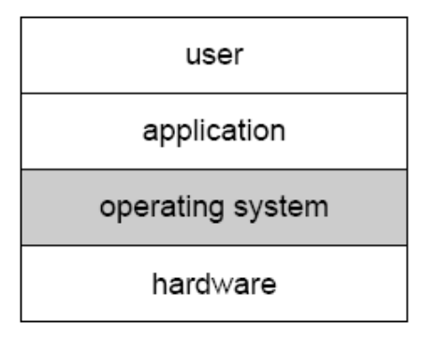
User Operating System Interface – CLI操作系统的用户界面
CLI allows direct command entry命令行界面允许直接命令操作
    Sometimes implemented in kernel, sometimes by systems program有的在内核中实现，有的做成系统程序
    Sometimes multiple flavors implemented – shells
    Primarily fetches a command from user and executes it主要是获取一条命令并执行它
      Sometimes commands built-in, sometimes just names of programs一种方法是命令解释程序本身包含代码以执行这些命令；另一种是系统程序实现大部分命令，命令解释程序只要用命令来识别文件以装入内存并运行
        If the latter, adding new features doesn’t require shell modification第二种方法增加新的命令不需要更改shell
User Interface of OS

Slide 11
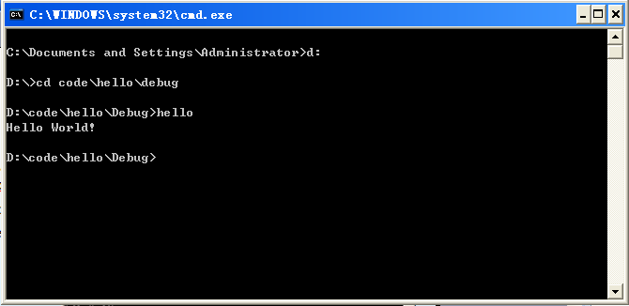
Command-line UI
Command-line interface
  User changes to the directory contains the executable “hello.exe”
  User type in the command “hello”
  Run the executable

Slide 12
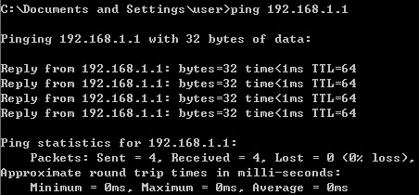
Windows command
最基本、最常用的测试物理网络连通性的命令Ping
ping 192.168.0.8 –t -l 2048 –n 8

Slide 13
Linux Shell command
文件与目录的操作 :ls
以长格式显示当前目录中所有文件的详细信息：
#ls –l
cp（拷贝文件）
将当前目录下的文件file1.txt复制成file2.txt：
#cp file1.txt file2.txt
mv（文件或目录更名或将文件由一个目录移到另一个目录）
将当前目录下的文件file1更名为file2:
#mv file1 file2
rm（删除文件或目录）
交互式删除当前目录下的所有非隐藏文件
#rm –i *
chmod（改变文件或目录的访问权限） chmod [who] [+| - | = ] [mode] 文件或目录
取消其他用户对目录xh的读，写和执行权限：
#chmod go-rwx xh

Slide 14
User Operating System Interface - GUI
User-friendly desktop metaphor interface桌面
  Usually mouse, keyboard, and monitor
  Icons represent files, programs, actions, etc图标代表文件、程序、系统功能等
  Various mouse buttons over objects in the interface cause various actions (provide information, options, execute function, open directory (known as a folder)
  Invented at Xerox PARC首次出现
Many systems now include both CLI and GUI interfaces
  Microsoft Windows is GUI with CLI “command” shell
  Apple Mac OS X as “Aqua” GUI interface with UNIX kernel underneath and shells available
  Solaris is CLI with optional GUI interfaces (Java Desktop, KDE)

Slide 15
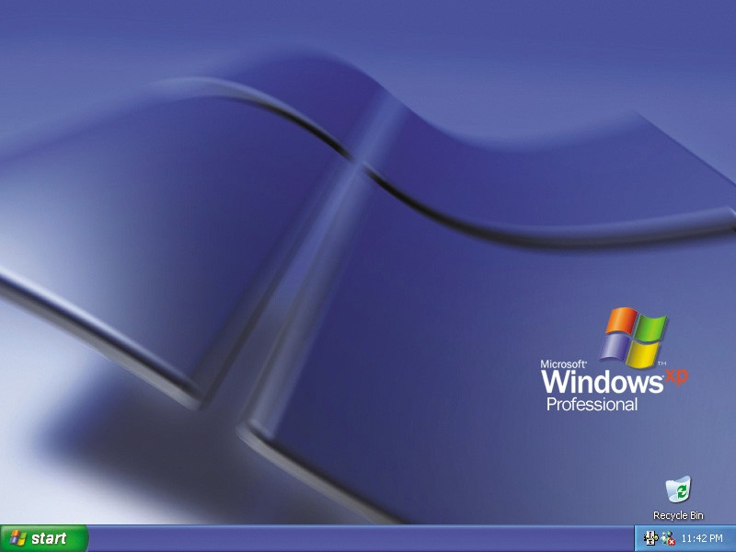
Graphical User Interface(GUI)
Graphical User Interface
  What you see is what you get

Slide 16
System Calls系统调用
Programming interface to the services provided by the OS操作系统提供的有效服务界面
Typically written in a high-level language (C or C++)高级语言编写
Mostly accessed by programs via a high-level Application Program Interface (API) rather than direct system call use一般使用更高级的应用程序接口设计程序
Three most common APIs are Win32 API for Windows, POSIX API for POSIX-based systems (including virtually all versions of UNIX, Linux, and Mac OS X), and Java API for the Java virtual machine (JVM)常用API
Why use APIs rather than system calls?为什么用API而不是系统调用？
可移植性、直观

Slide 17

Example of System Calls
System call sequence to copy the contents of one file to another file拷贝文件内容的系统调用序列

Slide 18

Example of Standard API
Consider the ReadFile() function in the
Win32 API—a function for reading from a file
A description of the parameters passed to ReadFile()
  HANDLE file—the file to be read所要读取的文件
  LPVOID buffer—a buffer where the data will be read into and written from读进写出的数据缓冲
  DWORD bytesToRead—the number of bytes to be read into the buffer将要读入缓冲的字节数
  LPDWORD bytesRead—the number of bytes read during the last read上次读操作读的字节数
  LPOVERLAPPED ovl—indicates if overlapped I/O is being used指示是否使用重叠的I/O

Slide 19
System Call Implementation
Typically, a number associated with each system call
  System-call interface maintains a table indexed according to these numbers每个系统调用有一个与其相关的数字，系统调用接口根据这些数字维护一个列表索引
The system call interface invokes intended system call in OS kernel and returns status of the system call and any return values系统调用接口调用所需的操作系统内核中的系统调用，并返回系统调用状态及其他的返回值
The caller need know nothing about how the system call is implemented调用者无需知道系统调用的实现细节
  Just needs to obey API and understand what OS will do as a result call之需要遵循API知道系统调用后系统作了什么
  Most details of OS interface hidden from programmer by API 对于程序员，通过API操作系统接口的大部分细节被隐藏
    Managed by run-time support library (set of functions built into libraries included with compiler)被执行支持库所管理

Slide 20

API – System Call – OS Relationship

Slide 21

Standard C Library Example
C program invoking printf() library call, which calls write() system call

Slide 22
Types of System Calls系统调用类型
Process control进程控制
File management文件管理
Device management设备管理
Information maintenance信息维护
Communications通信

Slide 23

Examples of Windows and Unix System Calls

Slide 24
Operating System Structure
Simple Structure
Layered Approach
Microkernels
Modules

Slide 25
操作系统结构-Simple Structure 简单结构
MS-DOS – written to provide the most functionality in the least space MS-DOS：利用最小的空间提供最多的功能
  Not divided into modules没有划分成模块
  Although MS-DOS has some structure, its interfaces and levels of functionality are not well separated没有很好的区分接口和功能层次
  一组过程集，各过程可相互调用，也叫整体系统结构。
  缺点：逻辑复杂，维护困难.

Slide 26

MS-DOS Layer Structure

Slide 27
Layered Approach分层方法
The operating system is divided into a number of layers (levels), each built on top of lower layers. The bottom layer (layer 0), is the hardware; the highest (layer N) is the user interface.操纵系统被分成若干层（级），最低层（0层）是硬件，最高层（N层）是用户接口
With modularity, layers are selected such that each uses functions (operations) and services of only lower-level layers模块性，每层只能利用较低层的功能和服务
有序分层的基本概念
  可简化设计的复杂度
  下层为上层提供服务
层次的设置应考虑的因素
  程序嵌套：各模块间嵌套关系复杂
  运行频率：随层次的增高，相应软件的运行速度就随之下降
  公用模块：低层
  用户接口：高层

Slide 28

Layered Operating System

Slide 29

Traditional UNIX System Structure

Slide 30
Microkernel System Structure微内核
Moves as much from the kernel into “user” space把内核空间的东西尽可能移到用户空间
Communication takes place between user modules using message passing在用户模块间利用消息传递来通信
Benefits:好处
  Easier to extend a microkernel很容易扩展系统
  Easier to port the operating system to new architectures很容易移植平台
  More reliable (less code is running in kernel mode)高可靠性
  More secure高安全性
Detriments:缺点
  Performance overhead of user space to kernel space communication用户空间与内核空间通信带来的性能影响

Slide 31
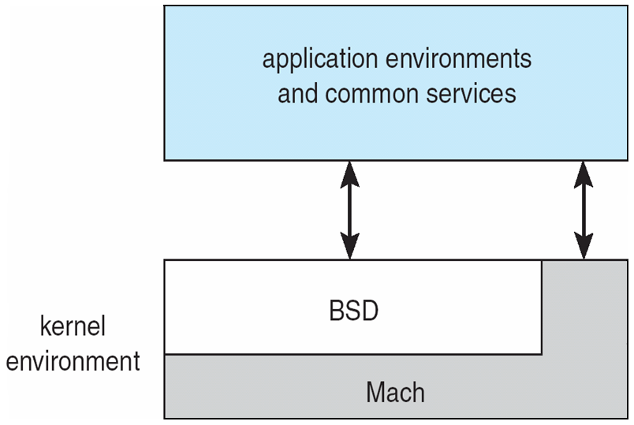
Mac OS X Structure

Slide 32
Modules模块
Most modern operating systems implement kernel modules很多现在操作系统实现了模块化的内核
  Uses object-oriented approach面向对象方法
  Each core component is separate内核的核心部件是分开的
  Each talks to the others over known interfaces通过接口通信
  Each is loadable as needed within the kernel可动态的加载给内核
Overall, similar to layers but with more flexible与分层方法类似，但更灵活

Slide 33
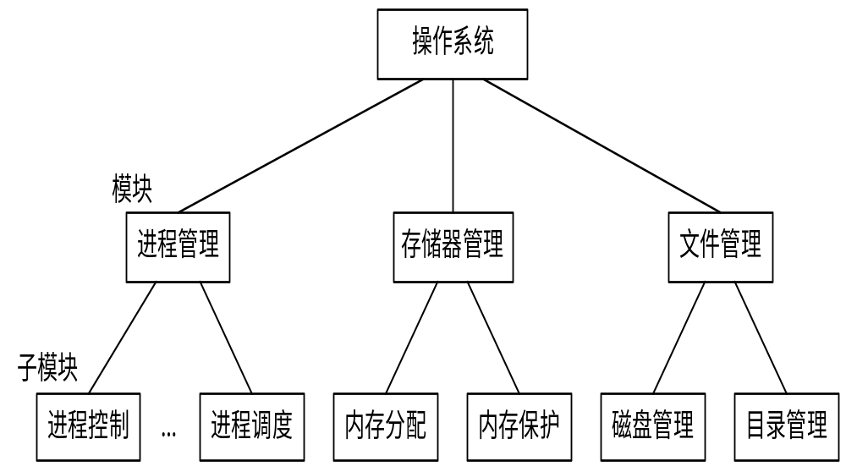
Modules模块

Slide 34
System Boot系统启动
Operating system must be made available to hardware so hardware can start it操作系统必须为硬件所使用
bootstrap program（引导程序） is loaded at power-up or reboot
  Typically stored in ROM or EPROM, generally known as firmware（固件）
  Initializes all aspects of system
  Loads operating system kernel and starts execution
Notes:
Pc上的加载：第一步运行ROM中的BIOS程序，做硬件自检以及确定启动顺序等工作.
第二步BIOS加载位于磁盘上的MBR（主引导记录）中的bootloader程序加载内存，该引导程序负责找到OS内核并执行。

Slide 35
Keywords
User interface(UI)
Command-line interface(CLI)
Graphical user interface(GUI)
Command interpreter
Shell
Desktop
System call
bootstrap program

Slide 36
End of Chapter 2

