Slide 1
Chapter 3: Processes

Slide 2
Chapter 3: Processes
Process Concept进程的概念
Process Scheduling进程调度
Operations on Processes进程的操作
Cooperating Processes进程协作
Interprocess Communication进程间通信
Communication in Client-Server Systems客户机-服务器系统通信

Slide 3
Objectives
To introduce the notion of a process -- a program in execution, which forms the basis of all computation
To describe the various features of processes, including scheduling, creation and termination, and communication

Slide 4
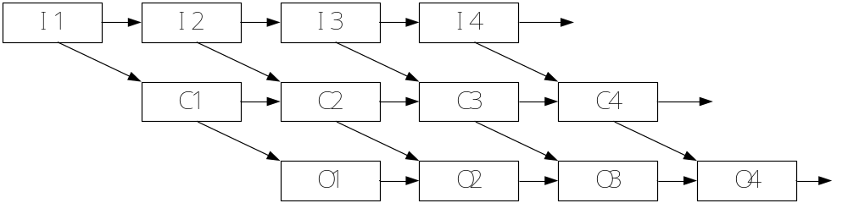
Concurrence（并发）
Current-day computer systems allow multiple programs to be loaded into memory and executed concurrently.

Slide 5
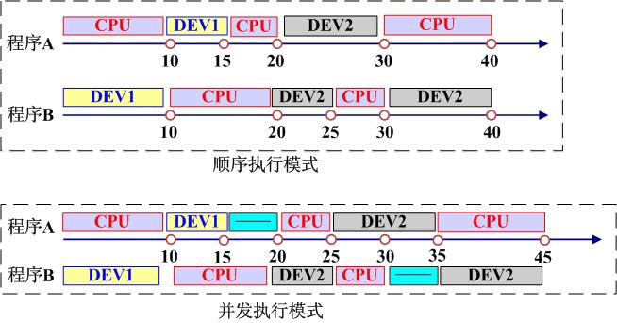
Efficiency

Slide 6
Efficiency
sequential execution:
  Cumulative Time：80
  CPU Efficiency：40/80 = 50%
  DEV1 Efficiency ：15 / 80 ＝ 18.75%
  DEV2 Efficiency ：25 / 80 = 31.25%
Concurrence
  Cumulative Time ：45
  CPU Efficiency ：40 / 45 = 89%
  DEV1 Efficiency ：15 / 45 = 33%
  DEV2 Efficiency ：25 / 45 ＝ 55.6%

Slide 7
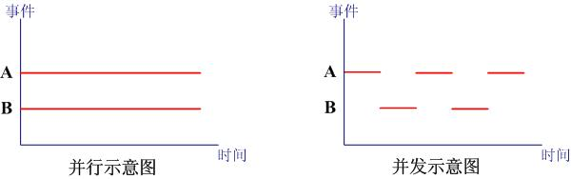
并行（Parallel）vs 并发（Concurrency）

Slide 8
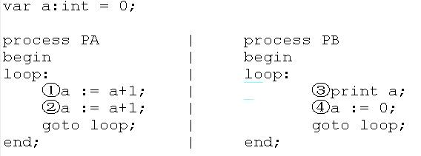
Problem
①②③④ ①②③④ ①②③④… 2222…
①③②④ ①③②④ ①③②④… 1111…

Slide 9
Process Concept进程的概念
Textbook uses the terms job and process almost interchangeably 本书中作业=进程
Process – a program in execution;

Slide 10
进程与程序有何差别？
  进程是一个动态概念，程序是一个静态概念；
  进程有生命周期，有诞生有消亡，短暂的；而程序是相对长久的。
  进程具有并发性，而程序没有；
  进程是竞争计算机系统资源的基本单位，其并发性受到系统本身的制约；
  不同的进程可以包含同一程序，只要程序所对应的数据集不同

Slide 11
进程和程序的区别与联系
进程 | 程序
动态 | 静态
暂时 | 永久
并发 | ——
PCB | ——
多个 | 一个

Slide 12

Process Concept 进程的概念
A process includes:
  Text section 文本段（代码段）
  program counter 程序计数器
  Stack堆栈
  data section数据段

Slide 13
Process State进程状态
As a process executes, it changes state
  new: The process is being created新的
  running: Instructions are being executed运行
  Waiting（block）: The process is waiting for some event to occur等待
  ready: The process is waiting to be assigned to a processor就绪
  terminated: The process has finished execution终止

Slide 14

Diagram of Process State进程状态图
一个进程的生命期中，每个状态将经历几次？

Slide 15
进程状态转换（1/2）
就绪 --> 运行
  调度程序选择一个新的进程运行
运行 --> 就绪
  运行进程用完了时间片
  运行进程被中断，因为一高优先级进程处于就绪状态

Slide 16
进程状态转换（2/2）
运行 --> 等待
    OS尚未完成服务
    对一资源的访问尚不能进行
    初始化I/O 且必须等待结果
    等待某一进程提供输入 (IPC)
等待 --> 就绪
  当所等待的事件发生时

Slide 17

Process Control Block (PCB)
Container for the unique information for each process when they are running in the operating system
PCB用来保存程序运行期间的重要信息
  (1)进程存在的唯一标识
  (2)记录了OS所需的用于描述进程及控制进程所需的全部信息
Information associated with each process
Process state进程状态
Program counter程序计数器
CPU registers CPU寄存器
CPU scheduling information CPU调度信息
Memory-management information 内存管理信息
Accounting information 记账信息
I/O status information I/O状态信息
进程与PCB是一一对应的

Slide 18

CPU Switch From Process to Process
CPU在进程间的切换

Slide 19
Context Switch上下文切换
When CPU switches to another process, the system must save the state of the old process and load the saved state for the new process当CPU切换到另一个进程的时候，系统需要保存老进程的状态，并且加载新进程的状态
Context-switch time is overhead; the system does no useful work while switching 上下文切换的时间是系统的额外开销，切换时系统不做任何有用的工作
Time dependent on hardware support时间与硬件支持密切相关

Slide 20
Organizing PCBs
Process Space and Size 进程空间和大小
  每个进程的控制块PCB要占据一定的内存
  系统中允许并发执行的进程数是有限的
  Linux Kernel 2.2X中最多能够支持4090个用户进程同时工作

Slide 21
Process Scheduling Queues进程调度队列
Ready queue – set of all processes residing in main memory, ready and waiting to execute就绪队列
Device queues – set of processes waiting for an I/O device设备队列：等待I/O设备的进程
Processes migrate among the various queues进程在不同的队列间移动

Slide 22

Ready Queue And Various I/O Device Queues
就绪队列和各种不同的设备队列
每种设备拥有自己的设备队列

Slide 23

Representation of Process Scheduling

Slide 24
Schedulers调度程序
Long-term scheduler (or job scheduler) – selects which processes should be brought into the ready queue长期调度（作业调度）：选择一个进程进入内存的就绪队列
  批处理程序→提交而不是马上执行->放到存储设备的缓冲池中
  I/O为主 vs CPU为主-》合理的组合
Short-term scheduler (or CPU scheduler) – selects which process should be executed next and allocates CPU短期调度（CPU调度）：从就绪队列中选择一个进程，并为之分配CPU
两者区别：执行的频率

Slide 25
进程的复杂状态
多个进程竞争内存资源
  内存资源紧张
  无就绪进程，处理机空闲：I/0的速度比处理机的慢的多，可能出现全部进程阻塞等待
解决方案：
  Swapping(交换技术)：换出一部分内存到外存，以腾出内存空间。
  Virtual Memory(虚拟存储技术)：每个进程只装入一部分程序和数据（存储管理部分）。

Slide 26
对换技术、交换技术（Swapping）
将内存中暂时不能运行的进程，或暂时不用的数据和程序，换出到外存，以腾出足够的内存空间，把已经具备运行条件的进程，或进程需要的数据和程序，换入内存。
分析：
  针对进程的存在位置（内存或者外存），进一步增加“阻塞挂起”和“就绪挂起”两种状态

Slide 27

Addition of Medium Term Scheduling
中期调度（交换）

Slide 28
Process Creation进程创建
Parent process create children processes, which, in turn create other processes, forming a tree of processes父进程创建子进程，子进程继续创建，从而形成一棵进程树
Generally, process identified and managed via a process identifier (pid)
Resource sharing 资源共享
  Parent and children share all resources父子进程共享所有资源
  Children share subset of parent’s resources子进程共享部分父进程的资源
  Parent and child share no resources父子进程不共享任何资源
Execution
  Parent and children execute concurrently子进程和父进程并发执行
  Parent waits until children terminate父进程等待直到子进程终止

Slide 29

A tree of processes on a typical Solaris

Slide 30

Process Creation (Cont.)
Address space地址空间
  Child duplicate of parent 子进程是父进程的复制品
  Child has a program loaded into it 子进程装入另一个新程序
UNIX examples
  fork system call creates new process
  exec system call used after a fork to replace the process’ memory space with a new program
Notes:
阅读以下文档，了解进程创建是如何实现的。
在Linux中运行里面的代码并理解。
http://blog.csdn.net/jason314/article/details/5640969

Slide 31
Process Creation (Cont)
A new process is created by the fork() system call. The new process consists of a copy of the address space of the parent process.
Child processes continue execution at the instruction after the fork().
The return value of fork() for child process is 0, but that for parent is an integer value greater than 0. The integer value is his child PID.
it is meaningless to create two same processes. so the child should be allocated a new task to do, we can use exec() system call to accomplish it in child process.
exec() can replace a process’s memory space with a new program(executable file).
Notes:
A new process is created by the fork() system call. The new process consists of a copy of the address space of the original process. Both processes continue execution at the instruction after the fork();, with one difference, the return code for the fork() is zero for the child process, whereas the process identifier of the child is returned to the parent.
The exec() system call is used after a fork() system call by one of the two processes to replace the process’s memory space with a new program. In this manner, the two processes are able to go their separate way and communicate with each other.

Slide 32
Process Creation (Cont)
The exec() system call is used after a fork() system call by one of the two processes to replace the process’s memory space with a new program. In this manner, the two processes are able to go their separate way and communicate with each other.
Notes:
A new process is created by the fork() system call. The new process consists of a copy of the address space of the original process. Both processes continue execution at the instruction after the fork();, with one difference, the return code for the fork() is zero for the child process, whereas the process identifier of the child is returned to the parent.
The exec() system call is used after a fork() system call by one of the two processes to replace the process’s memory space with a new program. In this manner, the two processes are able to go their separate way and communicate with each other.

Slide 33
C Program Forking Separate Process
int main()
{
pid_t pid;
/* fork another process */
pid = fork();
if (pid < 0) { /* error occurred */
fprintf(stderr, "Fork Failed");
exit(-1);
}
else if (pid == 0) { /* child process */
execlp("/bin/ls", "ls", NULL);
}
else { /* parent process */
/* parent will wait for the child to complete */
wait (NULL);
printf ("Child Complete");
exit(0);
}
}

Slide 34
Process Termination进程终止
Process executes last statement and asks the operating system to delete it (exit)进程完成执行最后的语句并使用系统调用exit请求操作系统删除自身
  Output data from child to parent (via wait)进程可以返回状态值给父进程（通过wait）
  Process’ resources are deallocated by operating system进程的资源被操作系统释放
Parent may terminate execution of children processes (abort)父进程能够中止子进程的执行
  Child has exceeded allocated resources子进程使用了超过它所分配到的一些资源
  Task assigned to child is no longer required 子进程的任务不再需要
  If parent is exiting如果父进程结束了
    Some operating system do not allow child to continue if its parent terminates一些操作系统不允许子进程继续执行
      All children terminated - cascading termination级联终止

Slide 35
Blocking process进程阻塞
引发事件
  请求系统服务
  启动某种操作
  新数据尚未到达
  无新工作可做

Slide 36
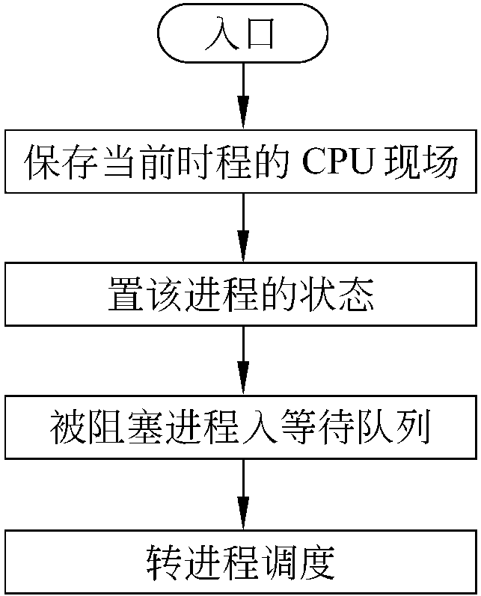
Blocking process
Save state(现场）
Update PCB (state:running ->waiting)
Put the PCB into a wait queue
Go to scheduler(why ?)

Slide 37
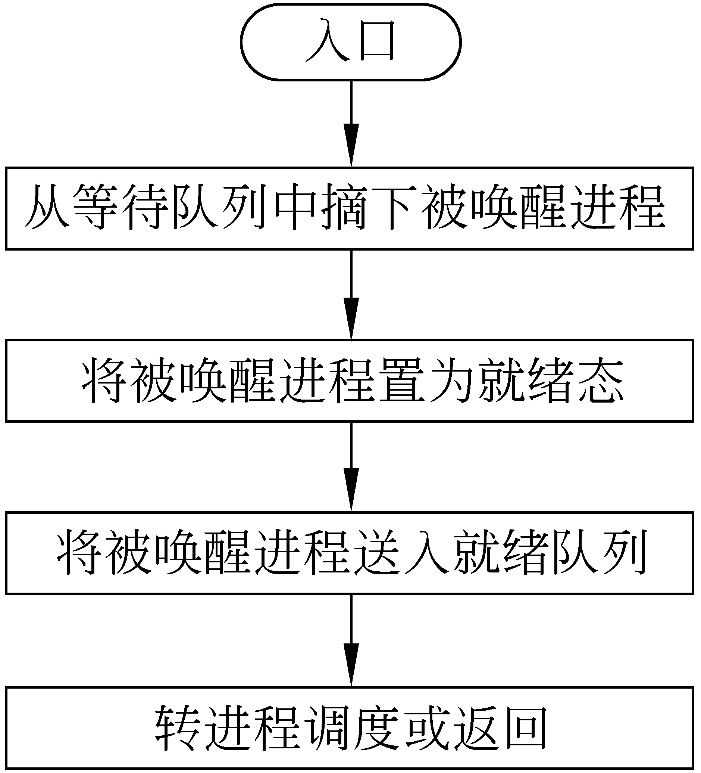
Wakeup process(唤醒进程）
Update PCB (state: waiting ->ready )
Put PCB into ready queue
Maybe go to scheduler

Slide 38
Interprocess Communication
Processes within a system may be independent or cooperating
Cooperating process can affect or be affected by other processes, including sharing data
Reasons for cooperating processes:
  Information sharing
  Computation speedup
  Modularity
  Convenience
Cooperating processes need interprocess communication (IPC)
Three models of IPC
  pipe
  Shared memory
  Message passing
Notes:
Independent process cannot affect or be affected by the execution of another process
Cooperating process can affect or be affected by the execution of another process
Several users may be interested in the same of piece of information. Such as a shared file. We must provide an environment to allow concurrent access to such information.
Cooperating processes require an IPC mechanism that will allow them to exchange data and information.
Pipe is not concluded in text book, you should take notes in your textbook.

Slide 39

Communications Models

Slide 40
Interprocess Communication – pipe
pipe is a type of interprocess communication in early time.
processes can exchange data through pipe.
pipe can be used between parent and child processes or between brother processes.
pipe is a piece of memory(4096B).
发送进程
字符先进先出
接收进程

Slide 41
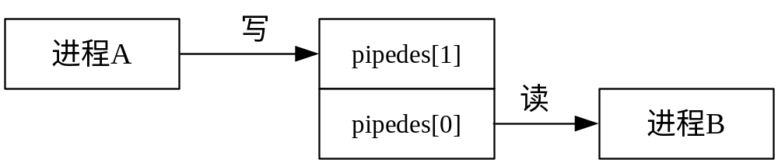
Interprocess Communication – pipe
#include <unistd.h>
int pipe(int pipedes[2]); //create a pipe
pipedes[2]:file descriptor array.
pipedes[1] is the file descriptor for writing,
pipedes[0] is the file descriptor for reading.
Notes:
you can use system call read and write to achieve communication.
sender process can write data into a pipe through pipedes[1], receiver process can read data from pipe through pipedes[0].
pipedes[1] represent the writing end of pipe, pipedes[0] represent the reading end of pipe.

Slide 42
Interprocess Communication – pipe
exercise：pipefork1.c

Slide 43
Interprocess Communication – shared memory
Interprocess communication using shared memory requires communicating processes to establish a region of share memory.
A shared-memory region resides in the address space of the process creating the shared-memory segment.
Other processes that wish to communicate using this shared-memory segment must attach it to their address space.
They can exchange information by reading and writing data in the shared areas.
The processes are also responsible for ensuring that they are not writing to the same location simultaneously.
You will explore the contents of shared memory in <Linux programming> in more details.
Notes:
Any two processes which want to exchange informations with each other can perform the communication.

Slide 44
Examples of IPC Systems - POSIX
POSIX Shared Memory
  Process first creates shared memory segment
  segment id = shmget(IPC PRIVATE, size, S IRUSR | S IWUSR);
  Process wanting access to that shared memory must attach to it
  shared memory = (char *) shmat(id, NULL, 0);
  Now the process could write to the shared memory
  sprintf(shared memory, "Writing to shared memory");
  When done a process can detach the shared memory from its address space
  shmdt(shared memory);

Slide 45
Interprocess Communication – Message Passing
Mechanism for processes to communicate and to synchronize their actions
Message system – processes communicate with each other without resorting to shared variables
IPC facility provides two operations:
  send(message) – message size fixed or variable
  receive(message)
If P and Q wish to communicate, they need to:
  establish a communication link between them
  exchange messages via send/receive
Implementation of communication link
  physical (e.g., shared memory, hardware bus)
  logical (e.g., logical properties)

Slide 46
Direct Communication
Processes must name each other explicitly:
  send (P, message) – send a message to process P
  receive(Q, message) – receive a message from process Q
Properties of communication link
  Links are established automatically
  A link is associated with exactly one pair of communicating processes
  Between each pair there exists exactly one link
  The link may be unidirectional, but is usually bi-directional

Slide 47
Indirect Communication
Messages are directed and received from mailboxes (also referred to as ports)
  Each mailbox has a unique id
  Processes can communicate only if they share a mailbox
Properties of communication link
  Link established only if processes share a common mailbox
  A link may be associated with many processes
  Each pair of processes may share several communication links
  Link may be unidirectional or bi-directional

Slide 48
Indirect Communication
Operations
  create a new mailbox
  send and receive messages through mailbox
  destroy a mailbox
Primitives are defined as:
send(A, message) – send a message to mailbox A
receive(A, message) – receive a message from mailbox A

Slide 49
summary
A process is a program in execution. As a process executes, it changes state. The state of process is defined by that process’s current activity. Each process may be in one of the following states: new, ready, running, waiting, or terminated.
A process, when it is not executing, is placed in some waiting queue. (device queue or ready queue).
Each process is represented by a PCB.（进程控制块）
Long-term scheduling is the selection of processes that will be allowed to contend for the CPU.长程：从后备队列（硬盘）加载到内存准备（他们处于ready状态）
Short-term scheduling is the selection of one process from the ready queue.（短程：选择一个在就绪队列使用CPU）
OS must provide a mechanism for parent processes to create child processes. The parent may wait for its children to terminate before proceeding, or the parent and child may execute concurrently.
Cooperating processes require an IPC（进程间通信） mechanism to communicate with each other.

Slide 50
summary
Process state（5）
Concurrently并发（单CPU多任务）
Process Control Block(PCB)进程控制块
Process scheduling进程调度
Job queue, ready queue, device queue队列
Long-term scheduler, short-term scheduler, medium-term scheduler
Swapping兑换（内存不足，将内存拿出，其他任务继续进行，当内存足够再拿进来）
Context switch（）
Process creating, process termination进程创建终止
Parent process, child process
Tree of processes进程树
IPC进程间通信

Slide 51
End of Chapter 3

