Slide 1
Online Social Networks and Media

Slide 2
Betweenness and Graph partitioning
Chapter 3, from D. Easley and J. Kleinberg book
Section 10.2.4, from A. Rajaraman, J. Ullman, J. Leskovec

Slide 3
Centrality Measures
Not all nodes are equally important
Centrality Analysis:
Find out the most important nodes in one network
Commonly-used Measures
Degree Centrality
Closeness Centrality
Betweenness Centrality
Eigenvector Centrality

Slide 4


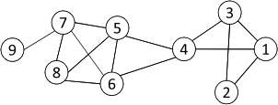
Degree Centrality
The importance of a node is determined by the number of nodes adjacent to it
The larger the degree, the more import the node is
Only a small number of nodes have high degrees in many real-life networks
Degree Centrality
Normalized Degree Centrality:
For node 1, degree centrality is 3;
Normalized degree centrality is
3/(9-1)=3/8.
Notes:
“A small number of nodes have high degrees” thanks to the power law

Slide 5
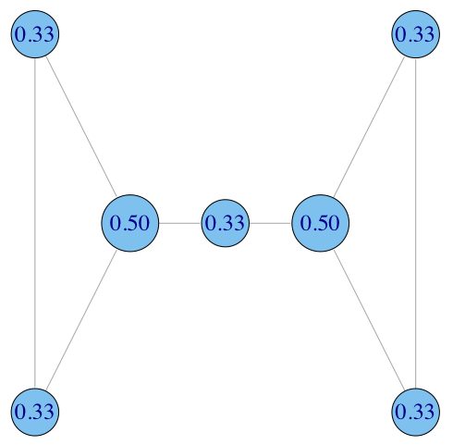
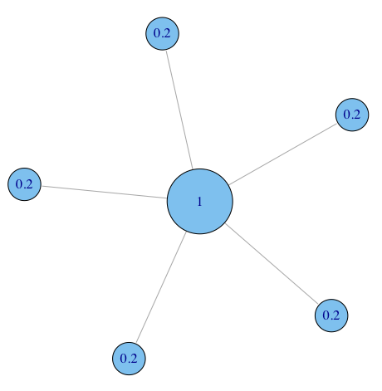

Degree Centrality (normalized)

Slide 6
Degree Centralization: how equal are the nodes?
How much variation is there in the centrality scores among the nodes?
Freeman’s general formula for centralization (can use other metrics, e.g. gini coefficient or standard deviation):
maximum value in the network

Slide 7
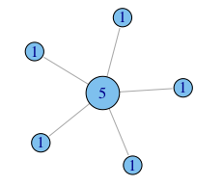
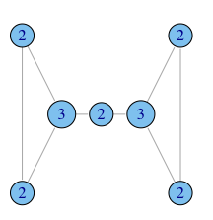
Degree Centralization
C_{D} = 0.167
C_{D} = 1.0
C_{D} = 0.167

Slide 8
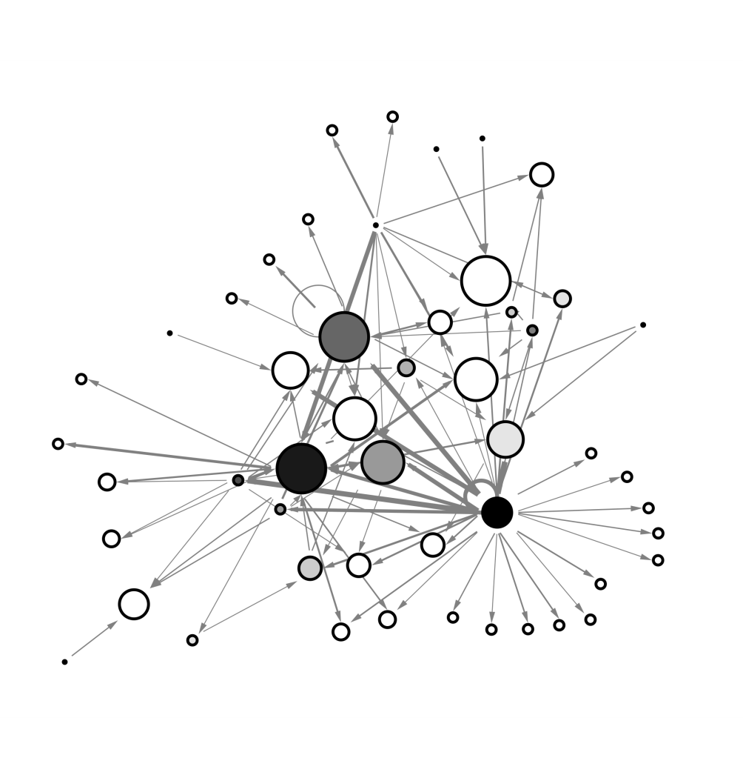
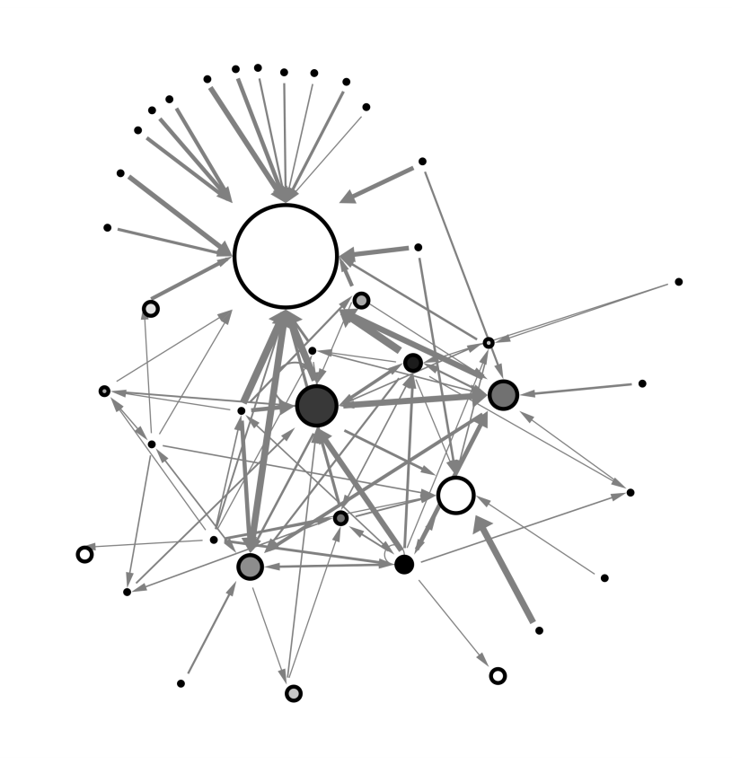
Degree Centralization
example financial trading networks
high centralization: one node trading with many others
low centralization: trades are more evenly distributed

Slide 9
when degree isn’t everything
In what ways does degree fail to capture centrality in the following graphs?

Slide 10

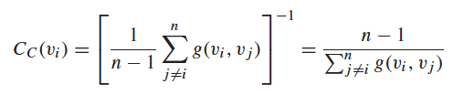
Closeness Centrality
“Central” nodes are important, as they can reach the whole network more quickly than non-central nodes
Importance measured by how close a node is to other nodes
Average Distance:
Closeness Centrality

Slide 11
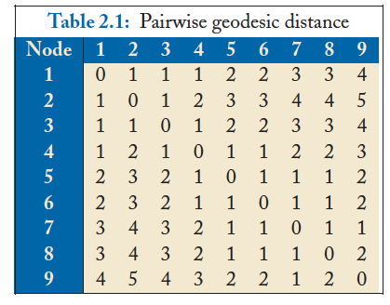
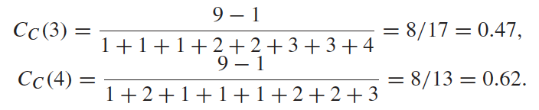
Closeness Centrality Example
Node 4 is more central than node 3

Slide 12

Closeness Centrality Example
A
B
C
D
E

Slide 13
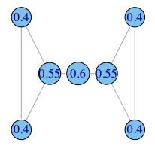
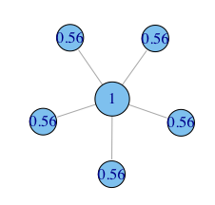
Closeness Centrality Example

Slide 14


Betweenness Centrality
Node betweenness counts the number of shortest paths that pass one node
Nodes with high betweenness are important in communication and information diffusion
Betweenness Centrality
The number of shortest paths between s and t
The number of shortest paths between s and t that pass v_{i}

Slide 15
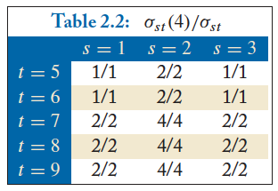

Betweenness Centrality Example
What’s the betweenness centrality for node 5?
The number of shortest paths between s and t
The number of shortest paths between s and t that pass v_{i}

Slide 16
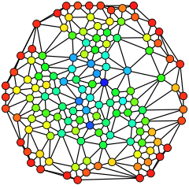
Betweenness Centrality Example
Blue (max)
Red (0)

Slide 17


Eigenvector Centrality
One’s importance is determined by one’s friends
If one has many important friends, one should be important as well.
The centrality corresponds to the top eigenvector of the adjacency matrix A.
A variant of this eigenvector centrality is the PageRank score.

Slide 18
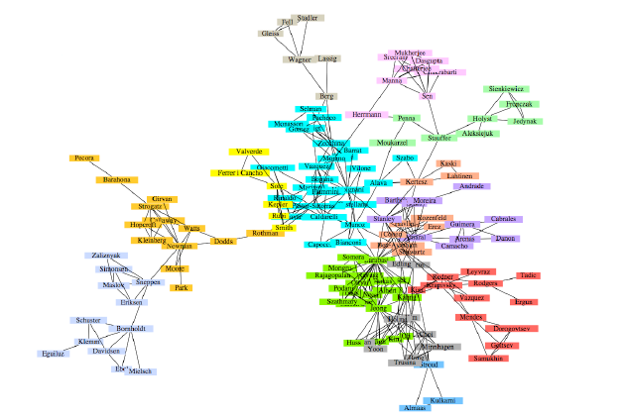
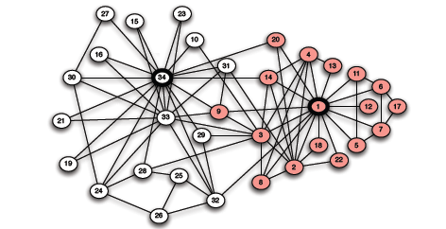
Betweenness and Graph Partitioning
Graph partitioning:
Given a network dataset, how to identity densely connected groups of nodes within it
Co-authorship network of physicists and applied mathematicians
Karate club

Slide 19
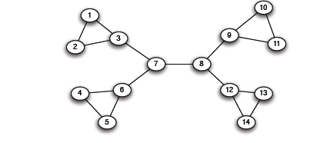
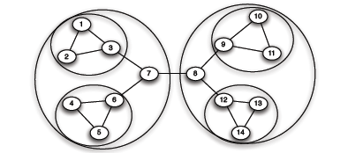
Betweenness and Graph Partitioning
Divisive methods: try to identify and remove the “spanning links” between densely-connected regions
Agglomerative methods: Find nodes that are likely to belong to the same region and merge them together (bottom-up)

Slide 20
Girvan and Newman
Divisive method
Finding bridges and local bridges?
Which one to choose?

Slide 21
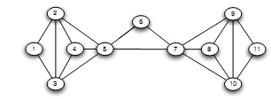
Girvan and Newman
There is no local bridge

Slide 22
Edge Betweenness
Betweenness of an edge (a, b): number of pairs of nodes x and y such that the edge (a, b) lies on the shortest path between x and y - since there can be several such shortest paths edge (a, b) is credited with the fraction of those shortest paths that include (a, b).
3x11 = 33
1x12 = 12
7x7 = 49
1
Edges that have a high probability to occur on a randomly chosen shortest path between two randomly chosen nodes have a high betweenness.
Traffic (unit of flow)

Slide 23
Girvan and Newman
1. The betweenness of all existing edges in the network is calculated first.
2. The edge with the highest betweenness is removed.
If this separates the graph -> partition.
3. The betweenness of all edges affected by the removal is recalculated.
Steps 2 and 3 are repeated until no edges remain.

Slide 24
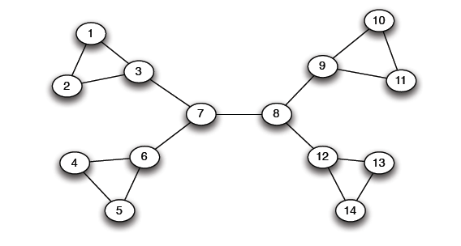
Girvan Newman method: An example
Betweenness(7, 8)= 7x7 = 49
Betweenness(1, 3) = 1X12=12
Betweenness(3, 7)=Betweenness(6-7)=Betweenness(8, 9) = Betweenness(8, 12)= 3X11=33

Slide 25
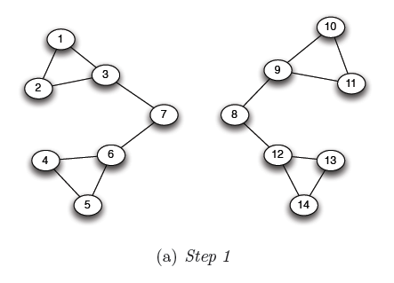
Girvan Newman method: An example
Betweenness(1, 3) = 1X5=5
Betweenness(3,7)=Betweenness(6,7)=Betweenness(8-9) = Betweenness(8,12)= 3X4=12

Slide 26
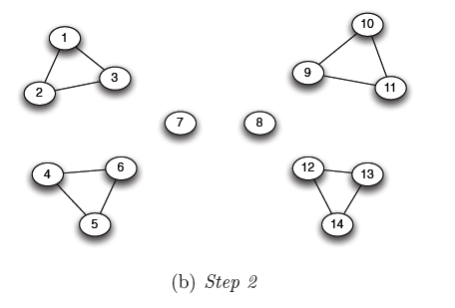
Girvan Newman method: An example
Betweenness of every edge = 1

Slide 27
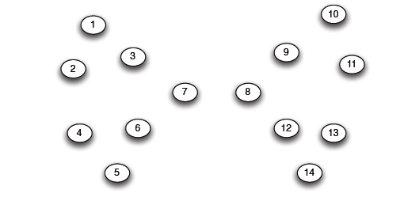
Girvan Newman method: An example

Slide 28
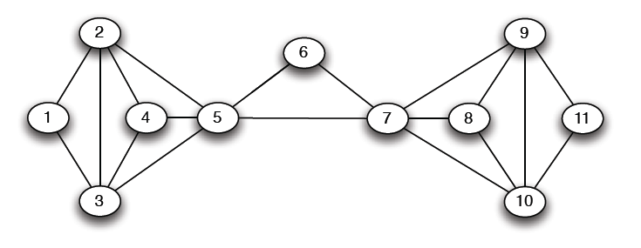
Another example
5X5=25

Slide 29
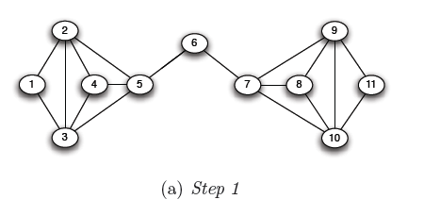
Another example
5X6=30
5X6=30

Slide 30
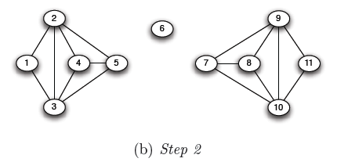
Another example

Slide 31
Girvan and Newman
34 president
1 instructor
Correct but node 9 (attached it to 34) – why? 3 weeks away from getting a black belt
Minimum cut approach – the same outcome

Slide 32
Computing Betweenness
Perform a BFS starting from A
Determine the shortest path from A to each other node
Based on these numbers, determine the amount of flow from A to all other nodes that uses each edge

Slide 33
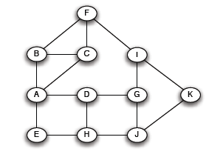
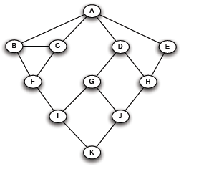
Step 1
Initial network
BFS on A

Slide 34
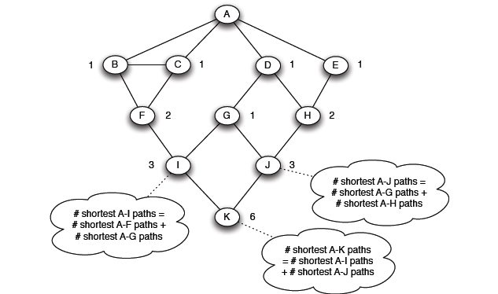
Step 2
Count how many shortest paths from A to a specific node
Level 1
Level 2
Level 3
Level 4
Top-down

Slide 35
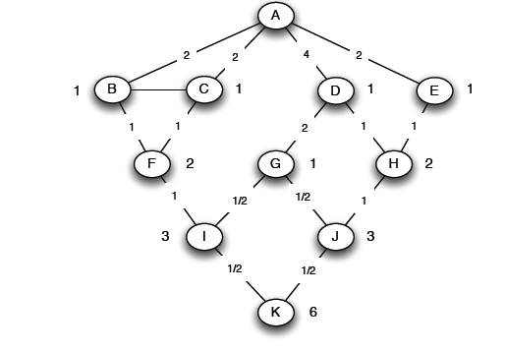
Step 3
For each edge e: calculate the sum over all nodes Y of the fraction of shortest paths from the root A to Y that go through e.
Each edge (X, Y) participates in the shortest-paths from the root to Y and to nodes (at levels) below Y -> Bottom up calculation
e

Slide 36
Step 3
Count the flow through each edge
Portion of the shortest paths to I that go through (F, I) = 2/3 +
Portion of the shortest paths to K that go through (F, I)
(1/2)(2/3) = 1/3
= 1
1/3+(1/3)1/2 = 1/2
Portion of the shortest paths to K that go through (I, K) = 3/6 = 1/2

Slide 37
Step 3: formula
(X, Y)
p_{X}
X
Y
p_{Y}
.. .
Y₁
Y_{m}

Slide 38
Computing Betweenness
Repeat the process for all nodes
Sum over all BFSs

Slide 39
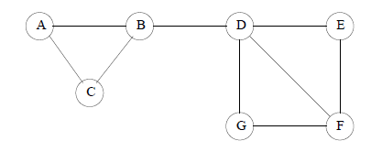
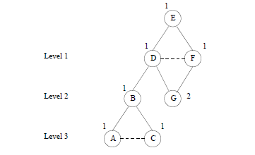
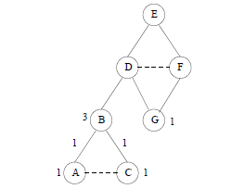
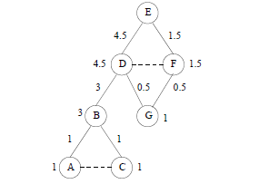
Example

Slide 40
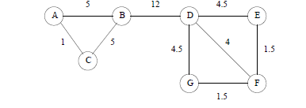
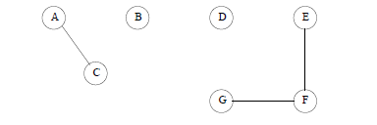
Example

Slide 41
Computing Betweenness
Issues
Test for connectivity?
Re-compute all paths, or only those affected
Parallel computation
“Sampling

Slide 42
Other approaches to graph partitioning
The general problem
Input: a graph G=(V,E)
edge (u,v) denotes similarity between u and v
weighted graphs: weight of edge captures the degree of similarity
Partitioning as an optimization problem:
Partition the nodes in the graph such that nodes within clusters are well interconnected (high edge weights), and nodes across clusters are sparsely interconnected (low edge weights)
most graph partitioning problems are NP hard

Slide 43
Measuring connectivity
What does it mean that a set of nodes are well or sparsely interconnected?
min-cut: the min number of edges such that when removed cause the graph to become disconnected
small min-cut implies sparse connectivity
This problem can be solved in polynomial time
Min-cut/Max-flow algorithm
U
V-U

Slide 44
Measuring connectivity
What does it mean that a set of nodes are well interconnected?
min-cut: the min number of edges such that when removed cause the graph to become disconnected
not always a good idea!
U
V-U
U
V-U

Slide 45
A bad example

Slide 46
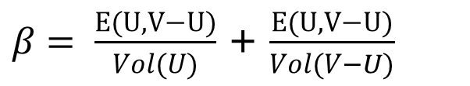
Graph expansion
Normalize the cut by the size of the smallest component
Cut ratio:
Graph expansion:
Other Normalized Cut Ratio:
$β= \frac{E(U,V−U)}{Vol(U)}$ + $\frac{E(U,V−U)}{Vol(V−U)}$
Vol(U) = number of edges with one endpoint in U
= total degree of nodes in U

Slide 47
Spectral analysis
The Laplacian matrix L = D – A where
A = the adjacency matrix
D = diag(d₁,d₂,…,d_{n})
d_{i} = degree of node i
Therefore
L(i,i) = d_{i}
L(i,j) = -1, if there is an edge (i,j)

Slide 48
Laplacian Matrix properties
The matrix L is symmetric and positive semi-definite
all eigenvalues of L are positive
The matrix L has 0 as an eigenvalue, and corresponding eigenvector w₁ = (1,1,…,1)
λ₁ = 0 is the smallest eigenvalue

Slide 49
The second smallest eigenvalue
The second smallest eigenvalue (also known as Fielder value) λ₂ satisfies
The eigenvector for eigenvalue λ₂ is called the Fielder vector. It minimizes
where

Slide 50
Spectral ordering
The values of x minimize
For weighted matrices
The ordering according to the x_{i} values will group similar (connected) nodes together
Physical interpretation: The stable state of springs placed on the edges of the graph

Slide 51
Spectral partition
Partition the nodes according to the ordering induced by the Fielder vector
If u = (u₁,u₂,…,u_{n}) is the Fielder vector, then split nodes according to a threshold value s
bisection: s is the median value in u
ratio cut: s is the value that minimizes α
sign: separate positive and negative values (s=0)
gap: separate according to the largest gap in the values of u
This works well (provably for special cases)

Slide 52
Fielder Value
The value λ₂ is a good approximation of the graph expansion
For the minimum ratio cut of the Fielder vector we have that
If the max degree d is bounded we obtain a good approximation of the minimum expansion cut
d = maximum degree

Slide 53
Networks and Surrounding Contexts
Chapter 4, from D. Easley and J. Kleinberg book

Slide 54
Introduction
Surrounding context: factors other than node and edges that affect how the network structure evolves
Homophily: people tend to be similar to their friends
Αριστοτέλης love those who are like themselves
Πλάτωνα Όμοιος ομοίω αεί πελάζει (similarity begets friendship)
Birds of a feather flock together
Factors intrinsic to the network (introduced by a common friend) and contextual factors (eg attend the same school)

Slide 55
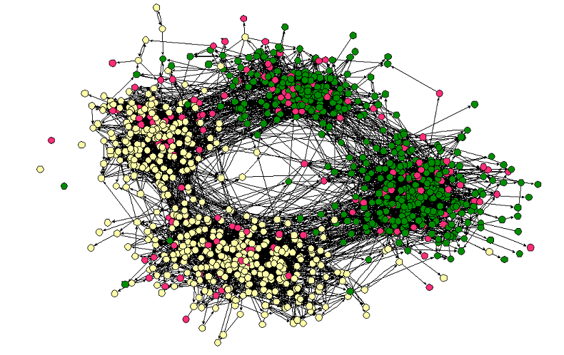
Homophily
Middle – High School
Race

Slide 56
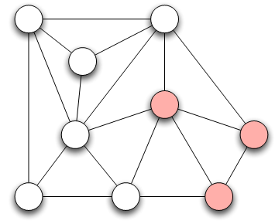
Measuring Homophily
If the fraction of cross-gender edges is significantly less than expected, then there is evidence for homophily
gender male with probability p
gender female with probability q
Probability of cross-gender edge?

Slide 57
Measuring Homophily
“significantly” less than
Inverse homophily
Characteristics with more than two values:
Number of heterogeneous edges (edge between two nodes that are different)

Slide 58
Mechanisms Underlying Homophily: Selection and Social Influence
Selection: tendency of people to form friendships with others who are like then
Socialization or Social Influence: the existing social connections in a network are influencing the individual characteristics of the individuals
Social Influence as the inverse of Selection
Mutable & immutable characteristics

Slide 59
The Interplay of Selection and Social Influence
Longitudinal studies in which the social connections and the behaviors within a group are tracked over a period of time
Why?
Study teenagers, scholastic achievements/drug use (peer pressure and selection)
Relative impact?
- Effect of possible interventions (example, drug use)

Slide 60
The Interplay of Selection and Social Influence
Christakis and Fowler on obesity, 12,000 people over a period of 32-years
People more similar on obesity status to the network neighbors than if assigned randomly
Why?
(i) Because of selection effects, choose friends of similar obesity status,
(ii) Because of confounding effects of homophily according to other characteristics that correlate with obesity
(iii) Because changes in the obesity status of person’s friends was exerting an influence that affected her
(iii) As well -> “contagion” in a social sense

Slide 61
Tracking Link Formation in Online Data: interplay between selection and social influence
Underlying social network
Measure for behavioral similarity
Wikipedia
Node: Wikipedia editor who maintains a user account and user talk page
Link: if they have communicated with one writing on the user talk page of the other
Editor’s behavior: set of articles she has edited
Neighborhood overlap in the bipartite affiliation network of editors and articles consisting only of edges between editors and the articles they have edited
FACT: Wikipedia editors who have communicated are significantly more similar in their behavior than pairs of Wikipedia editors who have not (homomphily), why?
Selection (editors form connections with those have edited the same articles) vs Social Influence (editors are led to the articles of people they talk to)

Slide 62
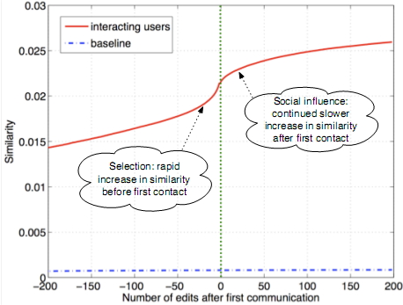
Tracking Link Formation in Online Data: interplay between selection and social influence
Actions in Wikipedia are time-stamped
For each pair of editors A and B who have ever communicated,
Record their similarity over time
Time 0 when they first communicated -- Time moves in discrete units, advancing by one “tick” whenever either A or B performs an action on Wikipedia
Plot one curve for each pair of editors
Average, single plot: average level of similarity relative to the time of first interaction
Similarity is clearly increasing both before and after the moment of first interaction
(both selection and social influence)
Not symmetric around time 0 (particular role on similarity): Significant increase before they meet
Blue line shows similarity of a random pair (non-interacting)

